Slide 1
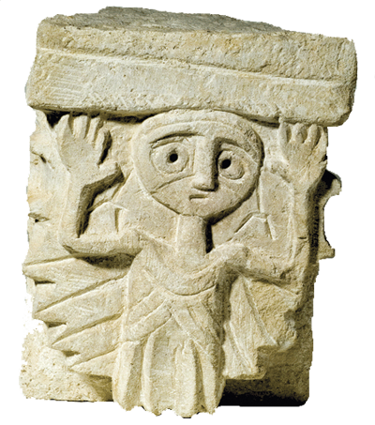
RUDINA HEADS
CHAPTER – Požega – April 2022

Slide 2
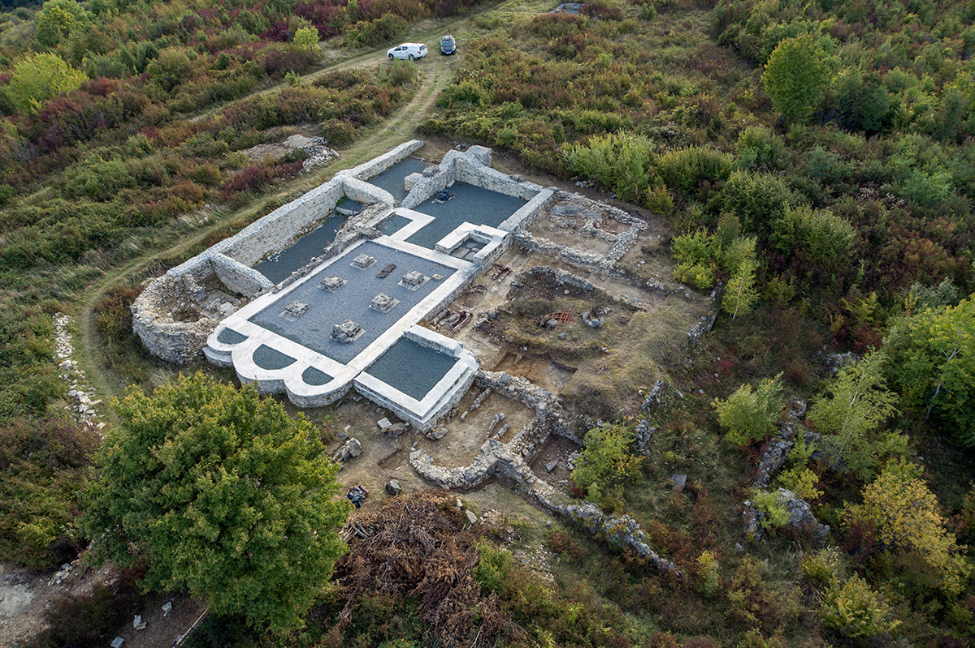
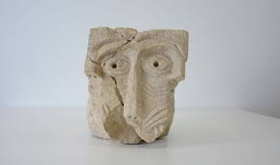
RUDINA ABBEY
one of the most important architectural complexes built in the Middle Ages in Slavonia
Benedictine Abbey of St. Michael the Archangel

Slide 3
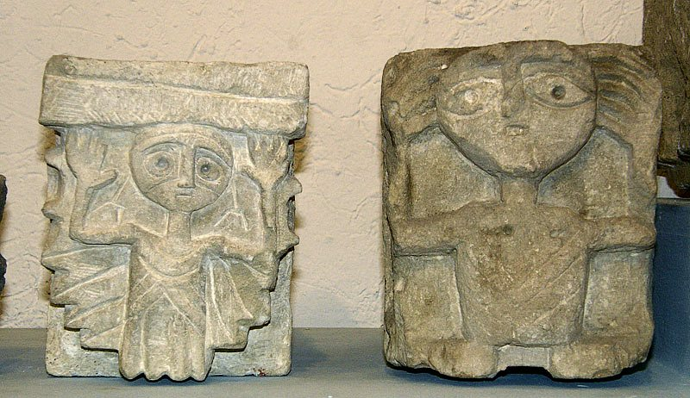
The abbey was abandonded in 1537 before the invasion of the Ottomans
The Rudina site has been destroyed for centuries by taking stone parts to the surrounding villages where the stone was used as a building material

Slide 4
monument of romanesque art in Contitental Croatia
22 stone sculptures that probably decorated the outer parts of the church walls (underroof elements)

Slide 5
WORKSHOP INSTRUCTIONS
Black marker pen
White papers
Photos of Rudine heads
CHOOSE YOUR PAL FROM SOME OTHER NATION
CHOOSE ONE OF THE HEADS
ILLUSTRATE IT IN ON A PAPER – WORK IN PAIR ON ONE ILLUSTRATION
POSTER WILL BE CREATED OUT OF ALL YOUR ILLUSTRATIONS!

