Slide 1
The legend of partenope

Slide 2
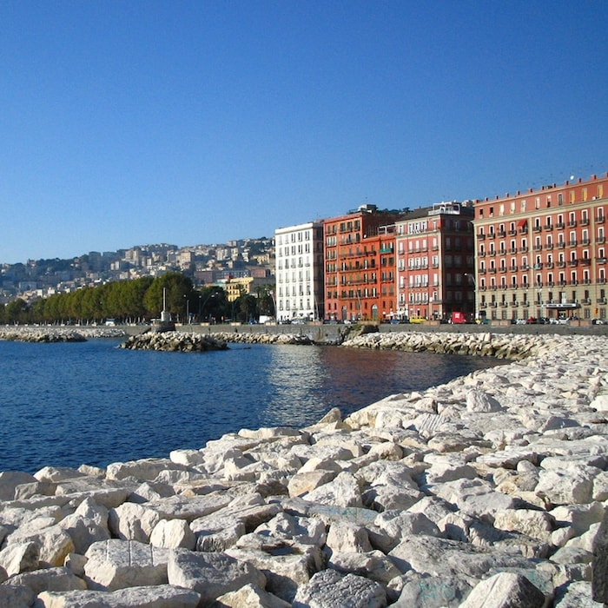
Partenope was a beautiful mermaid who lived among the rocks in the middle of the mediterrean sea.
One day the ship of Ulysses came upon hese rocks and Partenope tried to seduce the greek hero with his seductive song.

Slide 3
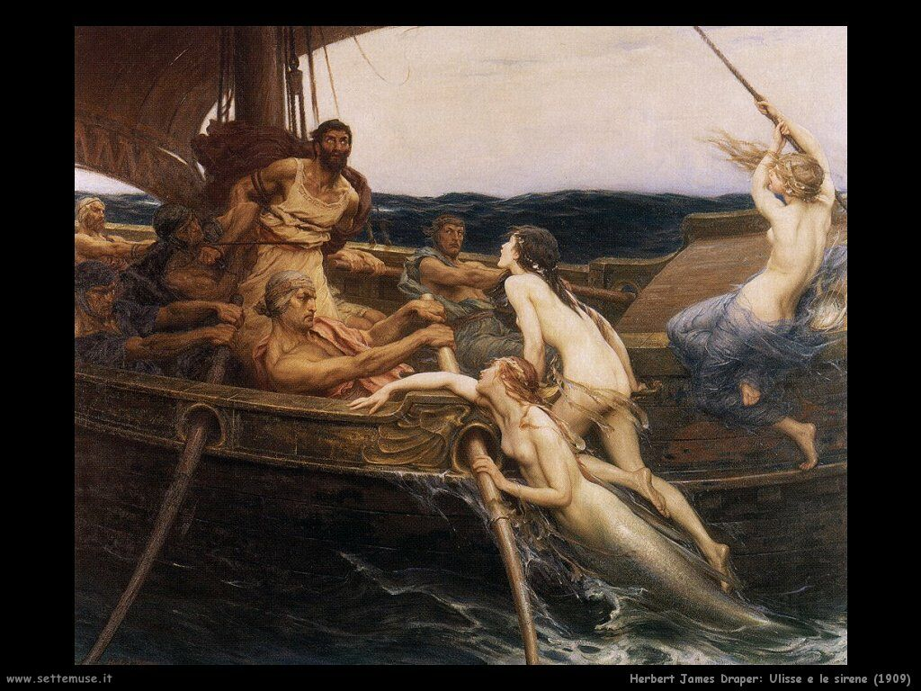
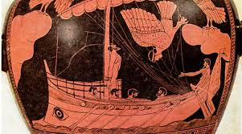
Ulysses, however, by binding to the mast maneged to repel his adavances, punging the mermaid in so much pain that led her to suicide.

Slide 4
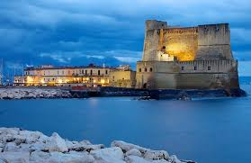
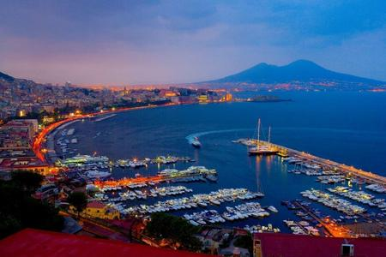
Jumped into the sea from a cliff, his body was left to the current, which swept up the island of Megaride, gave shape to the neapolitan landscape which inherited the perfect curves and stunning beauty of the mermaid.

Slide 5
The mermaid Partenope is the main character of an another legend.

Slide 6
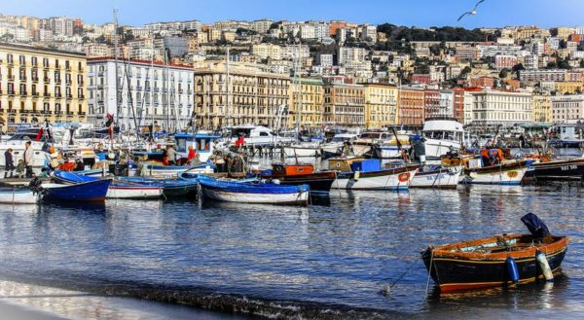
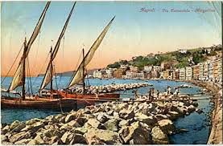
Every spring, this beautiful woman, emerged from the waters to greet the happy people on the gulf, delighting them with love and joy song.

Slide 7
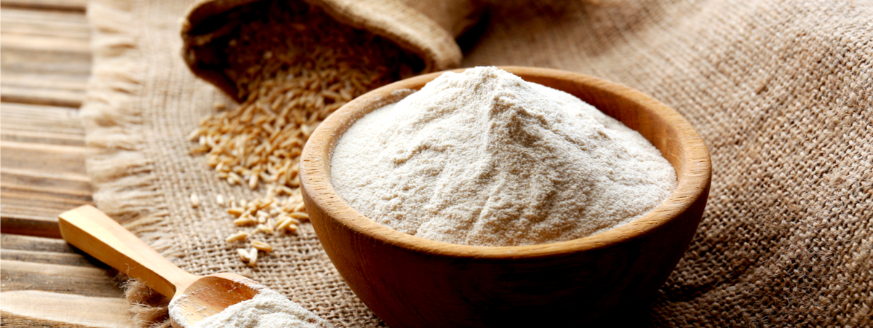
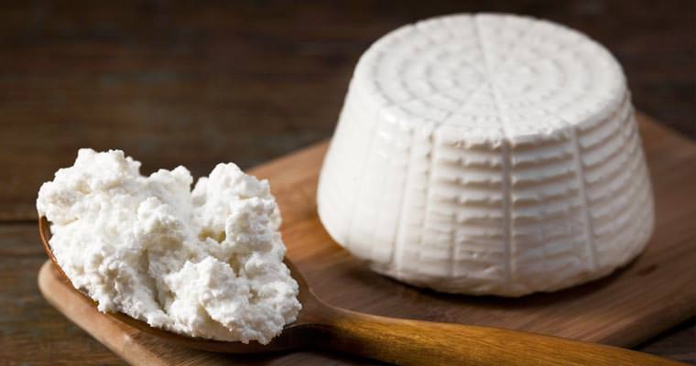
People, inebriated by her singing, to thank her, brought seven presents, each with a precise meaning:
Flour, symbol of wealth
Ricotta, symbol of abundance

Slide 8
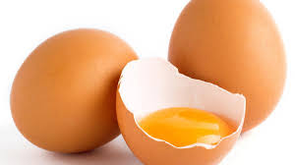
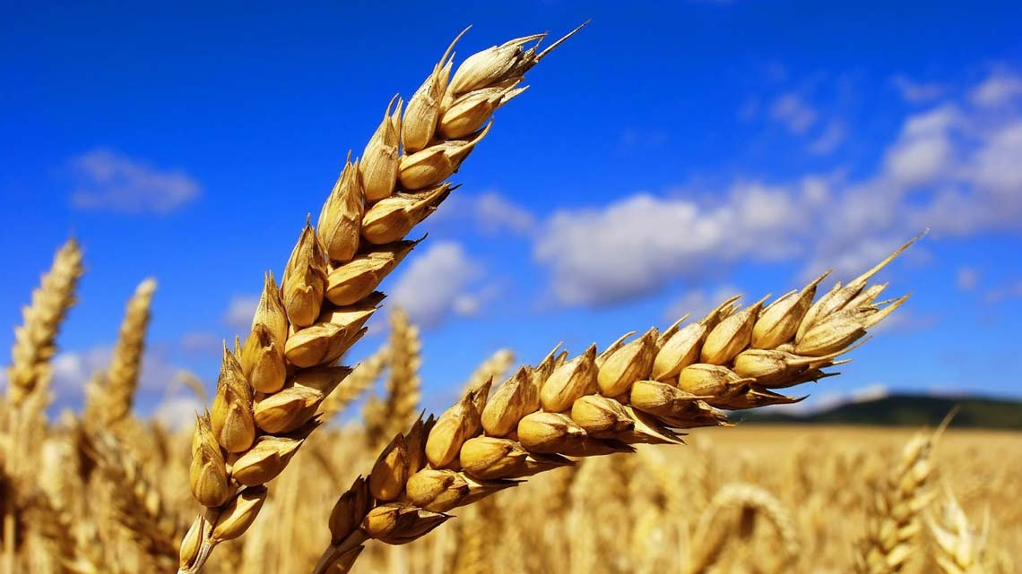
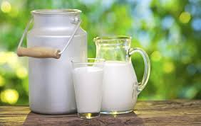
Eggs, symbol of reproduction
Wheat cooked in the milk, symbol of the fusion of the animal and vegetables reigns

Slide 9
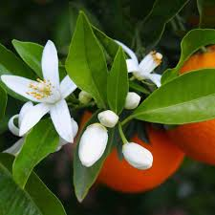
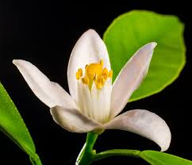
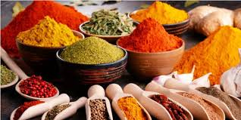
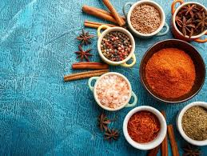
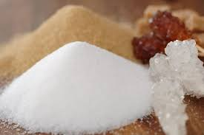
Orange Blossom, scent of the land of Campania
Spices, gift of all the people
Sugar, to praise the sweetness of her singing

Slide 10
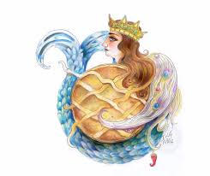
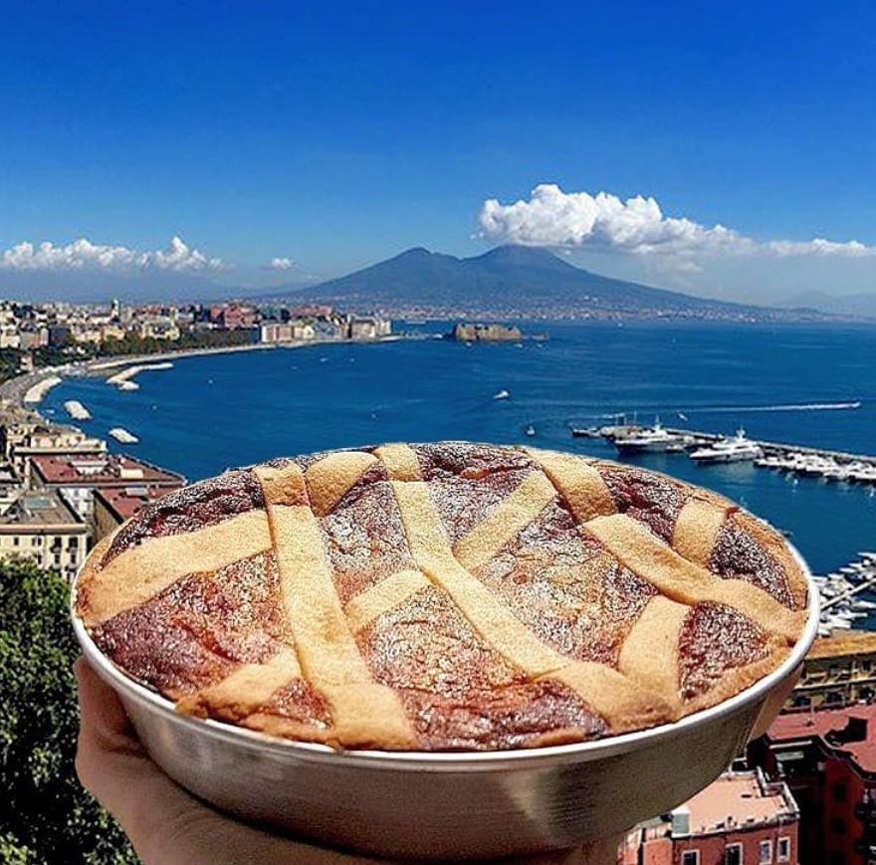
The mermaid, happy for so many gift, sank to go back to her crystalline house and put the precious offers at the feet of the gods.
These, inebriated by her pleasing singing, mixed with divine artes all the ingredients, transforming them into the first Pastiera.

Slide 11
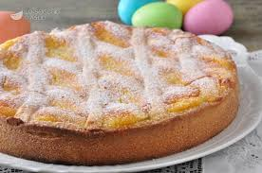
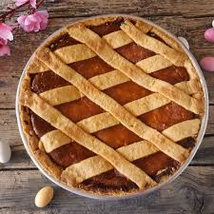
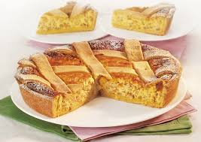
Then this dessert is entered in the Christian tradition becoming an Easter’s symbol, eaten still today.

