Slide 1
CROATIAN
LANGUAGE
WORKSHOP

Slide 2
CROATIAN LANGUAGE HRVATSKI JEZIK CROATIA HRVATSKA

Slide 3
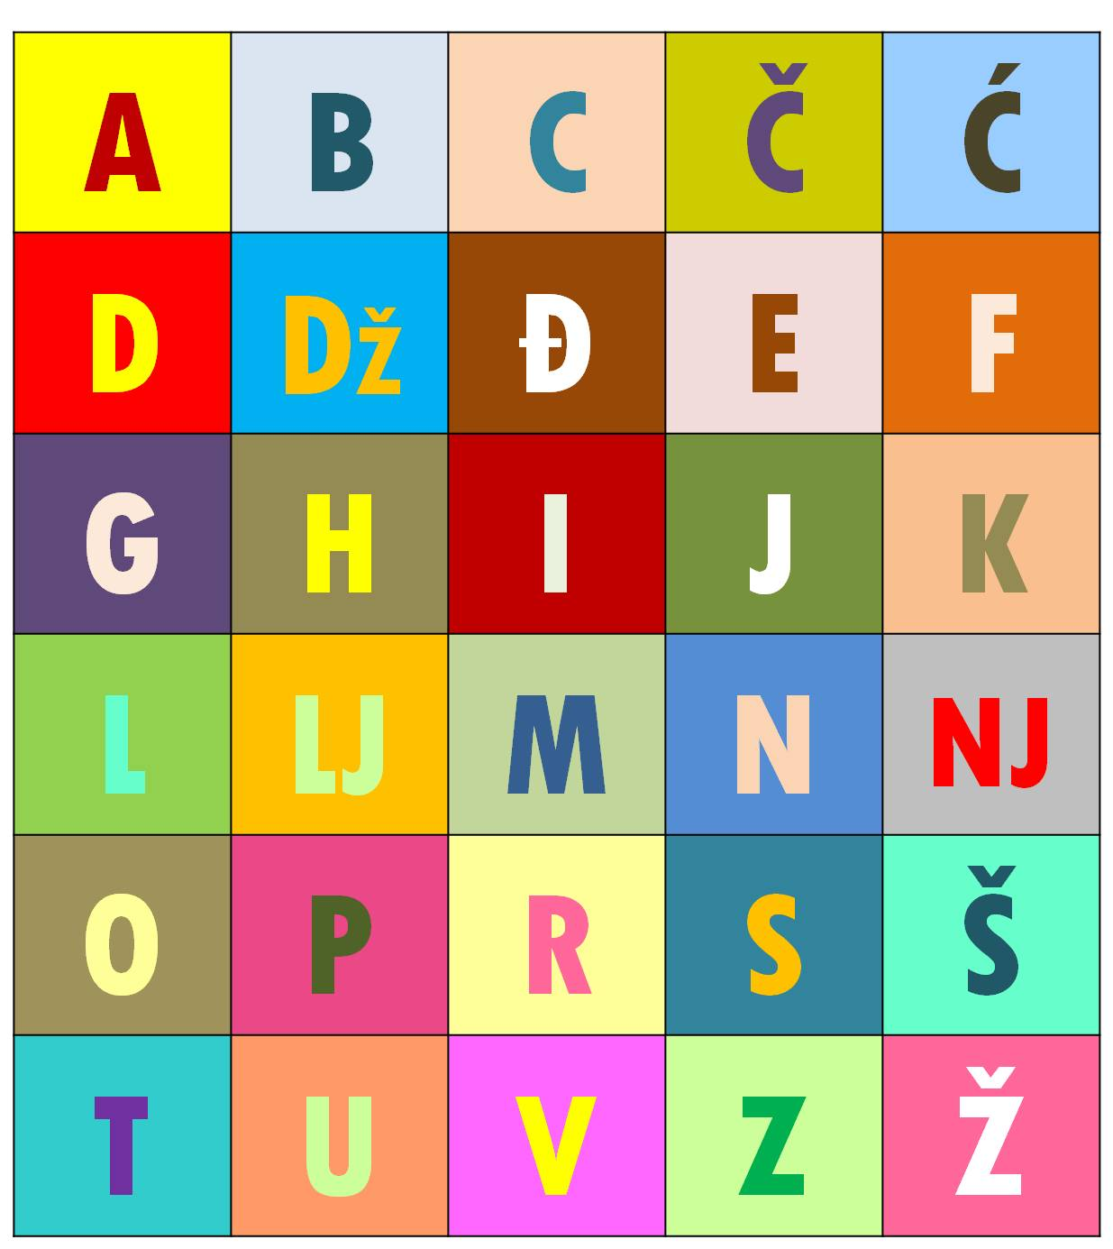
CROATIAN ALPHABET
HRVATSKA ABECEDA

Slide 4
TRY TO PRONOUNCE THESE SPECIFIC CROATIAN LETTERS:

Slide 5
❝If you talk to a man in a language he understands, that goes to his head. If you talk to him in his own language, that goes to his heart.❞ Nelson Mandela

Slide 6
DOBRODOŠLI!

Slide 7
HVALA!

Slide 8
VOLIM TE!

Slide 9
OBITELJ

Slide 10
MAJKA (MAMA)

Slide 11
OTAC (TATA)

Slide 12
JEZIK

Slide 13
KAVA

Slide 14
SRETAN ROĐENDAN!

Slide 15
YOU ALREADY MAY KNOW SOME CROATIAN WORDS… LET’S SEE…

Slide 16
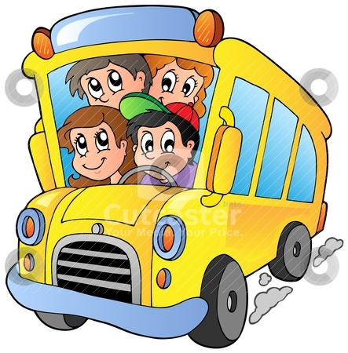
AUTOBUS (BUS)

Slide 17
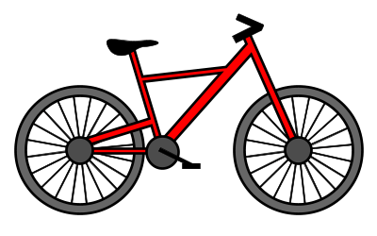
BICIKL (BICYCLE)

Slide 18
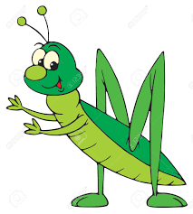
CVRČAK (CRICKET)

Slide 19
DIPLOMA (DIPLOMA)

Slide 20
EKONOMIJA (ECONOMICS)

Slide 21
FAKULTET (FACULTY)

Slide 22
GEOGRAFIJA (GEOGRAPHY)

Slide 23
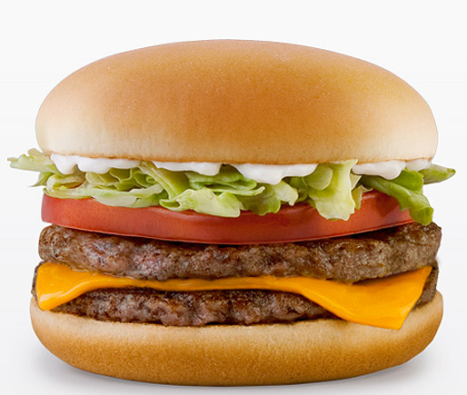
HAMBURGER (HAMBURGER)

Slide 24
INFORMACIJA (INFORMATION)

Slide 25
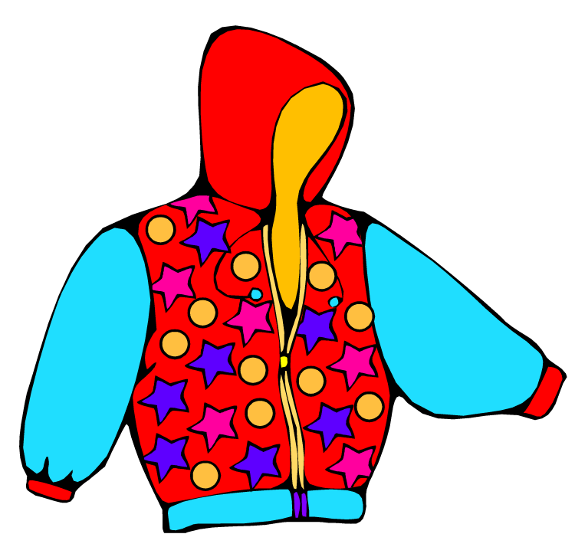
JAKNA (JACKET)

Slide 26
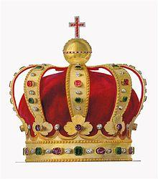
KRUNA (CROWN)

Slide 27
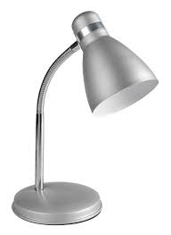
LAMPA (LAMP)

Slide 28
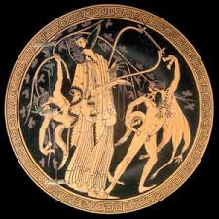
MITOLOGIJA (MYTHOLOGY)

Slide 29
NOS (NOSE)

Slide 30
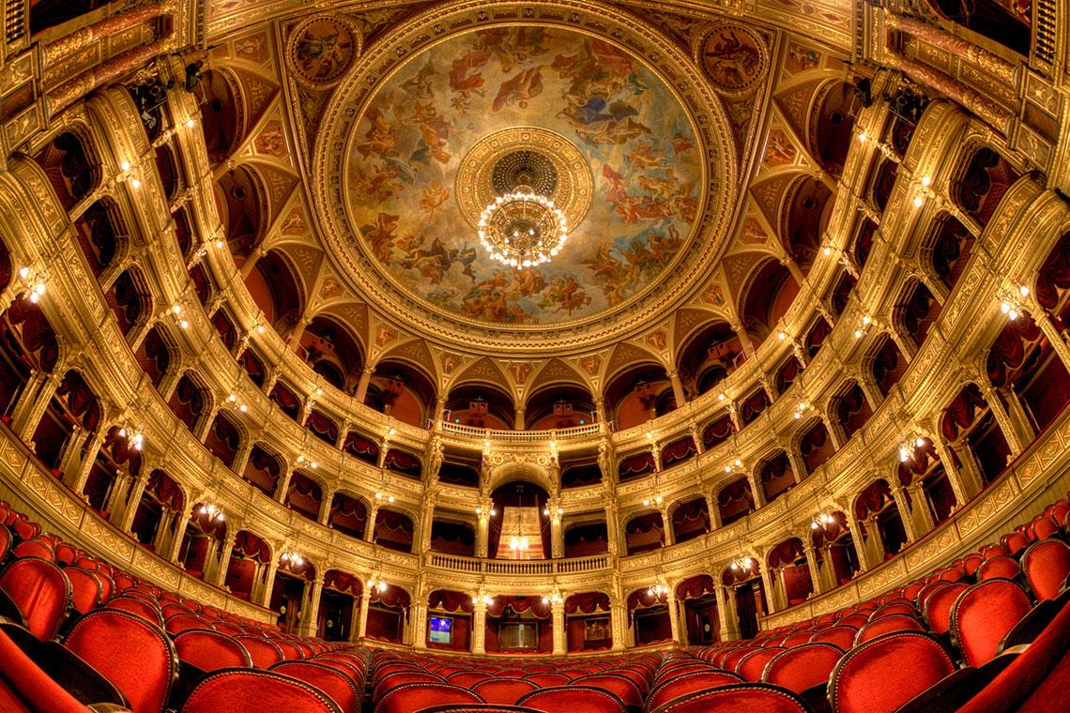
OPERA (OPERA)

Slide 31
PROFESOR (PROFESSOR)

Slide 32
RIJEKA (RIVER)

Slide 33
SUNCE (SUN)

Slide 34
TELEVIZIJA (TELEVISION)

Slide 35
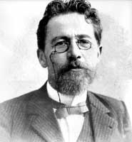
UJAK (UNCLE)

Slide 36
ZEBRA (ZEBRA)

Slide 37
CROATIAN GREETINGS

Slide 38
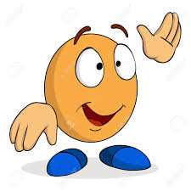
BOK! POZDRAV!
ZDRAVO!
eng: HI! HELLO!

Slide 39
POZDRAV! ZBOGOM! DOVIĐENJA! VIDIMO SE!
eng: GOODBYE! SEE YOU!

Slide 40
DOBRO JUTRO!
eng: GOOD MORNING!

Slide 41
DOBAR DAN!
eng: GOOD DAY / AFTERNOON!

Slide 42
DOBRA VEČER!
eng: GOOD EVENING!

Slide 43
LAKU NOĆ!
eng: GOOD NIGHT!

