Slide 1
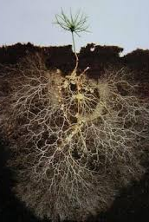
Literary Roots
Greece

Slide 2
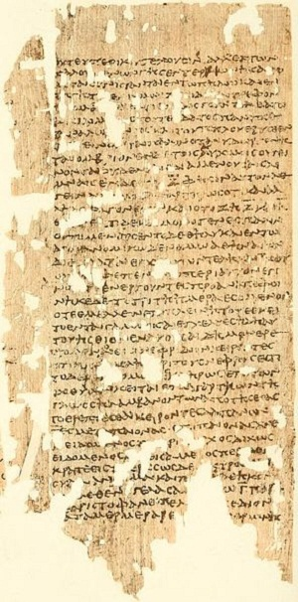
Epic poetry
Although epic poetry began well before the Ancient Greek civilization came about, it was an important part of the Greek culture starting in around the 6th century B.C. There is evidence that there were epic poems that were written as early as the 20th century B.C through civilizations such as the Mesopotamians, which is credited for producing the oldest surviving epic poem. However, once the Ancient Greeks started producing epic poetry, they were incredibly prolific, and the poets produced works that are still popularly enjoyed today. Here’s a look at the history of epic poetry in Ancient Greece.

Slide 3
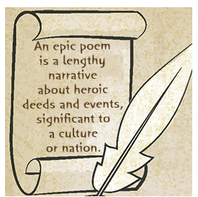
Epic poetry
So, what is an Epic poem exactly?
An epic poem is often described as a lengthy narrative poem that is set in a forgotten time and it describes the extraordinary acts of heroism from specific men or women who shaped the moral universe for the audience and made them understand themselves as a nation.

Slide 4
Epic poetry
All works of epic poetry begin en media res, which is a term that means, ‘in the middle of things.” On other words, each epic poem starts while the action of the story is already underway. Another key feature of epic poetry is that it was actually designed to be performed with music. Traveling bards would perform the poetry orally and the words were sung and often accompanied with music.

Slide 5
Epic poetry
As a result of this, many of the stories that we know of today were widely known and recognized by the people of Ancient Greece since hearing these performers was one of their top forms of entertainment.

Slide 6
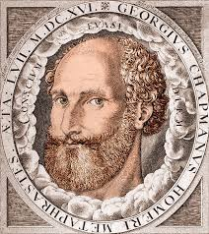
The most famous epic poet is the ancient Greek poet Homer who was a blind bard from Ionia. Homer is mostly known for his two epic poems 'the Iliad" and "the Odyssey“, which have had an enormous effect on Western culture, but very little is known about their alleged author.
Homer

Slide 7
The Mystery of Homer
Homer is a mystery. The Greek epic poet credited with the enduring epic tales of The Iliad and The Odyssey is an enigma insofar as actual facts of his life go. Some scholars believe him to be one man; others think these iconic stories were created by a group. A variation on the group idea stems from the fact that storytelling was an oral tradition and Homer compiled the stories, then recited them to memory. All this speculation about who he was has inevitably led to what is known as the Homeric Question—whether he actually existed at all. This is often considered to be the greatest literary mystery.

Slide 8
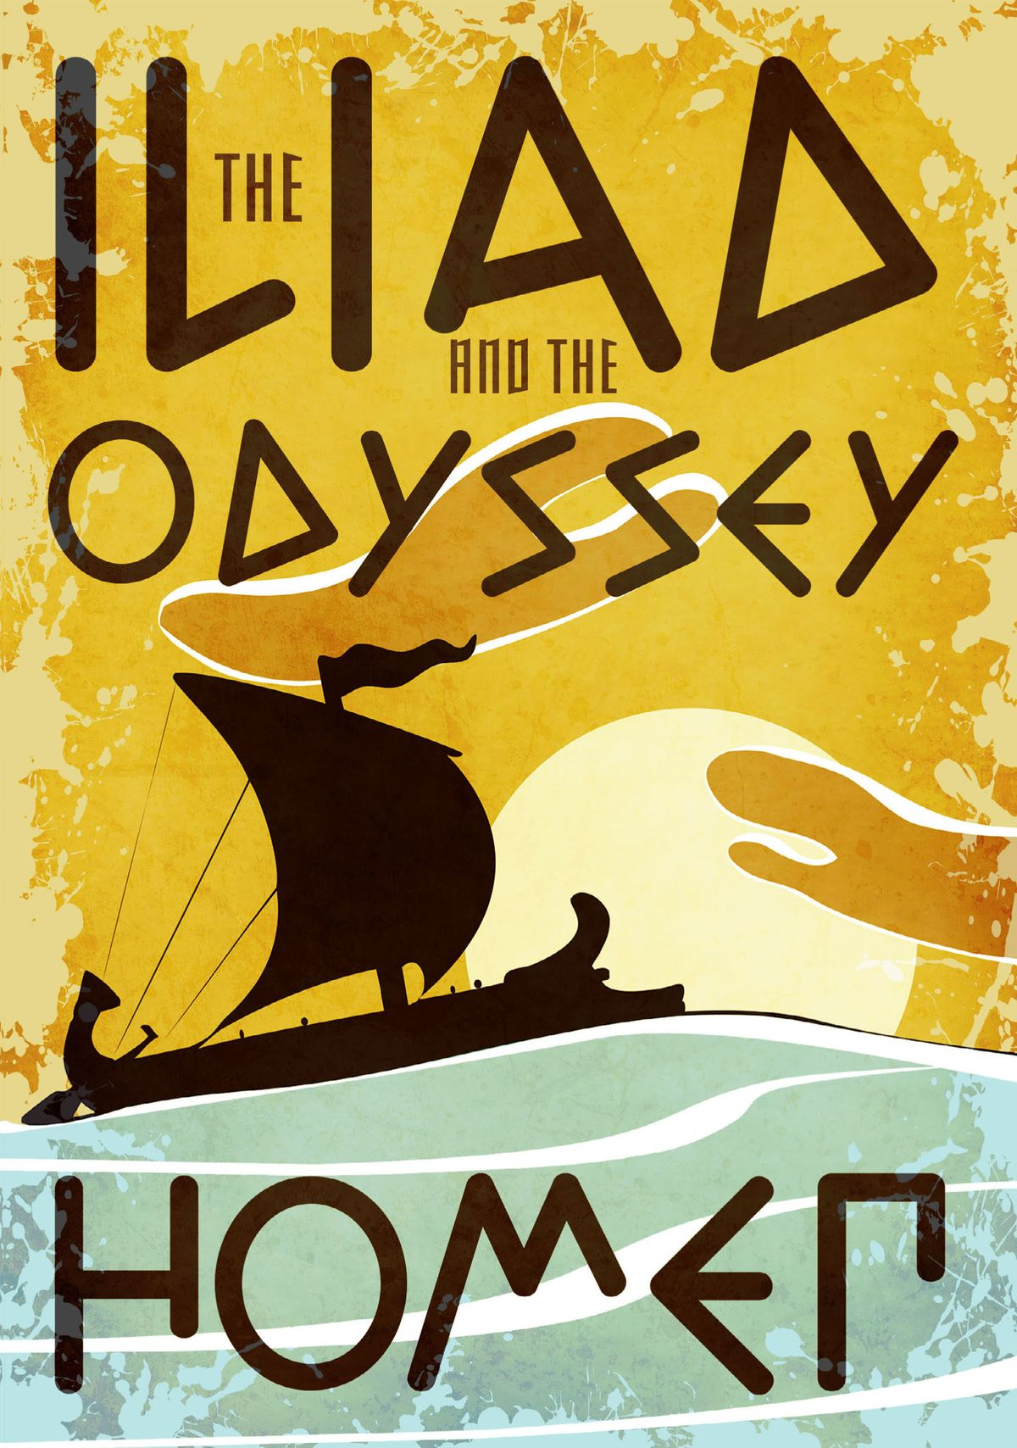
The Iliad
“The Iliad“ is an epic poem by the ancient Greek poet Homer, which recounts some of the significant events of the final weeks of the Trojan War and the Greek siege of the city of Troy (which was also known as Ilios or Ilium in ancient times). Written in the mid-8th Century BCE, “The Iliad“ is usually considered to be the earliest work in the whole Western literary tradition, and one of the best known and loved stories of all time.

Slide 9
The Iliad
Through its portrayal of the epic subject matter of the Trojan War, the stirring scenes of bloody battle, the wrath of Achilles and the constant interventions of the gods, it explores themes of glory, wrath, homecoming and fate, and has provided subjects and stories for many other later Greek, Roman and Renaissance writings. The poem consists of twenty-four scrolls, containing 15,693 lines of dactylic hexameter verse. The entire poem has a formal rhythm that is consistent throughout (making it easier to memorize) and yet varied slightly from line to line (preventing it from being monotonous).

Slide 10
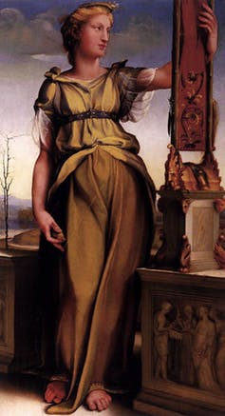
The Odyssey
The Odyssey of Homer is a Greek epic poem that tells of the return journey of Odysseus to the island of Ithaca from the war at Troy, which Homer addressed in The Iliad. In the Greek tradition, the war lasted for ten years. Odysseus then spent a further ten years getting home in the face of hostility from Poseidon, god of the earth and sea.
Penelope, waiting on Ithaca.
Painted by Domenico
Beccafumi circa 1514.

Slide 11
The Odyssey
Odysseus’s return to his island, however, is not the end of his woes. He finds that 108 young men from the local vicinity have invaded his house to put pressure on his wife Penelope to marry one of them. A stalemate exists, and it is only resolved by a bow contest at the end of the poem, which then leads to a slaughter of all the suitors by Odysseus and his son Telemachus. Peace on the island is eventually restored through the intervention of Athena, goddess of wisdom, victory and war.
Penelope, waiting on Ithaca.
Painted by Domenico
Beccafumi circa 1514.

Slide 12
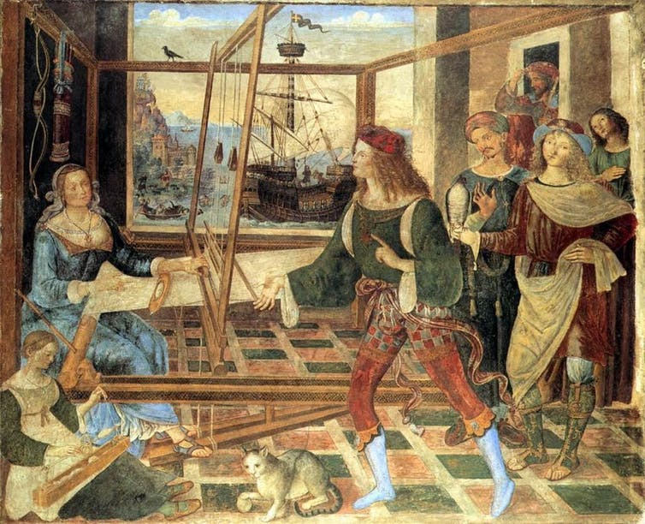
The Odyssey
The quest of Odysseus to get back to his island and eject the suitors is built on the power of his love for home and family. This notion of love conquering fear and hatred is a common theme in Greek quest mythology.
The Odyssey, like the Iliad, is divided into 24 books, corresponding to the 24 letters in the Greek alphabet. Within the middle section of the poem (Books 9-12), Odysseus describes all the challenges that he has faced trying to get home.
Penelope keeps her suitors at bay by spinning a shroud for three years. Painted by Pinturicchio circa 1500

Slide 13
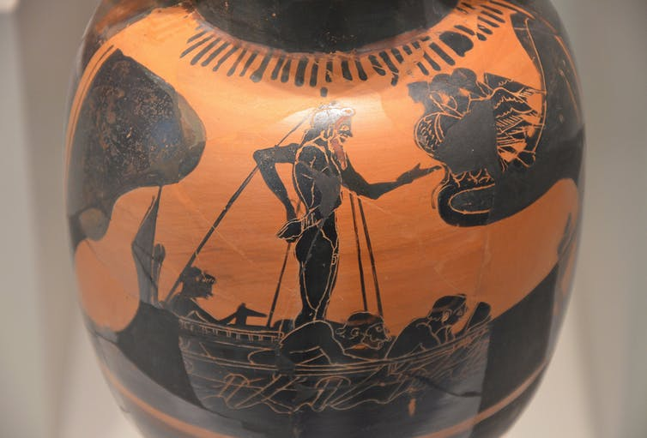
The Odyssey
These include monsters of various sorts, a visit to the afterlife, cannibals, drugs, alluring women, and the hostility of Poseidon himself. These challenges resemble those of earlier heroes like Heracles and Jason. In the Iliad, the hero Achilles faces no such challenges, indicating that the Odyssey has a very different idea of heroism.
Odysseus resists the Sirens

Slide 14
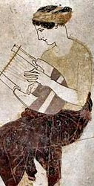
Lyric poetry in Ancient Greece
Lyric poems have a musical rhythm, and their topics often explore romantic feelings or other strong emotions. A lyric poem is narrated in the first person, it is short, and the poet tries to express his/her personal feelings with a songlike quality. Ancient Greek philosopher Aristotle created three distinctions of poetry: lyrical, dramatic, and epic. Lyric poetry originated in ancient Greek literature and was originally intended to be set to music, along with a musical instrument called a lyre, which looks like a small harp. The main Greek musician-poets were Sappho, Pindar, Anacreon and Alcaeus.

Slide 15
Sappho
Sappho was born around 620 B.C. to an aristocratic family on the island of Lesbos. Sappho was regularly counted among the greatest of poets, she was honored on coins and statuary and she was often referred to as "the Poetess". The poetry of Sappho was usually about love and passion and her poems were often conversational, which means they were giving an impression of immediacy and action. She was greatly admired in all ages for the beauty of her writing style. In her poetry she often involved goddesses, especially Aphrodite. Sappho also wrote about herself, her community and her times. Sappho wasn’t just a great poet; she was also the president of the world’s first woman’s club. Therefore Sappho was very important because through her poems she discussed problems that women faced and their feelings.

Slide 16
Pindar
Pindar was born around 518 B.C., in Thebes, and through his poems he celebrated victories achieved in the Pythian, Olympic, Isthmian, and Nemean games. Pindar traveled around the Greek world and achieved a Panhellenic reputation. More than half of Pindar's forty-six victory songs begin with a short prayer and thirty-three of Pindar's odes describe one or more myths that describe the victories. The odes have moral advice with reference to religious conceptions and other values. Therefore Pindar was important as his poems were composed to celebrate the Greek heroes; his forty-six victory songs were linked to athletic achievements.

Slide 17
Anacreon
Anacreon was born at Teos, around 582 B. C., and he is seen on several coins holding a lyre in his hand. He was never able to remain in the same place for very long, being continually forced to relocate because of political problems. Anacreon wrote all of his poetry in the ancient Ionic dialect and his verses were primarily in the form of monody, which means that they were to be performed by a single voice rather than by a chorus. His poetry touched on universal themes of love, infatuation, disappointment, revelry, parties, festivals, and the observations of everyday people and life. Anacreon had a reputation as a composer of hymns; he was notable for his drinking songs and hymns. They glorified the enjoyment of life, the subjects generally being wine, women, and pleasure.

Slide 18
Alcaeus
Finally, Alcaeus was born around 620 B.C. into the aristocratic governing class of Mytilene, the main city of the island of Lesbos. His poetry reveals that he had been involved in the politics of Mytilene however his poems may be classed in four groups: hymns in honour of gods and heroes, love poetry, drinking songs, and political poems. While Alcaeus was in Lesbos a civil war broke out; his experiences in war and politics are reflected in his extant poetry. There are references to the soldiers emphasizing the effort they put in order to survive, but he also describes in his poems the war zone including feelings and emotions. However he had other poems containing lively references to the lighter side of life, including songs of praise or triumph, gambling, friendship, and the sea.

Slide 19
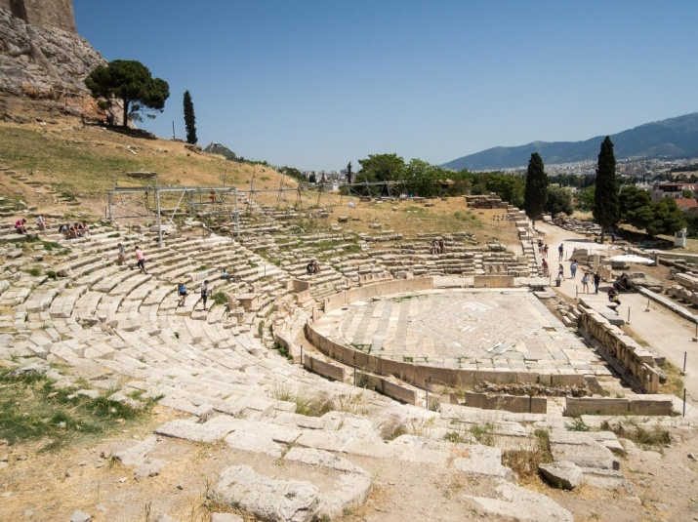
Ancient Greek Drama
The ancient Greek drama was a very famous theatrical culture that flourished in ancient Greece from 700 BC. Athens, the capital of Greece, which became a significant cultural, political, and military power and was established as part of a festival called the Dionysia, which honoured the god Dionysus. It happened four times a year, where citizens from all over Greece would gather to worship Dionysus.

Slide 20
Each selected poet would submit three tragedies and one satyr play, a type of short parody performance on a theme from mythology with a chorus of satyrs, the wild followers of Dionysos. The plays were judged on the day by a panel, and the prize for the winner of such competitions, besides honour and prestige, was often a bronze tripod cauldron. From 449 BCE there were also prizes for the leading actors (prōtagōnistēs).

Slide 21
Plays were performed in an open-air theatre (theatron) with wonderful acoustics and seemingly open to all of the male populace (the presence of women is contested). From the mid-5th century BCE entrance was free. The plot of a tragedy was almost always inspired by episodes from Greek mythology, which we must remember were often a part of Greek religion. As a consequence of this serious subject matter, which often dealt with moral right and wrongs, violence was not permitted on the stage, and the death of a character had to be heard from offstage and not seen. Similarly, at least in the early stages of the genre, the poet could not make comments or political statements through his play.

Slide 22
The early tragedies had only one actor who would perform in costume and wear a mask, allowing him to impersonate gods. Later, the actor would often speak to the leader of the chorus, a group of up to 15 actors (all male) who sang and danced but did not speak. The actor also changed costumes during the performance (using a small tent behind the stage, the skēne) and so break the play into distinct episodes. Later, these would develop into musical interludes. Eventually, three actors were permitted on stage but no more - a limitation which allowed for equality between poets in competition. However, a play could have as many non-speaking performers as required, so that plays with greater financial backing could put on a more spectacular production. Due to the restricted number of actors then, each performer had to take on multiple roles where the use of masks, costumes, voice, and gesture became extremely important.

Slide 23
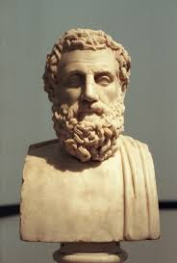
Aeschylus
Aeschylus, also recognized as the father of tragedy, is the first of the three early Greek tragedians whose plays survived. He was the founder of all serious Greek drama (although some credit that honour to Phrynichus or the even earlier Thespis). Only seven of over seventy plays written by Aeschylus have survived into modern times, the best-known being “The Oresteia” trilogy.
Aeschylus is said to have been born in about 525 or 524 BC in Eleusis, a small town just northwest of Athens. As a youth, he worked at a vineyard until the god Dionysus visited him in his sleep and commanded him to turn his attention to the art of tragedy. His first play was performed when he was only 26 years old (in 499 BCE), and fifteen years later he won his first prize at Athens’ annual Dionysia playwriting competition.

Slide 24
Some of Aeschylus’ Tragedies
Agamemnon (458 B.C) the king Agamemnon faces the consequences of his decision to keep his promise to the other kings, even though it meant killing his own daughter (Iphigeneia).
Libation Bearers Agamemnon’s son Orestes has to decide whether to kill his own mother because she killed his father.
Eumenides (458 B.C) a jury has to decide whether Orestes, having killed Clytemnestra, is guilty of murder.
The Choephori 450 B.C.
The Persians 472 B.C.
Prometheus Bound. 430 B.C.

Slide 25
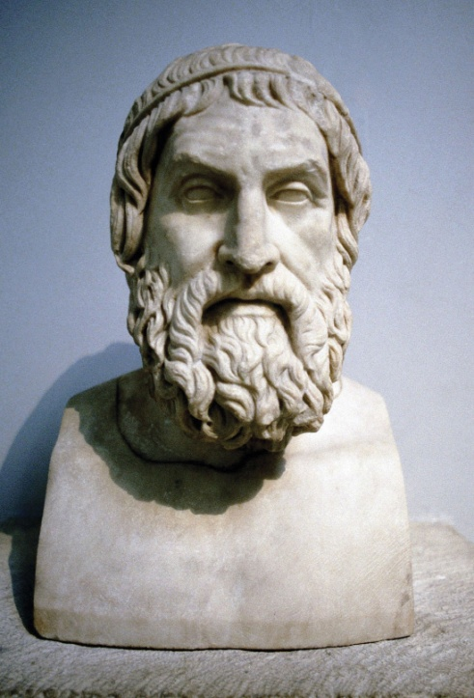
Sophocles
Sophocles was the second of the three great ancient Greek tragedians and only 8 of his 123 plays have survived in a complete form. He was the most-awarded playwright in the Dionysia dramatic competitions of the city-state of Athens. Sophocles the son of Sophillus, a wealthy armour manufacturer in the rural community of Hippeios Colonus in Attica, just outside Athens, which would later become a setting for at least one of Sophocles’ plays. He was born in about 496 BCE and his artistic career began in about 468 BC when he took first prize in the Dionysia theatre competition over the first, Aeschylus. Sophocles died at the age of ninety, in 406 or 405 BC, having seen within his lifetime both the Greek triumph in the Persian Wars and the terrible bloodletting of the Peloponnesian War. His son, Iophon, and a grandson, also called Sophocles, followed in his footsteps to become playwrights themselves.

Slide 26
Sophocles’ Tragedies
Antigone (c. 442 BCE) about a woman torn between public and private duty.
Oedipus The King (429 - 420 BCE) about the famous king who loved his mother a little too much.
Philoctetes (409 BCE) on how Odysseus persuades the hero to join the Trojan War.
Oedipus at Colonus (401 BCE) the final part of the trilogy about Oedipus.
Ajax (date unknown) on the hero of the Trojan War and his wounded pride.
Electra (date unknown) about two siblings who take revenge for their father’s murder.
Women of Trachis (date unknown) about the wife of Hercules and her failed attempt to regain her husband’s affections.

Slide 27
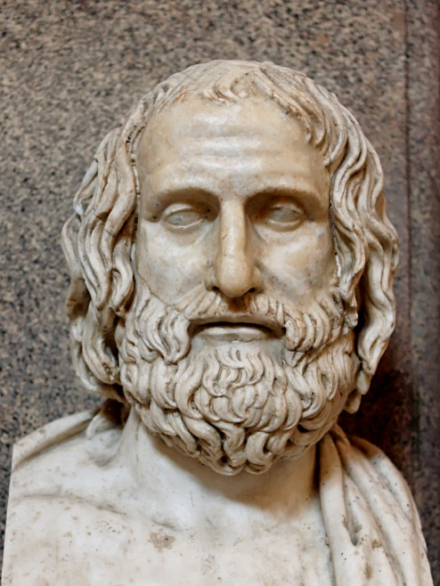
Euripides
Euripides was the last of the three great tragedians of classical Greece, and only eighteen of Euripides’ ninety-five plays have survived in a complete form, along with fragments of many of his other plays. He is known primarily for having reshaped the formal structure of traditional Greek tragedy by showing strong female characters and intelligent slaves, and by satirizing many heroes of Greek mythology. He is considered to be the most socially critical of all the ancient Greek tragedians, and his plays seem quite modern in comparison with those of his contemporaries.
According to Legend, Euripides had a wealthy family and was born in Salamis 480 BC, at the location and on the day of the Persian War’s greatest naval battle. He was married twice, to Choerile and Melito, and had three sons and a daughter who, they say was killed after an attack. Euripedes first competed in the Dionysia, the famous Athenian dramatic festival, in 455 BC and it was not until 441 BC that he won his first prize, and over the course of his lifetime, he claimed just four victories.

Slide 28
The Cyclops (438 B.C.) An ancient Greek play
Alcestis (438 B.C.) His oldest surviving work about the wife of Admetus, Alcestis, who sacrificed her life and replaced his in order to bring her husband back from the dead.
Medea (431 B.C.) This story is based on the myth of Jason and Medea. Opening in conflict, Medea is an enchantress who becomes abandoned by her husband Jason as he leaves her for someone else for political gain. To take revenge, she kills the children they had together.
The Heracleidae (ca. 428 B.C.) Meaning "Children of Heracles", this tragedy based in Athens follows Heracles' children. Eurystheus seeks to kill the children to keep them from performing revenge on him and they try to stay protected.
Hippolytus (428 B.C.) This Greek play is a tragedy based on the son of Theseus, Hippolytus, and can be interpreted to be about love, jealousy and death.
Andromache (ca. 427 B.C.) This tragedy out of Athens shows the life of Andromache as a slave after the Trojan War. The drama focuses on the conflict between Andromache and Hermione, her master's new wife.
Euripides’ Tragedies
Only eighteen of Euripides’ ninety-five plays have survived in a complete form, along with fragments of many of his other plays.

Slide 29
Aristophanes
Aristophanes, (born c. 450 BCE—died c. 388 BCE) was the greatest representative of ancient Greek comedy and the one whose works have been preserved in greatest quantity. Little is known about the life of Aristophanes, and most of the known facts are derived from references in his own plays. He was an Athenian citizen belonging to the clan named Pandionis, but his actual birthplace is uncertain.
He began his dramatic career in 427 BCE with a play, the Daitaleis (The Banqueters). He is thought to have written about 40 plays in all. A large part of his work is concerned with the social, literary, and philosophical life of Athens itself and with themes provoked by the Peloponnesian War (431–404 BCE). That war was essentially a conflict between imperialist Athens and conservative Sparta and so was long the dominant issue in Athenian politics. Aristophanes was an opponent of the statesmen who controlled the government of Athens throughout the better part of his maturity, and he lived to see the revival of Athens after its defeat by Sparta.

Slide 30
Aristophanes
Aristophanes’ reputation has stood the test of time; his plays are still frequently published and produced in numerous translations, which manage with varying degrees of success to convey the flavour of Aristophanes’ puns and witticisms.

Slide 31
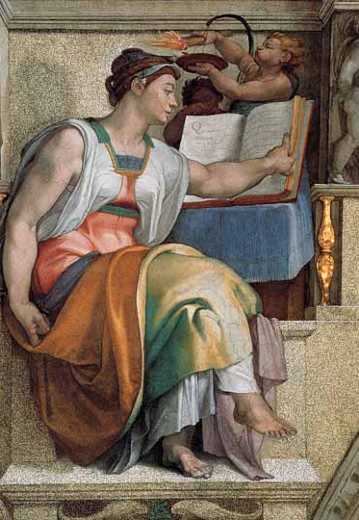
Ancient Greek Historiography
The historical period of ancient Greece is unique in world history as it is the first period attested directly in proper historiography. The word 'historiography' itself originates from two Greek words, 'historia' which translates to narrative or enquiry and 'graphia' meaning writing, that started taking place around 500BC.

Slide 32
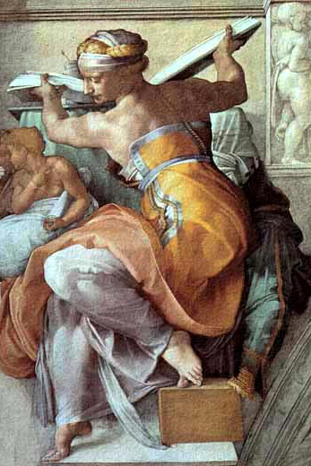
Greek historiography originated in the activities of a group of writers whom the Greeks called logographoi (“logographers”). Logography was the prose compilation of oral traditions relating to the origins of towns, peoples, and places. It combined geographical with cultural information and might be seen as an early form of cultural anthropology. Hecataeus of Miletus, the best known of the logographers, defined his task in his Genealogia (c. 490 BCE) as follows: “I write what I consider the truth, for the things the Greeks tell us are in my opinion full of contradictions and worthy to be laughed out of court.” The logographers also served as advocates and speech writers in the courts, and the need to ascertain facts and make arguments clearly influenced their writings.

Slide 33
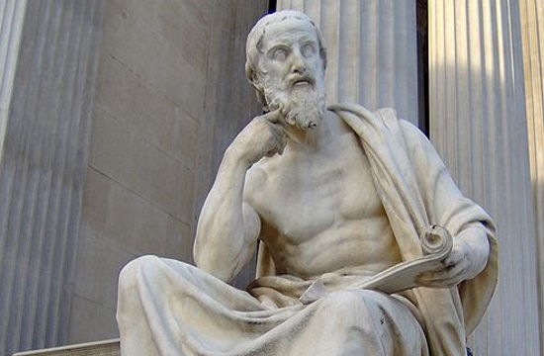
Herodotus is known as the 'father of history'. This title was accorded to him as he was motivated to "prevent the traces of human events from being erased by time, and to preserve the fame of the important and remarkable achievements produced by both Greeks and non-Greeks; among the matters covered is, in particular, the cause of the hostilities between Greeks and non-Greeks.
Herodotus

Slide 34
In order to be inspired, Herodotus spent his life traveling from one Persian territory to another. He crossed the Mediterranean to Egypt and traveled through Palestine to Syria and Babylon. He headed to Macedonia and visited all the islands of the Greek Archipelago. He sailed through the Hellespont to the Black Sea and kept going until he hit the Danube River. While he traveled, Herodotus collected what he called “autopsies,” or “personal inquiries”: He listened to myths and legends, recorded oral histories and made notes of the places and things that he saw.
Herodotus

Slide 35
He was the first person to ever collect and critically explain the cause and effect of certain events such as the Greco-Persian war. His historical narratives were written between the 420s and 450s BC; covering the entire field (military, political, diplomatic, economic and social history), while the extension of his work reaches about a century in the past. Few of his successors that continued writing were Thucydides, Xenophon, Plato and Aristotle. These authors however limited their focus on military, political, diplomatic history and humanities, broadly avoiding economic and social history.
Herodotus

Slide 36
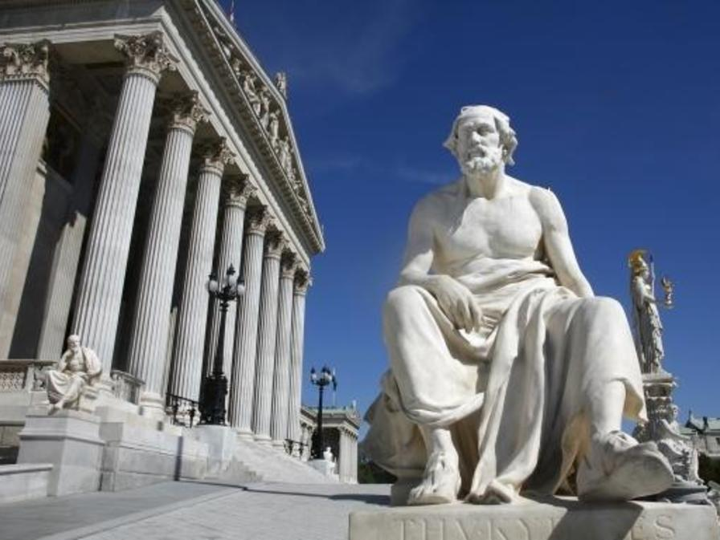
Another great historian, Thucydides chronicled nearly 30 years of war and tension between Athens and Sparta. His “History of the Peloponnesian War” set a standard for scope, concision and accuracy that makes it a defining text of the historical genre.
Thucydides

Slide 37
In its chronologies and narrative, this historiography is a marvel of direct prose, as Thucydides combines multiple sources into a single compelling voice. In the completed sections of the work, the narrative is interrupted by speeches from the warring sides’ principal leaders. Thucydides is careful to note that at times he records only the gist of what was said, or what he thinks should have been said.
Thucydides

Slide 38
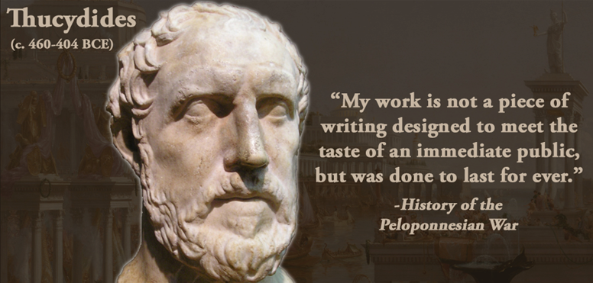
He also studied the details of siege warfare; the difficulties of the heavily armed combat in mountain country and of fighting against the fierce but unruly barbarians of the north; an army trying to force a landing from ships against troops on shore; the one great night battle, at Syracuse; the unexpected recovery of the Athenian fleet after the Sicilian disaster—all in all these aspects of the war he took a keen professional interest. However unlike Herodotus, Thucydides’ topic was his own time.
Thucydides

