Slide 1
SITGES AND
THE ART NOUVEAU
SANTIAGO RUSIÑOL

Slide 2
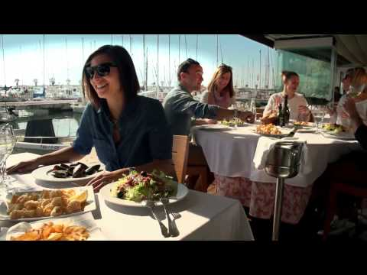
SITGES

Slide 3
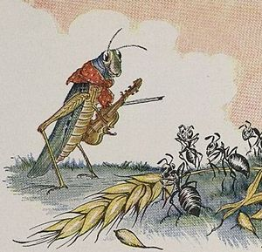
LITERATURE AND ART NOUVEAU
Regenerationism
L’art pour l’art (art for art’s sake): symbolism

Slide 4
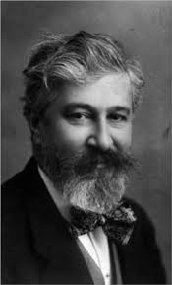
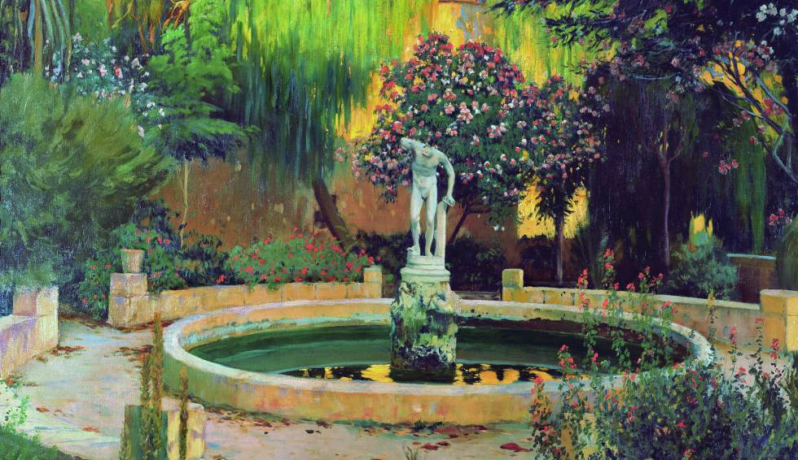
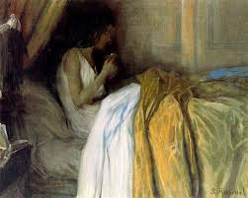
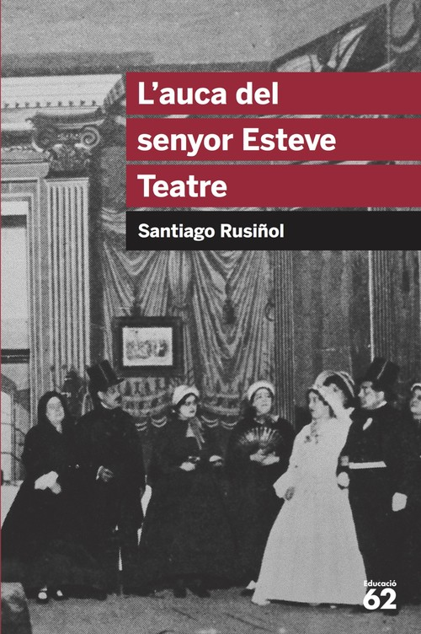
SANTIAGO RUSIÑOL

Slide 5
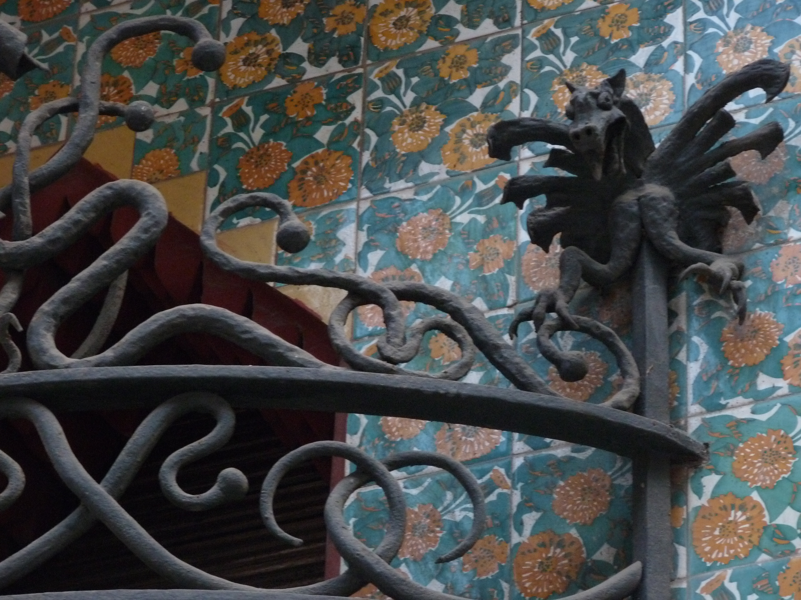
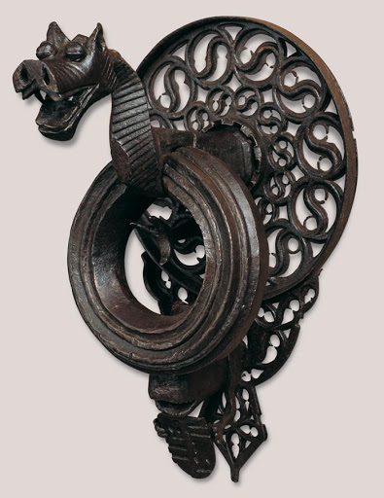
CAU FERRAT

Slide 6
FAREWALL
Hope we all like this, oh poets! And to achieve it, we have two great examples in front of us: on the one hand the waves breaking against the hard rocks, on the other hand the perseverance of men forging and mastering virgin iron. Flexible like loving water you can tear down the stone hearts; brave like those Middle Age ironsmiths who could bend the willings of elements.
We work among kissing and hammer blows ; and while here all together, among all our people without fear of foreigners ears to art and poetry, we could relieve and scream what we cannot dare to say many times surrounded by the great flock sheep; that we prefer to be poets and we despise and cry over those who do not feel poetry; we prefer Leonardo, Da Vinci or Dante to a village or a province; we prefer to be crazy and symbolists, decadent writers rather than being low and docile; common sense is overwhelming our land; and here in our country we are cautious enough; we would rather, it doesn’t matter if we are Don Quixotes instead of Sancho Panza’s, in those lands where so many Sancho-Panza freely pasture or not even to read books in those places were none are read.

Slide 7
SCHEDULE SITGES
8.55 Train Station
9.00 Train to Sants Estació- Sants to Sitges
10.15-11.30 Escape room
Group 1: Croatia+ Turkey
-12.00 Museum
-13.00 Painting
Group 2: Sweden+ 3 Greeks
-11.45-12.15 Draft
-12.30-13.30 Museum
-13.30-14.00: Painting
Group 3: 2 Greeks+Italy
-11.45-12.45 Painting
-13.00-14.00 Museum

