Slide 1
Informatics
Multimedia

Slide 2
Photography & Video
Photography = recording scenes from reality on the layer of material that is sensitive to light that falls on it
Video = visual projection on the move, usually bugged
Composition rules:
Rule of thirds
Leading lines
Point of view
Depth
Framing
Symmetry
Patterns
...

Slide 3
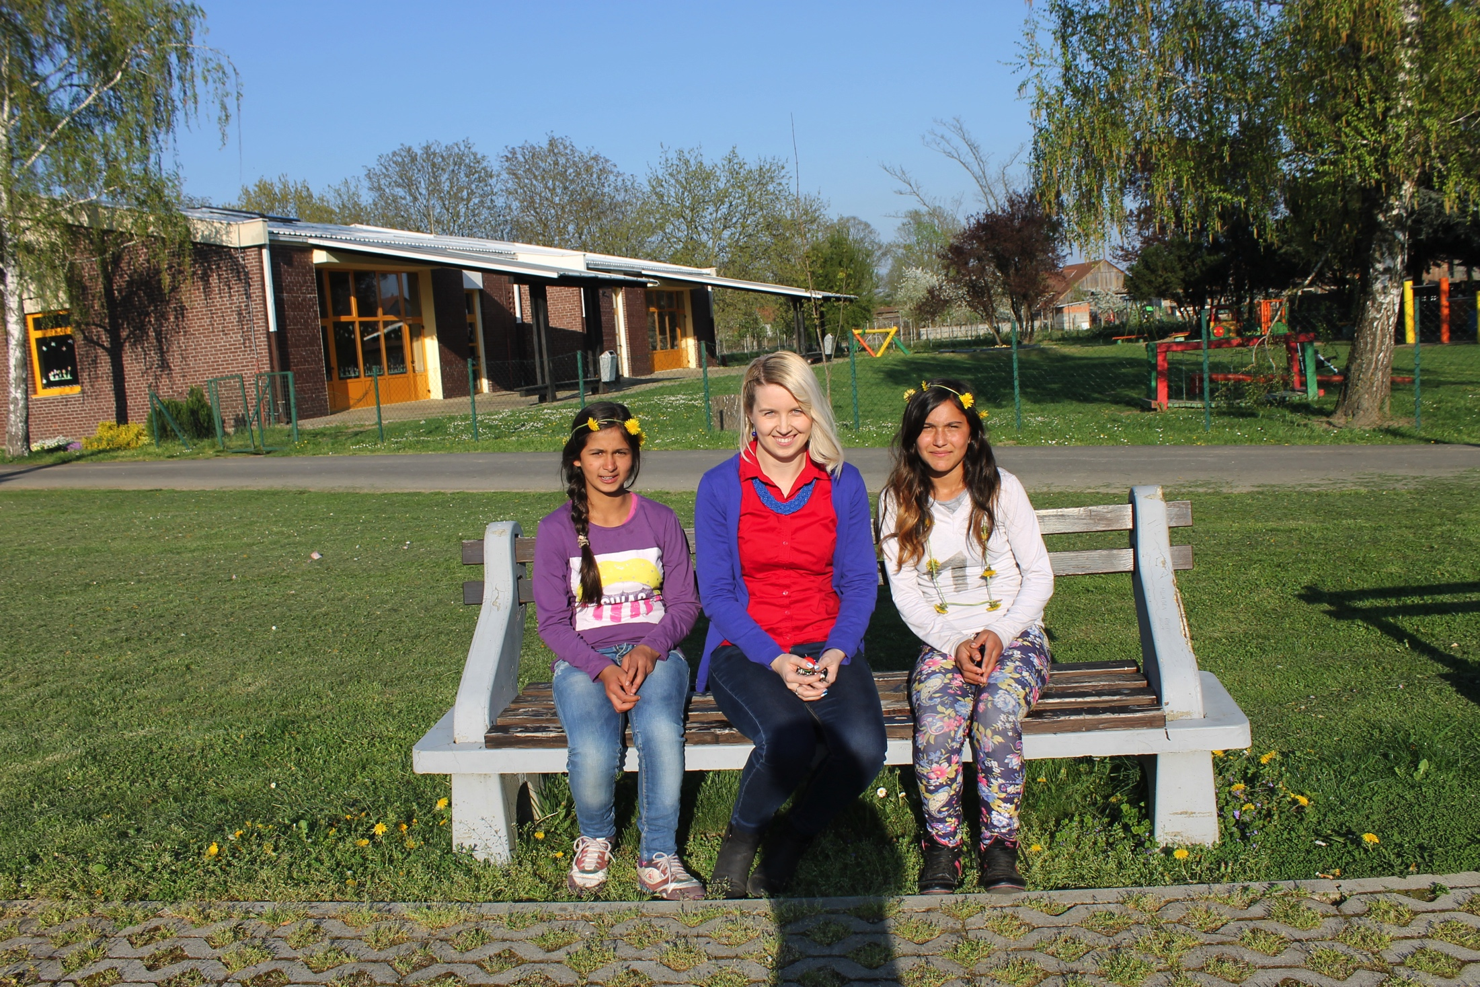
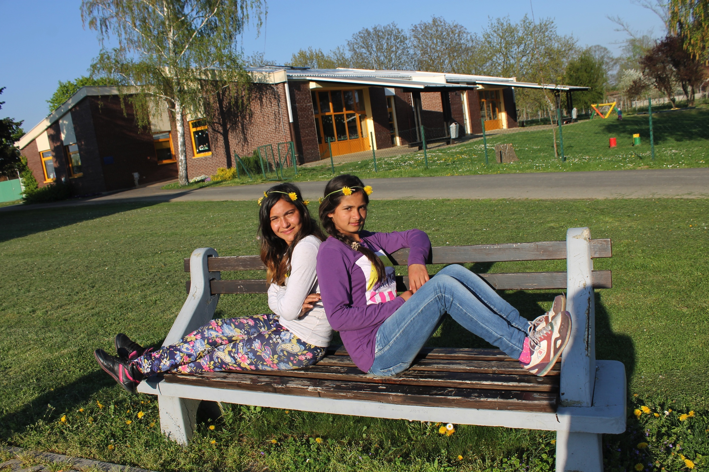

Slide 4
Camera
How to properly hold a camera
Functions of camera:
Manual
Aperture priority
Shutter priority
Programme
Auto
No flash
Portrait
Landscape
Macro
Sport
Nighttime
Video

Slide 5
