Slide 1
WELCOME TO SOU “LJUPCO SANTOV” KOCHANI, NORTH MACEDONIA

Slide 2
In the next several slides, you will follow a presentation about our school ☺

Slide 3
ENJOY!☺

Slide 4
SCHOOLYARD

Slide 5
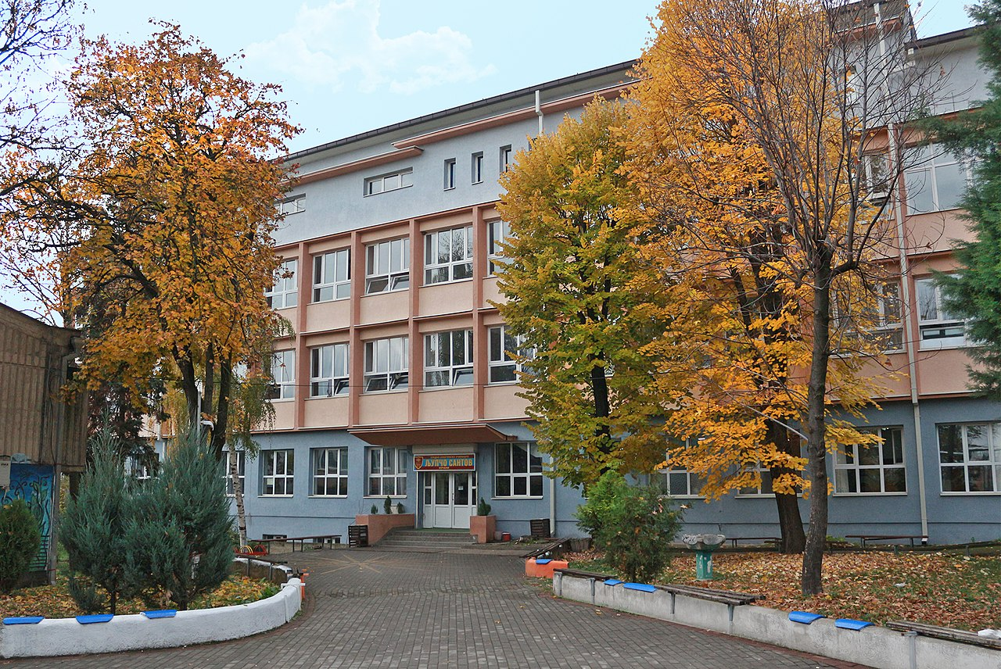

Slide 6
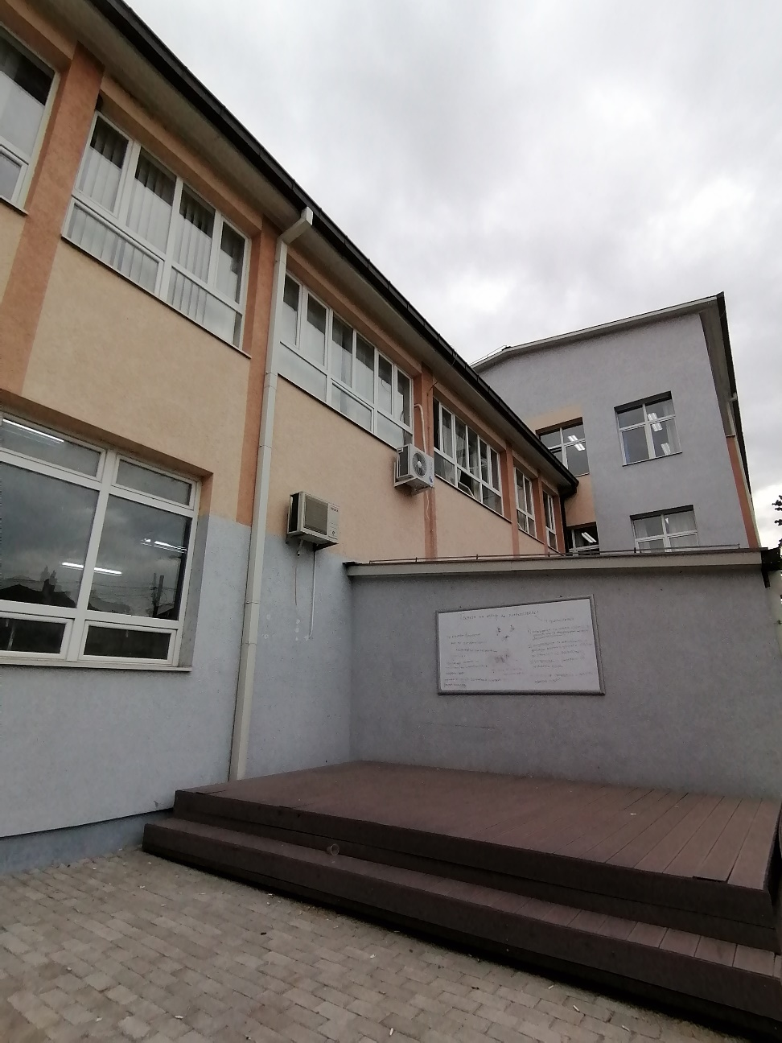
OUTDOOR CLASSROOM

Slide 7
FIRST FLOOR

Slide 8
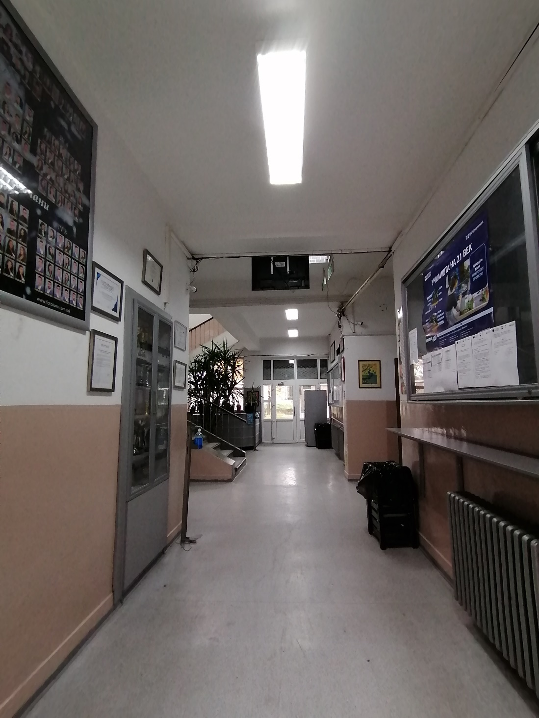
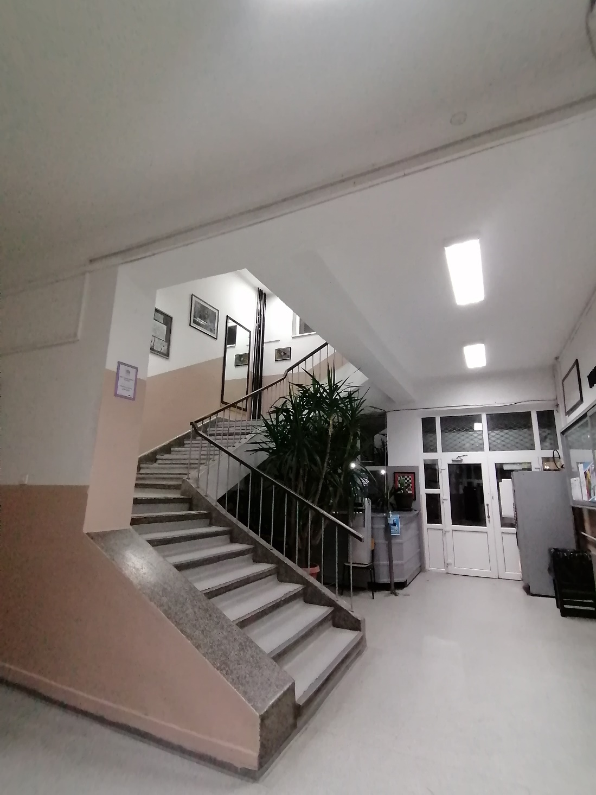

Slide 9
REGULAR CLASSROOMS

Slide 10
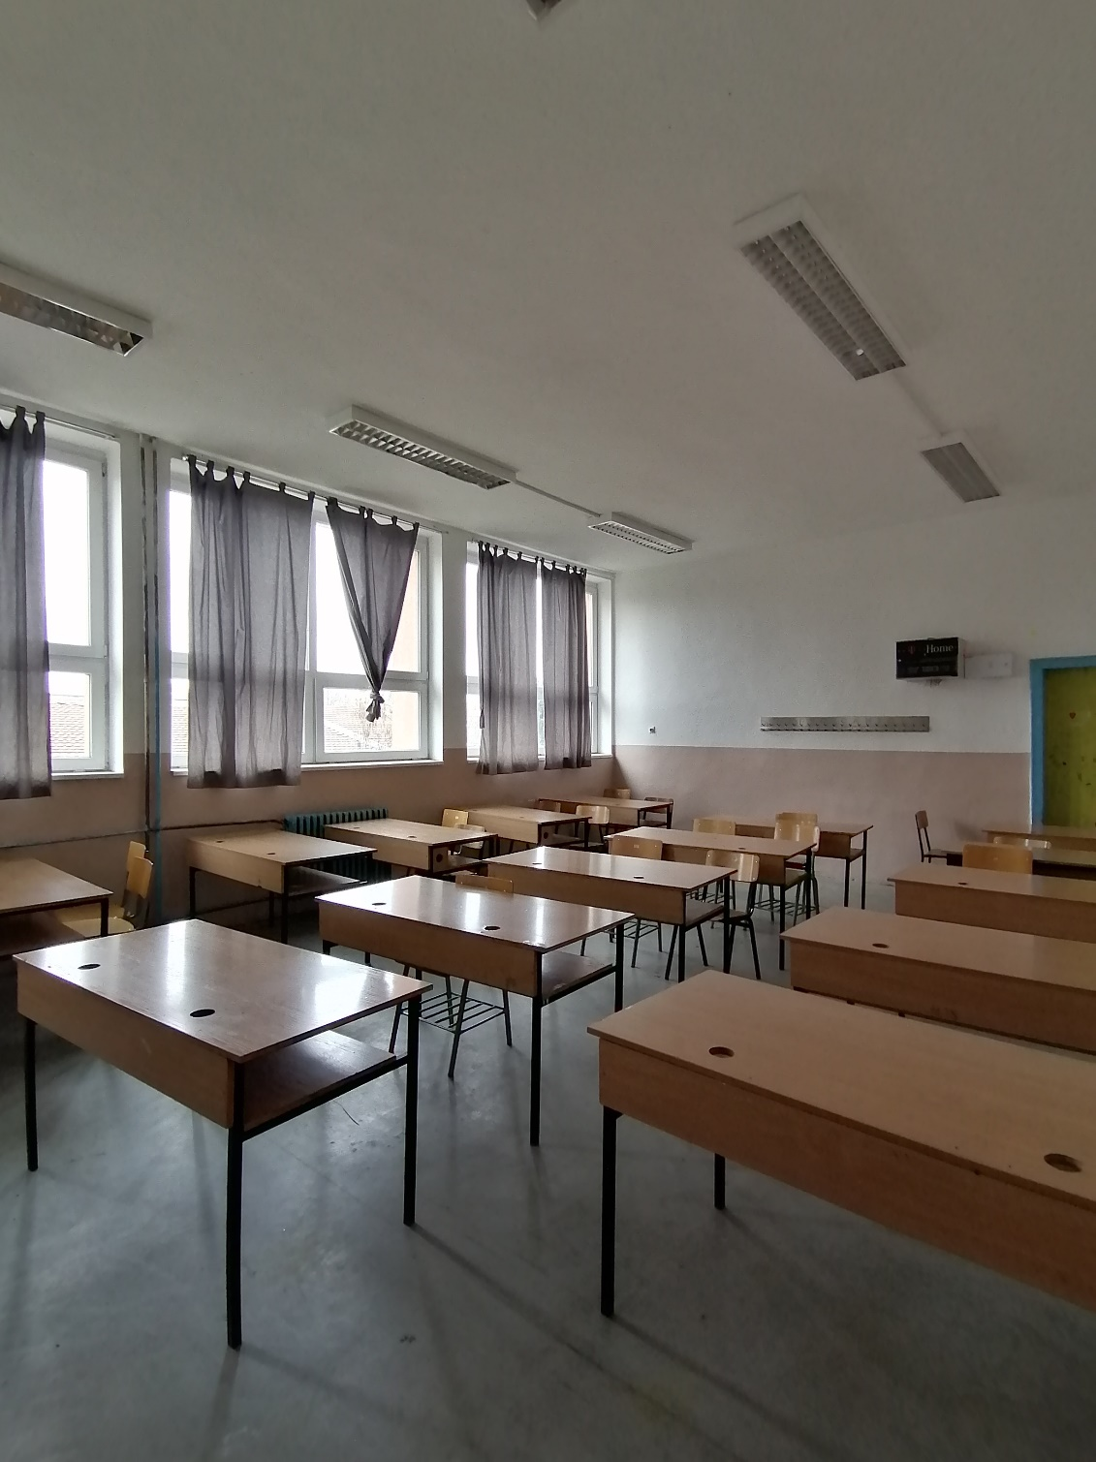
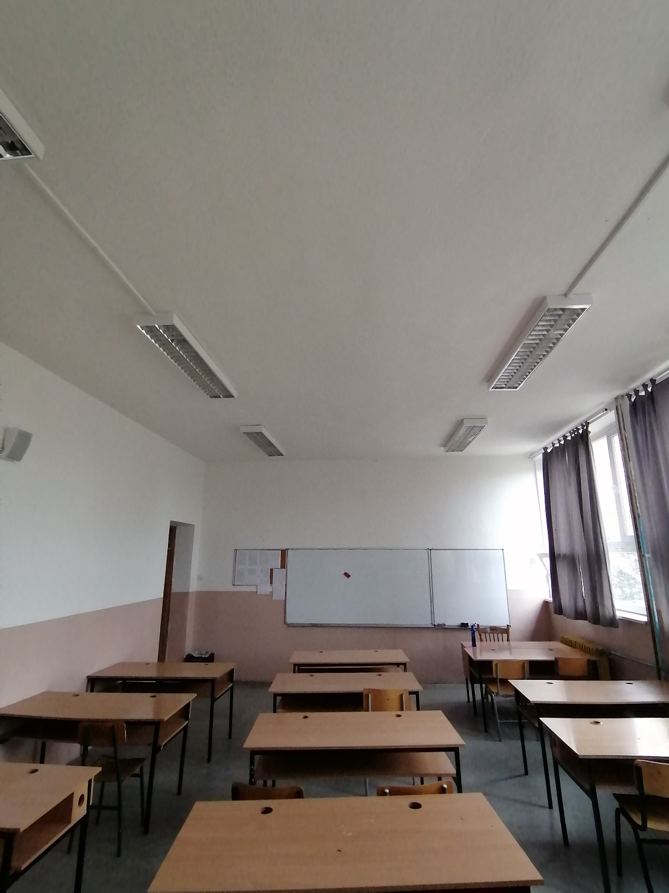

Slide 11
THE SCHOOL LIBRARY

Slide 12
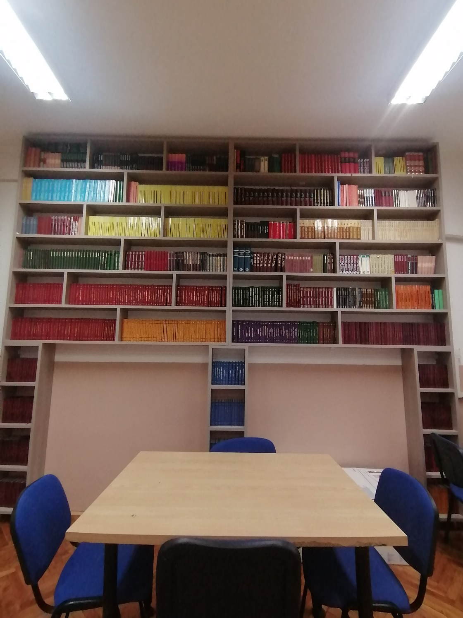
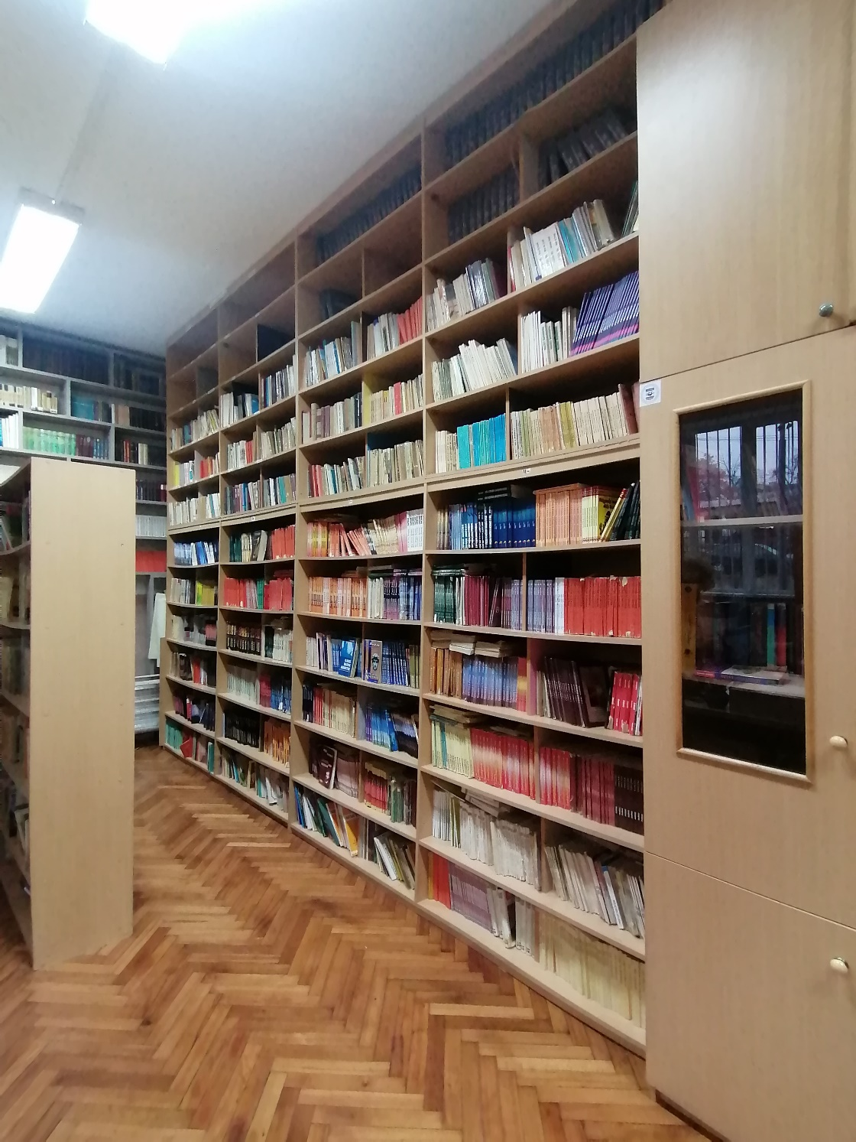

Slide 13
THE SCHOOL GYM

Slide 14
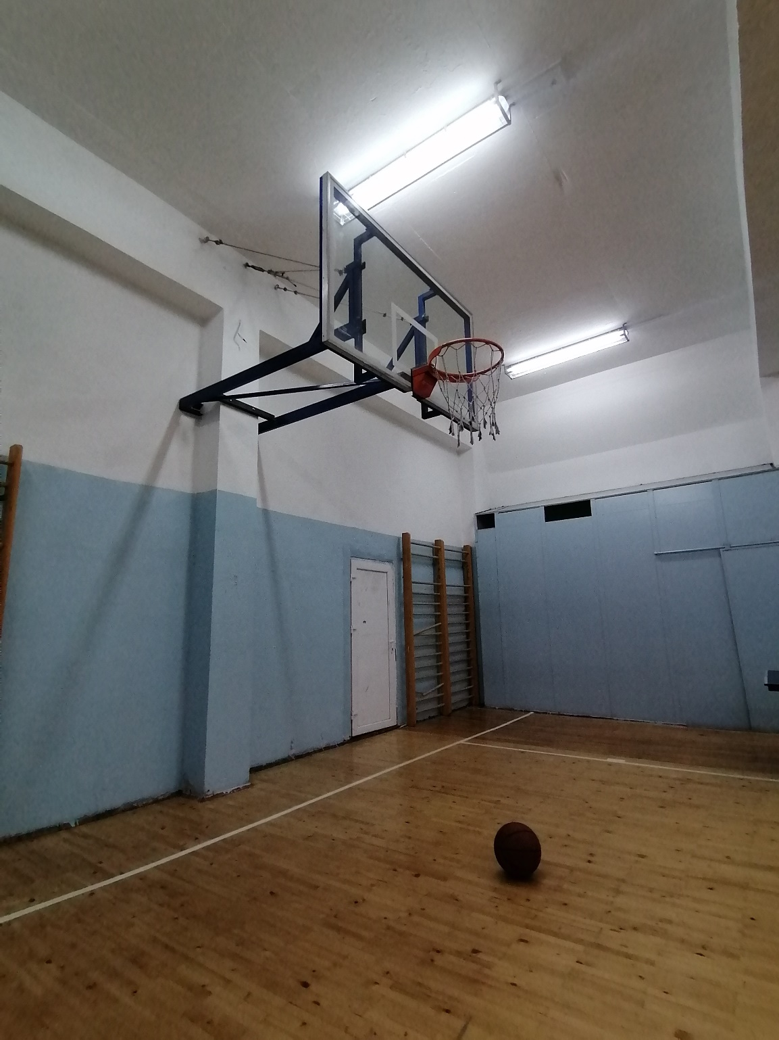
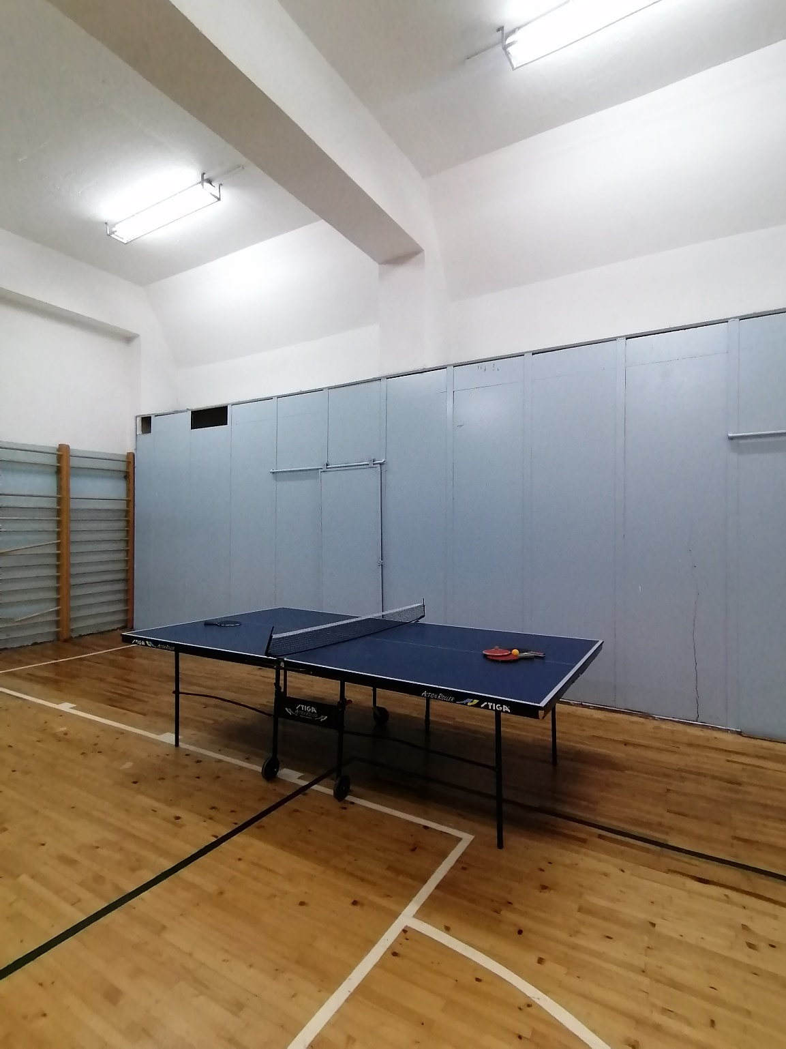

Slide 15
MUSIC CLASSROOM

Slide 16
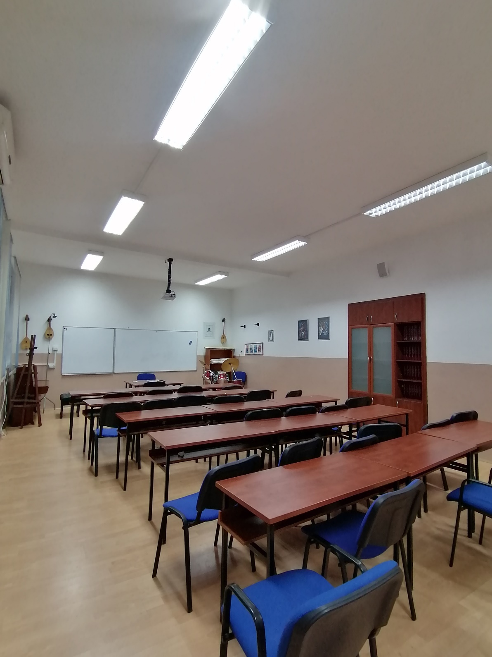
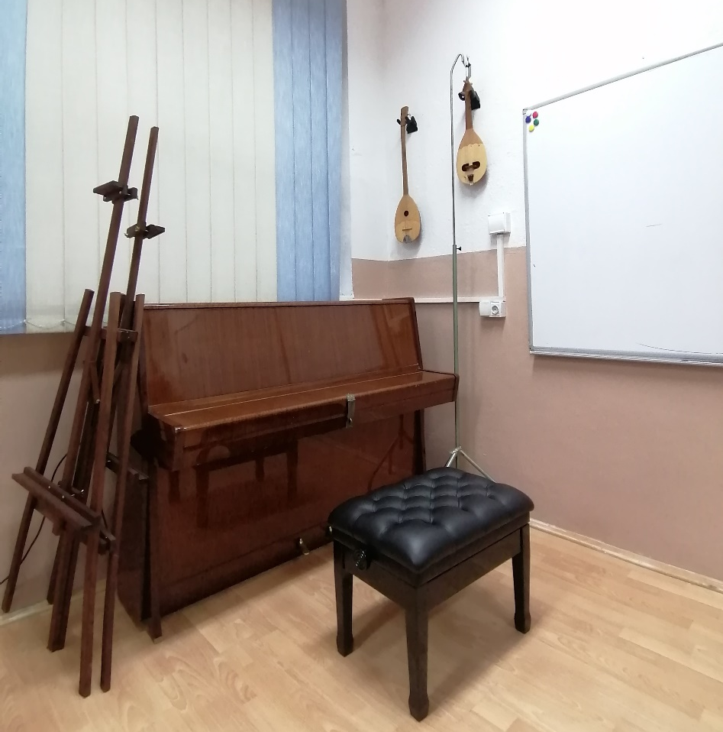
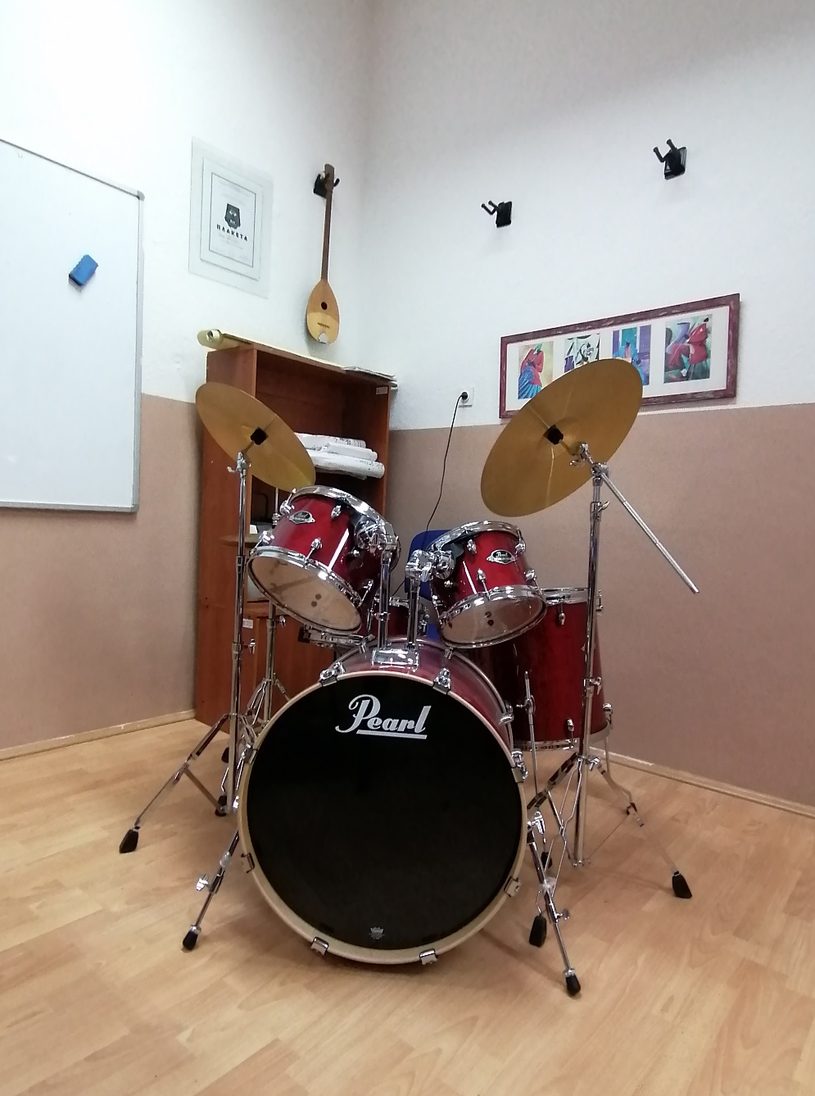

Slide 17
SECOND FLOOR

Slide 18
PHYSICS CLASSROOM

Slide 19
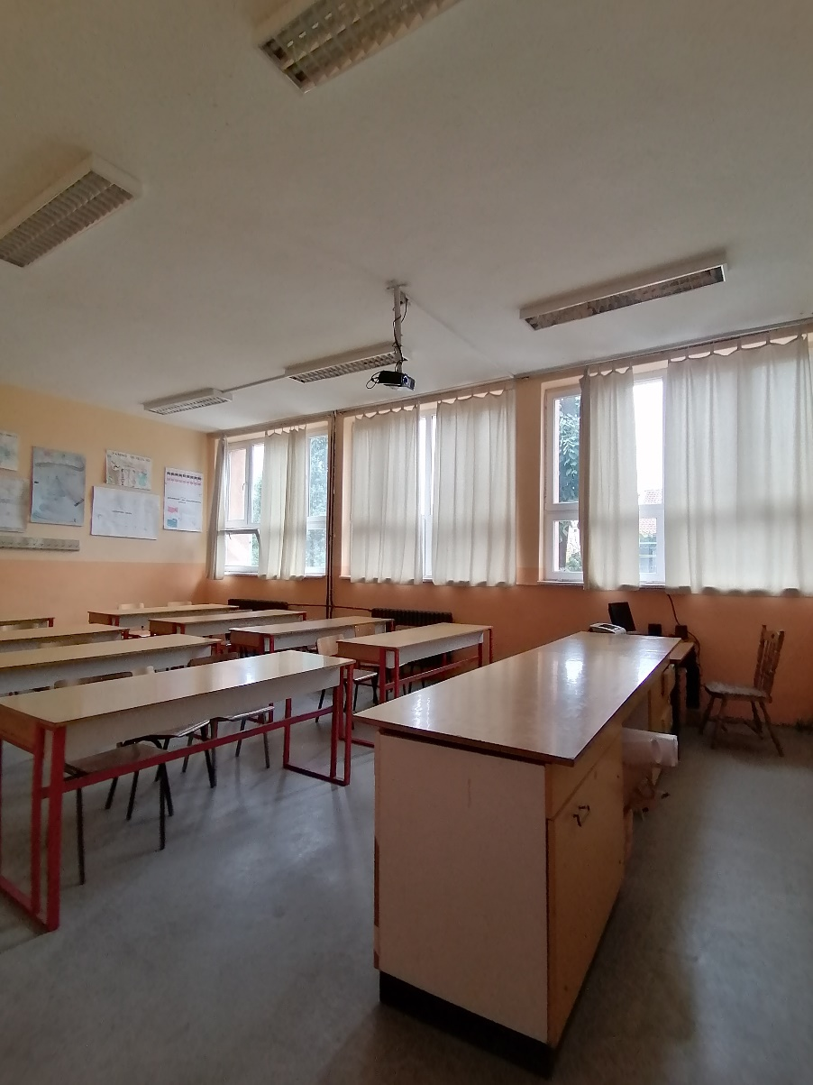
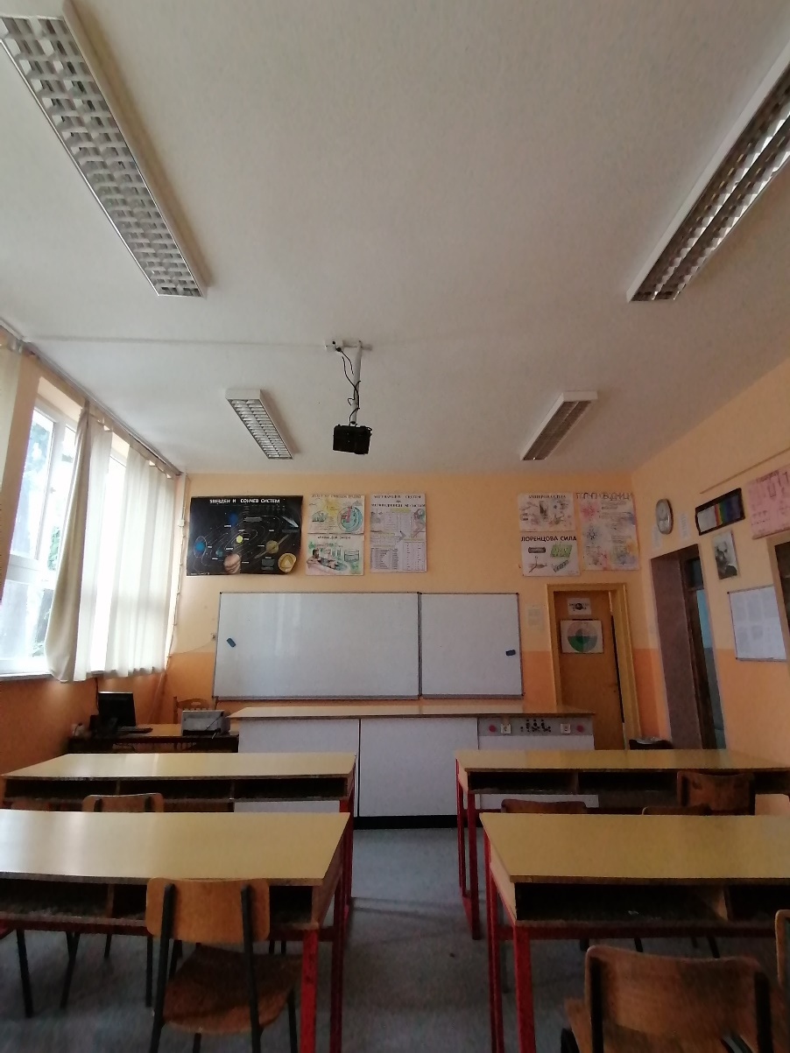
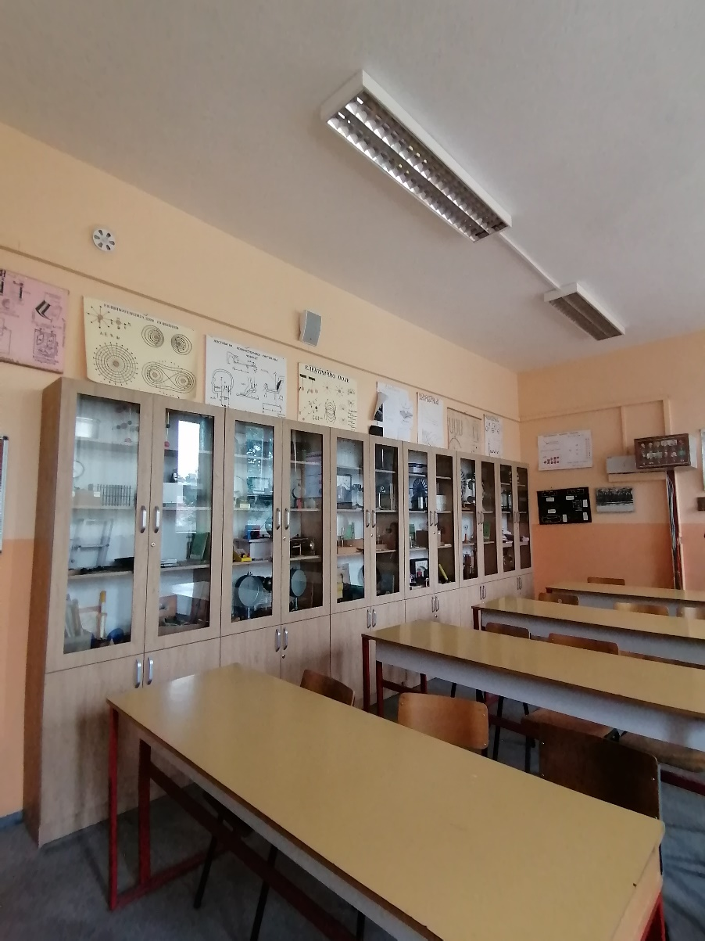

Slide 20
THE SCHOOL LAB

Slide 21
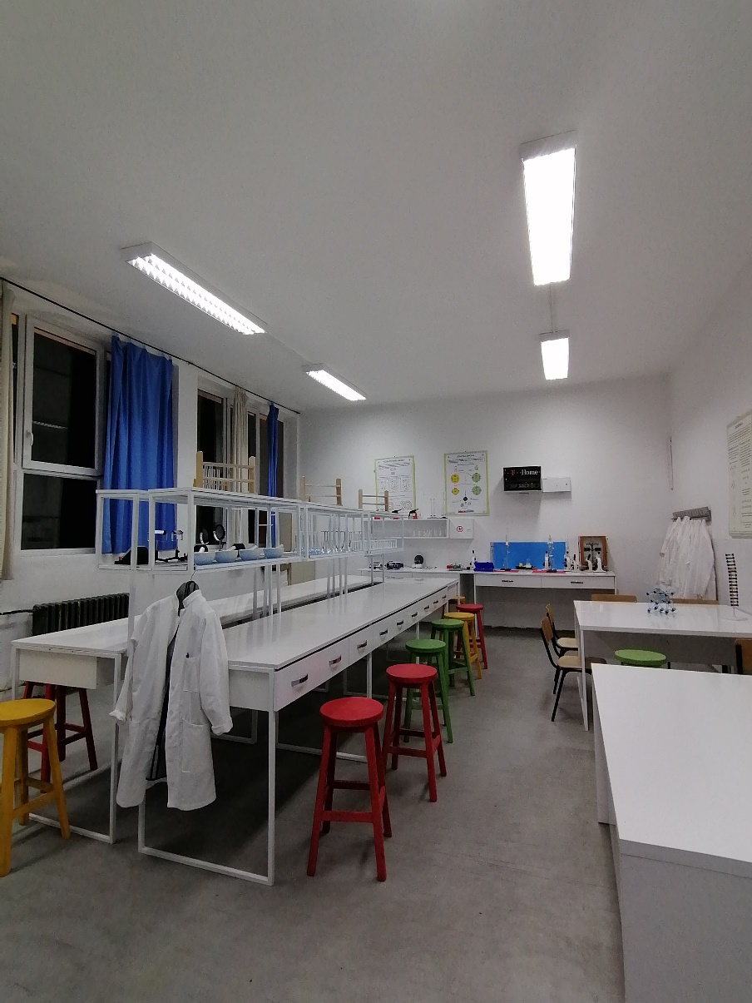
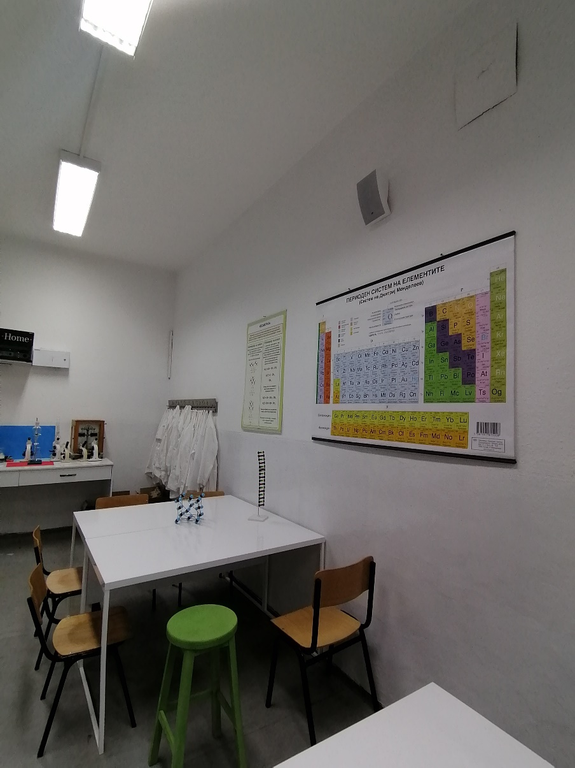
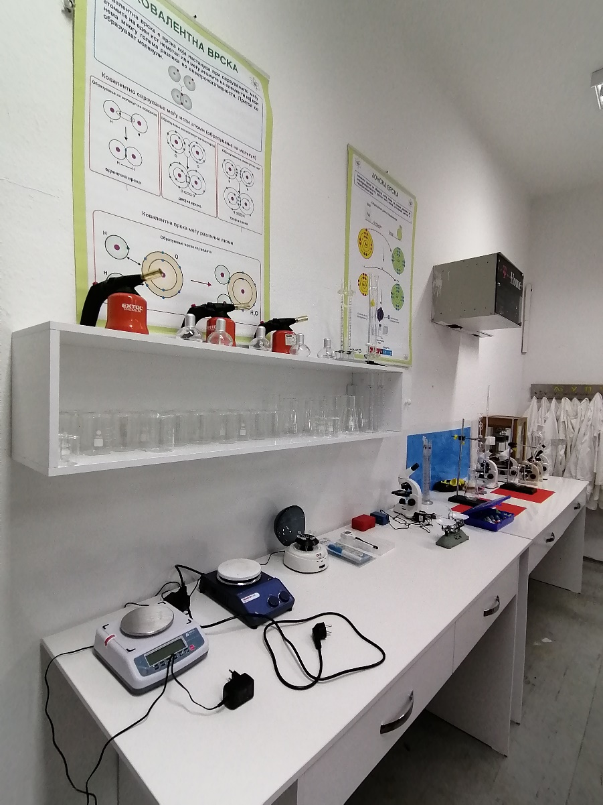

Slide 22
PRACTICE ROOM

Slide 23
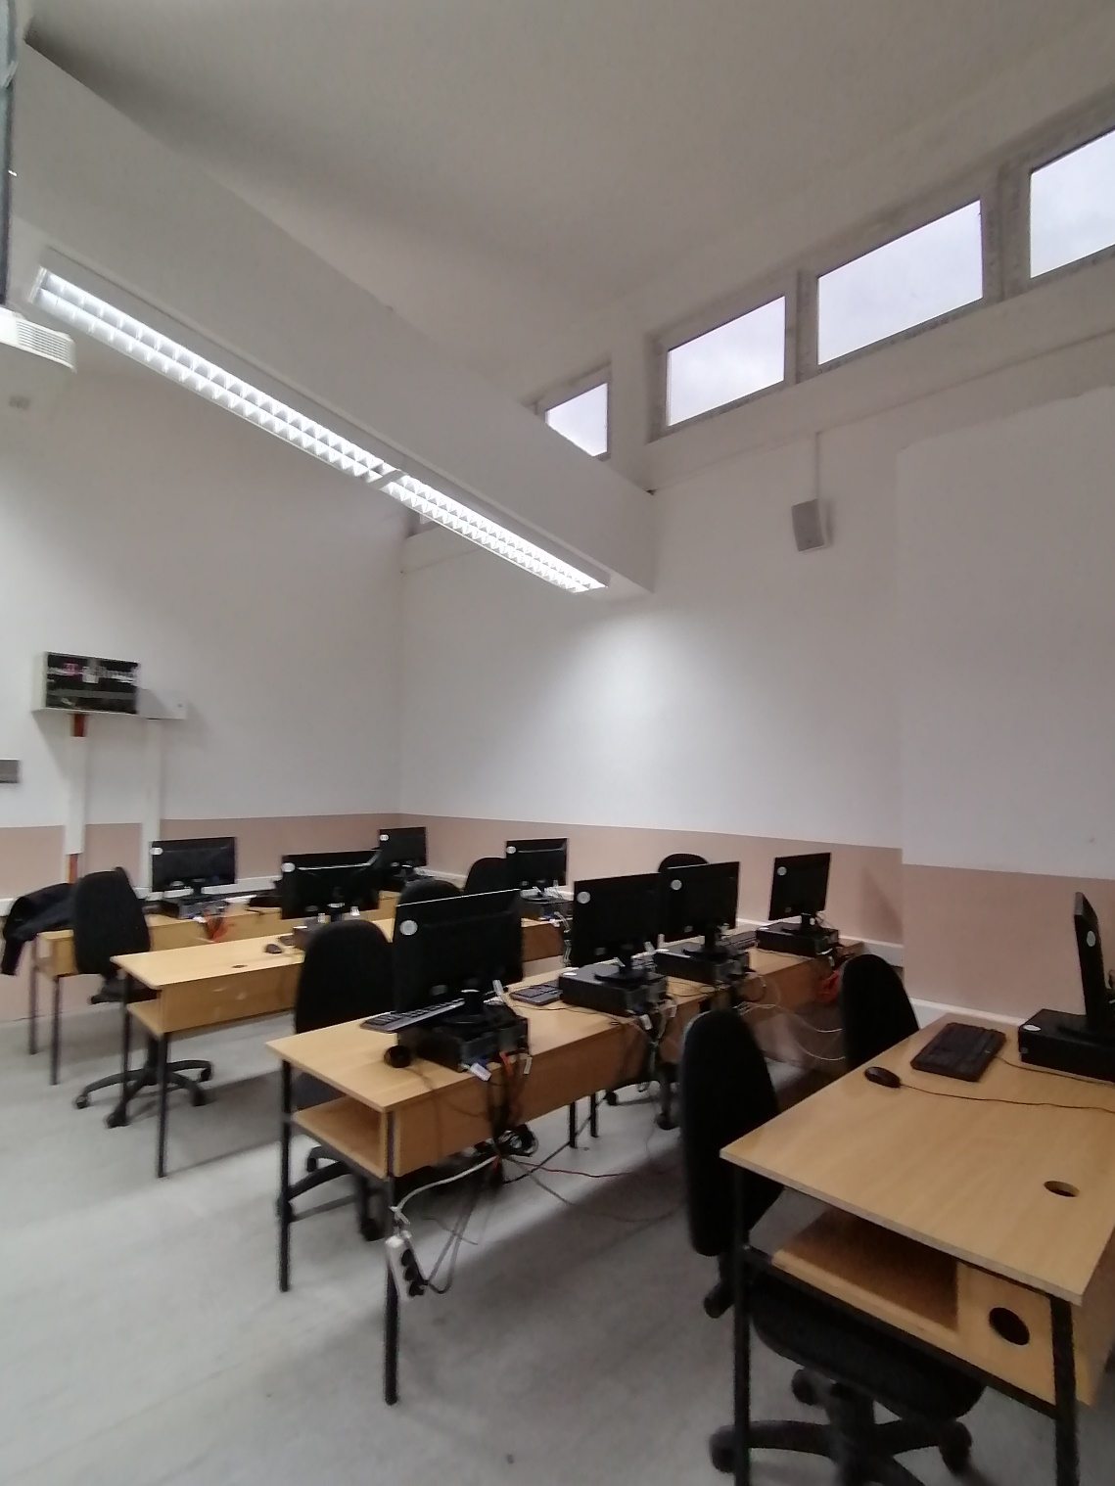
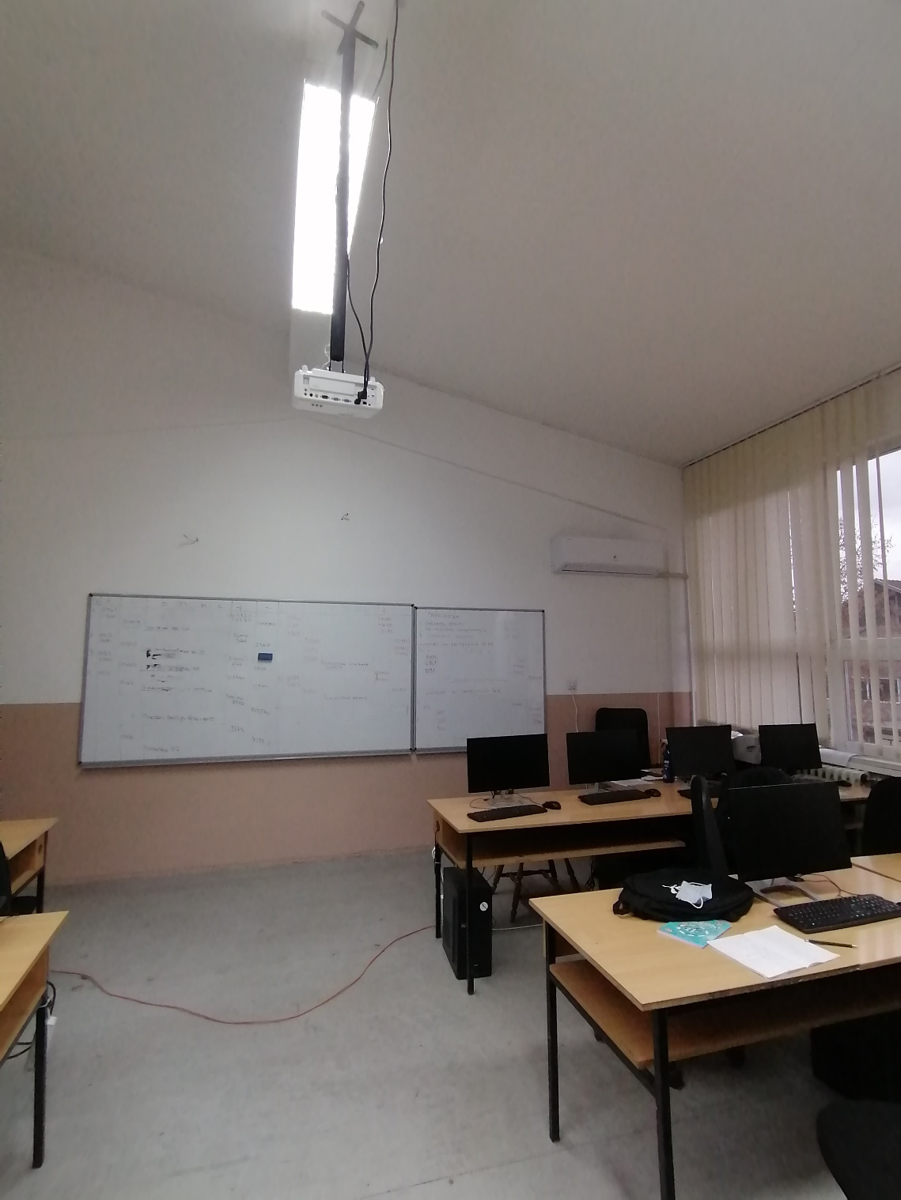

Slide 24
CLASSROOM FOR PRESENTATIONS

Slide 25
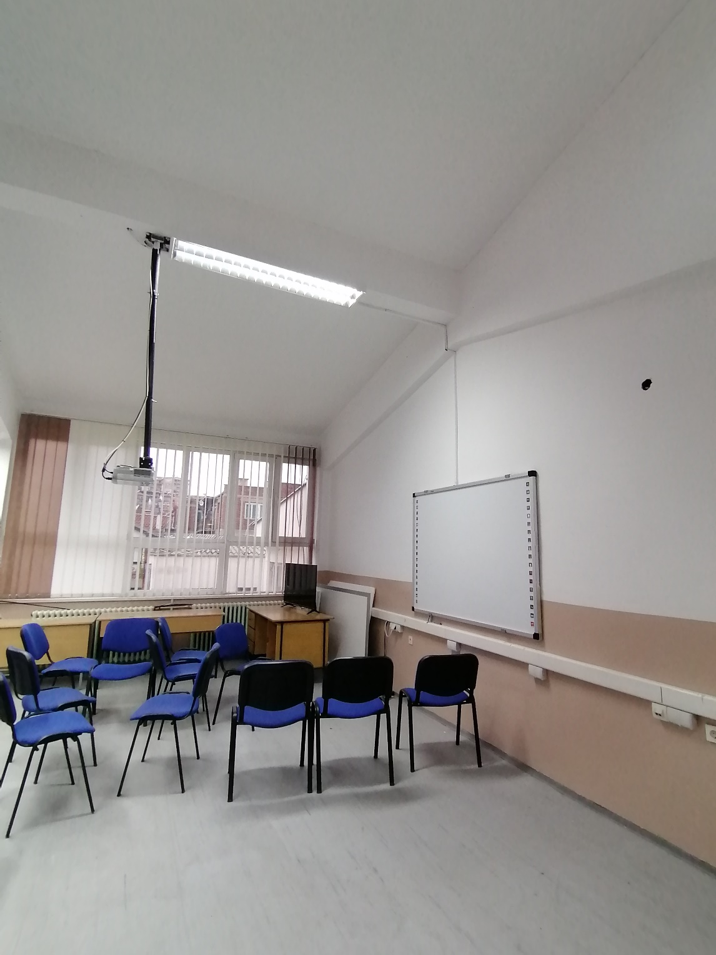
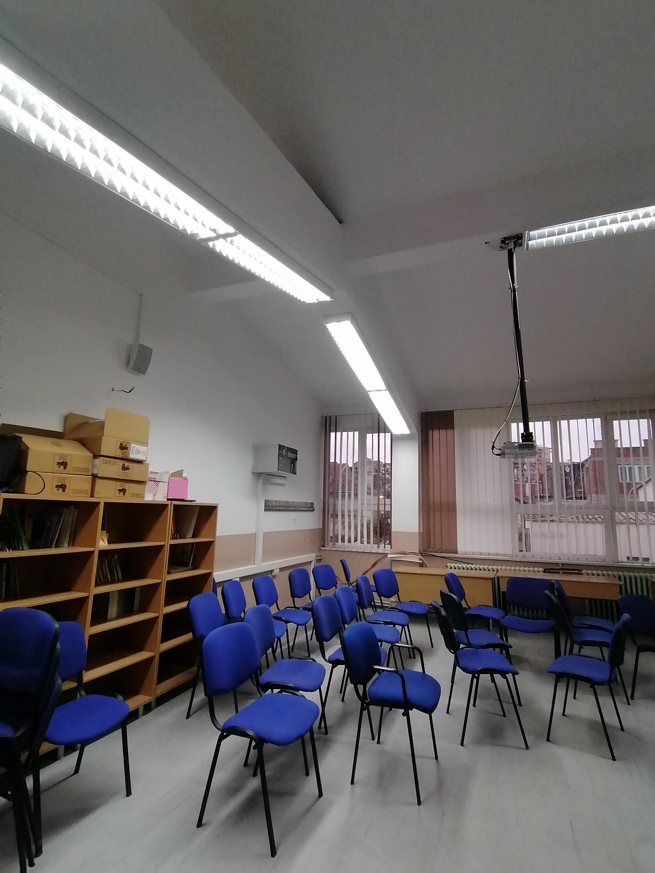

Slide 26
THIRD FLOOR

Slide 27
INFORMATICS TECHNOLOGY CLASSROOM

Slide 28
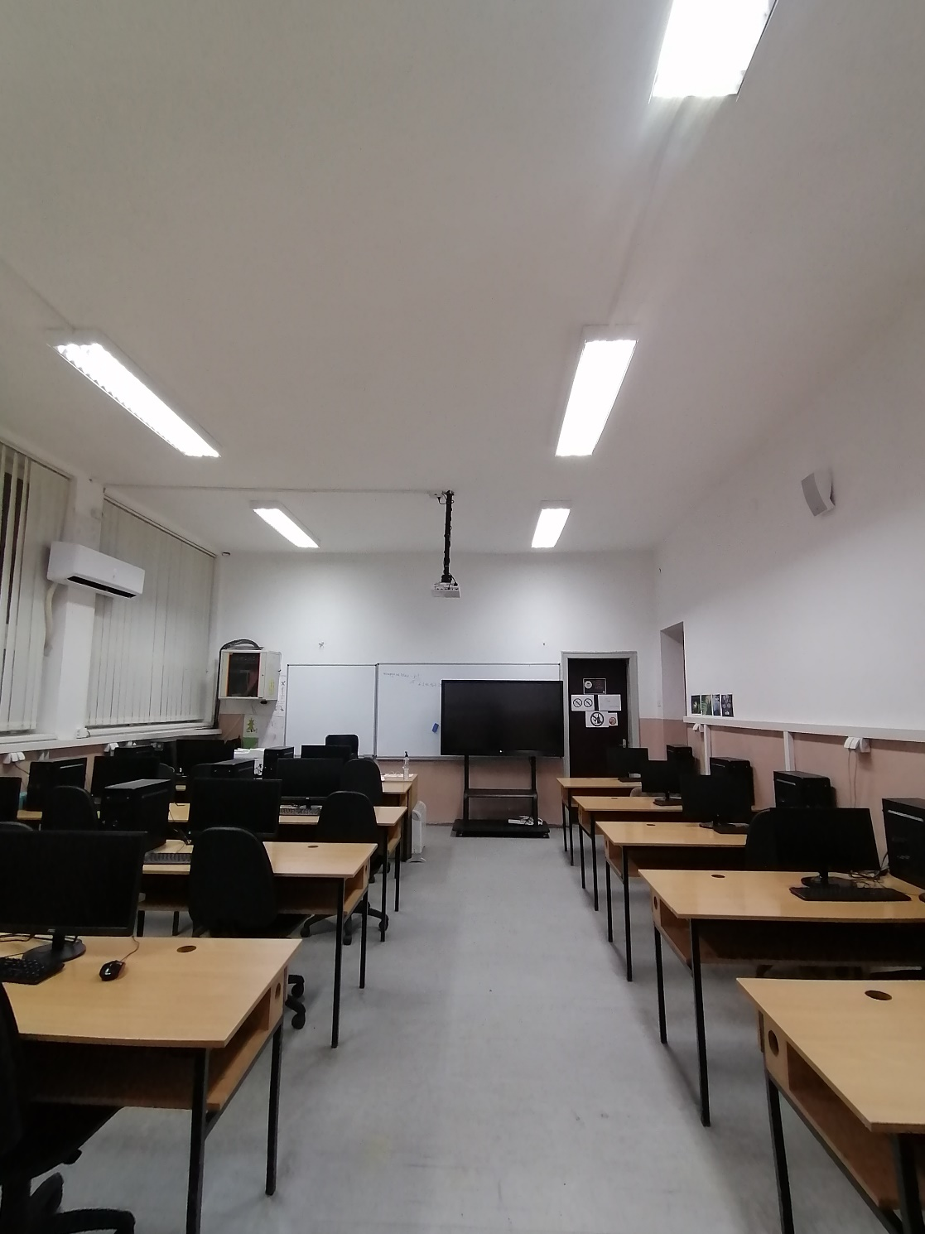
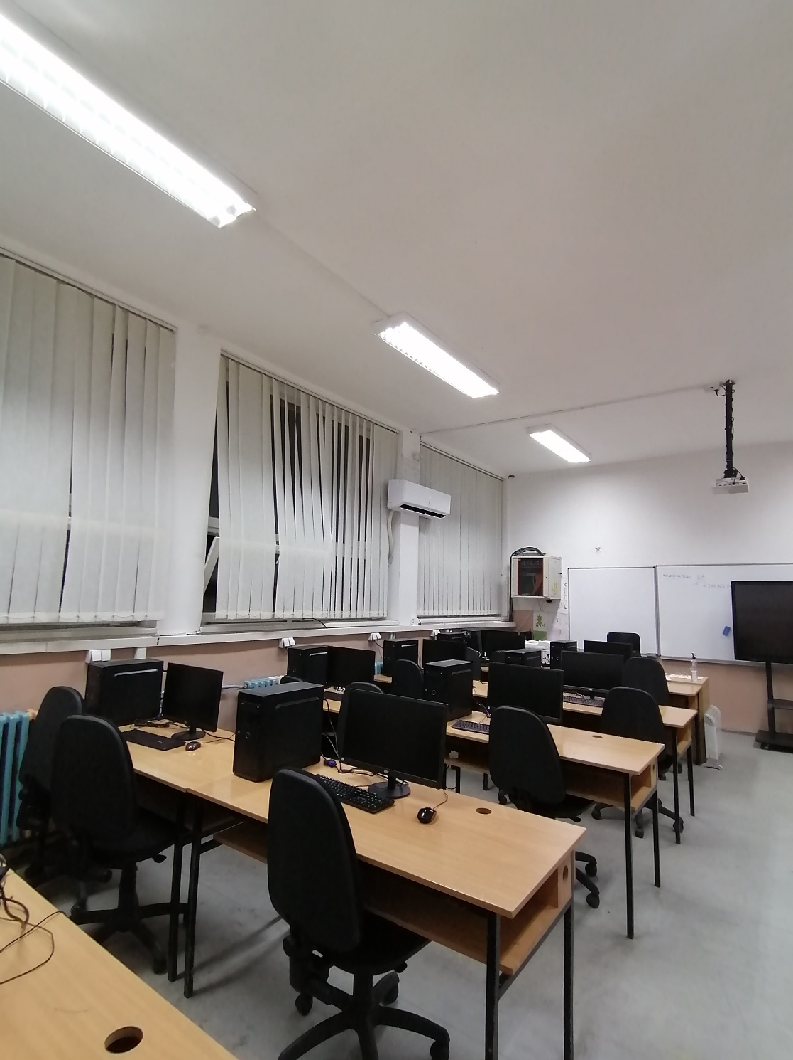

Slide 29
ART CLASSROOM

Slide 30
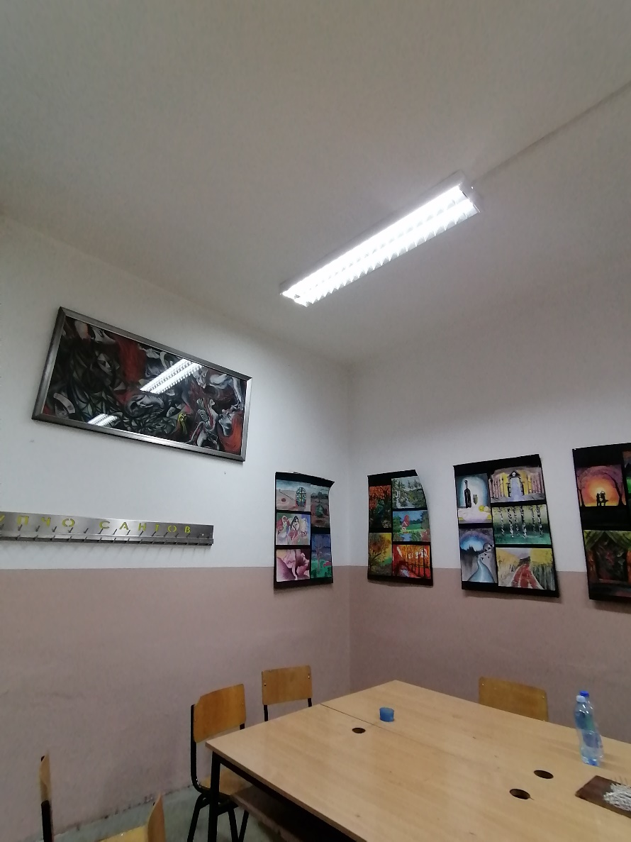
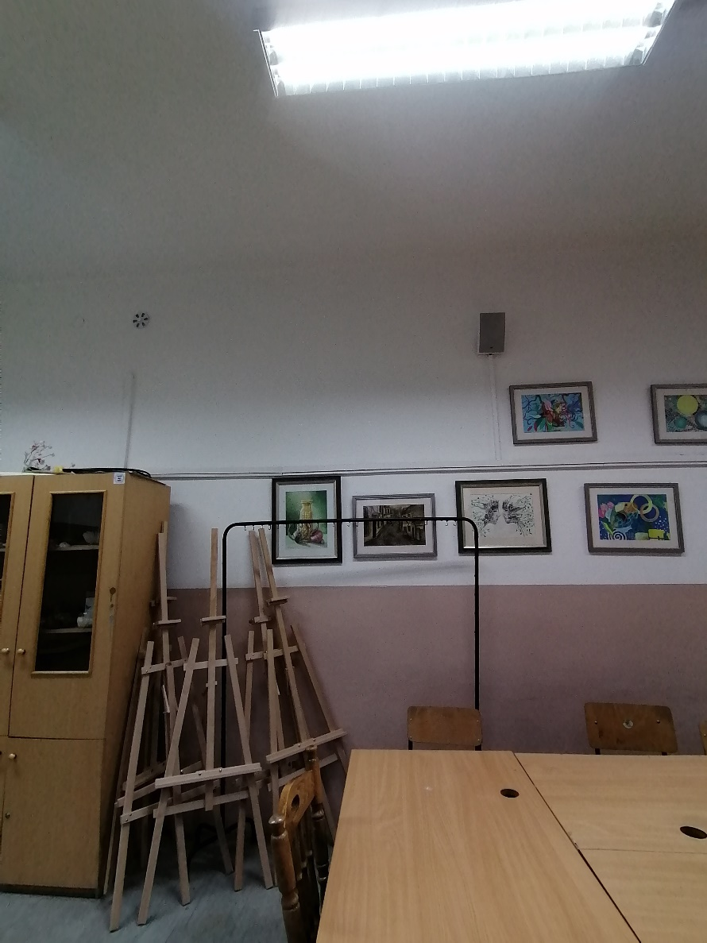
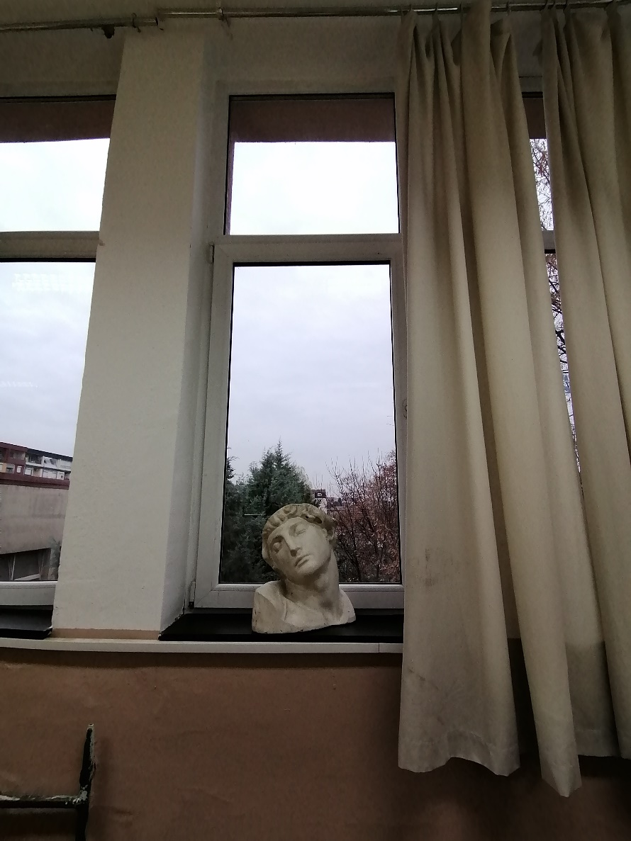

Slide 31
FOURTH FLOOR

Slide 32
MULTI MEDIA CENTER

Slide 33
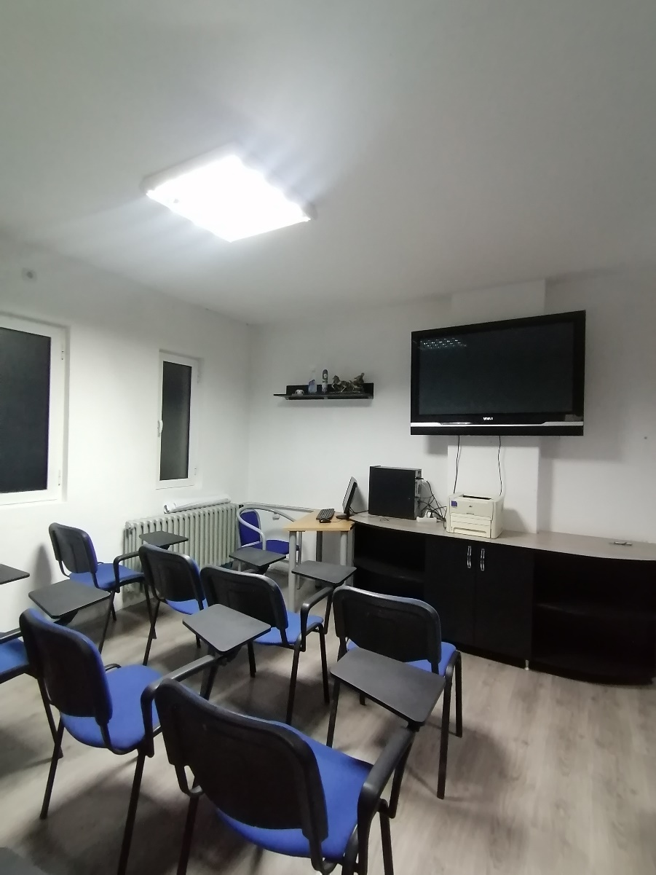
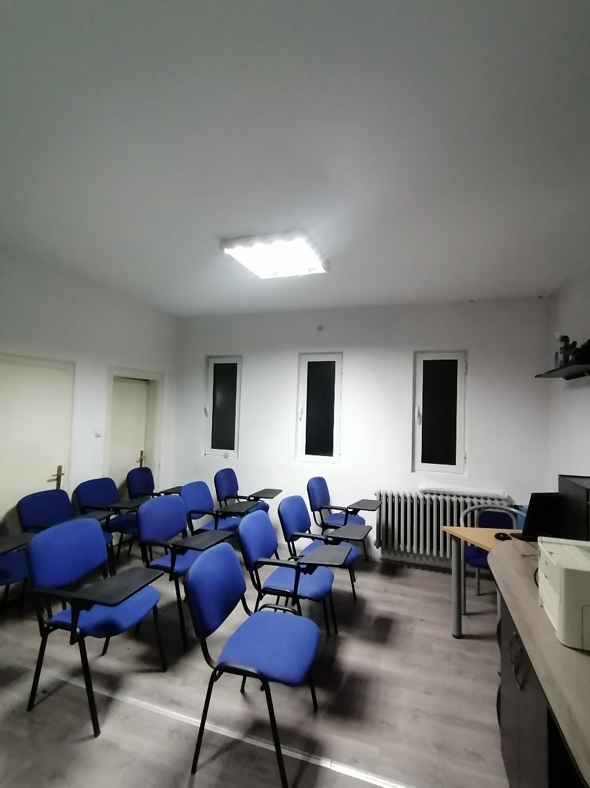
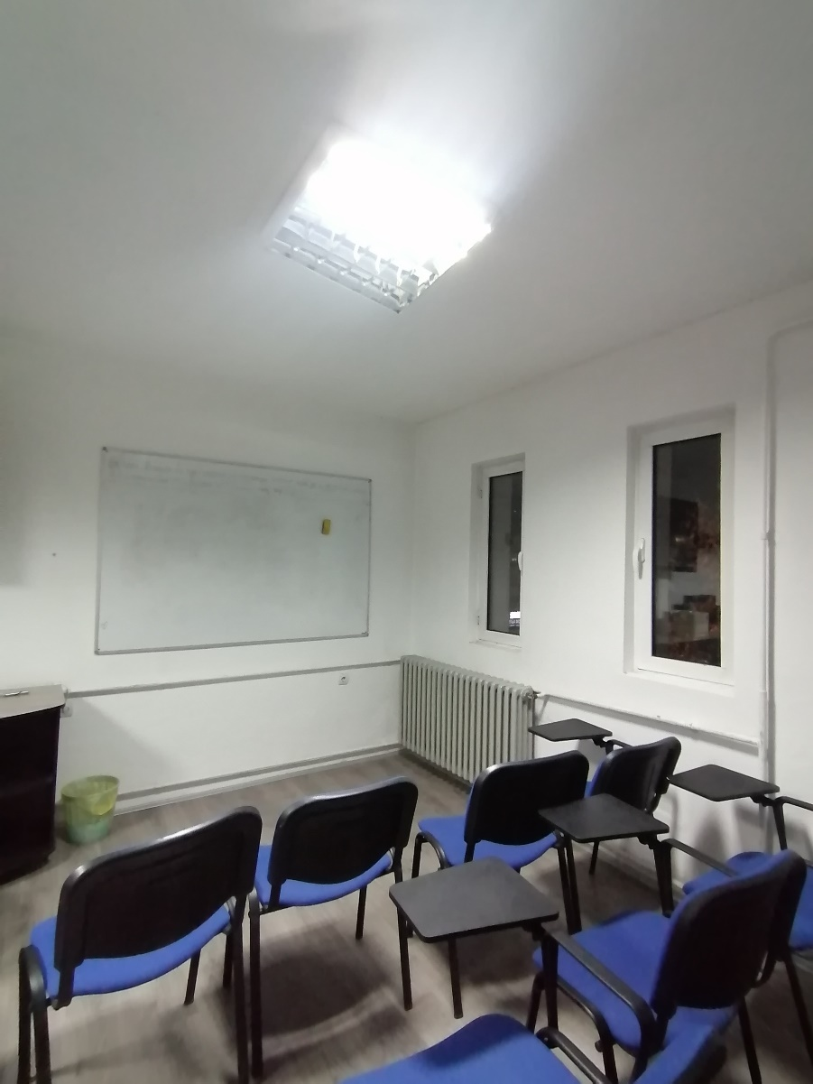

Slide 34
THANKS FOR YOUR ATTENTION! WE HOPE YOU LIKED IT!☺

