Slide 1
THE LOGO COMPETITION IN SUDUVOS GYMNASIUM

Slide 2
LOGOTYPE CONTEST

Slide 3
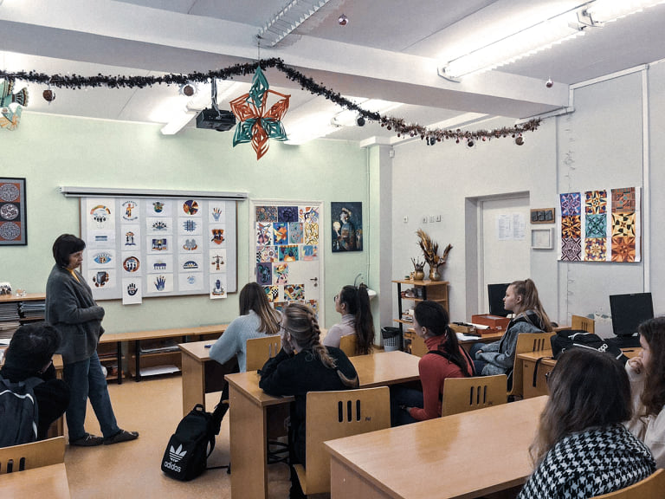
AWESOME WORDS

Slide 5
MEGA SUPER ULTRA DEMOCRATIC

Slide 6
