Slide 1
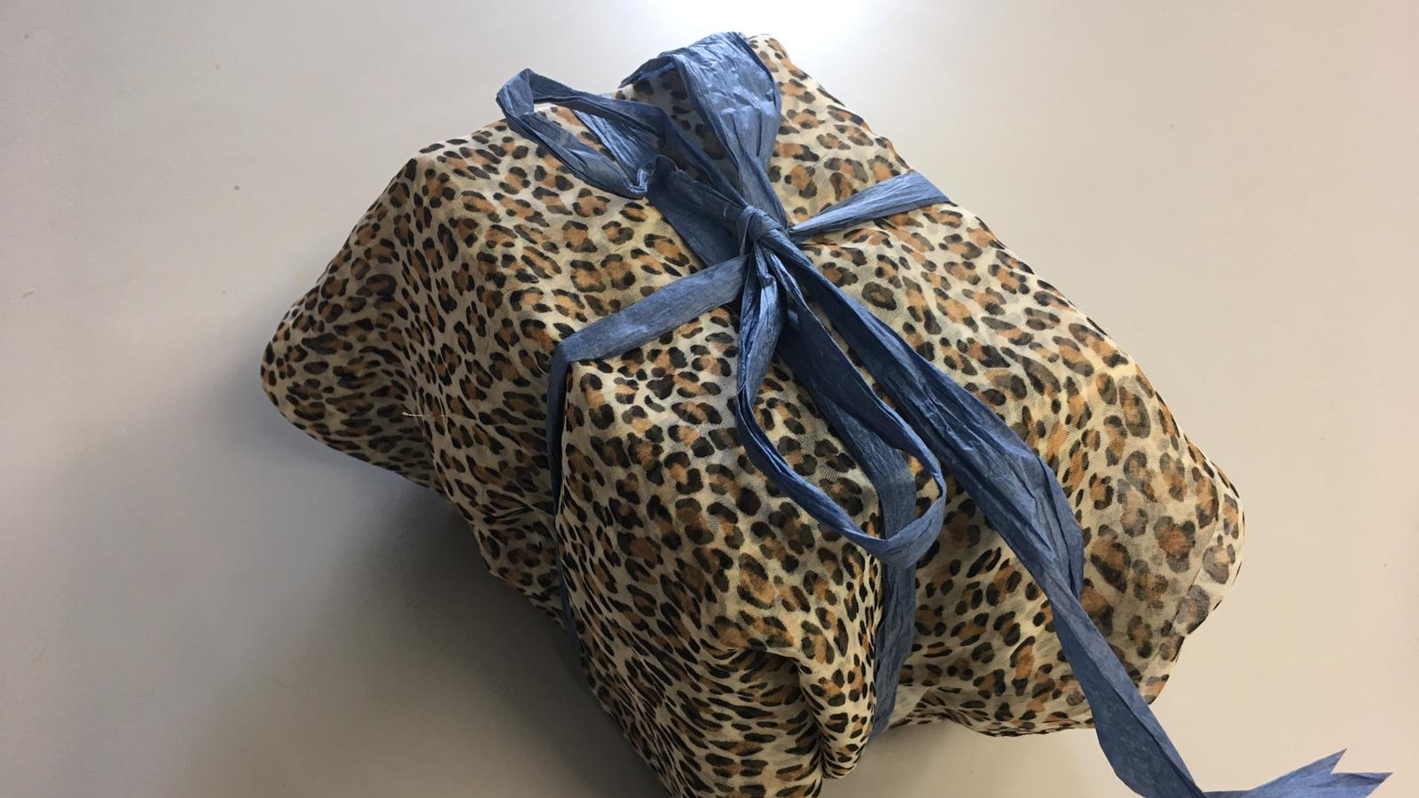
Gift giving in finland
Made by Oulu International School students

Slide 2
Different gift-giving occassions
When do Finns give gifts?
Christmas eve; 24th December
Birthdays
After confirmation ceremonies
Name days
Valentine's day; 14th February
House warming
Graduation
Easter
Anneversaries

Slide 3
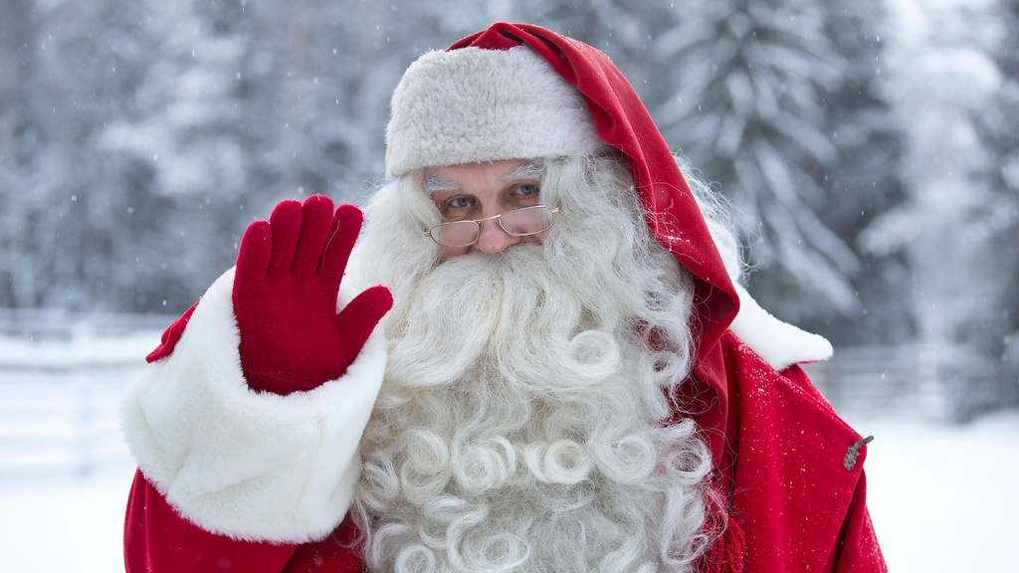
Christmas (Joulu)
Finnish people celebrate Christmas on the 24th of December.
We open Christmas presents in the evening when Joulupukki (Santa Claus) comes.
Our children get to see an actual Santa Claus and sit on his lap.
We sing Christmas carols!
Fig.1. Siren Kaisa. ”Saiko lehti kertoa…” MTV Uutiset. 13th April 2018. Accessed 2nd.May 2019.

Slide 4
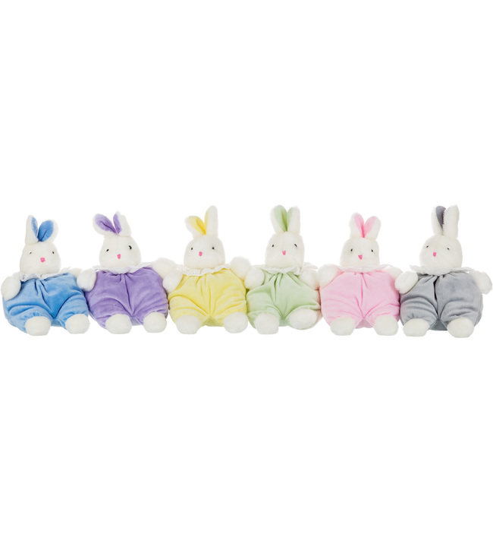
Birthdays (Syntymäpäivä)
People get presents on their birthdays
When children are born, they are given soft plush bunny toys called Ainu-pupu.
Often young children throw birthday parties for their friends
The guests usually bring a gift to the party host
Some gifts are for example, toys, candy, money, giftcards etc.
Fig 2. "Ainu ensipupu" Kärkkäinen. Accessed 3rd May 2019.

Slide 5
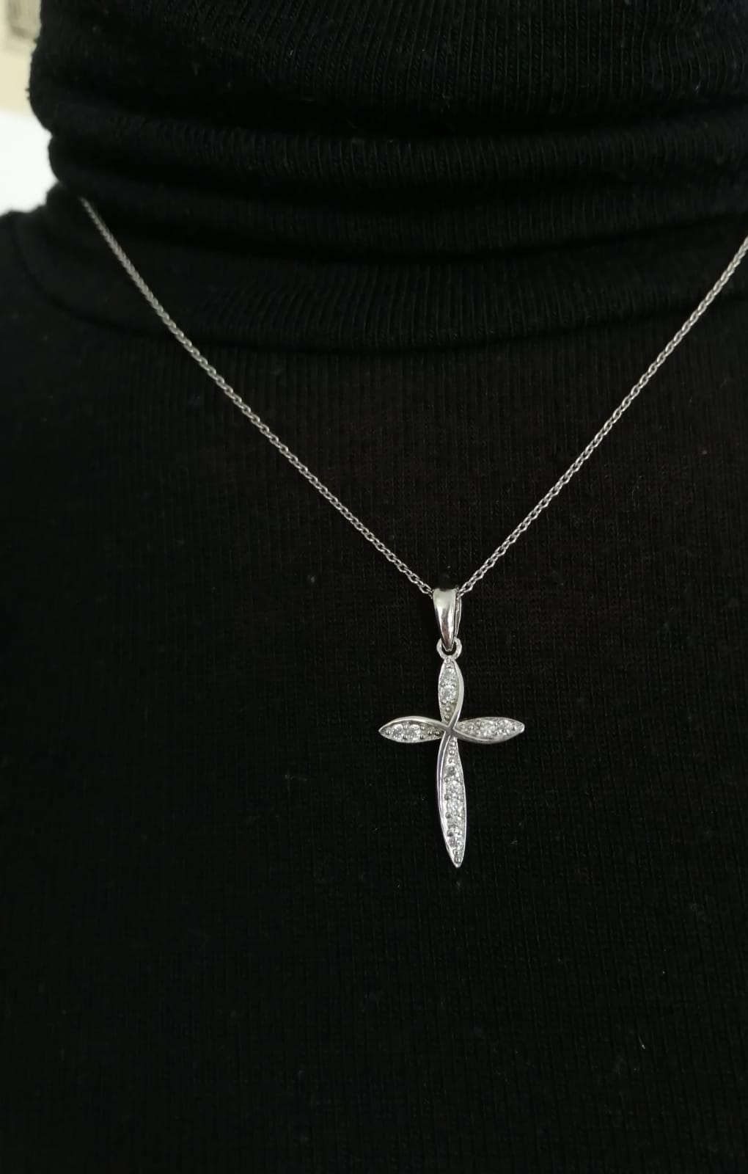
After confirmation ceremonies
In Finland, most children attend confirmation school at 15.
They do this to become confirmed in the Lutheran church, which allows you to get married in the church.
After you are confirmed, you're usually gifted money, flowers.
Godparents purchase you a cross pendant, which you wear as a necklace.
Finland is a majorly Lutheran country, so the necklace symbolises faith in God and repentence.

Slide 6
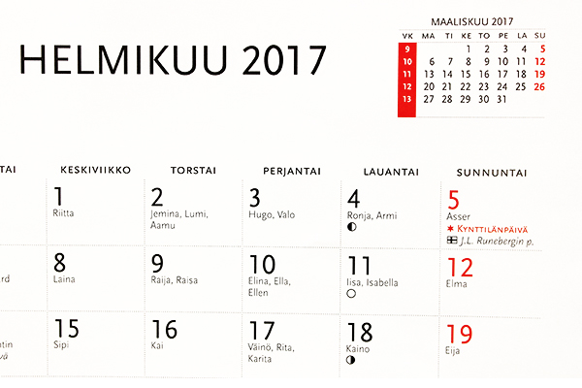
Name days (Nimipäivä)
Even though uncommon, some Finns give and receive small gifts during name days.
Each day of the year is assigned to a Finnish name (e.g. Adela/Alina's name day is on 22.4)
This is called a 'Nimi kalenteri'

Slide 7
Valentines day (Feb. 14th)
In Finland, Valnetine's Day is called Ystävänpäivä, which translates to Friendship Day!
We celebrate not just relationships between lovers, but also our friendships.
We give chocolates and flowers to our loved ones while saying, "Hyvää Ystävänpäivä!", which means "Happy Friendship Day!
minun ystäväni
1. Minun ystäväni on kuin villasukka, joka talvella lämmittää. Minun ystäväni on kuin niitynkukka, joka saa minut hymyilemään. Kertosäe: Ota kädestä kiinni, tule kanssani rantaan, vien sinut katsomaan. Kuinka aurinko laskee puiden taakse, ja saa taivaan punertamaan. Minä olen vielä pikkuinen, ja siksi tahtoisin. Oppia tän´ maailman, paljon paremmin. Ja kun mä sitten joskus, olen aikuinen. Niin toivon että oppimasta koskaan lakkaa en. http://www.youtube.com/watch?v=H9Gd-BjkA78

Slide 8
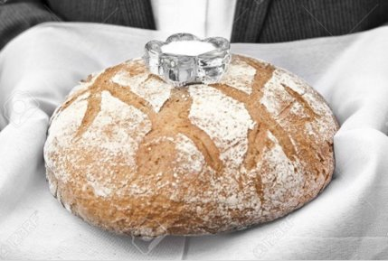
House warming!
When Finnish people move into a new house, it is tradition that visitors to the new house give salt and bread as a gift
The salt is meant to give luck.
The bread, which is usually rye bread (ruisleipä), symbolises hospitality and trust, and welcoming them into a new house.
Fig 3. "Leipää ja suolaa..." White Featherdream. Published: 26th July 2015. Accessed 3rd May 2019

Slide 9
Graduations
When Finnish children graduate from high-school (lukio), they usually host special parties.
In the parties, their parents, grandparents, and godparents, and family friends give them gifts to congratulate the on graduating.
Examples of the gifts include money, flowers, and jewelry.

Slide 10
Easter!
During Easter, children go door to door asking for chocolate.
"Virvon, varvon, tuoreeks' terveeks' tulevaks' vuodeks', vitsa sulle, palkka mulle."
That is the chant said when waving a witch stick, which kids make during Easter.
Easter egg hunts are also common for small kids.
Children also get to paint the eggs!
Fig 4. "Virpomisoksien Koristelu". K-ruoka. Accessed 3rd May 2019.

Slide 11
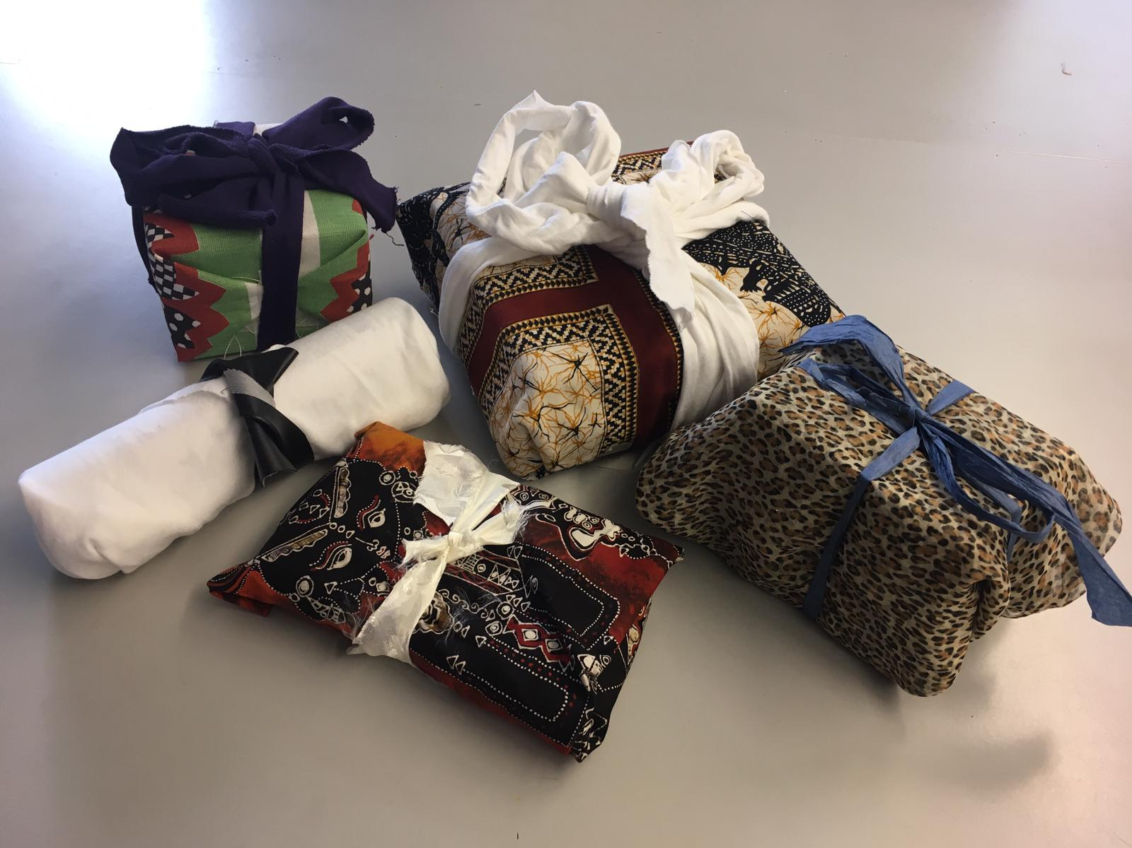
Wrapping gifts
We used recycling material to wrap our gifts
We used recycled cloth to wrap the presents by cutting them to fit the gifts and making the bow.
We also used unused paper to add decorative details to our gifts.
Our goal in this was to show others that we can pair our gift-giving with going green and that we don't always have to buy gift wrap, which saves the planet and our money. Be creative and have fun!

