Slide 1
Ways to save water
Tips to save water

Slide 2
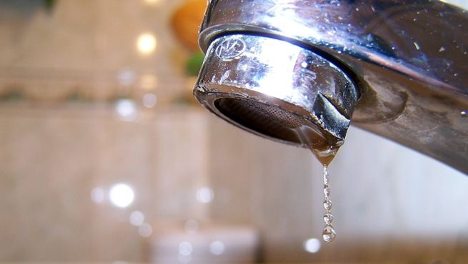
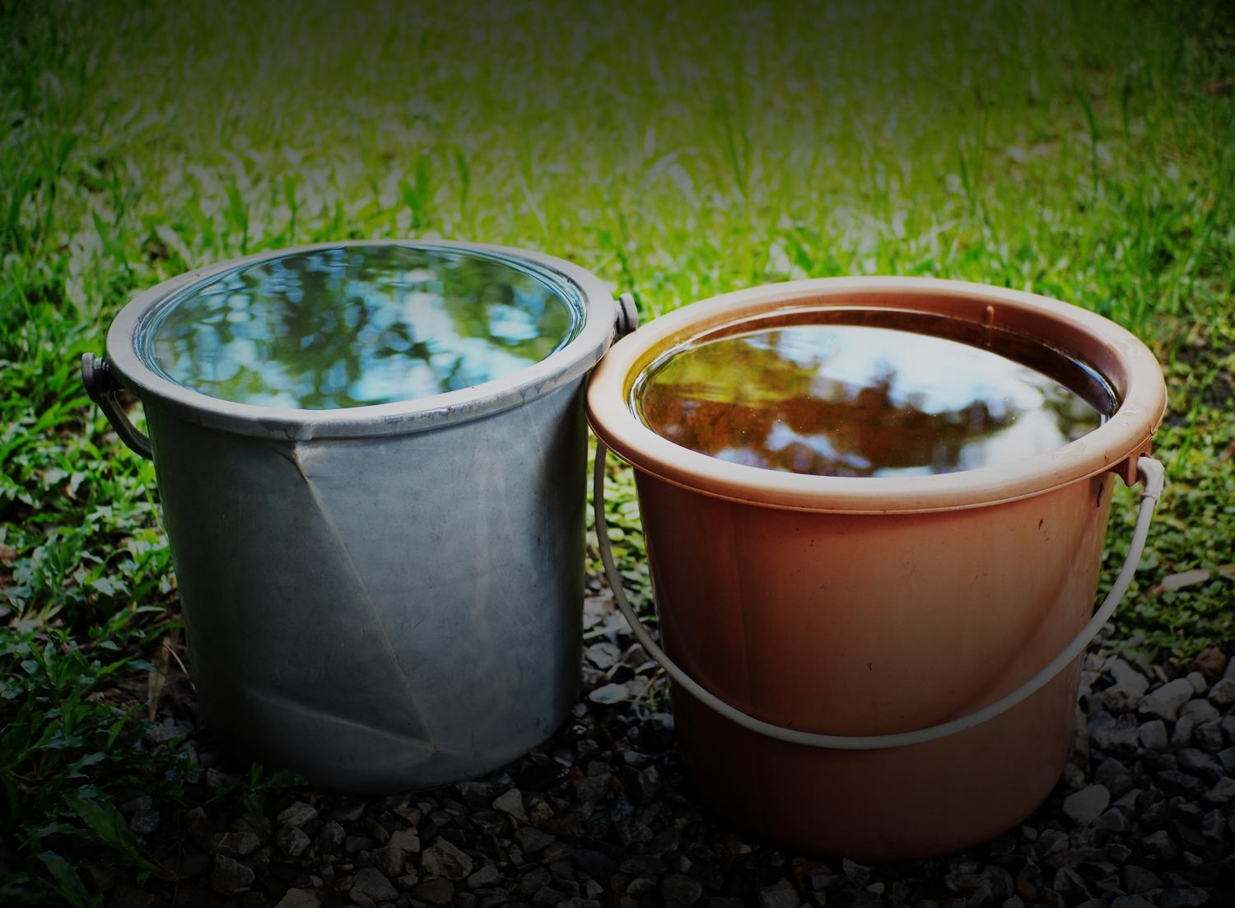
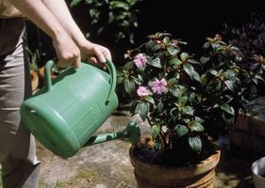
Don't let the faucets drip when you are not using them.
Pick up the water when you wait for it to warm up, and then use it again (watering, rubbing the floor ...).
Water your plants at dawn or dusk, as this will prevent the water from evaporating before being absorbed.

Slide 3
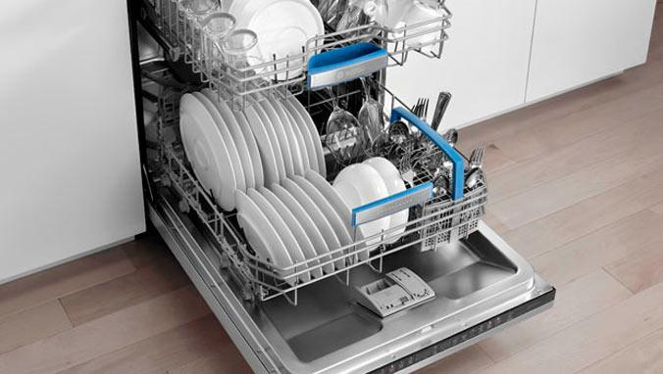
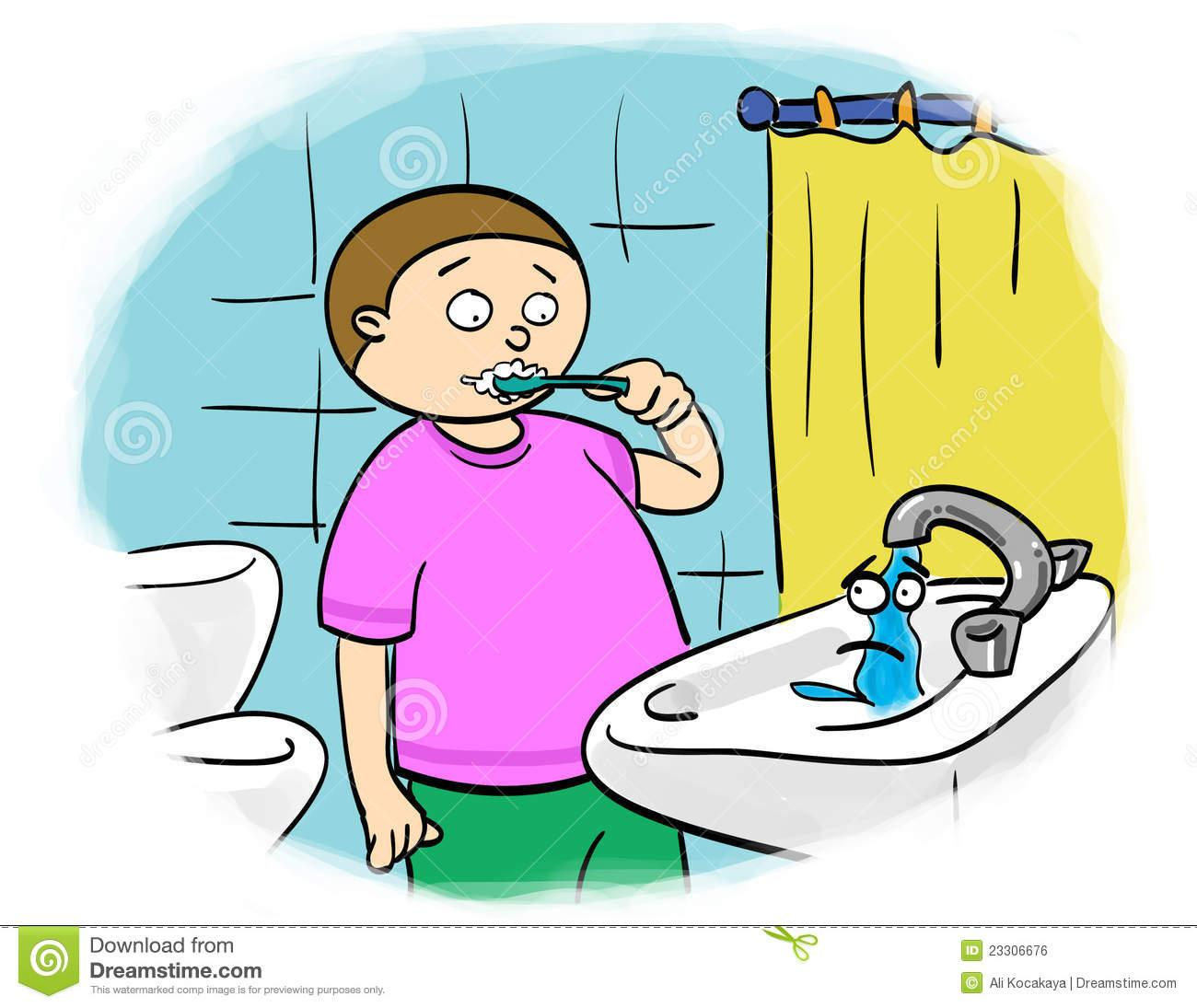
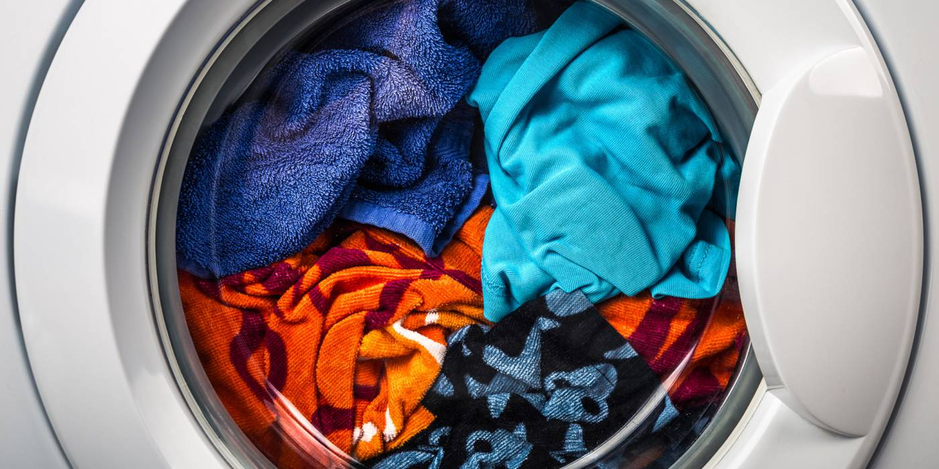
Don't leave the tap open when brushing your teeth or shaving. With this usual practice, up to 30 liters per person per day are wasted.
Use the dishwasher and washing machine only when it is completely full and using a water saving program. It can save you 2500 to 2800 liters per month.
Take a shower instead of bathing. A shower means an average saving of 400 liters per day and home.

Slide 4
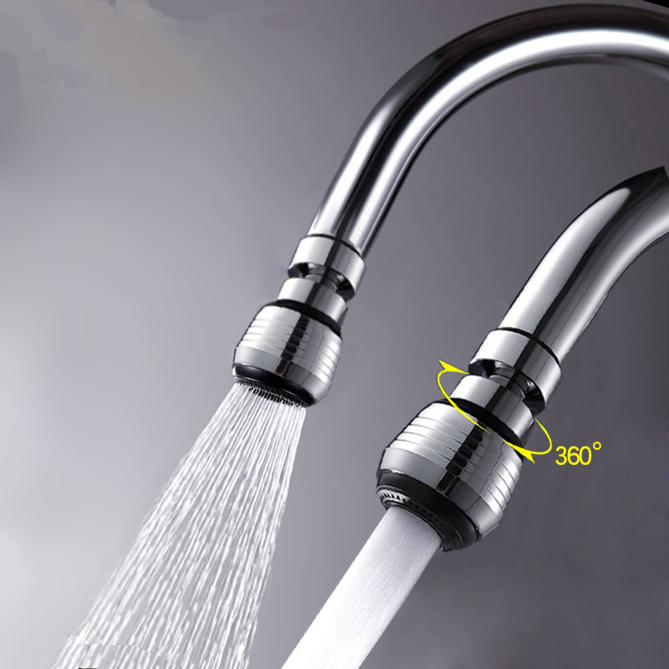
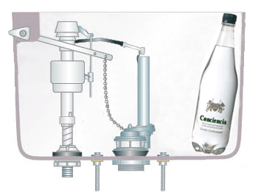
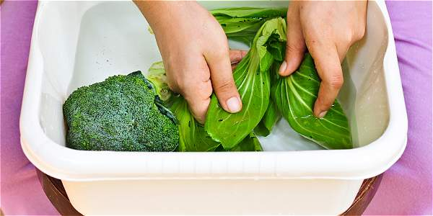
Place two full bottles inside the toilet tank and save 2 to 4 liters each time you use it.
Place diffusers and other saving mechanisms in taps, you will make better use of water, reducing your consumption
Wash fruits and vegetables in a bowl of water and do not clean them under the tap.

Slide 5
END

