Slide 1
Energy production in Finland

Slide 2
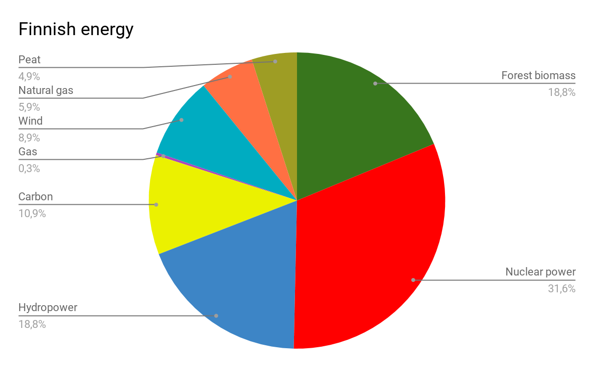
General information

Slide 3
Fossil fuel
About peat: most common uses are forestry and agriculture, swamp conservation and peat production. In addition to these uses, approximately one third of Finland’s peatlands are still in a natural state.
The peat power plant of Haapavesi started operation in 1989. It is now a reserve energy plant.
important fossil fuels: coal 9% , oil 23%, natural gas 6% & peat 5%
Finland lacks domestic sources of fossil energy and must import substantial amounts of petroleum, natural gas
46% of Finland’s energy production is from fossil fuels

Slide 4
Power stations in Finland that use fossil fuels
Meri-Pori Power Station (560 MWe) uses coal, Vuosaari Power Station (630 MWe) uses natural gas and Kristiina Power Station (450 MWe) fuel oil.
Fossil power plants in Finland:
11 coal
37 peat
24 natural gas
34 oil

Slide 5
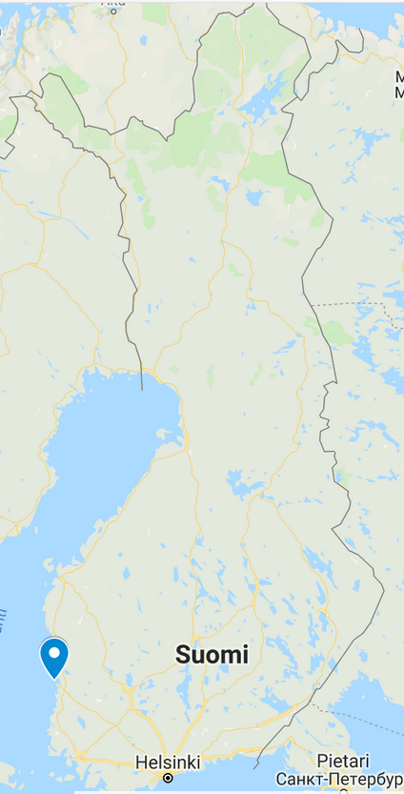
The biggest coal power station in Finland is located in Meri-Pori
founded in 1994
one of the cleanest coal power stations in the world
Catalytic nitrogen removal equipment
modern combustion technology

Slide 6
Nuclear power
Finland has four nuclear reactors providing about 30% of its electricity
→ A fifth reactor is under construction and another is planned, to take
the nuclear contribution to about 60% and replace coal
→ Provisions for radioactive waste disposal are well advanced
Finland's four existing reactors are among the world's most efficient
→ 90% of Finland’s electricity needs should be met by domestic production, which is currently 80%
Notes:
and a construction licence application for a sixth unit has been submitted to the Government

Slide 7
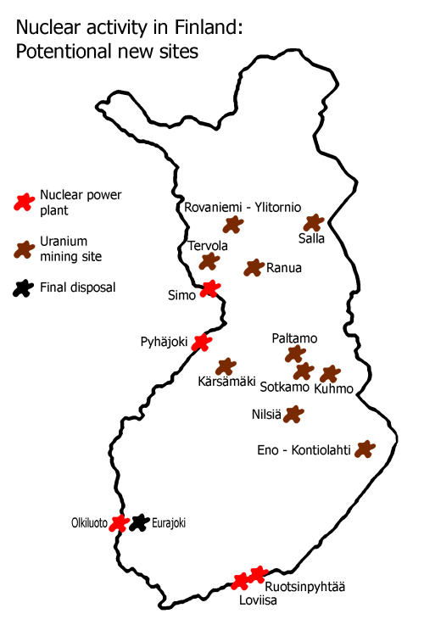
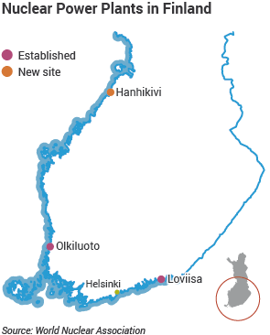

Slide 8
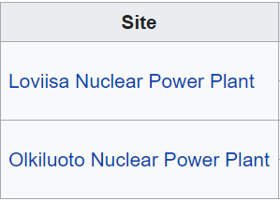
January
Nuclear power plays a major role in the implementation of the Finnish Climate and Energy Strategy
nuclear power plants produce virtually no greenhouse gas emissions
Gross generation = net generation + usage within the plant (also known as in-house loads)
Notes:
→ Finland's nuclear power reactors under construction, planned and cancelled (one each) (taulukossa siis nämä)

Slide 9
Biomass
25 % of Finnish energy consumption
In energy production, biomass refers mainly to a wide range of organic waste, such as wood, food residues, plants containing sugar and starch and human waste from sewage plants.
The forest industry uses nearly 80% of bioenergy in Finland, producing electricity, heat and industrial steam.
The world’s largest biofuel power plant is located in Pietarsaari.
electricity 265 MW, thermal power 160 MW, steam power 100 MW
The target is to increase the use of biomass energy so that during the 2020s its share rises one third of energy production.

Slide 10
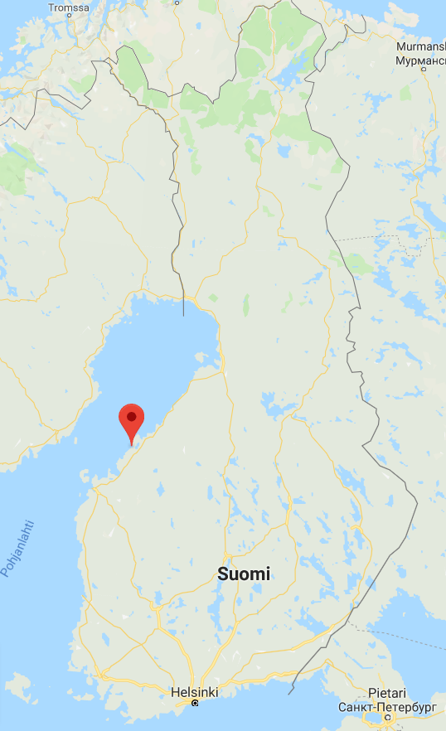
The largest biofuel power plant is located in Pietarsaari

Slide 11
Wind Power
In 2017 Finnish wind power capacity was 2044 MW.
It was used to produce 4,8 TWh on electricity which was 5,6% of Finnish energy consumption
70% of wind power plants are owned by Finnish companies
42% of all wind power plants are constructed in Northern Ostrobothnia
The largest wind power plant is in Kristiinankaupunki in Ostrobothnia
It has 34 wind mills
It was completed in 2018
Wind power is rising in Finland
It is planned that wind power will cover 30% of energy production in 2035

Slide 12
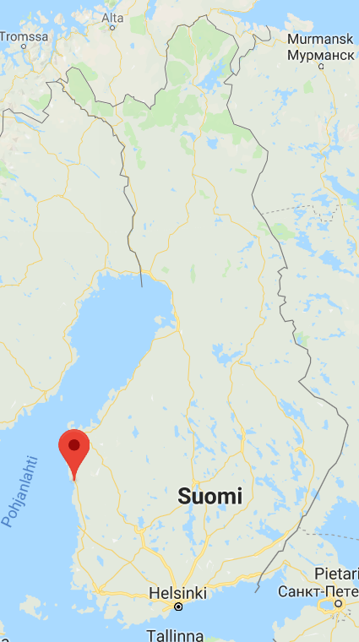
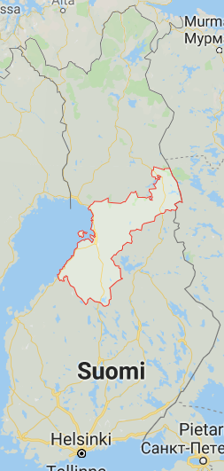
The largest wind power plant is in Kristiinankaupunki
42% of all wind power plants are constructed in Northern Ostrobothnia

Slide 13
Hydropower
220 hydroelectric plants in Finland
10 - 20% of Finnish energy consumption
→ depending on precipitation levels and other hydrological conditions
power 3100 MW
the largest hydropower plant is in Imatra
built in 1928
yearly output 100 GWh
average annual production covers the annual electricity use of 50,000+ households with electric heat
improvement could be possible but it's unlikely because of EU Water Framework Directive

Slide 14
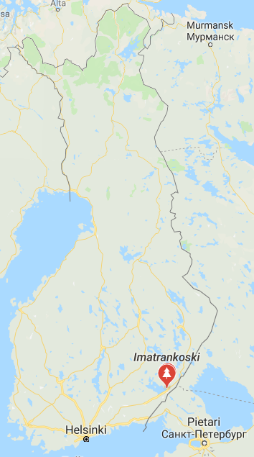
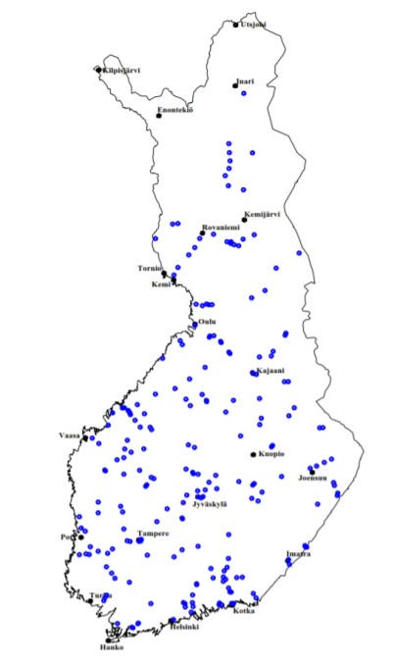
Finnish hydropower plants
The largest hydropower plant
is located in Imatra

Slide 15
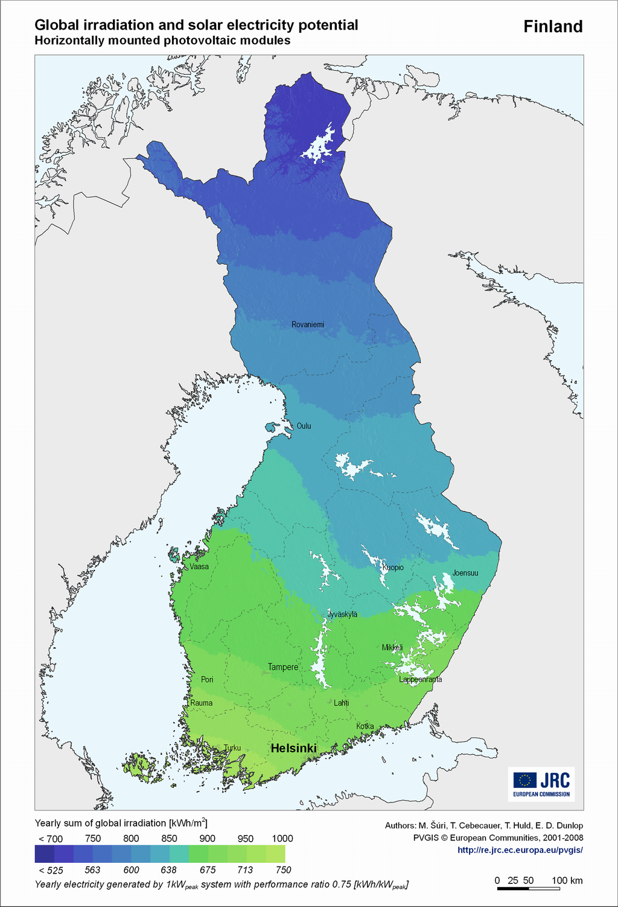
Solar power
In Finland the solar power is only 0,2% of the whole generation of electricity.
In Finland the amount of light is even higher in summer than in Central Europe
From November to February solar energy in Finland is hardly recovered
Many people have solar panels on their summer cottages and houses
The worst part is the price of the solar panels which depends on its quality, around a few thousand euros

Slide 16
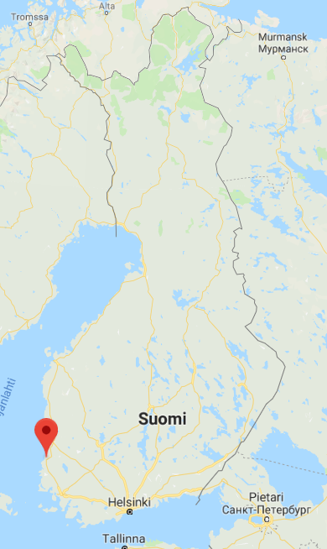
Solar park Rauma
the largest solar plant in Finland
is located in Rauma
power 500 kW
consists of 1800 solar panels
built in 2017

