Slide 1
CONSTRUCTING A COMPUTER
ERASMUS+ / KA2
“SCIENCE AROUND US”
GENIKO LYKEIO ARIDAIAS
2018-2021
By : Konstantinos Nousis

Slide 2
Designing the Computer
To begin with, you must decide what the basic use of the computer will be. Before you buy some "pieces" - computer components (Hardware) or calculate a budget to fit your financial condition, you need to know what you plan to use your computer for. Typical computers used for things like browsing and subroutines (e.g. Microsoft Word and Excel) may use older, less expensive PC components, while computers that focus on gaming or processing large heavy files will need more powerful, modern components.

Slide 3
Create a budget
It is very easy to start buying attractive pieces without thinking about your budget, until you realize that you are out of money and do not have all the necessary components to “build” your computer.
Set a limit (eg between € 300 and € 400) and try to stay within it (The amount depends on the kind of use of your computer).
Common sense should also guide your purchases. For example, if your budget for the processor (CPU) is € 100, but there is a nicer, better, newer model at a discount price at your tech store, let’s say from € 200 it’s down to € 120, spending an extra € 20 is probably a better long-term investment.

Slide 4
Find out which accessories to buy. No matter how expensive your computer is, you will need the following information for your project:
CPU (Central Processing Unit) Processor - Acts as the "brain" of your computer.
The main processor companies are RYZEN and INTEL.
This one is a RYZEN brand.

Slide 5
Motherboard.
The Motherboard acts as an interface between all the components of your computer and the processor.
RAM(Random Access Memory)
The random access memory indicates how much memory your computer has for processing items. The more RAM you have, the faster your computer will run, especially while multitasking.

Slide 6
HDD(Hard Disk Drive)
The Hard disk drive stores and processes data. There are many with different storage rates.
You can buy a traditional hard drive. Or you can choose a more expensive SSD (Solid State Drive) which is faster if you want an extremely fast drive.
The fastest SSDs can be attached with an M.2, which is a port that most modern motherboards have.

Slide 7
Case
This is necessary for the storage and cooling of your components. There are many different types, but some have better cooling due to better air flow
PSU(Power Supply Unit)
This PSU supplies power to all the components of your computer and it is also the interface between your computer and the outlet to which you connect your computer. Power Supplies are separated by their certification and by their power capacity (eg 550Watt).

Slide 8
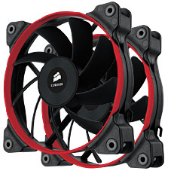
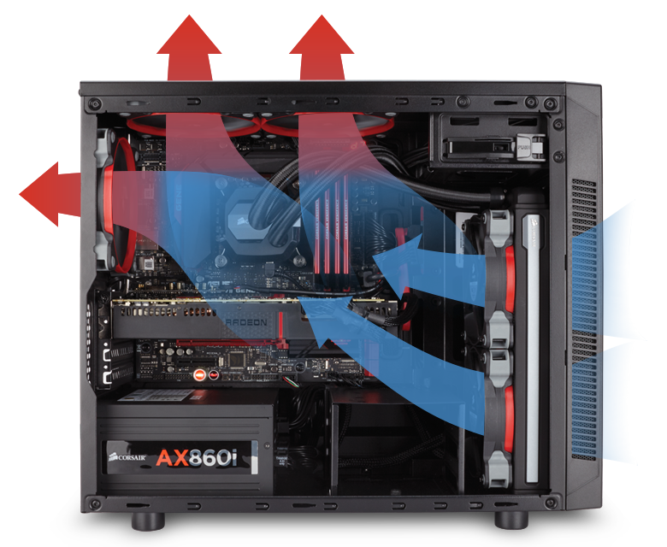
GPU(Graphics Processing Unit)
Otherwise known as Graphics Card, it is used to render images to your computer. While most processors have a built-in graphics processing unit (GPU), you can purchase an enhanced model if you intend to use your PC for intensive editing or playing games.
Cooling system
This keeps the inside of your box at a safe temperature and is required especially for computers made for games and data processing.

Slide 9
Purchasing Computer Parts
You need to know where to buy PC components from.
You need to sit down and look at various online stores for the best prices.
It would be advisable not to buy used items in any condition, even if they are within the limits of the warranty of the manufacturer.
Search for each component separately and make sure you read the other customers’ comments for more information in general, to ensure compatibility of the pieces and pay attention to the comments on the pros and cons of the product related to your own preferences.

Slide 10
Attention to Compatibility mainly for the Processor with the Motherboard
You should choose a motherboard that is compatible with your processor. This can be verified by checking lists of supported processors for your motherboard. Some sites also display a list of supported motherboards for your processor.
RAM also needs a compatibility check with the motherboard, depending on the manufacturer but also on the type of support (DDR, DDR2, DDR3, DDR4). The modern ones are the DRR4 , which are the fastest so far. The DDR and DDR2 cards are already "outdated“ and very rarely used, but still found in some online stores.

Slide 11
Buy the right RAM card
RAM is responsible for storing data from functioning programs, so it's very important.
Before you buy a RAM card, be sure to check both the processor and the motherboard for the type of RAM that is supported.
There is a limit to the amount of RAM your computer can use and this limit is dictated by the maximum memory of your processor. For example, installing 16 GB of RAM on a computer that only supports 8 GB would be a waste of money.
Depending on your motherboard, you will usually buy either DDR3 RAM for slightly obsolete PCs or DDR4 RAM. The type of RAM supported by your motherboard will be noted in the description of technical specifications of the motherboard.

Slide 12
Power Supply
Make sure the Power Supply can handle the required load.
The Power Supply gives power to all the electrical components of your computer. Some boxes come with a power supply already installed, but others require you to put your own. The power supply must be powerful enough to sustain all your components. Do not worry about the fact that it might waste electricity by supplying more power than you need, as it will only deliver as many Watts as you use and the number in its power indication is only its maximum capacity.
If your computer is for gaming and data processing, you will need a 550W power supply or more.

Slide 13
PC Case
Find a box that is functional and also attractive.
The size of the box depends on the number of disks and card slots that you need, as well as the size and type of the motherboard (Full ATX, ATX, Micro ATX and Mini ATX).
Make sure you have a box that can fit all your components, including your hard disk drive.

Slide 14
Preparing to build a computer
Use an antistatic cable (band) to prevent electrostatic discharge (ESD) which can be fatal to the computer.
If you cannot use an antistatic cable, plug the power cord into an electrical socket (but do not switch it on) and hold your hand on the device (power supply) each time you touch any sensitive ESD components.

Slide 15
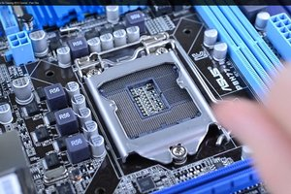
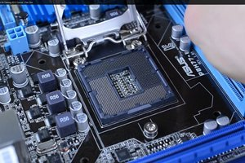
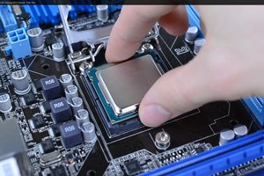
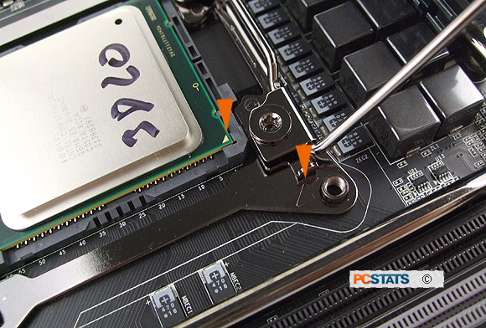
Processor clasp
Take out the motherboard and put it on the package.
Remove the processor and set it aside.
Open the socket of the motherboard and insert the processor (Attention! The processor and the motherboard have a small triangle in the lower corners for proper placement).

Slide 16
Coolers and RAM cards
After you have connected them, put thermal paste on top of the processor and button the heatsink on (screw it on diagonally, ie first the top right and the bottom left screws and then the opposite, top left and bottom right, this way the paste will be smeared correctly and will not come out of the edges).
Now take the RAM cards and fasten them, depending on how many sockets there are in the motherboard and how many RAM cards you have. You will know from the motherboard booklet in which motherboard socket you should button each one.

Slide 17
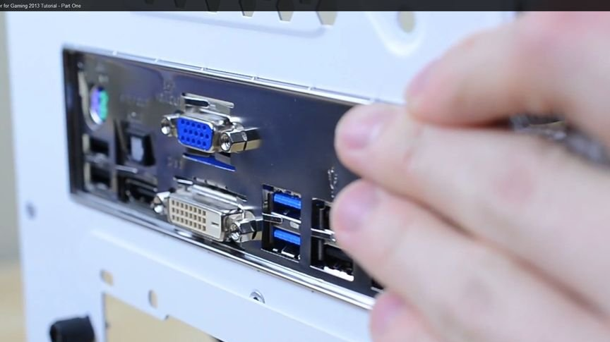
Preparing a box for the motherboard
Open the box.
Unscrew the side panel (or slide it to the back of the case) to open it.
After opening it install the I / O Shield. Your motherboard comes with a small piece of metal (I / O Shield) that will fit over the motherboard ports. Install this in a rectangular hole in the back of the box and simply secure it in place.
The standoffs that are already installed in the box need a little attention because they should be in the right places for proper installation of the motherboard.

Slide 18
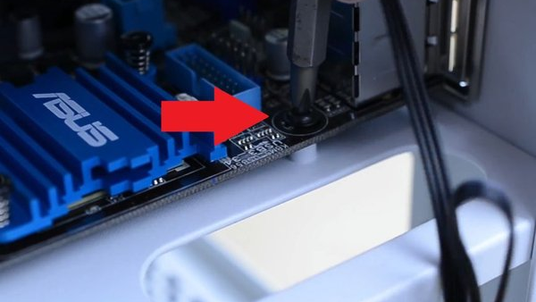
Motherboard installation
Secure the motherboard. After the standoffs are installed correctly, place the motherboard in the box and push it towards the I / O Shield. All rear ports must fit in the I / O Shield holes.
Use the screws provided to secure the motherboard to the standoffs through the shielded screw holes in the motherboard.

Slide 19
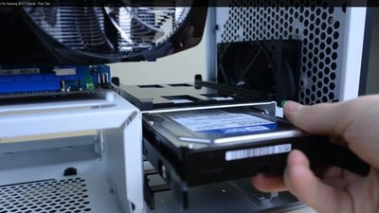
Hard Disk Installation
Remove the hard disk drive from your computer. Secure the plastic clamp to the back of your hard drive. Slide the hard drive holder back into the drive slot.

Slide 20
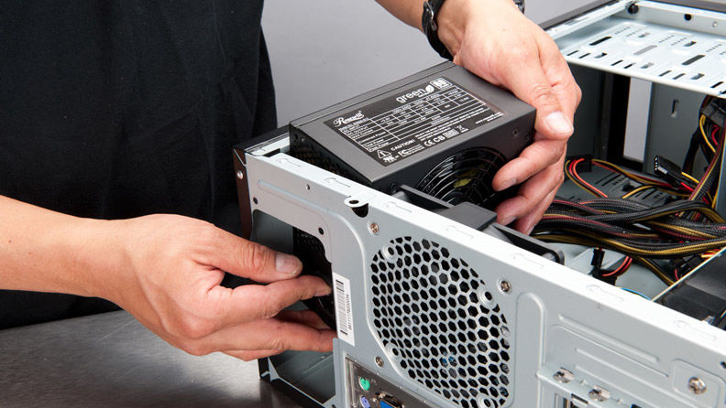
Power Supply Installation
Some boxes have a power supply already installed, while others will require you to purchase the power supply separately and install it yourself.
Make sure the power supply is installed in the correct orientation and that nothing obstructs the power supply fan. The power supply is usually attached at the top of the box. You can determine where the power supply should be installed by looking for a missing part on the back of the case.
Then pull the wires out of the box and push the power supply until it is evenly spaced. Connect the power supply with the included screws.

Slide 21
Cable connection
Connect the blue USB 3.0 cable to the specified location.
Connect the HD audio cable to the indicated position.
There will be some other cables for your motherboard. Refer to the booklet on how and where to connect them for your specific model.

Slide 22
Power supply connection
Connect the power supply to all the necessary components. If you have not already connected the power supply to components that need power, make sure it is connected to the following locations: (Motherboard, Graphics Card, Hard Drives).
There will be a 6 pin PCIe socket coming from the power supply. This empowers your graphics card. Some graphics cards need two (6pin + 2pin) but others may not.
There will be ports at the top of the graphics card. You will connect an 8-pin to the motherboard processor and a 24-pin to the motherboard.

Slide 23
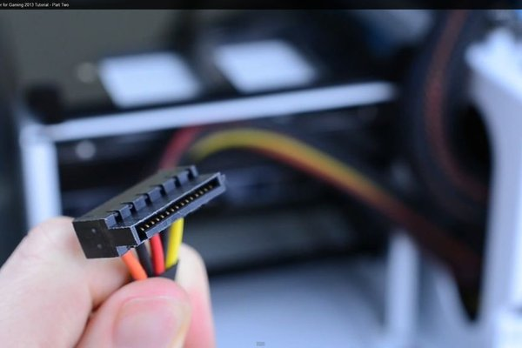
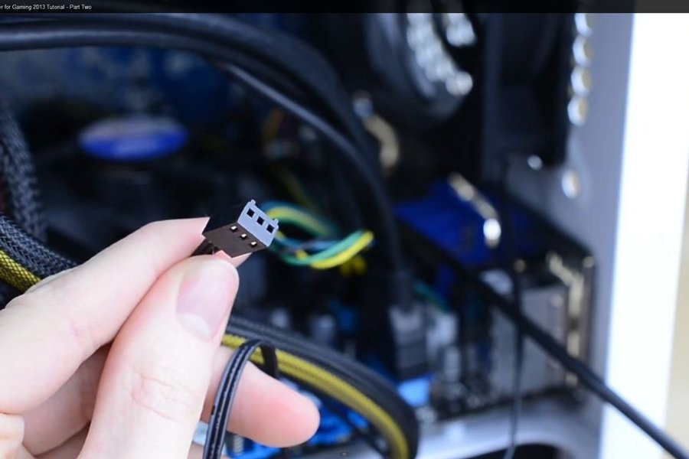
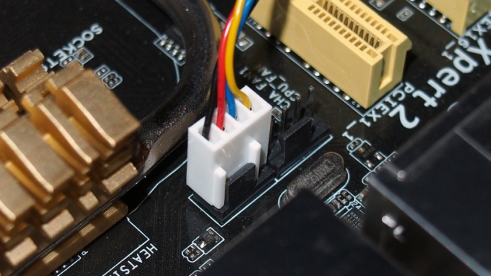
Connections with HDD and CPU fans
Now connect the processor lights and heatsink (on the motherboard it indicates what kind of connection each socket has, i.e. 3 or 4pin).
Connect this cable to the hard drive and then connect the sata cable.

Slide 24
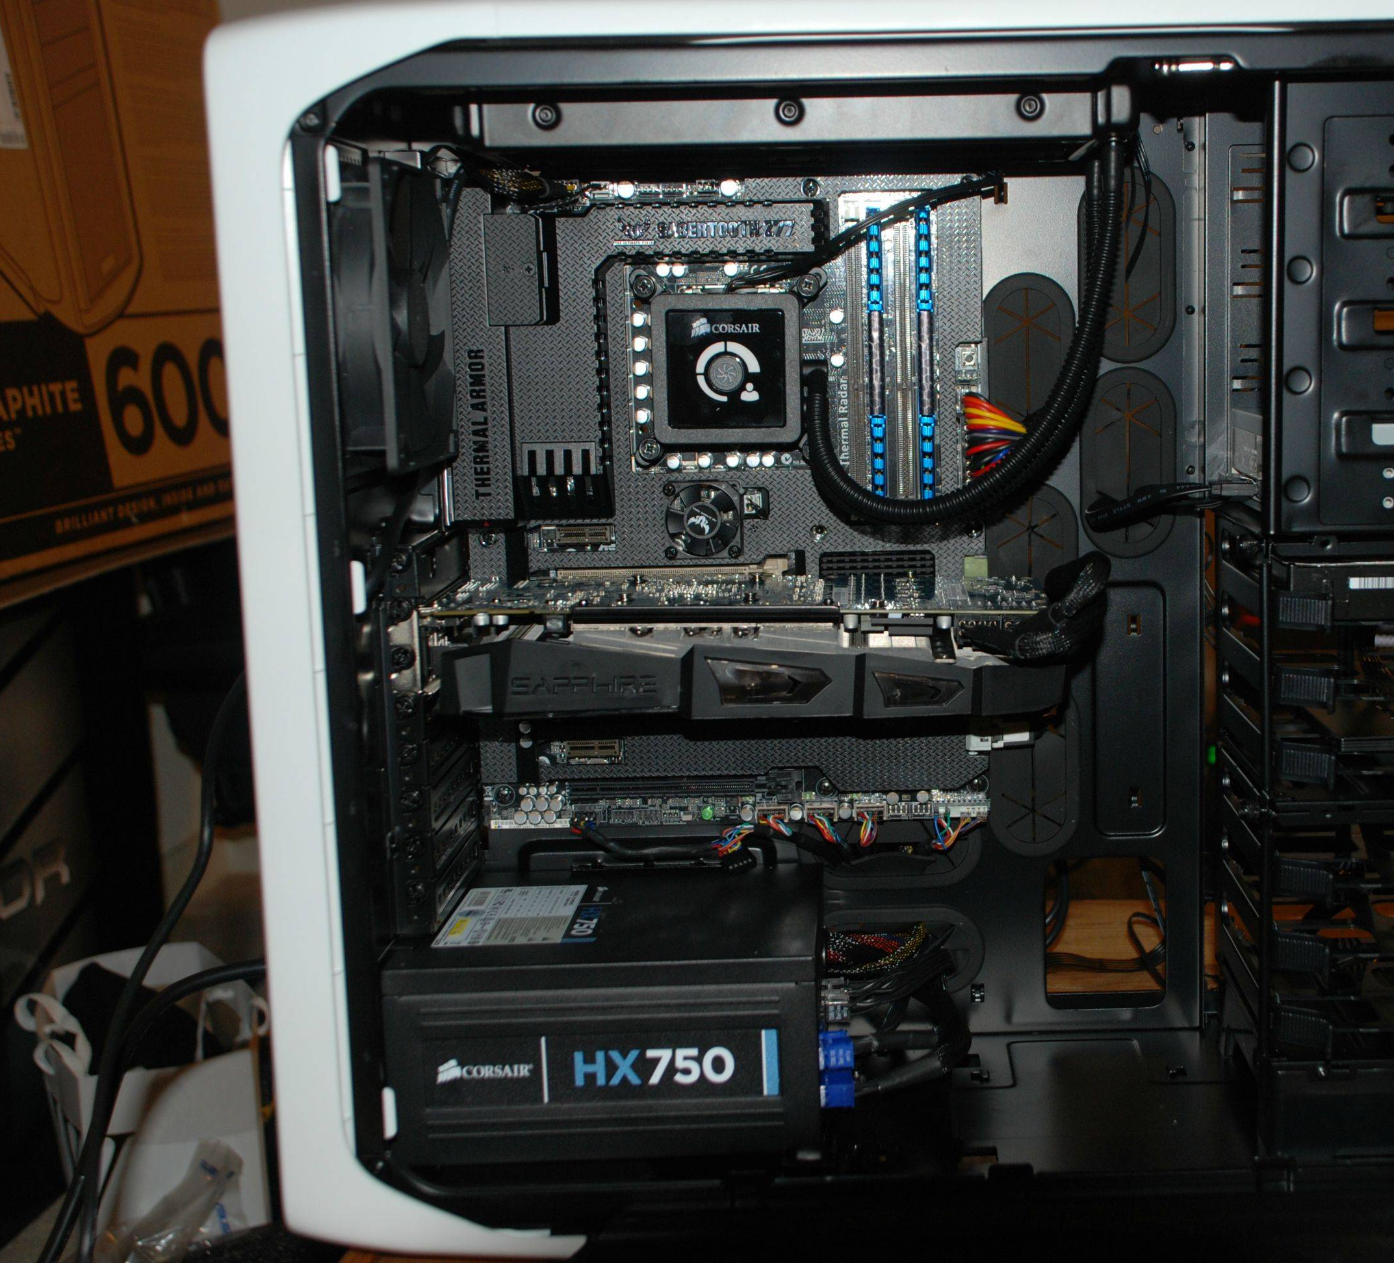
Cable Management
Before the completion you can tidy your cables, but it also depends on what box you have. Cable Management gives a better appearance and better air flow.
This process is a bit difficult and takes a lot of time but it is worth it. If you have a box with a window on the side and you want it to look nice visually, I would recommend it, but if you get a "closed" box, ie without a window, it may not be worth spending too much time on this.

Slide 25
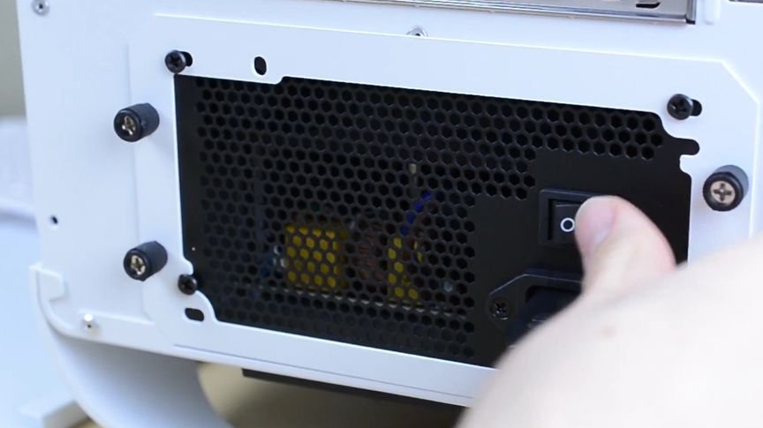
Completion of Construction
Once you have installed and connected the various internal electronic components of your computer all you have to do is make sure that none of the cables are obstructing the power supply.
Now close the box and plug the power cord into the socket and press the power switch to “on”.
Press the power button on the box and (hopefully) your computer will turn on.
If you have succeeded, you will still need to install the operating system (Windows OS) and drivers. But if the computer does not turn on, check if you forgot something or if a cable is not connected.

Slide 26
Bibliography
http://i.imgur.com/9h6YW.jpg
https://cdn.instructables.com/FZV/QWLU/IVA4UQM6/FZVQWLUIVA4UQM6.LARGE.jpg
https://cdn.instructables.com/F3Z/MFG6/HH2VNUSQ/F3ZMFG6HH2VNUSQ.LARGE.jpg?auto=webp&crop=3:2
https://forum.nextinpact.com/applications/core/interface/imageproxy/imageproxy.php?img=https://i11.servimg.com/u/f11/18/96/85/87/amd-ry10.jpg&key=1973a3e2f6b6619f345a86aaceef9599deaa2f80aa309caffa90c3d3b8d4787b
https://i.ytimg.com/vi/mAtBalSfe8Y/maxresdefault.jpg
https://www.instructables.com/id/Build-a-Gaming-Computer/
https://zonait.ro/wp-content/uploads/2017/02/RYZEN_1080-Wallpaper.jpg
http://www.pcstats.com/articleimages/201311/install2011_8757.jpg
knousis23@gmail.com

