Slide 1
Static Electricity Box
Made by very intelligent high school kidz (Viola, Krista, Nea ja Harri)

Slide 2
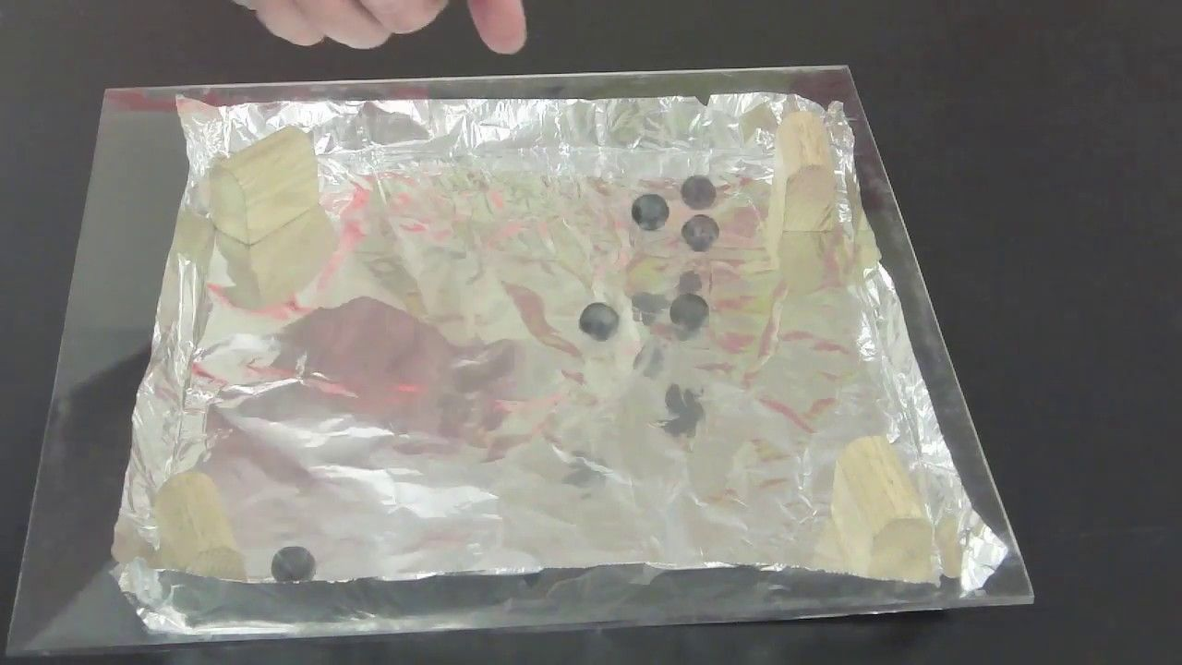
What is it about?
Rubbing a sheet of clear plastic with a hand or forearm, a towel, or piece of fur will give it a static electric charge that will cause styrofoam pith ball to bounce and “race” around it's surface.
The balls will continue to move until the charges on the plastic and balls are balanced

Slide 3
Why this works?
Static electricity is when charges (+ and -) are separated from one another
While this experience happens, the charges are separated onto the surfaces, and are “stuck in place”
A major property of charges is that opposite charges attract each other, and like charges repel each other
That is, - attracts +, but - repels -
However, anything that has a neutral charge will be attracted to either - or +

Slide 4
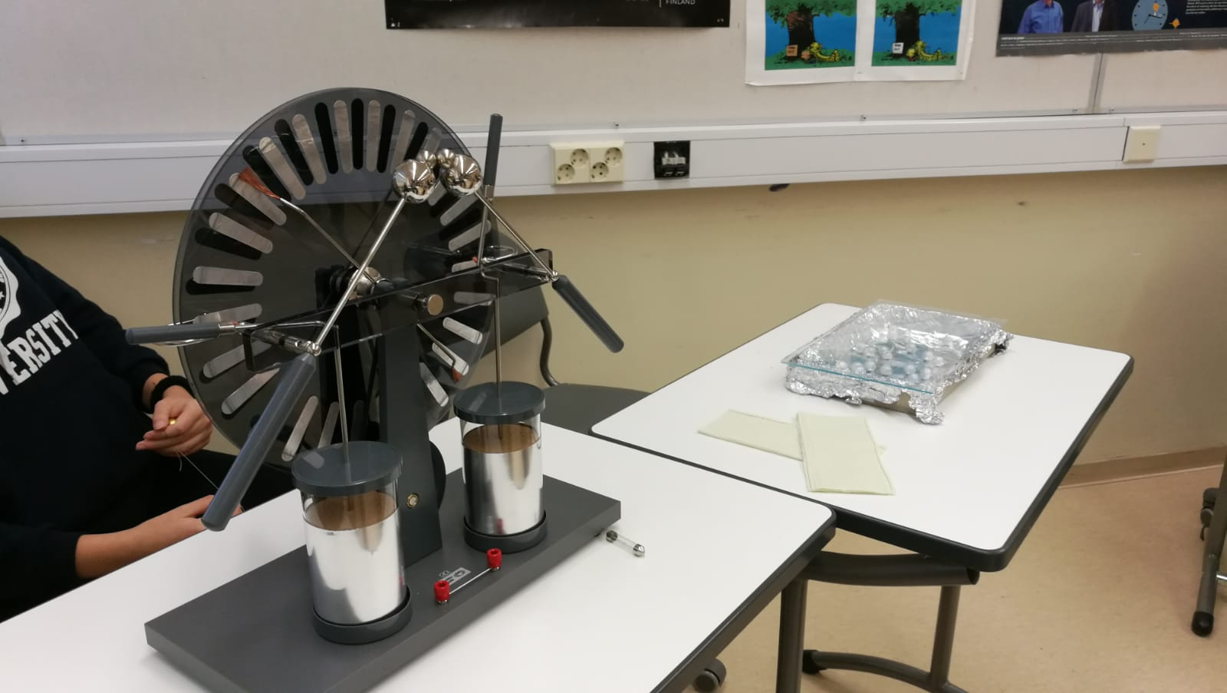
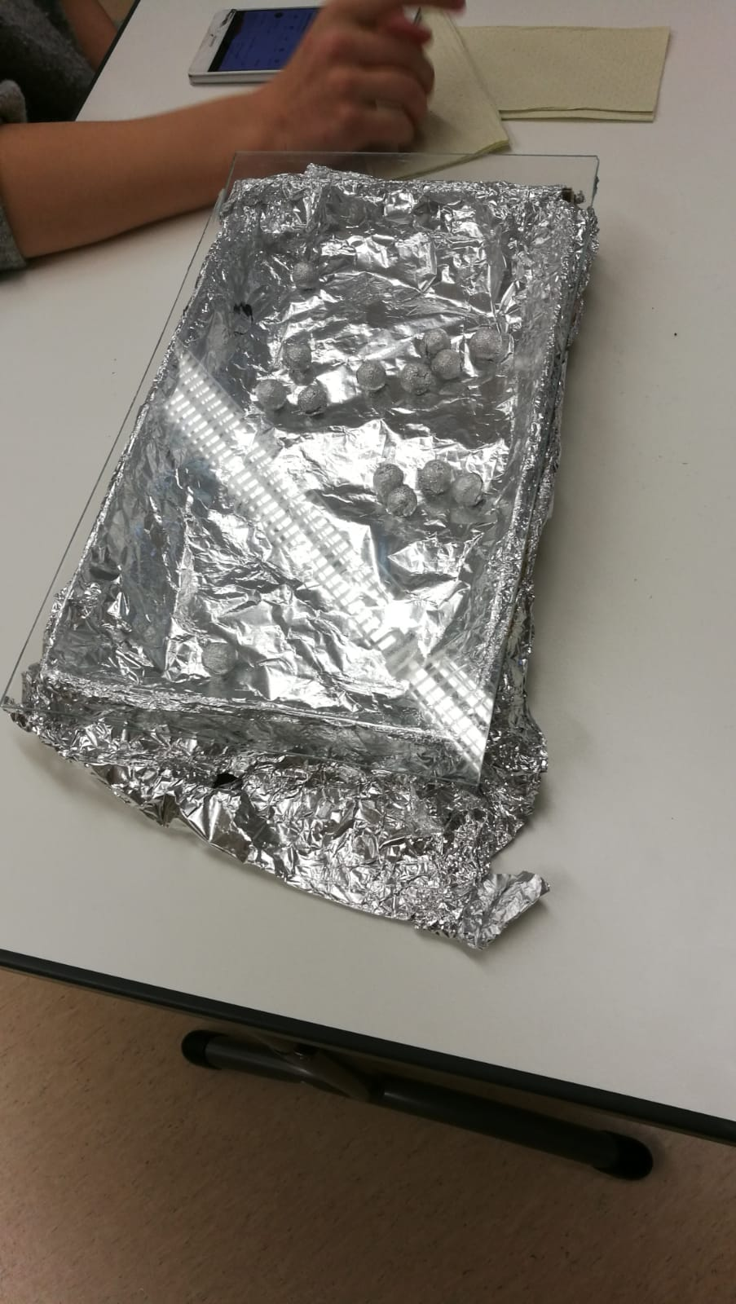
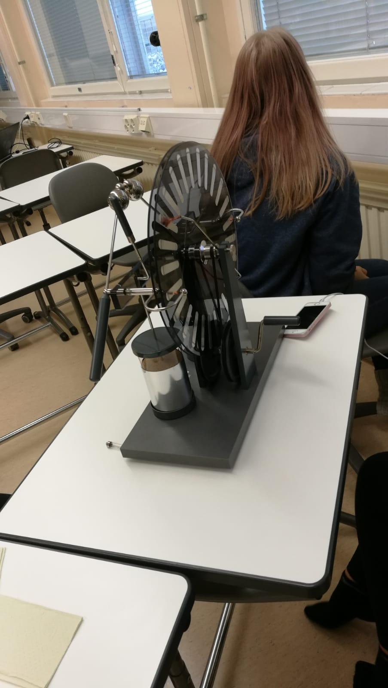
Pictures of our static electricity workshop
We also used Wimshurst machine to demonstrate the static electricity

Slide 5
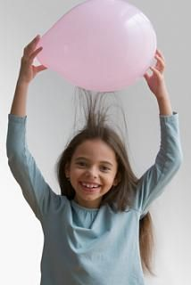
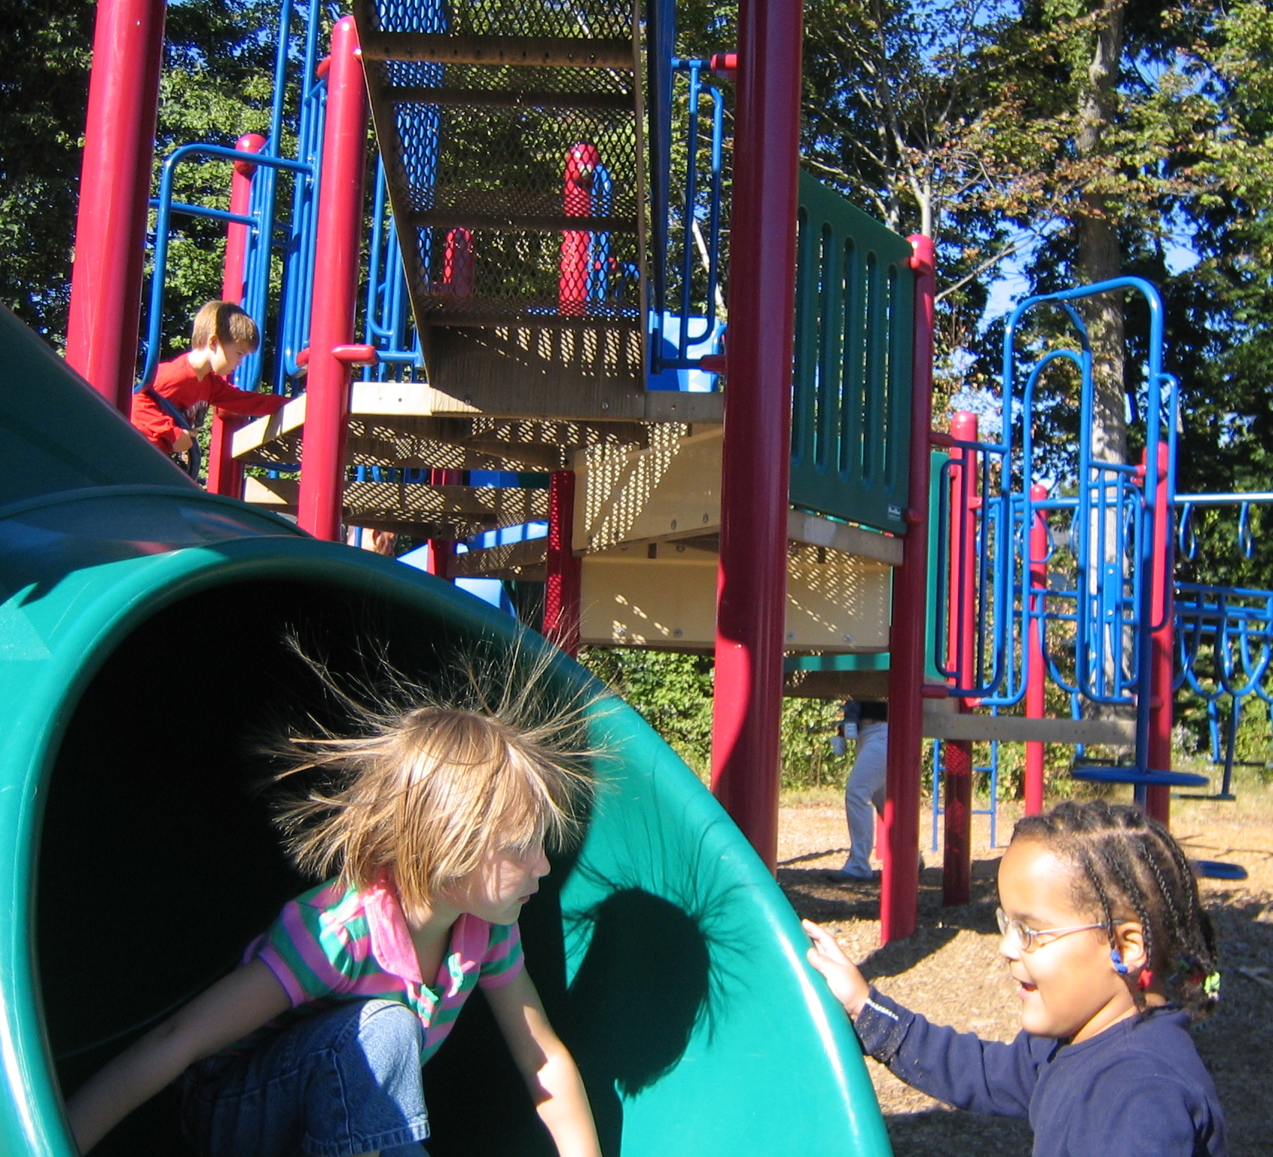
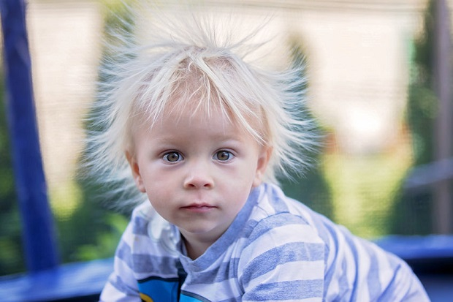
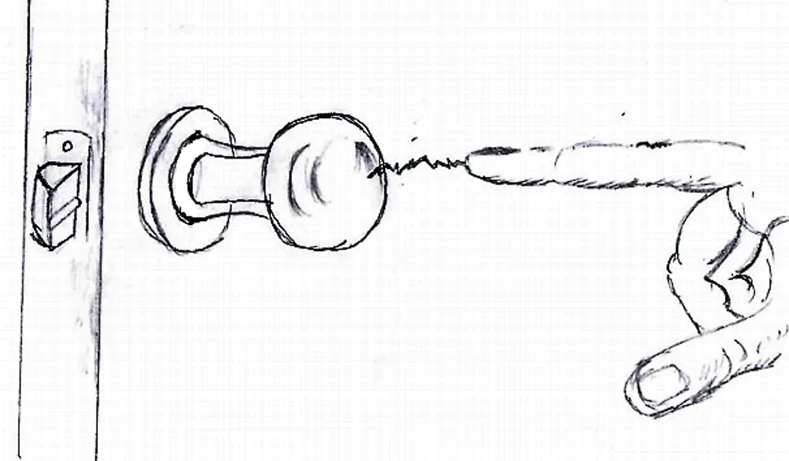
Other examples of static electricity

