Slide 1
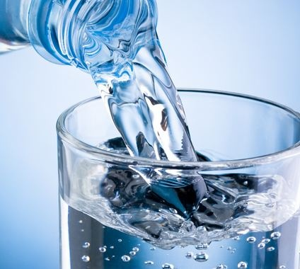
Water treatment in Polish health resorts Chemical and therapeutic properties of mineral and spring waters in Poland
WERONIKA PISZCZEK ID
MATEUSZ MARKOWSKI IIB

Slide 2
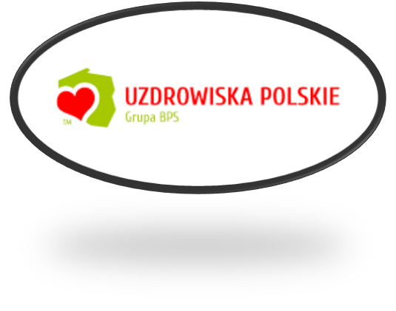
There are 44 resorts in Poland which have the status of a health resort. The region with the largest number of health resorts (11) is the Lower Silesian Voivodship.

Slide 3
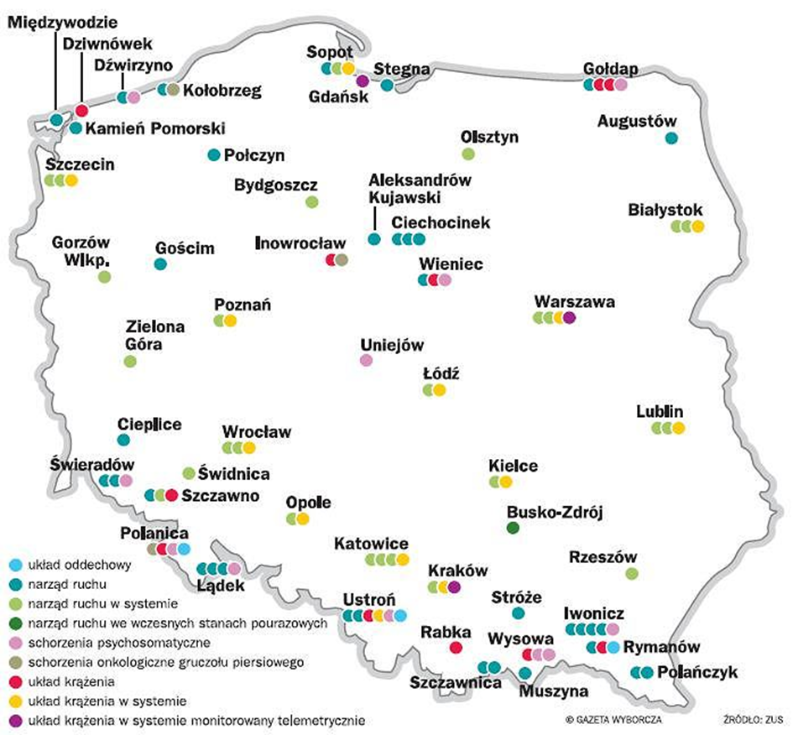
Do you want to improve your appearance, health and well-being?
Go to a spa! Thanks to a variety of aesthetic, health and relaxation treatments, your life will gain a new glow.
The majority of health resorts in Poland are located in mountain regions, slightly fewer in the coastal zone and the fewest in the lowlands. Mineral springs that occur there are used to improve your health, beauty and well-being. Although it’s microclimate, mud or concentration of specific gases that makes a place a spa, without mineral water, in principle there is no spa.

Slide 4
HOW DOES HEALING WATER AFFECT OUR BODY?
FIGHTS
DIABETES
IMPROVES METABOLISM
CURES
GASTRITIS
CURES PEPTIC ULCER DISEASE
CLEANSES THE KIDNEYS

Slide 5
Waters classified as therapeutic have usually much more minerals than others (from 2000 to 24 000 mg/l) and this is what they owe their strong therapeutic properties to.

Slide 6
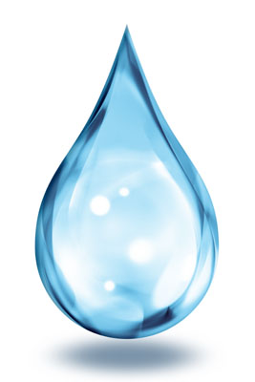
The most popular therapeutic waters occurring in Poland are:
acidulous waters containing calcium and sodium bicarbonates, and carbon dioxide
iron acidulous waters, which also provide iron and alkaline compounds;
sodium chloride waters, which in addition to sodium chloride contain iodine, bromine and iron;
sulphuric waters - apart from sulphur compounds, they often contain sodium chloride

Slide 7
HYDROTHERAPY
It is one of the oldest and most extensive methods of physical therapy, based on therapeutic use of water in the form of baths, showers, watering, washing, rinsing and other treatments.

Slide 8
In Poland, medicinal waters are found in almost all geological units. The distribution of these waters is uneven, which is due to specific geological conditions. Also, their chemical composition depends on geological structure and hydrogeological conditions of the area. Most medicinal waters occur in the southern part of Poland, in the Sudetes and the Carpathians, including the Carpathian Foothills. It is where there are over 70% of the total number of Polish spas and towns with medicinal water.

Slide 9
Balneology is very popular mainly in health resorts and spas. Poland boasts of rich deposits of healing mineral waters. Spa waters have a rich chemical composition and are ideal for therapeutic baths and inhalations, irrigations and drinking.
Balneology
It is one of the oldest fields of spa medicine, which uses the healing properties of groundwater and a special kind of peat.

Slide 10
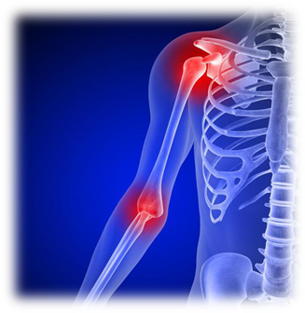
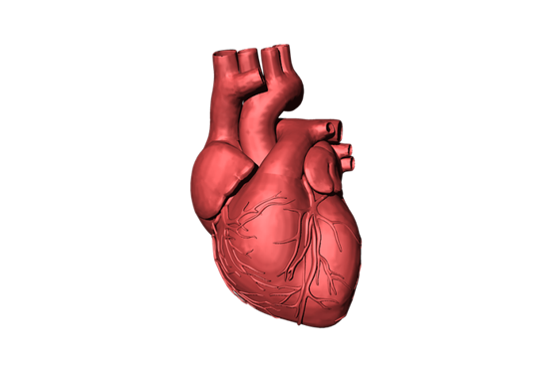
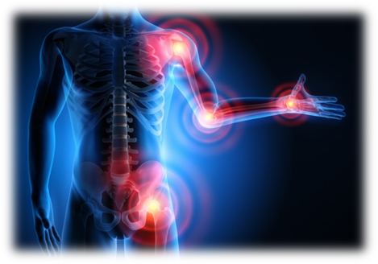
Brine baths are suitable for orthopaedic trauma conditions, rheumatic, neurological and gynaecological diseases
Acidulous water baths are recommended for some heart diseases, hypertension, ischaemia of lower limbs and organ neuroses
Hydrosulphide and sulphide baths are recommended for orthopaedic trauma conditions, rheumatic diseases, selected dermatological diseases and ischaemia of the lower limbs

Slide 11
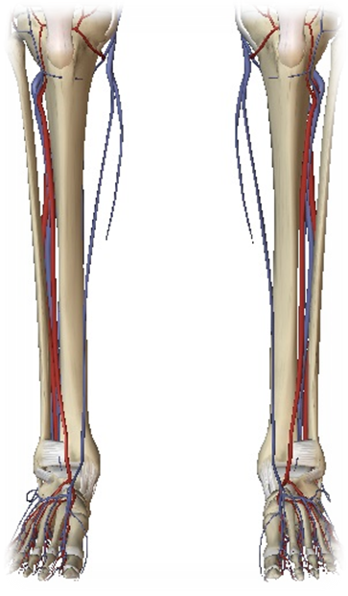
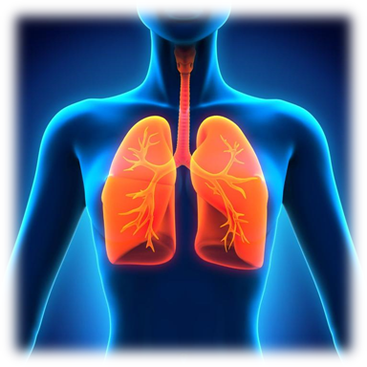
Radon baths are used in peripheral vascular diseases, diseases of the upper respiratory tract, rheumatic and gynecological diseases
Bathing in an oxygen-ozone mixture, although not very well known, is perfect for lower limb vascular diseases caused by atherosclerotic lesions or diabetic complications

Slide 12
Selected spas in Poland
Uniejów
Lowland health resorts: Augustów, Krasnobród, Busko Zdrój, Nałęczów, Ciechocinek, Połczyn Zdrój, Goczałkowice Zdrój, Przerzeczyn Zdrój, Gołdap, Solec Zdrój, Uniejów, Horyniec Zdrój, Supraśl, Inowrocław, Swoszowice, Konstancin, Wieniec Zdrój
Coastal health resorts: Kamień Pomorski, Świnoujście, Kołobrzeg, Ustka, Sopot, Dąbki
Submontane health resorts: Cieplice Zdrój, Piwniczna Zdrój, Czerniawa Zdrój, Polanica Zdrój, Długopole Zdrój, Polańczyk, Duszniki Zdrój, Rymanów Zdrój, Iwonicz Zdrój, Szczawno Zdrój, Kudowa Zdrój, Ustroń, Muszyna Zdrój, Wapienne
Mountain health resorts: Jedlina Zdrój, Szczawnica, Krynica Zdrój, Świeradów Zdrój, Lądek Zdrój, Wysowa Zdrój, Rabka Zdrój, Żegiestów Zdrój

Slide 13
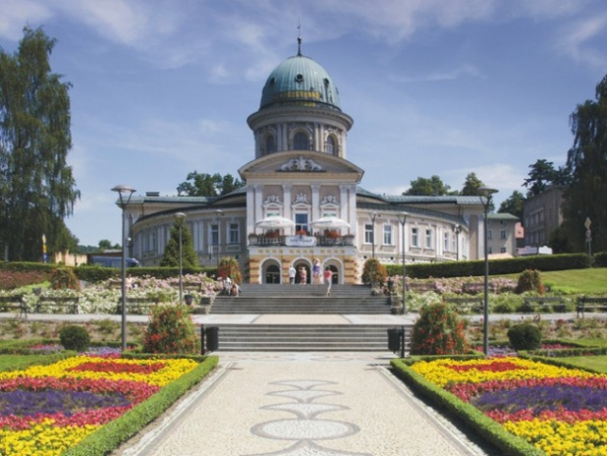
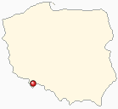
LĄDEK ZDRÓJ
The oldest Polish health resort, known already in the 15th century. Osteoporosis, rheumatism, female genital diseases, cardiovascular, digestive, respiratory and locomotor system diseases are treated there. Visitors are very keen to visit this place and bathe in a swimming pool filled with thermal mineral water. Picturesque surroundings invite you to walks and mountain hiking.

Slide 14
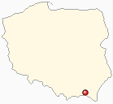
RYMANÓW ZDRÓJ
You can treat heart and orthopedic diseases there. Many of the 12 Rymanów spas accept children as patients. Rymanów has favourable conditions, useful in treatment of chronic throat and respiratory diseases. Rymanów mineral waters are hydrocarbon sodium and iodine waters, used for effective treatment of people suffering from diseases of the urinary tract.

Slide 15
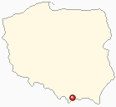
SZCZAWNICA
There are 12 acidulous water springs in the spa, the value of which was first mentioned in the 16th century. An inherent element of the spa is the wonderful Mineral Water Pump Room, where guests can drink bicarbonate, sodium, iodide and bromide water, rich in mineral salts and numerous micronutrients.

Slide 16
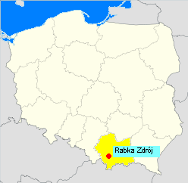
RABKA
A town, which in some way specialized in medicine.
In addition to the Institute for Natural Medicine and spas, there exist
spa hospitals and a branch of
Regional Institute for Tuberculosis
and Lung Diseases, a specialist
institution known throughout Poland.
Another attraction is Rabczańska graduation tower.

Slide 17
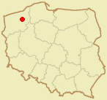
POŁCZYN ZDRÓJ
Rheumatic diseases, osteoporosis, nervous system disorders and infertility are successfully treated there. Rehabilitation of children affected by cerebral palsy is also held there. The town is surrounded by lakes of Drawa Lake District - it is a real paradise because there are brine water springs and deposits of healing peat.

Slide 18
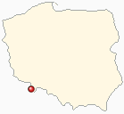
DŁUGOPOLE ZDRÓJ
You can undergo rehabilitation after infectious jaundice there. Local mineral waters are radon or iron acidulous waters, calcium-magnesium bicarbonate waters - used to treat obesity. The Nysa Kłodzka river flowing there creates an ideal landscape for relaxation and treatment.

Slide 19
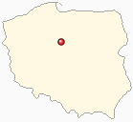
CIECHOCINEK
You can treat hypertension, female genital diseases and obesity there. Graduation towers generate a therapeutic microclimate for the respiratory system. In addition, it is possible to treat skin and motor organs diseases. The main attraction of this spa is a powerful graduation tower serving as an inhalatorium in the open air. The city has a rich therapeutic base - a mineral water pump room as well as rehabilitation and thermal-brine pools are located near the local spas.

Slide 20
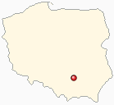
BUSKO ZDRÓJ
A spa specializing in post-traumatic rehabilitation. Dermatological, cardiological, neurological and rheumatic diseases are also treated there. Natural qualities of Busko Zdrój as a health resort are sulphide waters, iodide-bromide brines and healing peat resources. The area is enriched by picturesque nature reserves: "Owczary" containing a sulphate-brine water spring and "Skoroniecz" rich in caves carved in gypsum rocks.

Slide 21
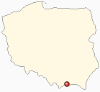
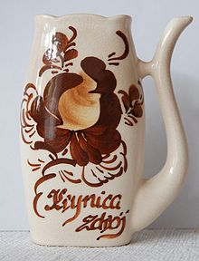
KRYNICA ZDRÓJ
PIJAŁKA
Diabetes, blood and hematopoietic diseases, kidney stones and female genital diseases are treated there. It has a new pump room, which provides mineral water from springs: Jan, Mieczysław, Słotwinka and Zuber.
Most of the Carpathian health resorts use beneficial properties of mineral waters called acidulous waters - this name means waters saturated with carbon dioxide in an amount exceeding 1000mg / dm3.
They are among others: Muszyna, Szczawnica, Swoszowice, Krynica Zdroj, Piwnicz and Rabka Zdroj.

Slide 22
KUDOWA ZDRÓJ
Properties of the climate have a very positive effect on a number of body processes: proper circulation, breathing and digestion, efficiency of the muscular and nervous systems. The major wealth of the spa is natural springs of mineral water.

Slide 23
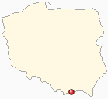
MUSZYNA
Resources of medicinal mineral waters are the main wealth of Muszyna. They contain necessary bioelements, such as magnesium, calcium, sodium, potassium,
iron, selenium. Muszyna meets the requirements for spa treatment of
respiratory system and digestive tract diseases.

Slide 24
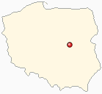
KONSTANCIN- JEZIORNA
The only health resort in the Masovian Voivodeship. It was granted the status of a spa in 1917, mainly due to excellent climate. Thanks to post-war geological research and drilling to obtain natural mineral waters, it acquired classical spa functions. New investments include, among others, a graduation tower working since 1978 and using brine (sodium chloride thermal water) obtained from a local well.

Slide 25
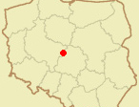
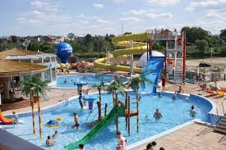
UNIEJÓW
It has had the status of a spa since 2011. It is a lowland spa and also a thermal spa. Geothermal waters are the main curative factor. Hot springs were discovered in 1978 during geological drilling at a depth exceeding 2000m. New Uniejów Baths were launched in 2012. The complex includes a swimming pool and wellness facilities.
In Uniejów, orthopaedic trauma conditions, diseases of the nervous system, rheumatic diseases, peripheral vascular diseases and skin diseases are treated.

Slide 26
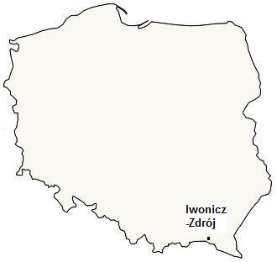
IWONICZ-ZDRÓJ
A foothill spa, located in the valley of the Iwonicz Stream. Climatic qualities, natural mineral waters and peat occurring there are the basic spa materials used in treatment. The first studies on the properties of Iwonicz waters were written in 1578. However, real health resort activities were undertaken there only in 1837. After the Second World War, the spa was resumed, renovating the facilities and equipping them with modern devices.

Slide 28
Thank you for your attention

