Slide 1
Latvia
DUNDAGA

Slide 2
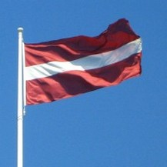
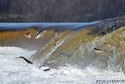
Facts about Latvia
Latvian flag is one of the oldest in the world
Latvia is among the world’s greenest countries
In Kuldiga, you can catch flying fish
Latvian women are the tallest in the world
The country also gave the world its first spy camera -’’Minox’’
The modern denim jean that is worn by people all over the world was first invented by a Latvian-Jewish tailor – Jacob W. Davis
Approximately 54% of Latvia is covered with forests
Juris Upatnieks was a Latvian scientist who created the 3D hologram
Latvian is one of the oldest languages in the world
Latvia has over 300’000 traditional folk songs, one of the largest collections in the world

Slide 3
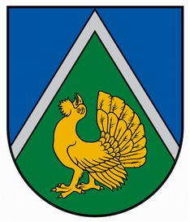
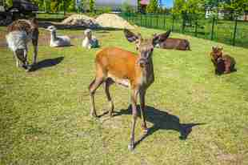
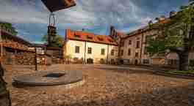
Facts about Dundaga
Dundaga Municipality is the biggest municipality in Latvia.
Dundaga Palace is one of the oldest castles in Latvia.
In Dundaga municipality is one of the most
protected monuments.
Dundaga is one of the oldest towns in Latvia.
Around Dundaga there are 19 rivers.
There are about 3500 people in Dundaga.
There are a lot of villages in Dundaga.
Dundaga has its own mini zoo.

Slide 4
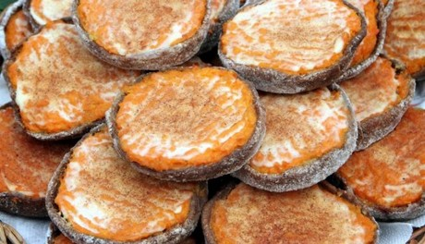
Dundaga traditional food
They are called ‘’carrot tarts’’
To make this you will need:
Potatoes, milk, butter, eggs,
sugar, salt, flour, honey, carrots
and sour cream.

Slide 5
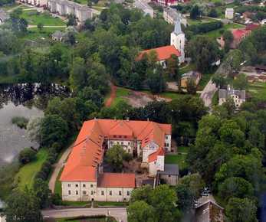
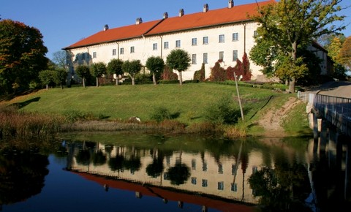
Dundaga castle
The exact time of construction is not known, though it was first mentioned in written sources in 1318.
Dundaga Castle is a medieval castle in Dundaga, Latvia, in the Dundaga municipality.
Like all other castles, Dundagas castle has its own hero, called Green Maiden, and its own tale.

