Slide 1
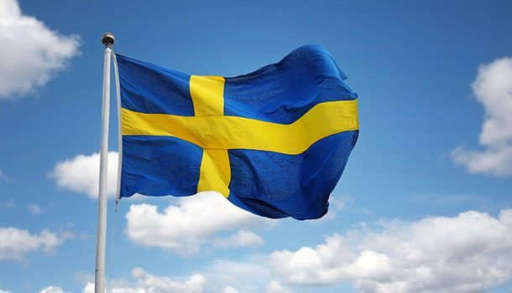
Sweden
Notes:
Alla presenterar sig.

Slide 2
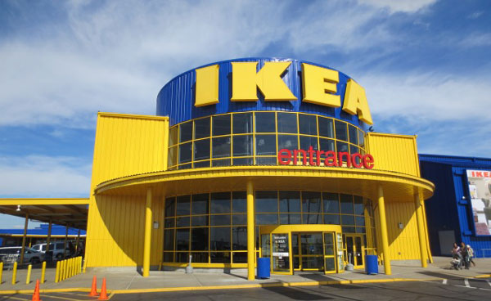
Quick facts about Sweden
Language: Swedish
Capital: Stockholm
Currency: Swedish crowns (SEK)
Population: 10 Million
Government: Monarchy
Notes:
Maja

Slide 3
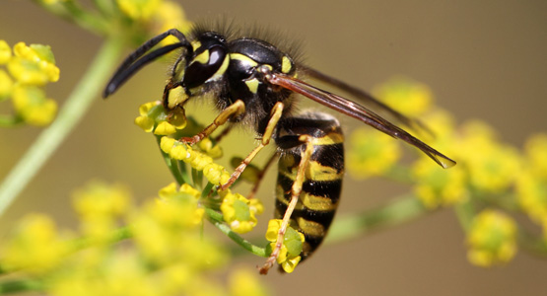
The most dangerous animal in Sweden is the wasp
(counting all deaths).
Notes:
Maja

Slide 4
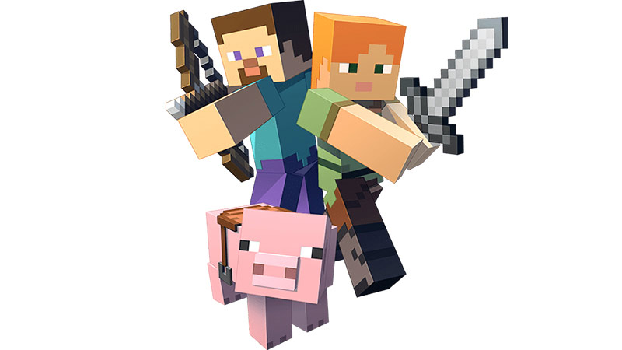
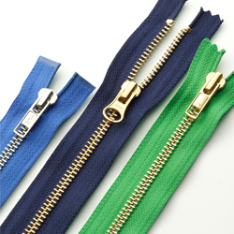
Swedish inventions
GPS
Zipper
Minecraft
Dynamite
Flat screen TV
Notes:
Alex

Slide 5
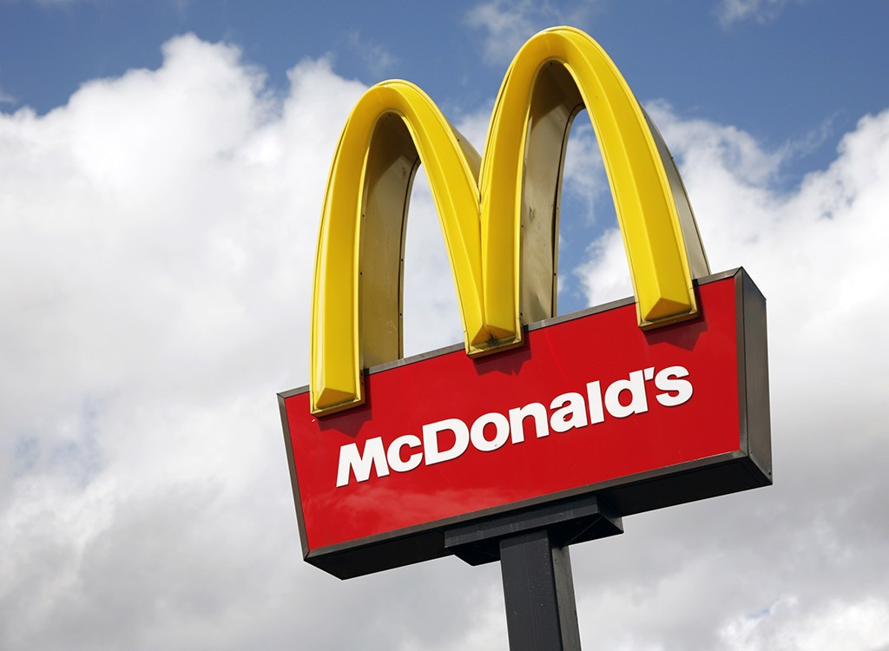
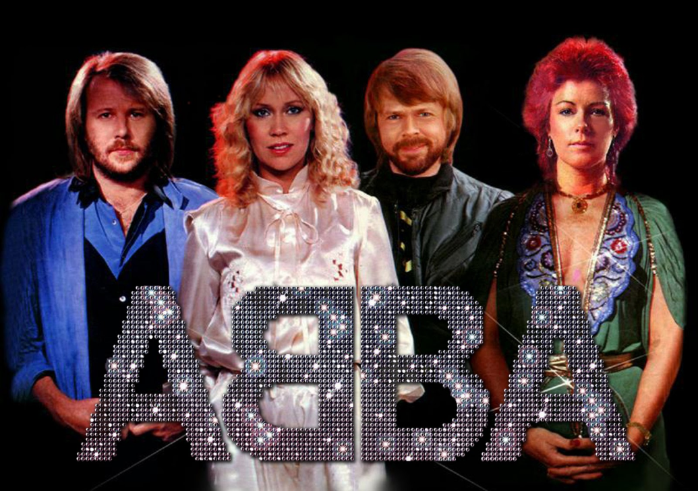
Random facts about Sweden
Most McDonald’s resturants per inhabitans
The Swedish band ABBA is the 4th best band in the history of music (if you count the number of sold records)
Notes:
Moska

Slide 6
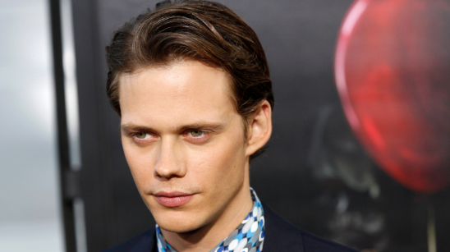
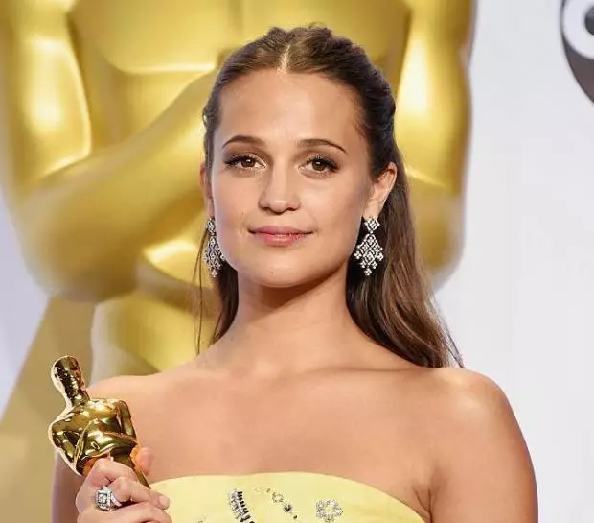
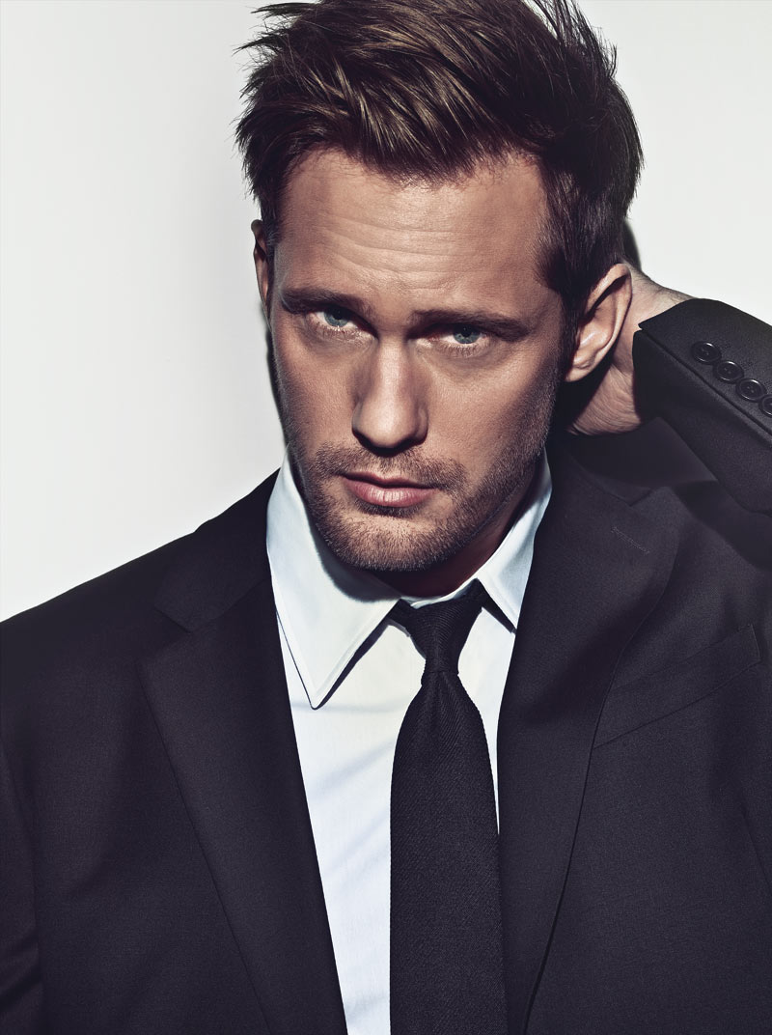
Swedes are the most beautiful peolpe
Notes:
Sebbe

Slide 7
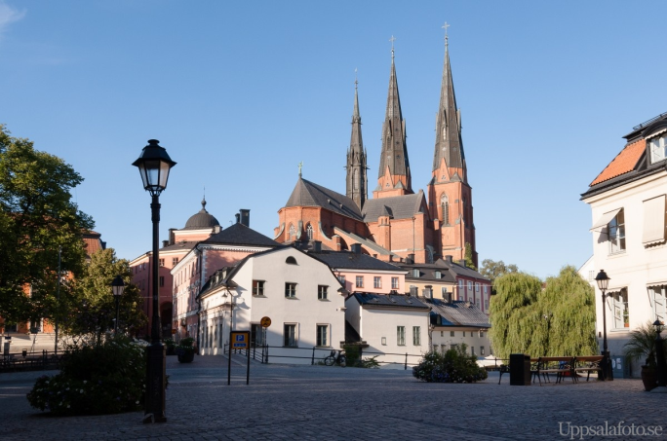
Religion
Only 29% of Swedes are religious. These figures rank Sweden as one of the least religious countries in the world.
The cathedral in Uppsala

Slide 8
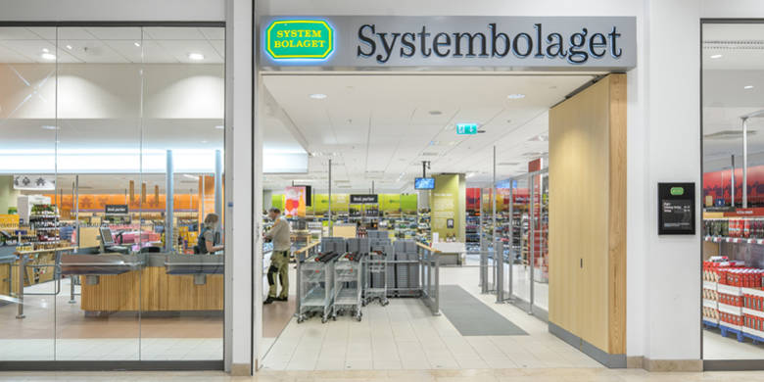
The only shop you can buy alcohol in is ”Systembolaget”, and you have to be at least 20 years old to buy.
Notes:
Samira

