Slide 1
LOOKING AT BOOKS
READ(Y)?
OŠ Ivana Mažuranića Vinkovci,
Mihaela Mišković

Slide 3
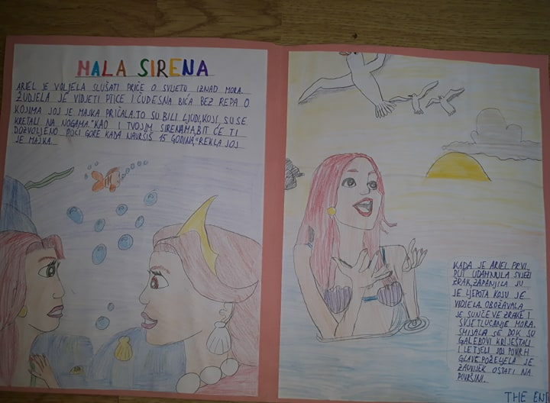

Slide 5
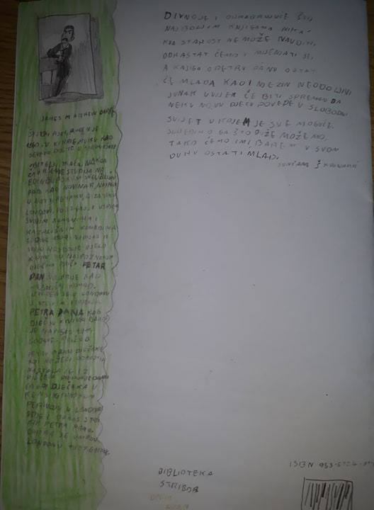

Slide 6
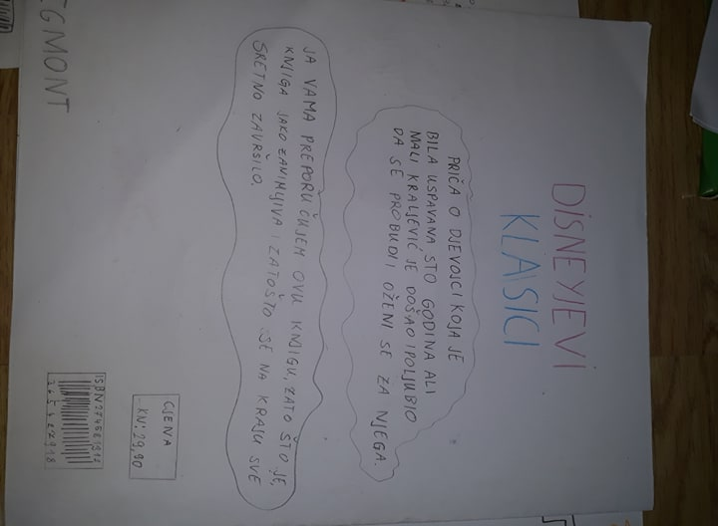

Slide 7
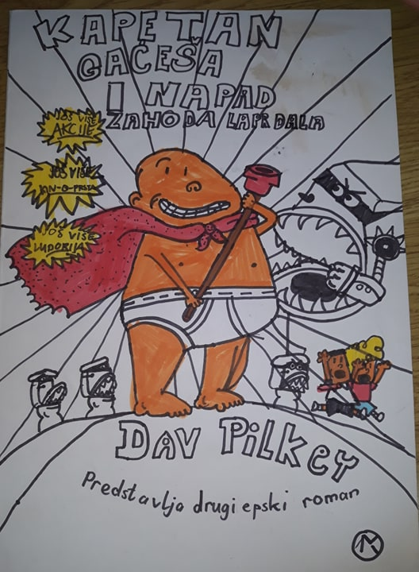

Slide 9
Thanks for your attention

