Slide 1
Conserving
Water
By Christopher & Jordi

Slide 2
How Conserving Water Helps
The Community
By Jordi

Slide 3
Conserving water can help the community in different ways. One reason to conserve water is because 97% of the earth's water is salt water, which is not suitable for drinking.

Slide 4
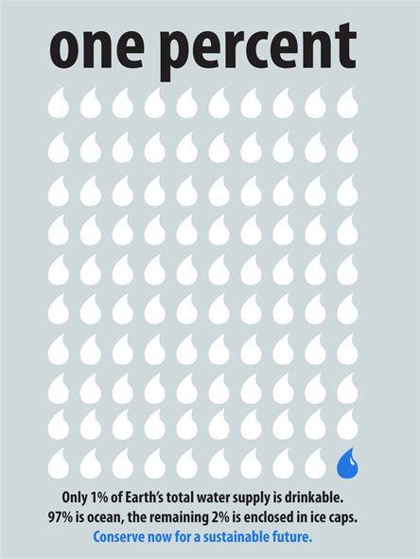
Since 97% of water is salt water, 3% is fresh water, and only 1% of that water is available for drinking and bathing purposes because 2% is frozen in ice caps.

Slide 5
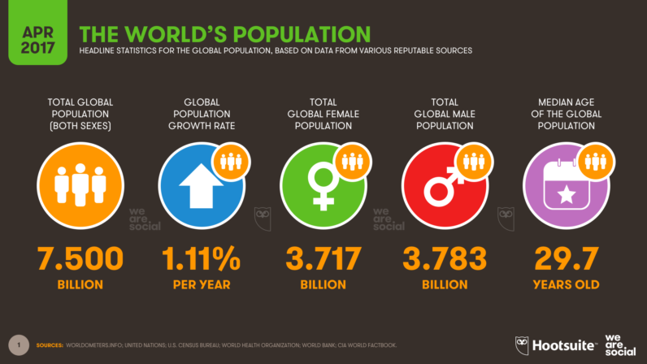
With that little water available for use, and with the high population of 7.442 billion people on Earth (according to World Banks in 2016), there is a limited amount of water we can use.

Slide 6
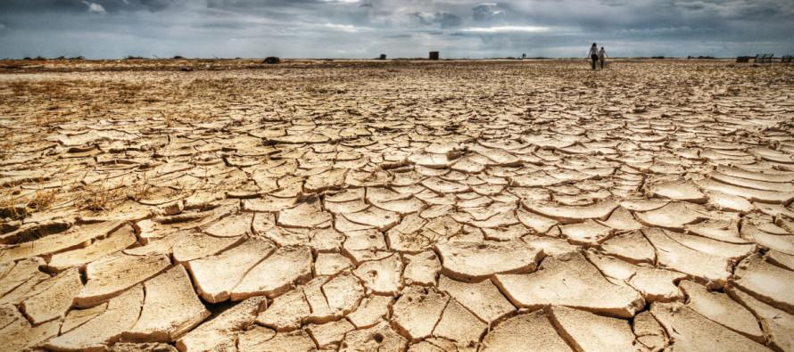
Another reason we should save water is because it will help reduce the amount of droughts, and the probability of a drought.

Slide 7
How to Conserve Water at
School, Home, and Globally.
By Christopher

Slide 8
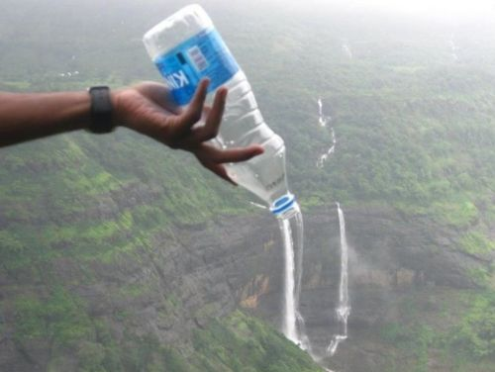
Conserving Water In School
Wash your hands for only five seconds.
Only fill your cup with the amount you will drink at the time.
Only fill your bottle of water at the water fountain for only the amount of water you will drink.
There’s no such thing as ‘old
water’.

Slide 9
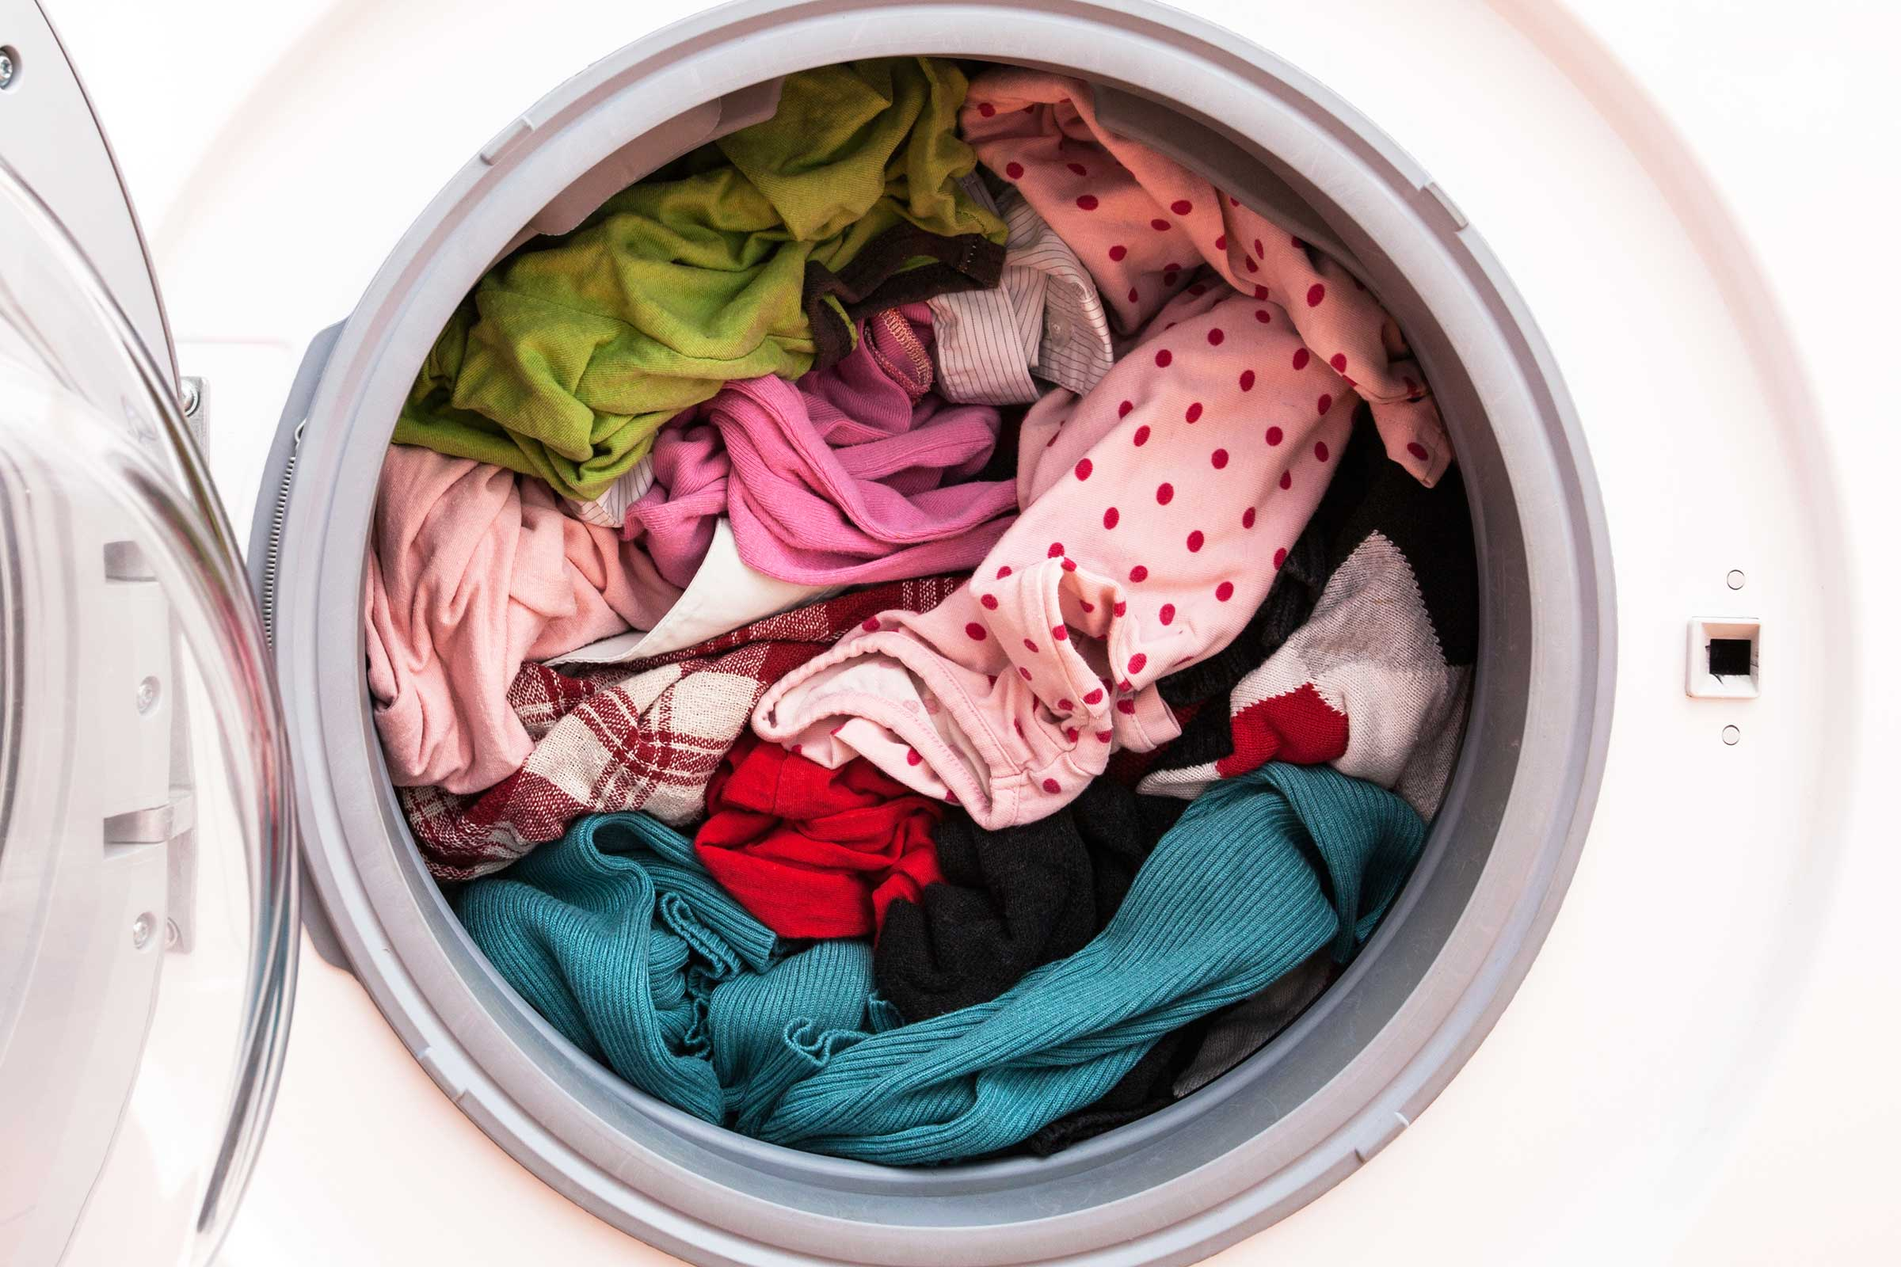
Conserving Water At Home
Do not flush the toilet when it is only contaminated with a little urine.
When cleaning your clothes with a washer, only commence the process when it is full.
Fill the dishwasher to the maximum capacity, before you start the dishwashing.

Slide 10
Conserving Water Globally
Decorate a poster board with ways to conserve water
Follow the ways to conserve water in school and home
When someone is not following the guidelines to conserve water, gently remind them that one day we’re going to run out of water, and that day because they wasted water there will be fatalities.

