Slide 1
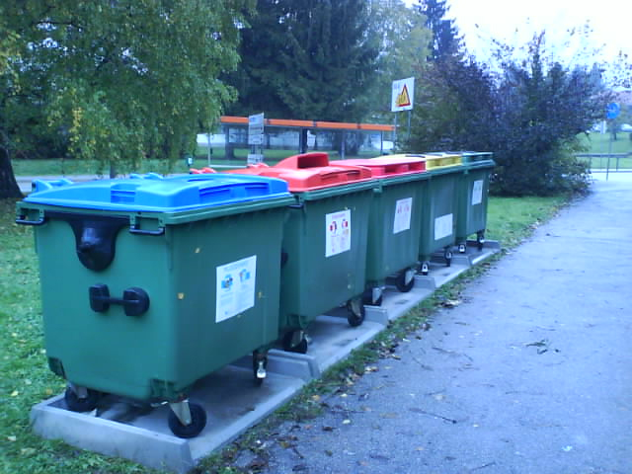
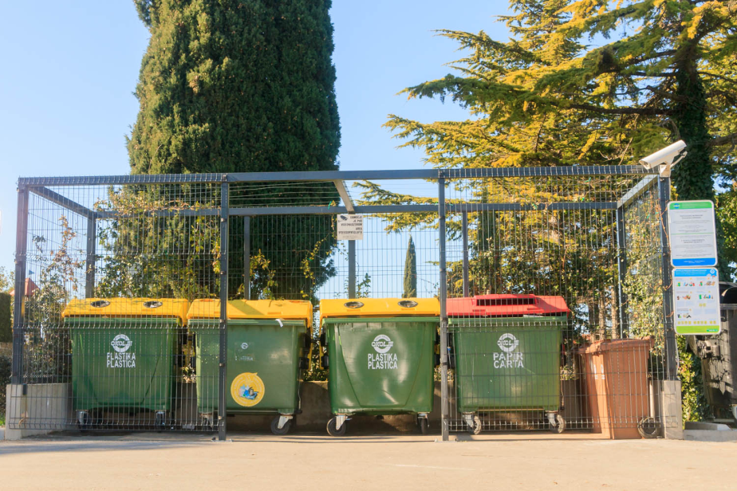
WASTE MANAGEMENT IN SLOVENIA

Slide 2
Slovenia has made good progress in waste management in terms of the separate collection of waste, reducing the amount of waste going to landfill and increasing the treatment and recycling of waste.
According to figures from Eurostat, the statistical office of the European Union, Slovenia recycled 54.1% of its waste in 2015, which puts it in third place in Europe.
The only countries to do better than Slovenia were Austria, which recycled 56% of its waste, and Germany, in first place with 66.1%.
There has also been a significant drop in the number of landfills to which waste is sent in an individual year.

Slide 3
PROBLEMS
1. Landfills are full of waste and are being closed. Rest of the waste (not separated one) has to be driven to the north of Slovenia or to Austria. That is expensive.
2. Although more and more people separate diligently the plastic, there is a problem… there is too much plastic waste, the factories which recycle plastic cannot handle anymore… collecting centers are full and there is a danger that they won‘t have anymore place to store the plastic that is waiting to be recycled.

Slide 4
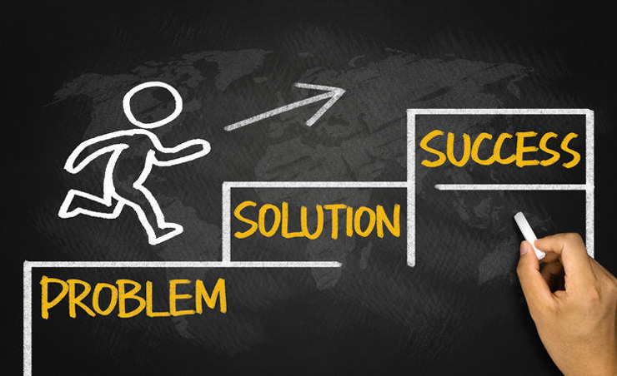
SOLUTIONS

Slide 5
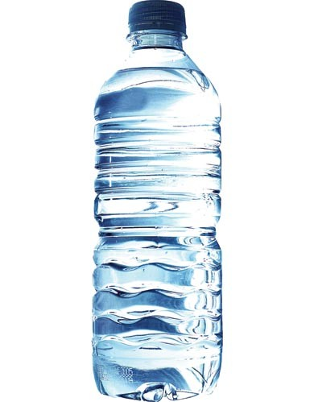
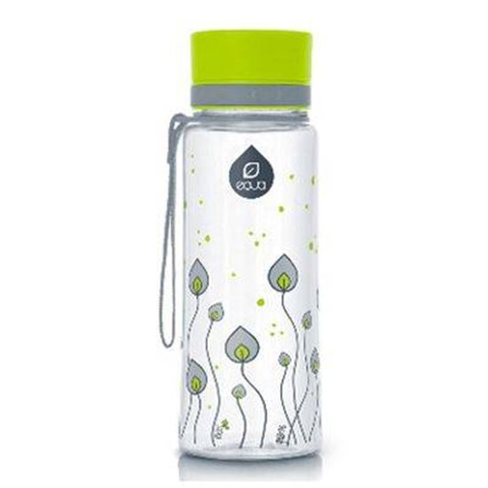
REDUCING
1. IN OUR SCHOOL:
Since this school year, pupils don‘t get
PLASTIC WATER BOTTLES anymore when sport,
cultural or science day is taking place away from
school. They have to bring a bottle from home and drink tap
water.
And we just got a donator who will
provide to all pupils a REUSABLE WATER
BOTTLE.
WHY NOT PET PLASTIC BOTTLES?
WATER FROM PET PLASTIC BOTTLES IS NOT HEALTHY,
IS MORE EXPENSIVE AND HAS BIG NEGATIVE IMPACT ON
THE ENVIRONMENT

Slide 6
2. ON NATIONAL LEVEL
THERE IS A BIG CAMPAIGN „I HAVE MY OWN CARRIER BAG“ TO REDUCE USING THE PLASTIC BAGS IN SHOPS

Slide 7
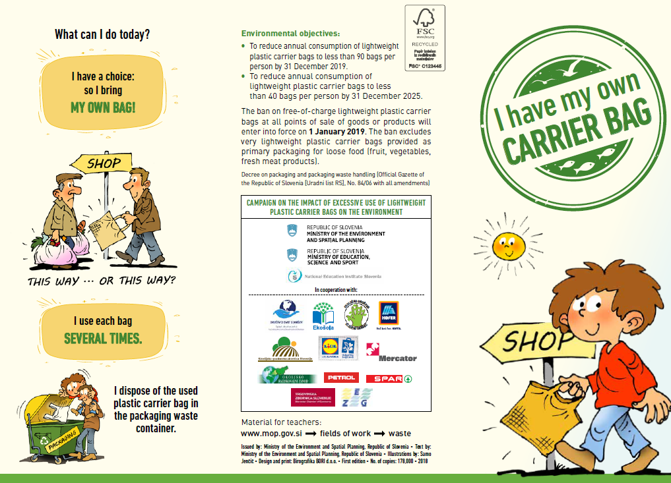

Slide 8
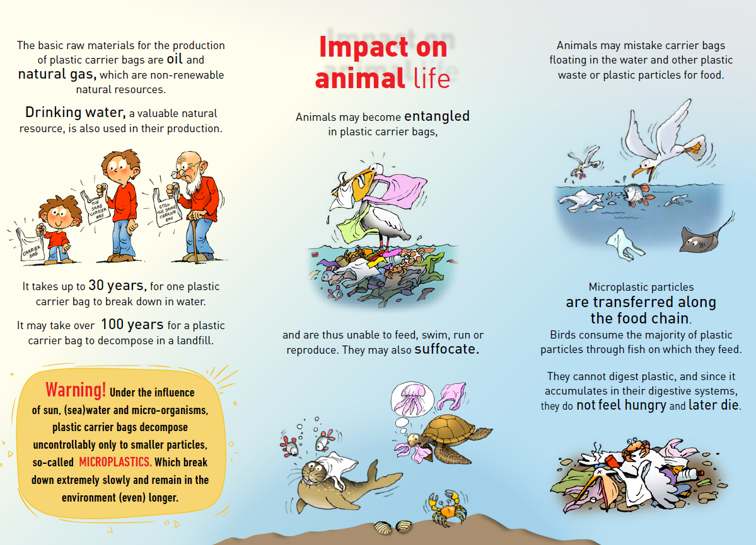

Slide 9
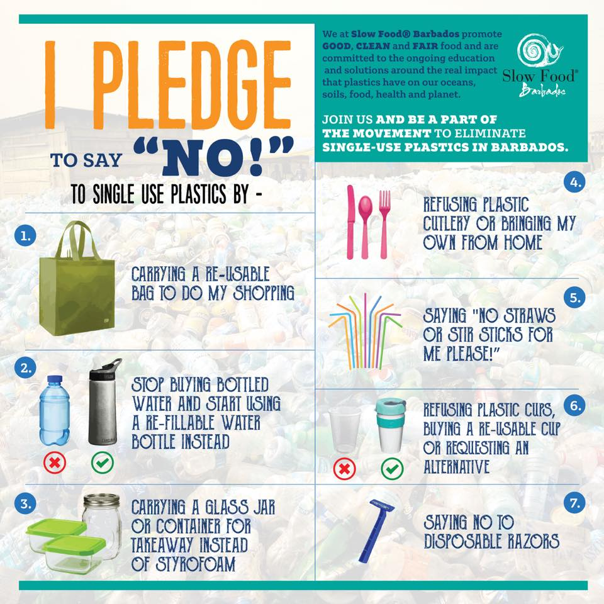
3. WORLDWIDE
THERE IS A BIG CAMPAIGN „STOP SINGLE-USE PLASTIC POLLUTION NOW “

