Slide 1
MIGRATORY BIRDS IN SLOVENIA

Slide 2
So far, 386 bird species have been noticed in Slovenia, 155 of them are endangered, and 223 nest in Slovenia.
21% of these bird species stay in Slovenia all year, the rest (79%) are migratory.
40% of migratory birds migrate short distance, that means that they usually winter in Europe, mostly in the Mediterranean.
39% migrate long distance - they fly to different parts of Africa.

Slide 3
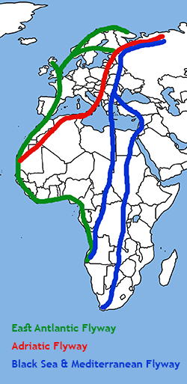
In general, there are four different flyways used by European migration birds.
Slovenia has a specific geographic position. It lies at the crossroads of three migration routes. This can be noticed in a large number of birds and in large variety of species.
Birds on their migratory routes tend to fly over the land area. Flying over open water is much more tiring and dangerous.

Slide 4
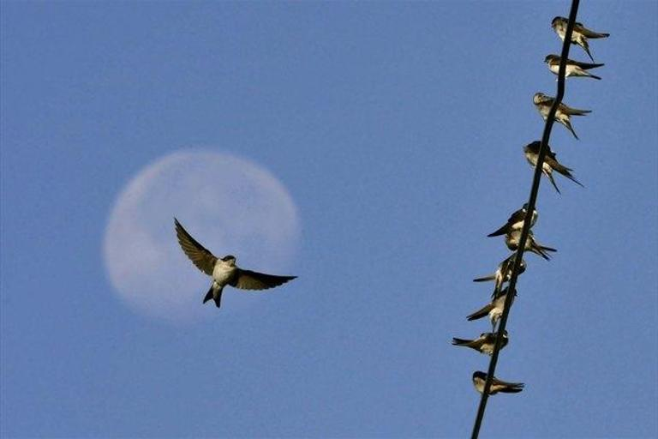
In Slovenia, the spring migration takes place between late March and early June, with its peak at the beginning of April.
The autumn bird migration is much longer, it lasts four months, from late August to early November.

Slide 5
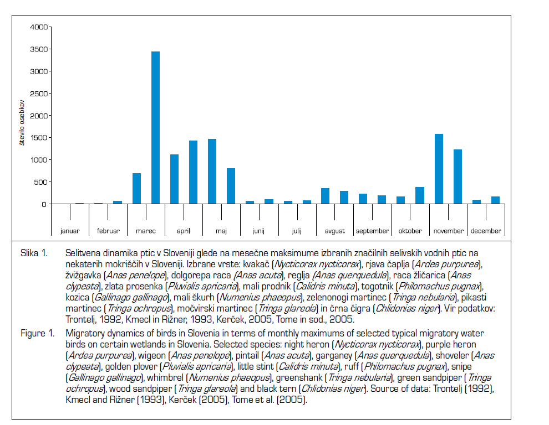

Slide 6
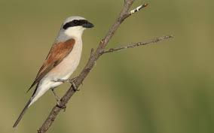
Most migratory birds winter in the Mediterranean.
Some birds which nest on the vast territories of northern Europe and Russia are satisfied with our winter conditions. Among them is the red backed shrike (Lanius collurio).

Slide 7
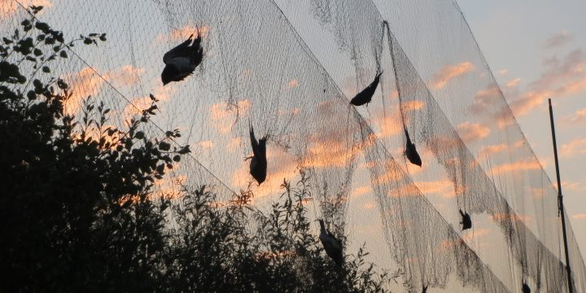
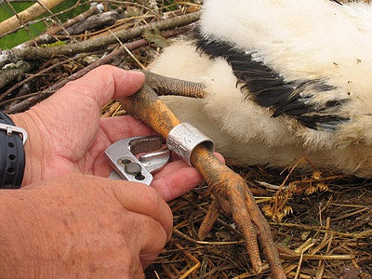
Where these birds come from and where they migrate
Ornithologists spot them through scheduled hunting and bird ringing.
In Slovenia, there has been a long tradition in organized hunting and bird ringing. Ornithological observatory was established in 1920 and among their activities there was also bird ringing. On a national scale these activities are coordinated by the Slovenian Museum of Natural History with the help of a wide range of amateur and professional ornithologists.

Slide 8
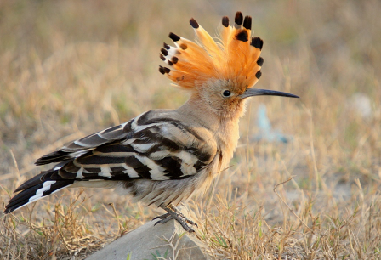
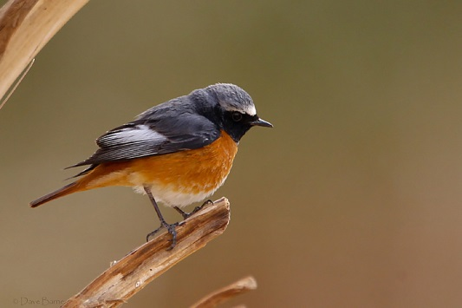
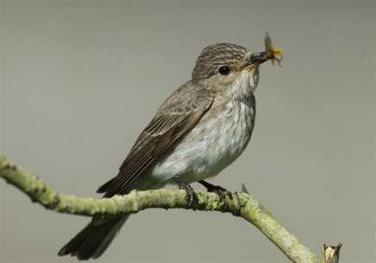
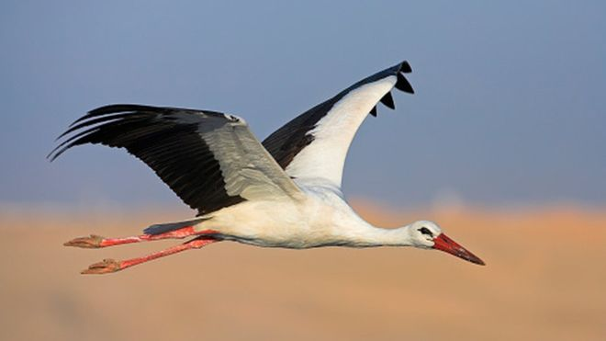
Some migratory birds are:
The Eurasian hoopoe, the red-backed shrike, the common redstart, the spotted flycatcher, the swallow, the stork, the common quail, the common tern, the sea hawk, the night heron, the little ringed plover, the sand martin, the honey buzzard, the tawny pipit, the European scops owl, the European roller, the whinchat, the common swift, the nightjar…

Slide 9
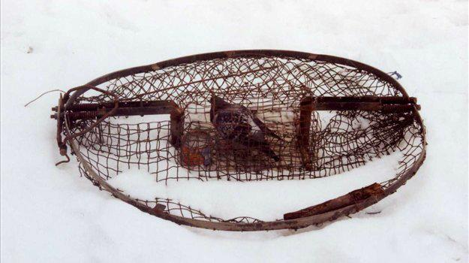
Illegal bird hunting
Unfortunately the journey of many migratory birds ends in nets, sticky traps and finally, they end up as food on tables or ornaments on walls. Slovenia has long been an oasis where migratory birds have been safe from illegal killing, especially compared to neighbouring Italy or the Balkan states.

Slide 10
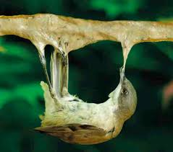
But the project »Stop Illegal Killing of Birds on the Adriatic Flypath« has recently revealed that this is not true. The number of criminal activities in Slovenia in which birds are the victims is much higher as we thought.
There is a lot of trapping of passerine birds in order to keep them in cages or sell them to the Italian black market. Trapping birds of prey and shooting where the victims in many cases are fish-eating birds are also common.
It is estimated that in Slovenia
8.000-46.500 birds are killed annually.

Slide 11
DOPPS (Slovenian Ornithological Organisation) has recently gathered information about 200 illegal activities concerning birds.
The systematic overview has been done as an introduction to a four-year project in which they will try to ensure safer bird migrations on the Adriatic flypath which runs over Slovenia.
The funds will be provided by Euronatur, an environment protection foundation.

Slide 12
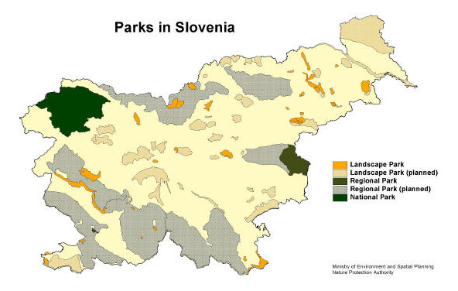
Wetlands conservation
Slovenia has done a lot on this issue. 14% of our country is protected.
Wetlands that are of great importance for birds in Slovenia are Sečovlje Salina Nature Park at the coast, the Drava and the Mura rivers with flooded woodlands in the North Eastern Slovenia, Ljubljansko Barje (marshes) and Lake Cerknica in the central part of the country.

Slide 13
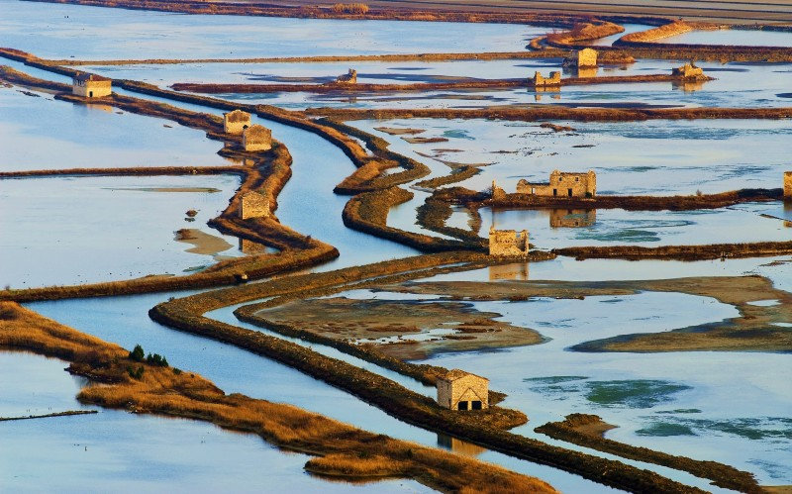
Sečovlje Salina Nature Park
Sečovlje Salina Nature Park that has been declared the first Slovenian Ramsar site and it is an Important Bird Area for wintering, migratory and breeding marine and wetland birds. It qualifies for a Specially Protected Area of Mediterranean Importance.
So far, 291 bird
species have been
established at the
Sečovlje salt pans.

Slide 14
Škocjan Inlet Nature Reserve
The goal of the protection of the Škocjan Inlet (the nearest protected area to our village) is the conservation of brackish and freshwater habitats and bird habitats, which nest, winter and stop during migration in this inlet in large numbers.
The Škocjan Inlet is a good example of cooperation between the representatives of civil society and the members of the Bird Watching and Study Association of Slovenia who have prevented the Škocjan Inlet from completely drying out and being covered with buildings.

Slide 15
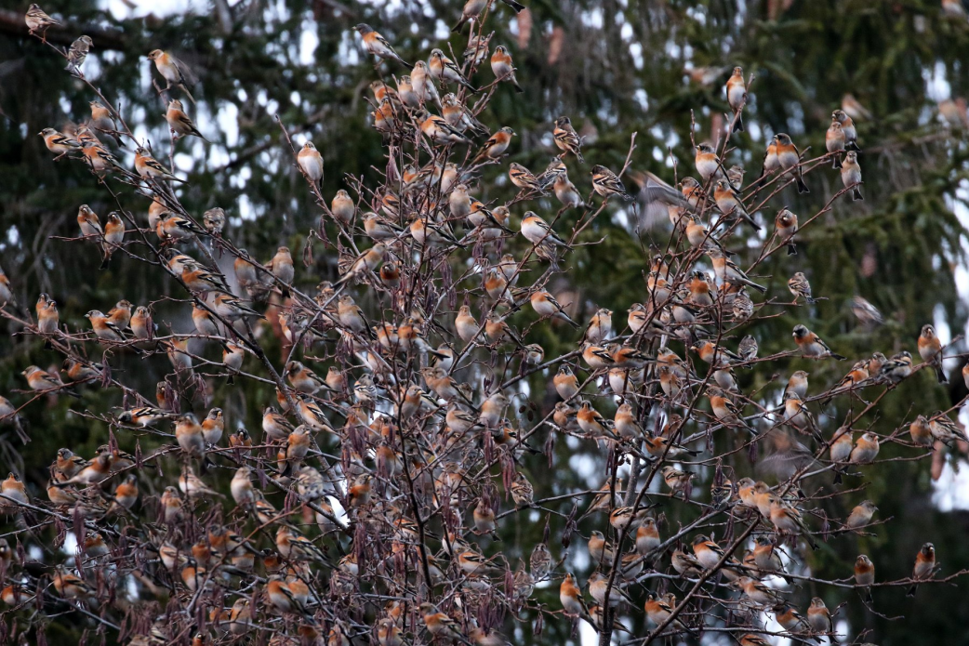
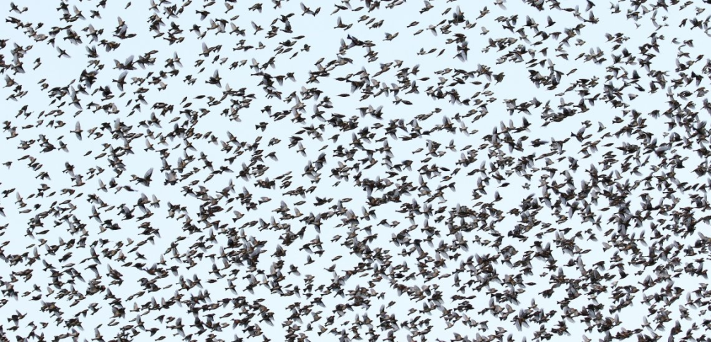
Incredible flock of 5 million bramblings (Fringilla montifringilla) wows Slovenia
These days Slovenia is witnessing an incredible birding event this winter. One so rare, it only happens once or twice in a decade – a huge flock of five million bramblings.

Slide 16
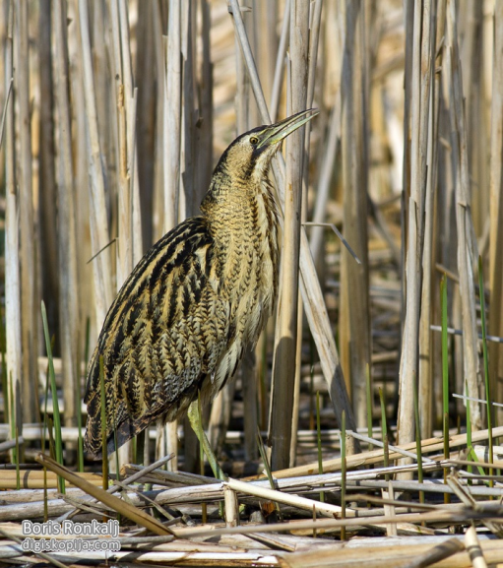
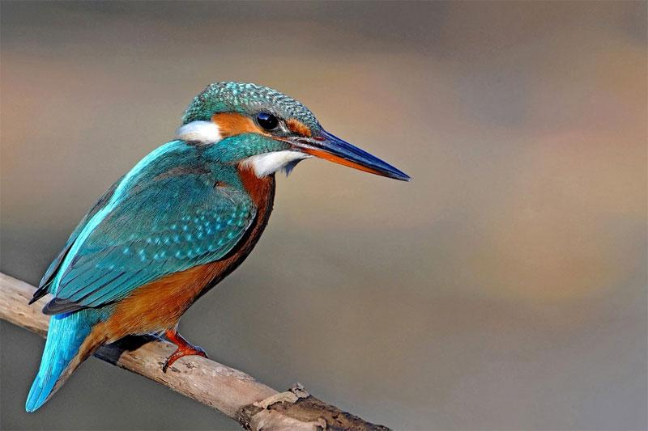
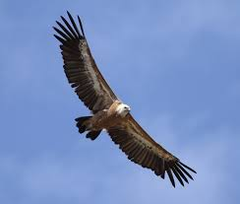
THE RED LIST OF BIRD SPECIES IN SLOVENIA

Slide 17
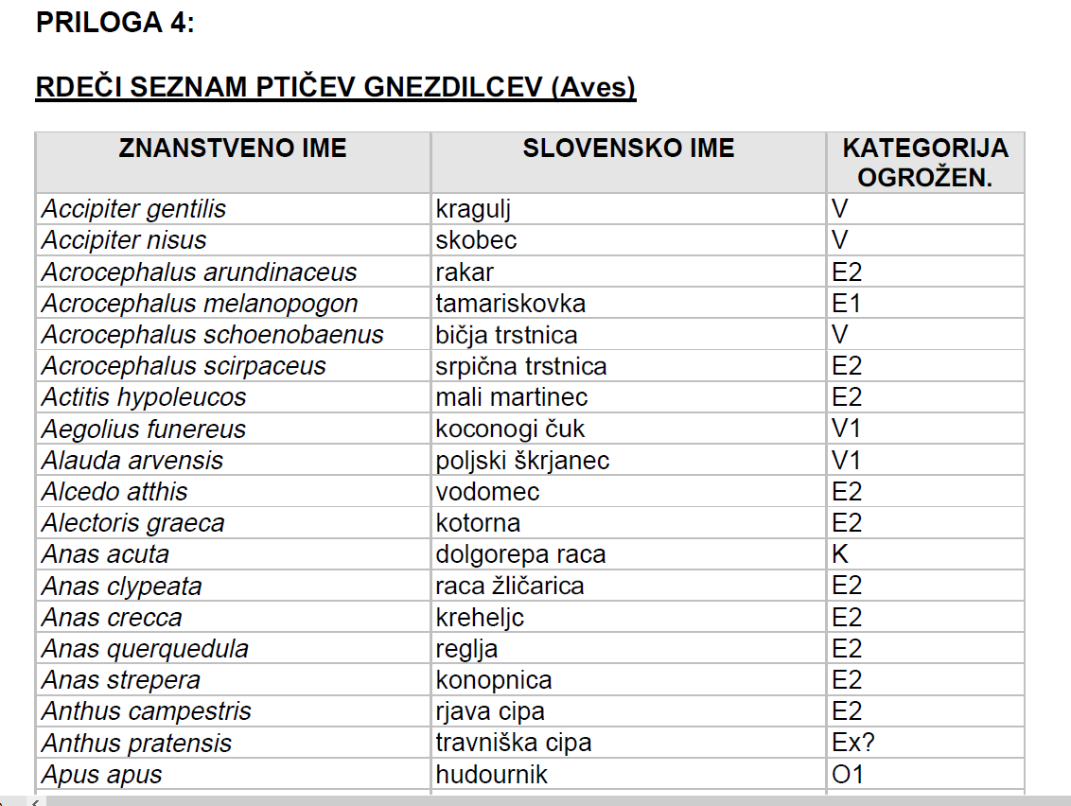
There are 143 species in the list

Slide 18
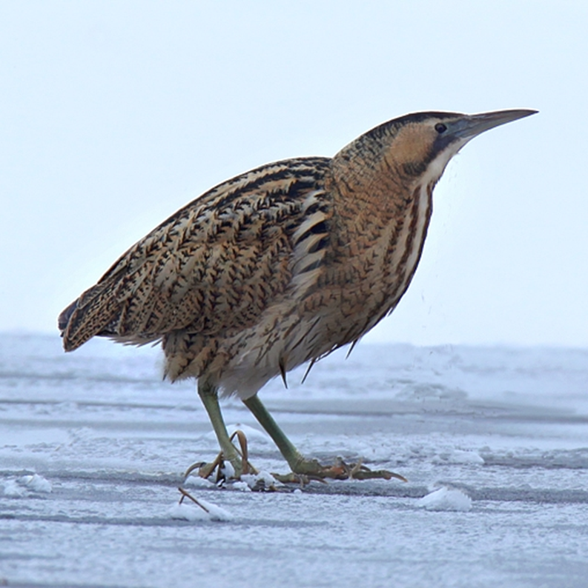
Conservation of the birds which are in the red list
The bittern (Botaurus stellaris)
Ex?

Slide 19
Lake Cerknica is the only nesting area of the bittern in Slovenia, so it is important to improve the nesting conditions on the lake in order to conserve this species in our country. Within the scope of project LIFE STRŽEN they are trying to establish a quiet zone and suitable living conditions for the bittern, which will enable undisturbed nesting of the species.
The bittern has strict requirements when it comes to choosing its nesting ground. It is especially shy during the nesting period. It nests in vast reed beds, since it needs a lot of peace to raise its young. It is most active at dusk, when it is looking for food by the water bank. It hunts animals, smaller than itself, such as fish, amphibians, reptiles, birds’ young, small mammals and large invertebrates, like beetles, dragonflies and their larvae.

Slide 20
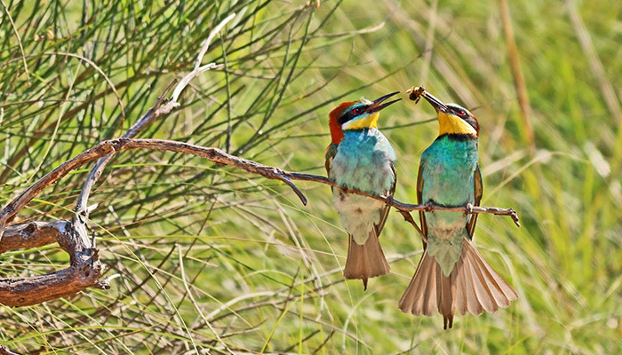
E2
European bee-eater (Merops apiaster)
It breeds in southern Europe and in parts of north Africa and western Asia. It is strongly migratory, wintering in tropical Africa.
This species, like other bee-eaters, is a richly coloured, slender bird. It has brown and yellow upper parts, whilst the wings are green and the beak is black.
They catch insects in flight, in sorties from an open perch. Before eating a bee, the European bee-eater removes the sting by repeatedly hitting the insect on a hard surface. It can eat around 250 bees a day.

Slide 21
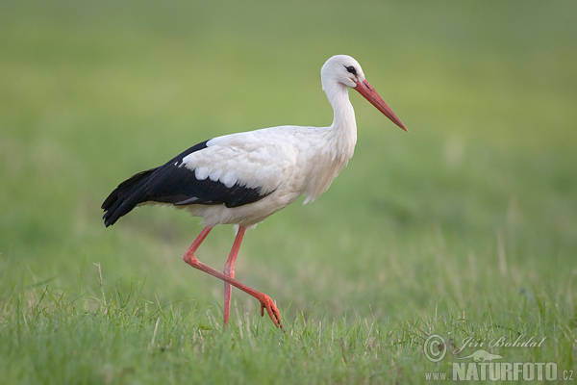
White stork (Acrocephalus arundinaceus)
V
It flies with its neck stretched forward and with its long legs extended well beyond the end of its short tail. Common food items include insects (primarily beetles, grasshoppers, locusts and crickets), earthworms, reptiles, amphibians, particularly frog species such as the edible frog (Pelophylax kl. esculentus) and common frog (Rana temporaria) and small mammals such as voles, moles and shrews.

Slide 22
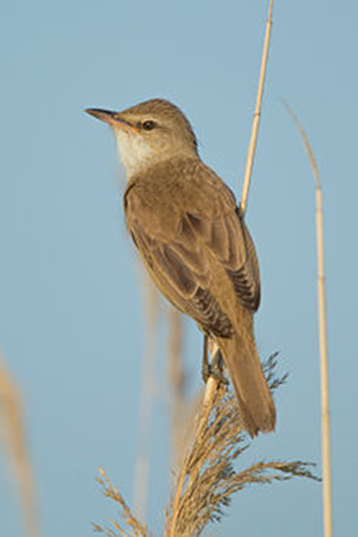
Some bird species in the red list
E2
Great reed warbler (Acrocephalus arundinaceus)
It measures 16–21 cm in length, 25 to 30 cm in wingspan and weighs 22 to 38 g.
It lives in Europe and westernmost temperate Asia. Its population has in recent decades increased around the eastern Baltic Sea.
It eats insect larvae, dragonflies, damselflies, beetles, spiders, small fish and frogs.

Slide 23
SOURCES
http://www.sos112.si/slo/tdocs/ujma/2006/vrezec.pdf
https://www.stat.si/StatWeb/en/news/Index/6910
http://fatbirder.com/links_geo/europe/slovenia.html
https://govori.se/zanimivosti/selitve-ptic-selivk-katere-so-in-le-kam-gredo/
http://ptice.si/naravovarstvo-in-raziskave/nezakonit-lov-ptic/
http://www.quark-magazine.com/pdf/quark07/0702CMWetlandsinSloveniaB.pdf
http://life.notranjski-park.si/en/project-area/

Slide 24
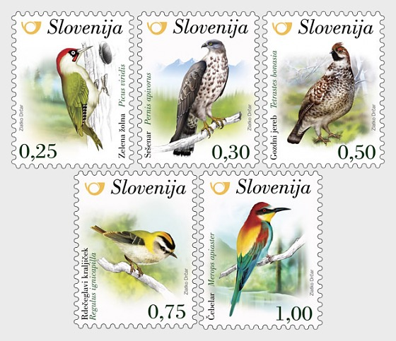
THE END

