Slide 1
Food and nutrients

Slide 2
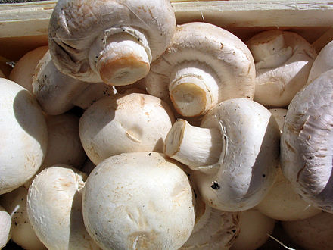
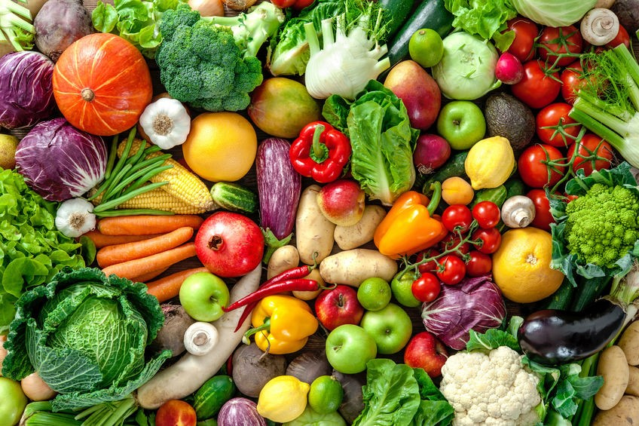
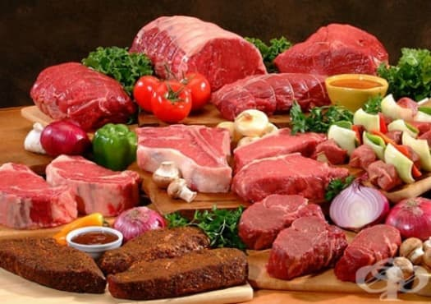
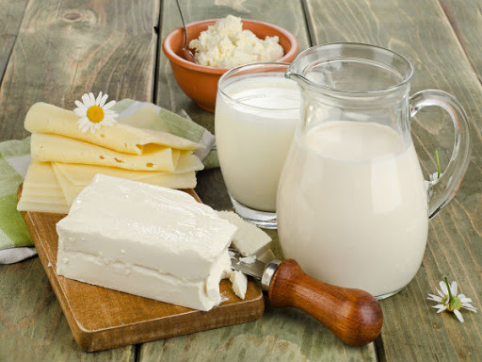
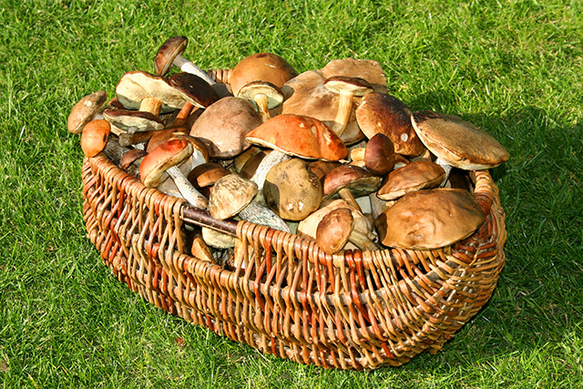
Nutrition and human food.
Nutrition is a basic life process in which a person receives, processes and assimilates food. From food he receives energy and building material. Man has a dependent diet - he takes ready-made nutrients, which are formed by plants or animals. By their origin, the food we eat is divided into:
Mushroom (edible mushrooms)
Vegetable
Animal

Slide 3
Nutrients
MAIN GROUPS OF SUBSTANCES IN HUMAN FOOD |  | MAIN FUNCTION OF SUBSTANCES | FOODS CONTAINING THEM IN LARGE QUANTITIES
NUTRIENTS | Proteins | Structural | Fish, milk, meat, etc.
 | Carbohydrates | Energy | Fruits, vegetables, honey, pasta, etc.
 | Fat | Backup | Butter, margarine, nuts, fatty meats and more.
FUNCTIONAL | Water Mineral substances Vitamins | They are necessary for the normal course of the body | Fruits, vegetables, etc.
ADDITIONAL | Spices, dyes, sweeteners, etc. | Improve the taste and appearance of food | Confectionery, cereals, chips, etc.

Slide 4
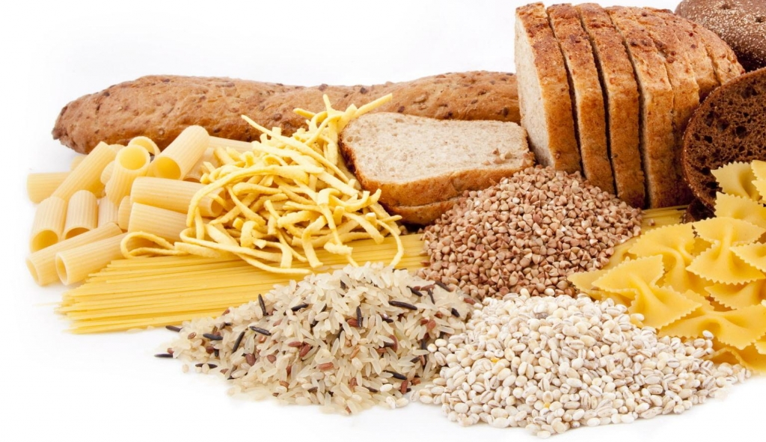
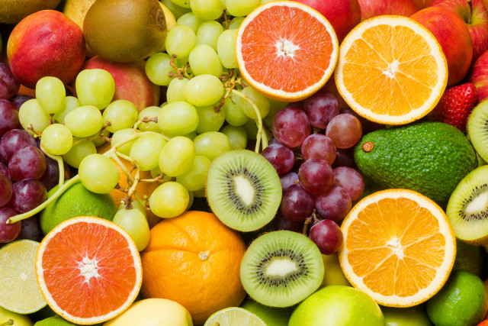
Nutrients in human food.
3.1. Carbohydrates:
Carbohydrates are a major source of energy for the body. They are found mainly in foods of plant origin. Plants form carbohydrates in the process of photosynthesis and accumulate (store) them in fruits, seeds, stems and roots. Rich in carbohydrates are: rice, potatoes, grapes, sweet fruits, nuts and more.

Slide 5
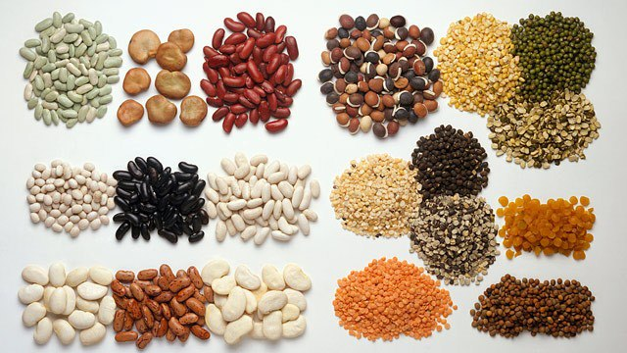
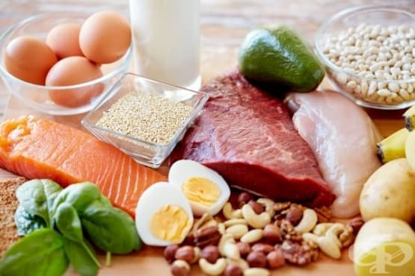
Nutrients in human food.
3.2. Proteins:
Proteins are a major source of building blocks for the body. Animal proteins are especially valuable because their composition is close to human proteins and is more easily absorbed by the body. Proteins build muscles, bones, nails, hair. Rich in protein are: beans, nuts, lentils, milk, cheese, meat, eggs, fish and more.

Slide 6
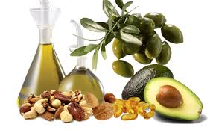
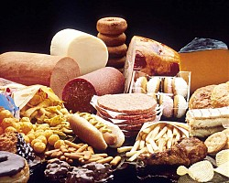
Nutrients in human food.
3.3. Fat:
Fat is a reserve source of energy for the body. They are more difficult to absorb by the organ and when increased intake are stored in the body and used as needed. In the human body, fat accumulates under the skin, around some internal organs (kidneys). They are important because they are part of the cell membranes (build them), but should be taken in moderation. Vegetable fats are preferred. Foods rich in fat are: fatty meat, fried foods, sausages, walnuts, sunflower seeds, olives and more.

Slide 7
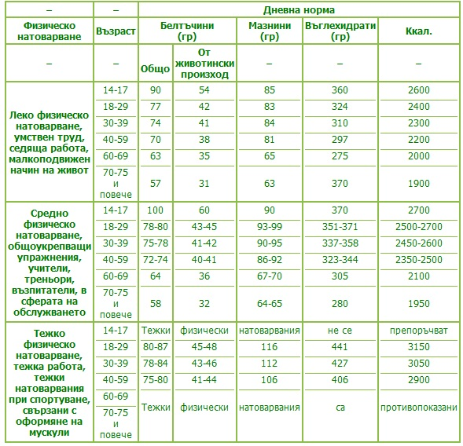
Nutrients in human food.
In order to grow and develop normally, the human body needs a variety of foods. Different foods contain different amounts of nutrients. The recommended amounts of different nutrients depend on a person's daily load.

Slide 8
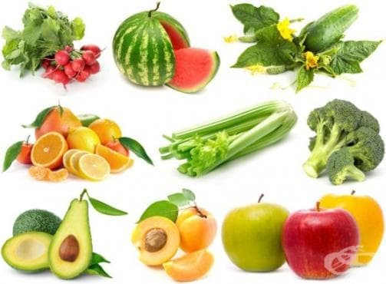
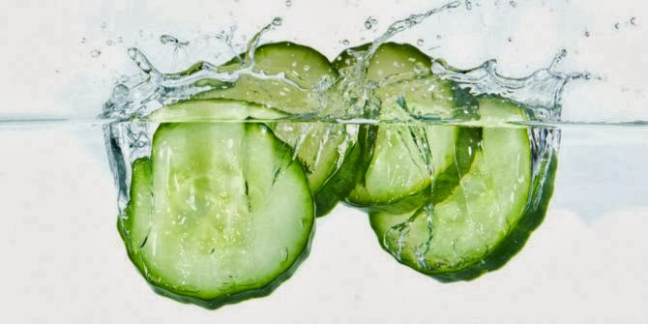
Functional substances in human food.
4.1. Water:
Water is an absolutely necessary ingredient in our food. It is part of the cytoplasm of cells, body fluids and is necessary for the normal course of processes in the body. It is part of the urine - it participates in the excretion of unnecessary substances from the body. In an adult, the water in the body is about 2/3 of his weight.

Slide 9
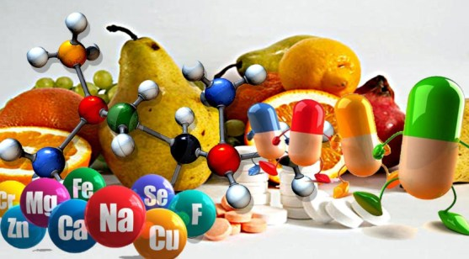
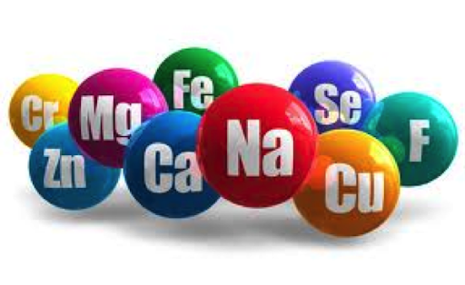
Functional substances in human food.
4.2. Mineral substances
Minerals are vital to the human body, albeit in small amounts. Contained in almost all foods and beverages. Calcium (Ca) is important for building bones and teeth. Contained in the largest quantities in milk and dairy products. Iron (Fe) is needed for the production of red blood cells. Contained in eggs, bread, vegetables. Iodine (J) is important for maintaining the balance of fats in the body. Contained in onions, drinking water, seafood and more. Also important are zinc (Zn), magnesium (Mg), potassium (K), sodium (Na).

Slide 10
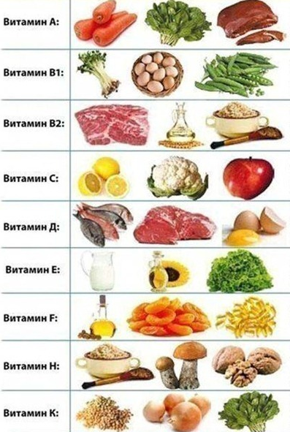
Functional substances in human food.
4.3. Vitamins:
Vitamins are vital for the human body, although they are taken in small amounts. They regulate metabolism. In their absence, disorders in the body can occur, and diseases can occur.
Vitamins A - important for skin, vision, hair. Contained mostly in fish oil, spinach, carrots. Vitamin
C - strengthens the body, is important for growth. Contained in rose hips, red peppers, citrus fruits, cabbage, strawberries and more. Vitamin
D - plays a role in bones and teeth, general health. Contained in fish, milk, cheese. It is also synthesized under the action of the sun in human skin.
B vitamins - general health of the body, central and peripheral nervous system. Contained in cereals, liver, egg yolk and more.

Slide 11
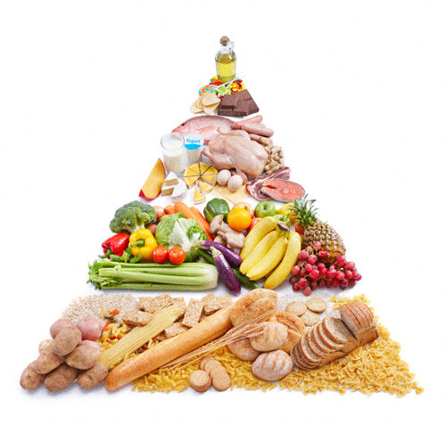
Human diet.
A diet in which the human body receives the necessary nutrients on a daily basis without accumulating excess reserves is called healthy.
For a healthy diet it is recommended: Eat a variety of foods. Three meals a day for an adult and five for children. Eating in a relaxed atmosphere, without rushing, if possible every day at the same time. Avoid late evenings, especially with high-fat foods. The food pyramids represent the recommended ratio of the amounts of nutrients in our food. These amounts depend on the person's age, health and his physical activity.

