Slide 1
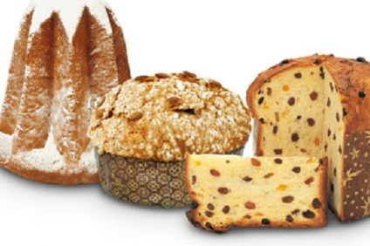
TRADITIONAL CHRISTMAS SWEETS FROM ITALY

Slide 2
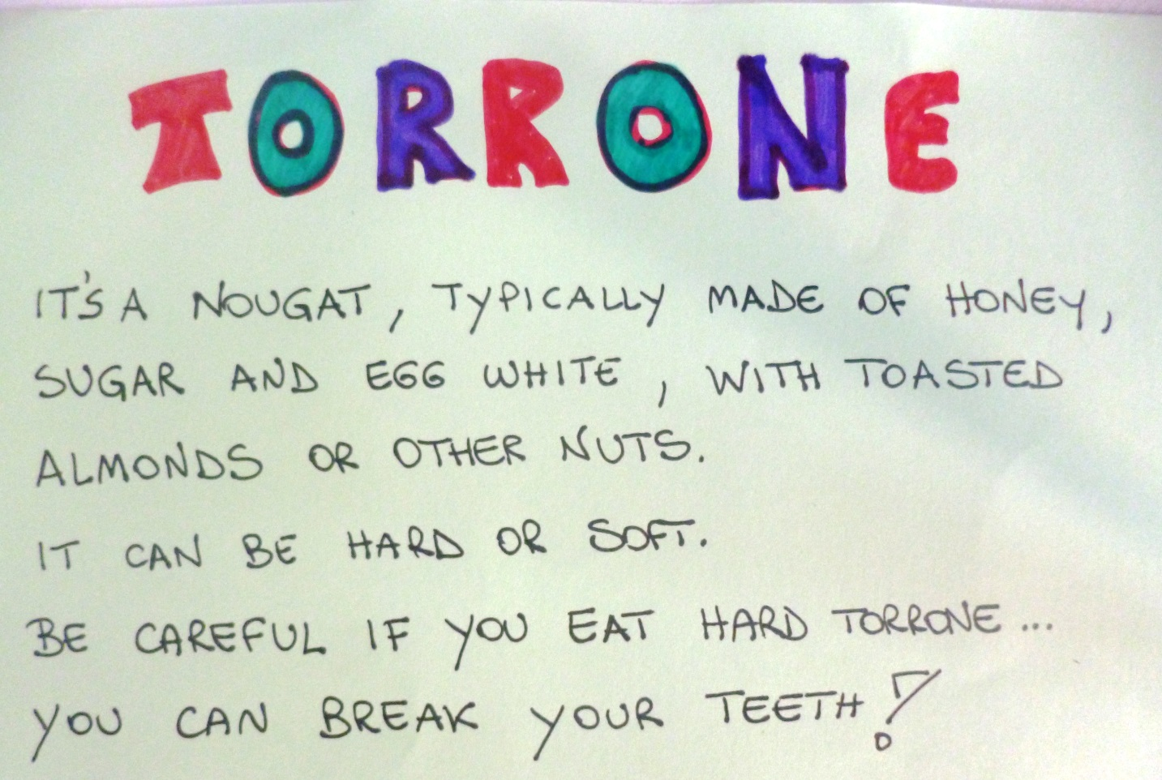
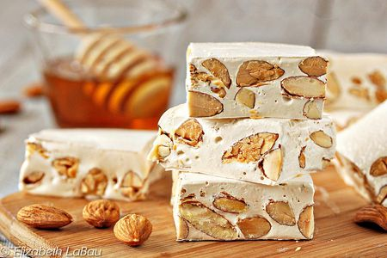

Slide 3
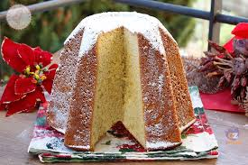

Slide 4
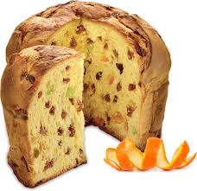

Slide 5
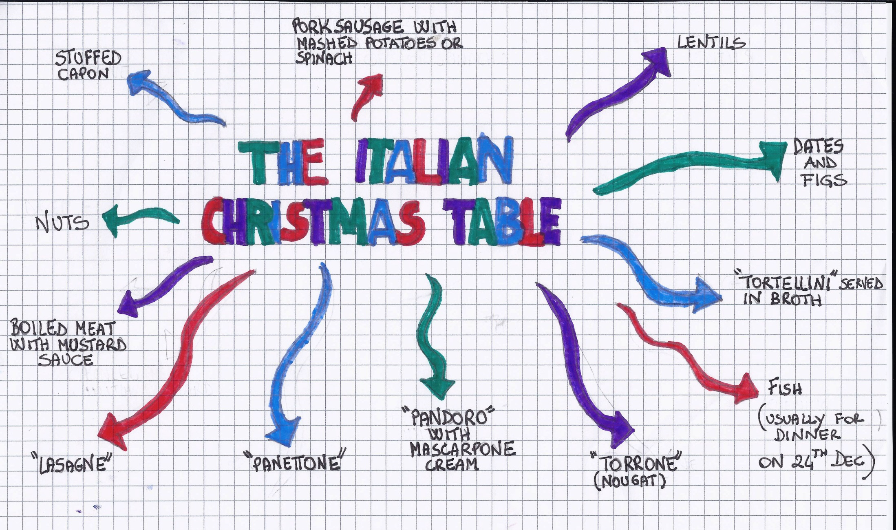

Slide 6
SEASON’S GREETINGS
BUONE FESTE!

Slide 7
3A - SALO’
Italy

