Slide 1
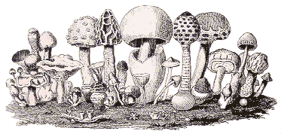
Fungi - their biology
Artur Baranowski

Slide 2
Content
Biology, Morphology & Nutrition
Importance of Fungi
FILMs & Additional Materials
Bibliography

Slide 3
Biology, Morphology & Nutrition

Slide 4
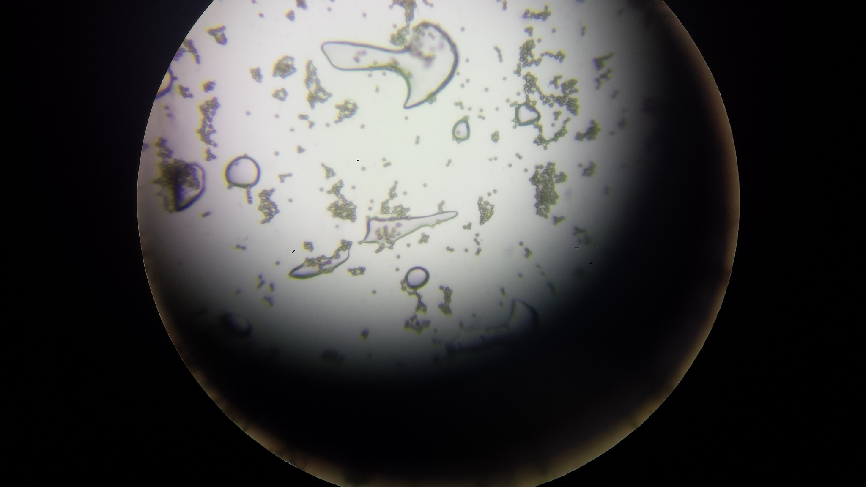
Fungi are a kingdom of mostly microscopic organisms that are closely related to animals. They include spore producing organisms such as mushrooms, yeast and molds.
Zdjęcie własne
Zdjęcie własne

Slide 5
Fungi are almost always invisible to the naked eye. At certain times, some fungi will produce large ‘fruiting bodies’ (“flowers”) called mushrooms that produce huge numbers of spores for reproduction.

Slide 6
A hypha /haiva/ (plural hyphae /haivi/, from Greek ὑφή, huphḗ, “web”) is a long, branching filamentous structure of a fungus.
In most fungi, hyphae are the main mode of vegetative growth, and are collectively called a mycelium.
https://www.google.pl/search?q=hypha&oq=hypha&gs_l=psy-ab.3..35i39k1j0i203k1l2j0i10i203k1j0i203k1l2j0i10k1j0l3.8981.9455.0.9809.2.2.0.0.0.0.446.584.0j1j4-1.2.0....0...1.1.64.psy-ab..0.2.583...0i7i30k1.0.Y8oBFXdkJJM
Notes:
Filamentous - nitkowaty
Hypha - strzępek
Hyphae - strzępki
Oomycete - lęgniowce, grzybopodobne lęgniowe (klasa organizmów)

Slide 7
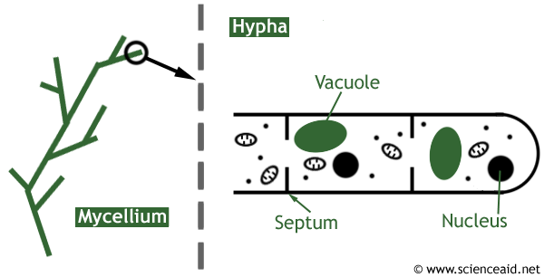

Slide 8
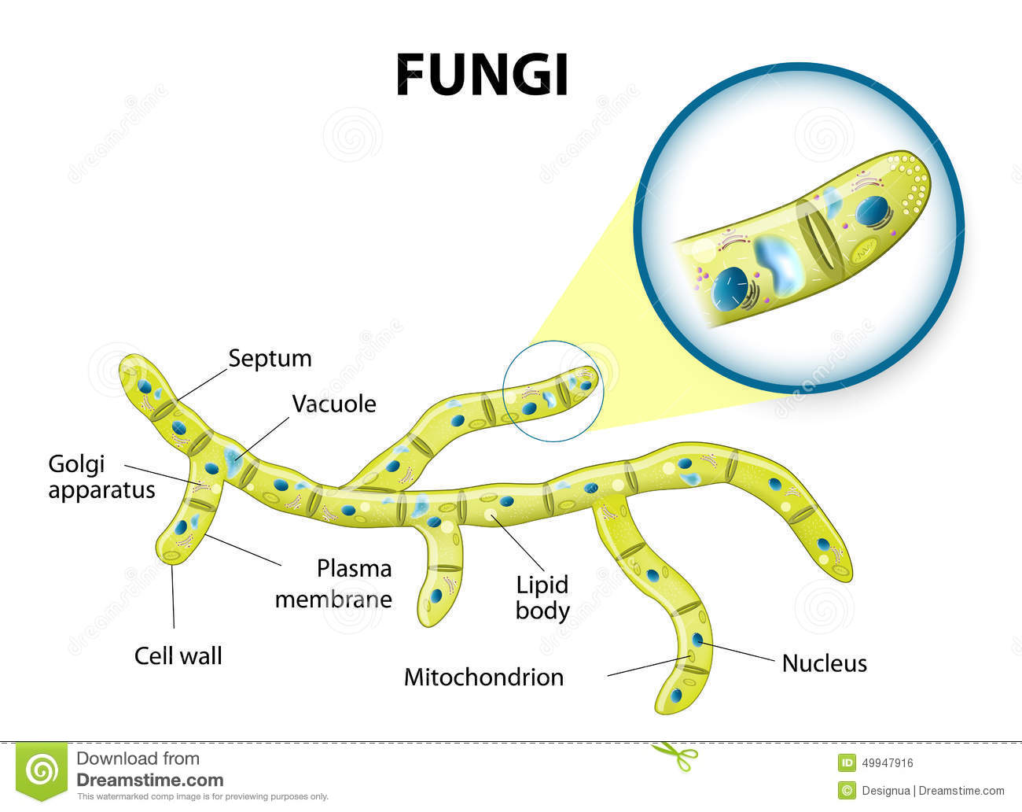

Slide 9
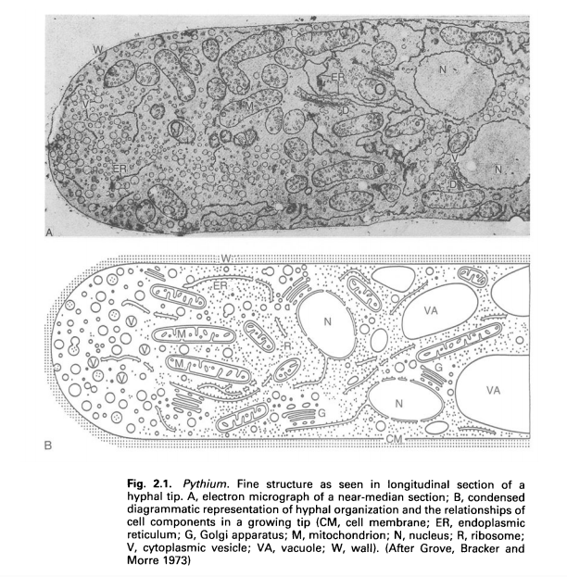
Notes:
Vesicle - pęcherzyk

Slide 10
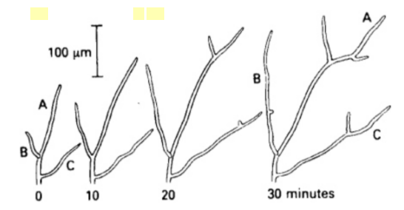

Slide 11
(A) Extracellular digestion and absorptive nutrition in fungi. (B) Invasive hyphae of C albicans in stratified epithelial tissue of mouse stomach. (X4,250)
https://www.ncbi.nlm.nih.gov/books/NBK8099/

Slide 12
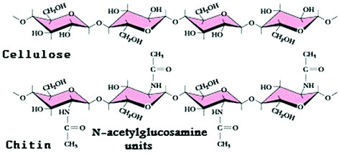
Fungi are different from all other living things by the type of cell wall they have surrounding each of their cells. As opposed to plants, bacteria and some protists which have cell walls made from other compounds (e.g. cellulose), the cell walls of fungi are made from a compound called ‘chitin’.
http://basicbiology.net/micro/microorganisms/fungi/

Slide 13
More than 100,000 species of fungi have been identified by biologists. It is estimated that more than 1.5 million species currently exist on Earth. Two groups of multicellular fungi contain over 95% of all species. One of these two groups is called ‘basidiomycetes’ which includes the mushroom producing fungi.
The study of fungi is known as mycology. Mycology is a very important field of biology because fungi are important for a number of ecological and economic reasons. Consequently, understanding these little organisms is very important to the well-being of humans.
http://basicbiology.net/micro/microorganisms/fungi/

Slide 14
2. Importance of Fungi

Slide 15
Fungi are very important for a number of reasons worldwide.
Mushrooms, truffles and yeast have a significant place in the food and alcohol industries as sources of food and in the process of fermentation. They are also used in the production of antibiotics.
http://basicbiology.net/micro/microorganisms/fungi/

Slide 16
Fungi are one of the most important decomposers of dead plant material and the recycling of nutrients back into ecosystems.
If nutrients were not recycled, a habitat would become infertile and struggle to support life.
On the flip side, all around the world fungi can be problematic for farmers because they can infect and decompose crops.
http://basicbiology.net/micro/microorganisms/fungi/

Slide 17
MYCORRHIZAE
Many fungi, known as mycorrhizae, live in close association with the roots of plants (e.g. Leguminous) and actually help them to absorb more nutrients (Nitrogen).
The vast majority of plants depend on help from fungi to successfully compete with neighbouring plants for nutrients.
http://basicbiology.net/micro/microorganisms/fungi/
Notes:
Mycorrhizae - /maikorajzi/
Leguminous - ligju:mines

Slide 18
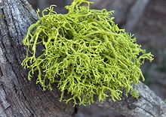
LICHENS
A lichen forms when a fungi and photosynthetic organisms, such as a green algae or cyanobacteria, form a symbiotic relationship.
https://www.google.pl/search?q=lichen&source=lnms&tbm=isch&sa=X&ved=0ahUKEwimnvf56eHWAhUmDMAKHVzBAaIQ_AUICigB&biw=1600&bih=794#imgrc=ZZvcse1r9oGjwM:
https://www.google.pl/search?q=lichen&source=lnms&tbm=isch&sa=X&ved=0ahUKEwimnvf56eHWAhUmDMAKHVzBAaIQ_AUICigB&biw=1600&bih=794#imgrc=BrbLRGif54JD7M:
https://www.google.pl/search?q=lichen&source=lnms&tbm=isch&sa=X&ved=0ahUKEwimnvf56eHWAhUmDMAKHVzBAaIQ_AUICigB&biw=1600&bih=794#imgrc=RQeFV26KI_SMLM:
http://basicbiology.net/micro/microorganisms/fungi/
Notes:
https://www.google.pl/search?q=lichen&source=lnms&tbm=isch&sa=X&ved=0ahUKEwimnvf56eHWAhUmDMAKHVzBAaIQ_AUICigB&biw=1600&bih=794#imgrc=RQeFV26KI_SMLM:
https://www.google.pl/search?q=lichen&source=lnms&tbm=isch&sa=X&ved=0ahUKEwimnvf56eHWAhUmDMAKHVzBAaIQ_AUICigB&biw=1600&bih=794#imgrc=BrbLRGif54JD7M:
https://www.google.pl/search?q=lichen&source=lnms&tbm=isch&sa=X&ved=0ahUKEwimnvf56eHWAhUmDMAKHVzBAaIQ_AUICigB&biw=1600&bih=794#imgrc=ZZvcse1r9oGjwM:

Slide 19
We can't survive without fungi.

Slide 20
3. FILM & Additional Materials

Slide 21
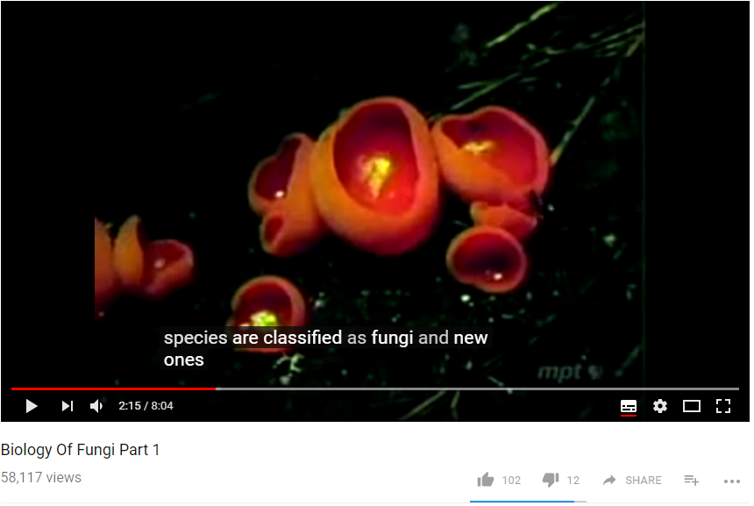
https://www.youtube.com/watch?v=4NO299do_l4

Slide 22
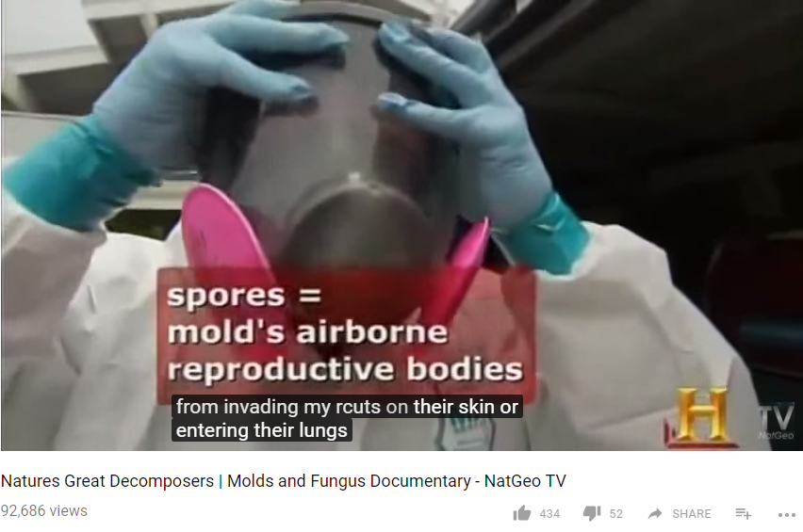
https://www.youtube.com/watch?v=Bfk0gKbQBuM
Notes:
Inoculate - zaszczepiać
Remediation - rekultywacja, poprawa

Slide 23
Bibliography
Ingold C.T. 2012. The Biology of Fungi. Springer Science & Business Media. https://books.google.pl/books?hl=en&lr=&id=t5xfBgAAQBAJ&oi=fnd&pg=PT6&dq=the+biology+of+fungi&ots=RAC4cURpFx&sig=y2HPEjLB-VItlTOjSxRVjkNYDH8&redir_esc=y#v=onepage&q=the%20biology%20of%20fungi&f=false
Ingold C.T., Hudson H.J. 1993. The Biology of Fungi. Growth and nutrition. pp 7-24
Baron S., editor. 1996. Medical Microbiology. 4th edition. Galveston (TX): University of Texas Medical Branch at Galveston.
Web pages
http://basicbiology.net/micro/microorganisms/fungi/

