Slide 1
Our holidays

Slide 2
In Croatia we celebrate many holidays.
Like Christmas,Easter,New year…But today I’m gonna tell you how we celebrate them in Croatia.

Slide 3
Christmas
We celebrate Christmas in winter.
For me Christmas is the biggest and the prettiest holiday in Croatia.
Every year for Christmas,our town is decoratet.It is so pretty.

Slide 4
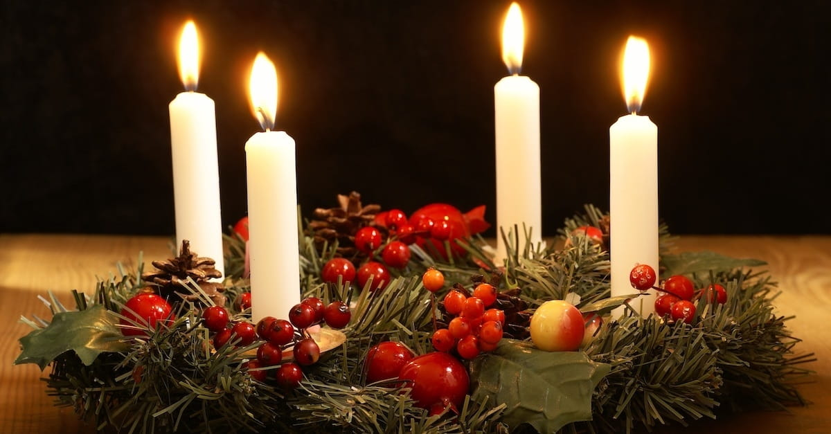

Slide 5
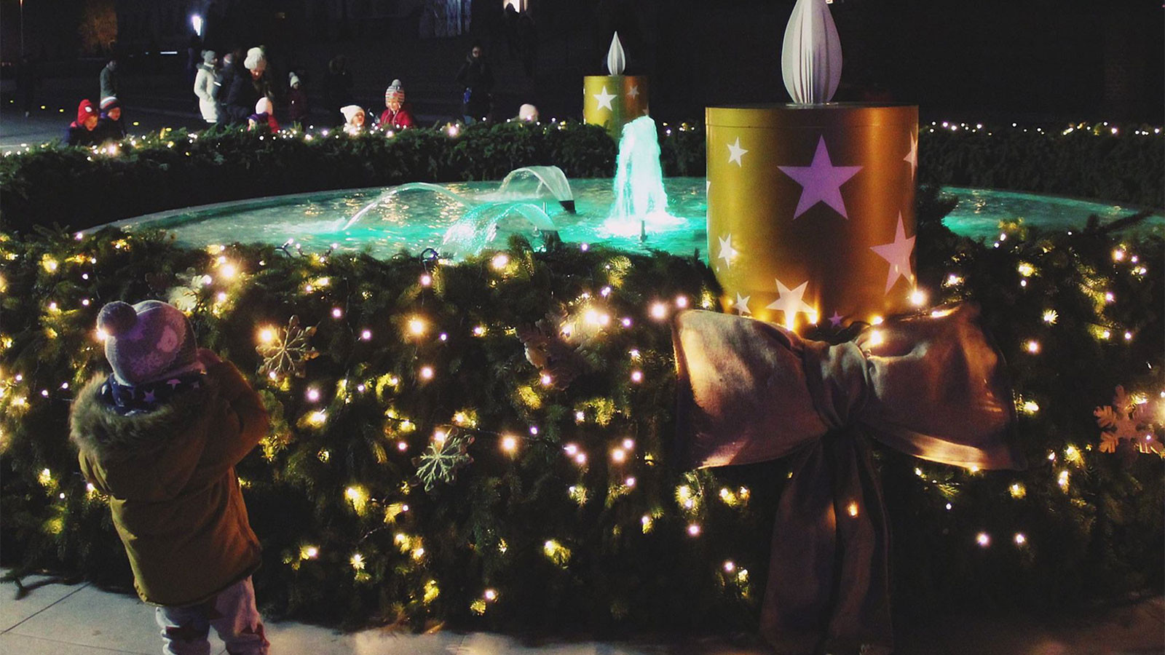

Slide 6
Easter
In spring we celebrate Easter.
Our Easter is pretty much the same as yours.We eat special food and we search for eggs in the morning.

Slide 7
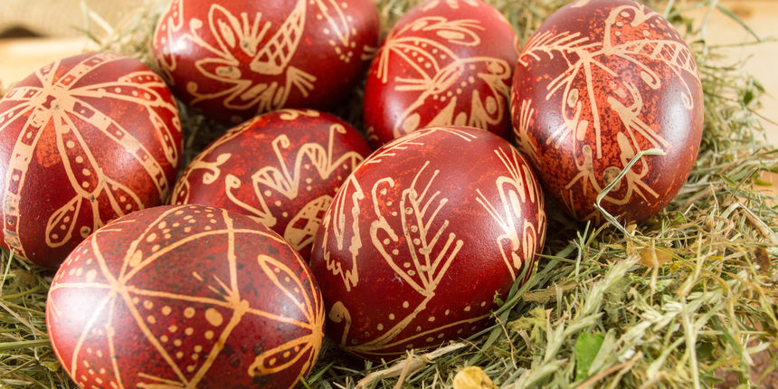

Slide 8
Đakovački vezovi
I live in Đakovo.In Đakovo we celebrate a holiday called Đakovački vezovi.
We celebrate that in summer.We celebrate that holiday 3 days,but it’s not the same every year.
It’s so fun to be part of that holiday

Slide 9
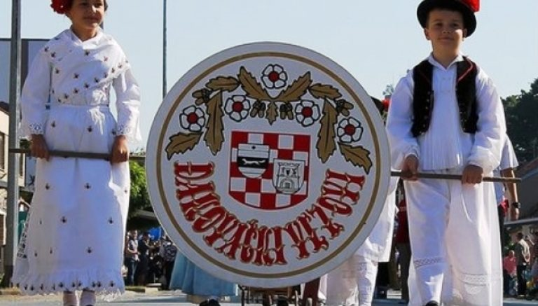

Slide 10
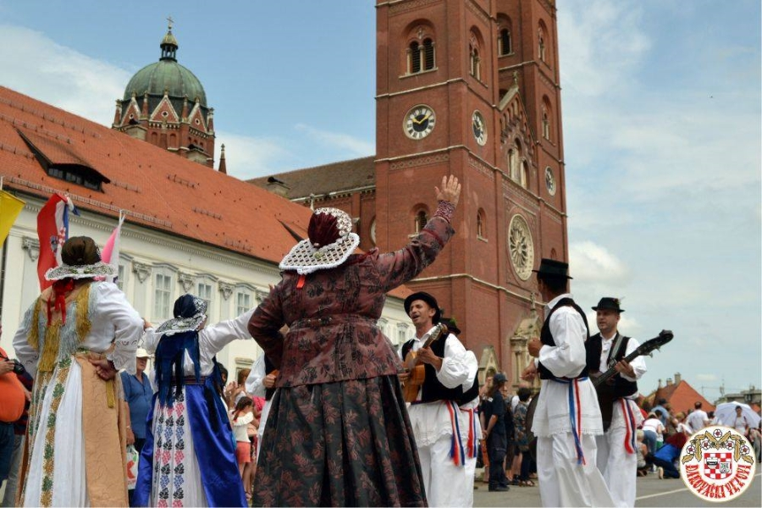

Slide 11
Now you know a little bit more about how we celebrate our holidays.I would like to hear about your way you celebrate your holidays.Bye!

Slide 12
THE END

