Slide 1
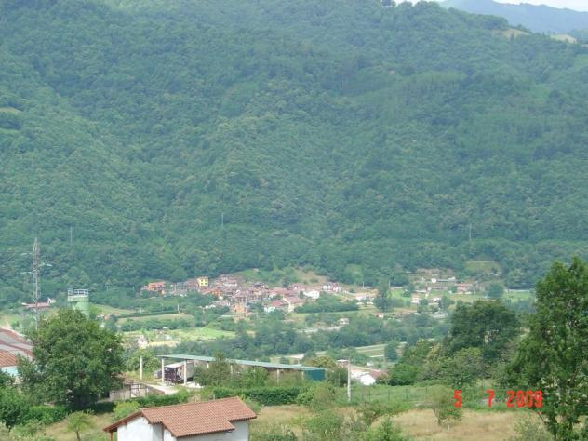
Carrio village

Slide 2
From Pola de Laviana

Slide 3
From Barredos

Slide 4
Church

Slide 5
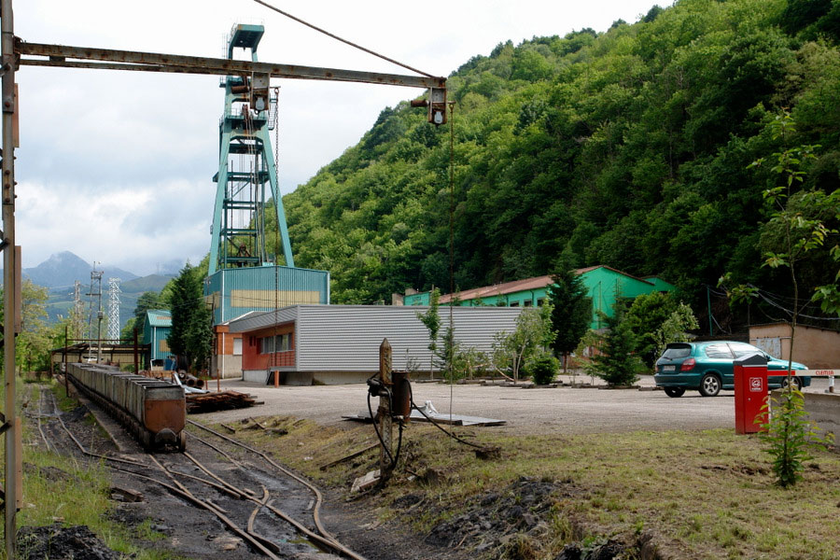
Coal mine

Slide 6
Float of Carrio

Slide 7
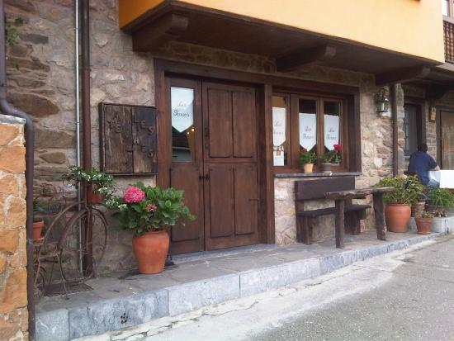
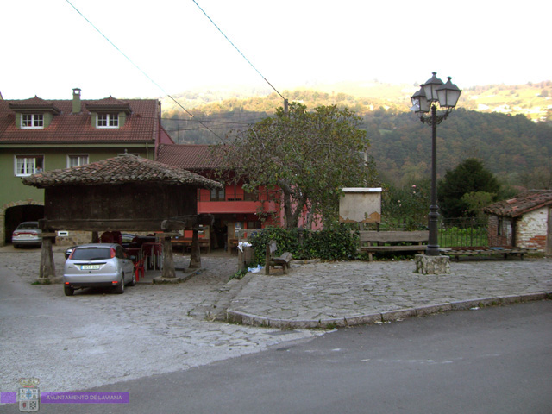
Bars and restaurant

Slide 8
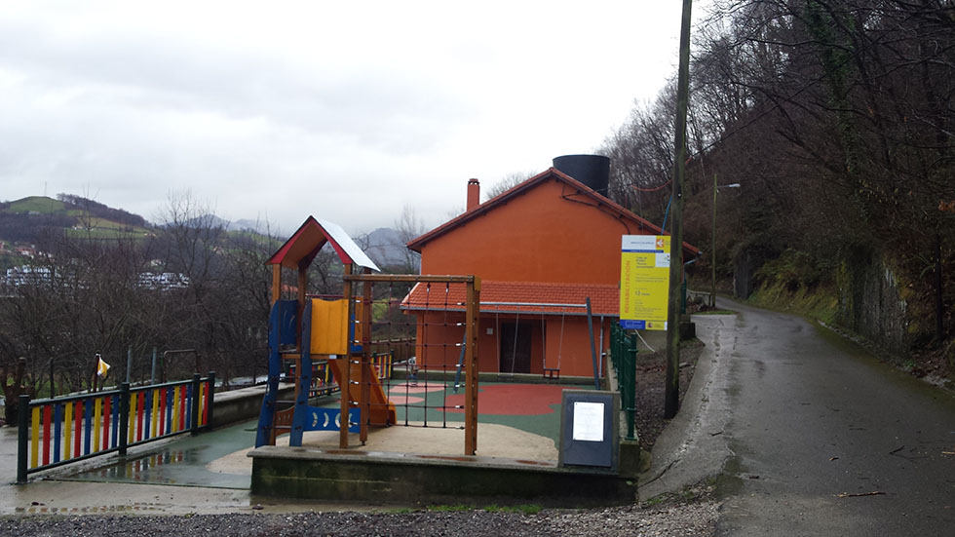
Community center and park

Slide 9
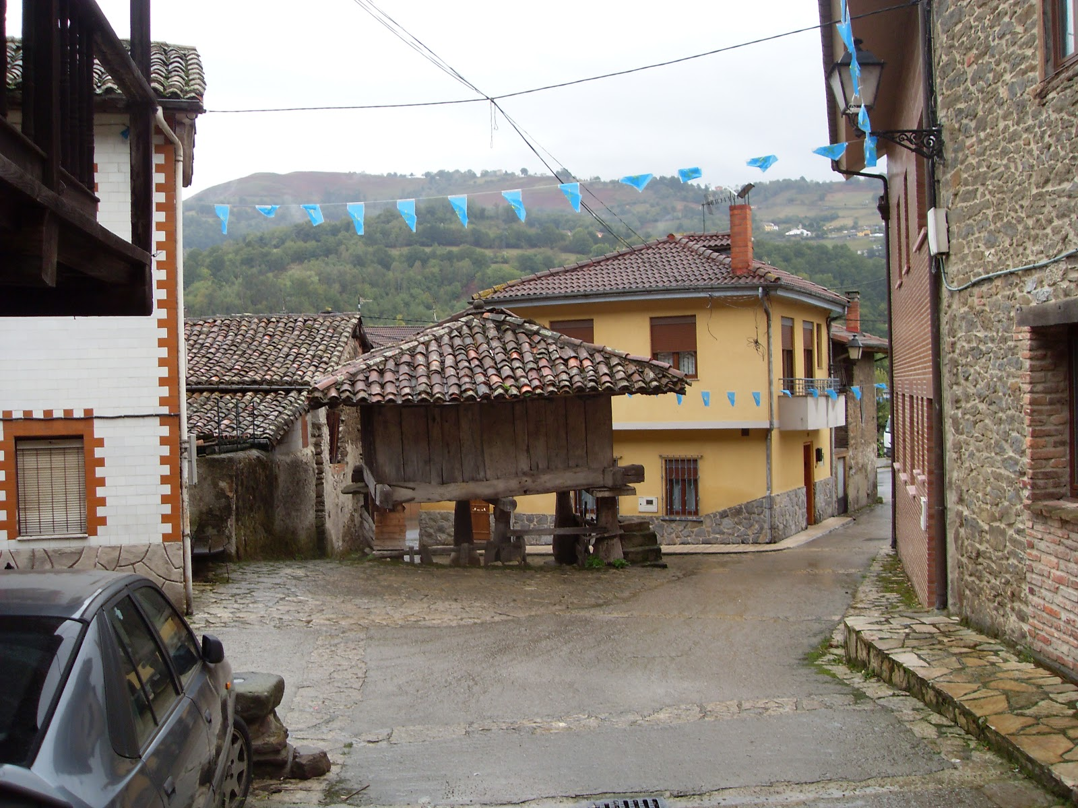
Hórreo

Slide 10
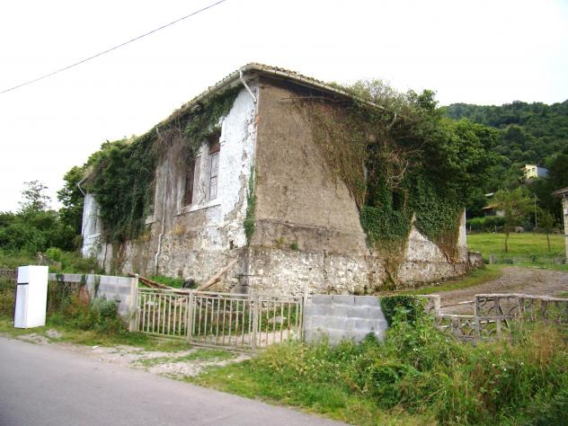
Old school

