Slide 1
Villoria

Slide 2
Villoria is a small village of Laviana in Asturias, Spain. It is a beautiful and quiet place. It has 1000 residents in its 30,9km² and it is a 340m high.

Slide 3
Some pictures of Villoria.

Slide 4
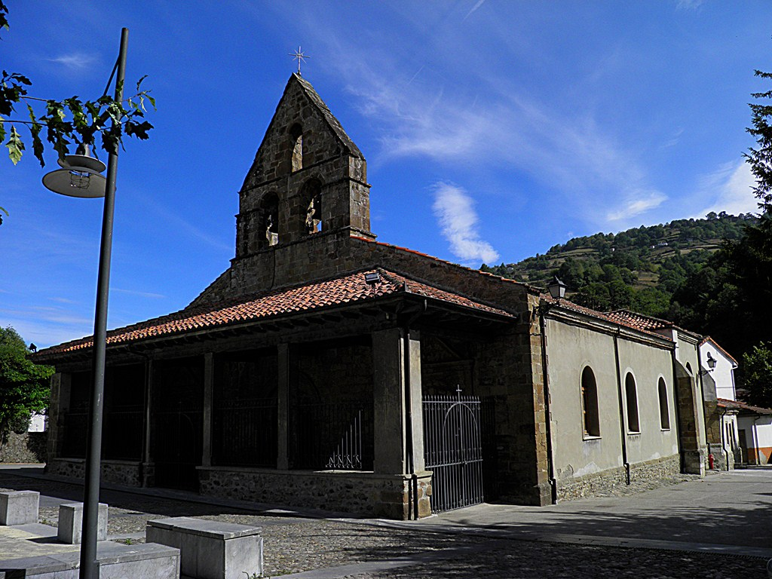

Slide 14
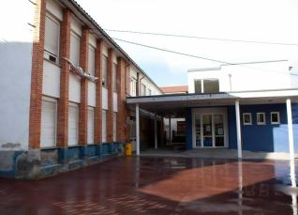
This is the school, it is very small and old.

