Slide 1
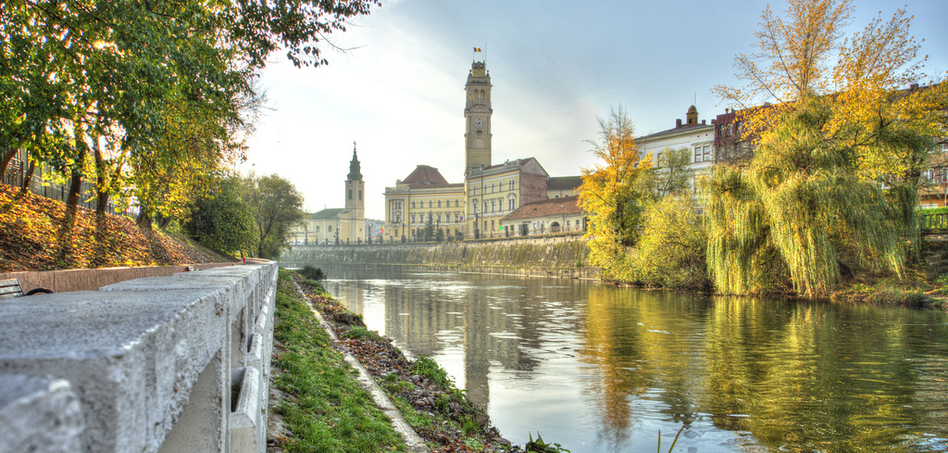
Oradea city
presentation made by
Denisa Tőrők - Romania

Slide 2
About Oradea:
Oradea is situated in the north-west of Romania, at about 10 kilometers from the western Romanian border with Hungary.
Oradea’s population is about 225.000 citizens.
The city is crossed by the "Crișul Repede" river.

Slide 3
There are lots of beautiful sights in Oradea :
The Fortress of Oradea
The Baroque Palace, formerly hosting the „Țării Crișurilor" Museum
The Church with Moon
The Roman-Catholic Cathedral
The „Black Eagle" Palace
The Central Library
The Theatre

Slide 4
History of Oradea:
Before the First World War in 1914-18 Oradea of today was part of Austria-
Hungary (the Austro-Hungarian Empire)
which was an agreement between the
Kingdoms of Austria and Hungary to run
their respective countries on a joint basis.
Oradea at this time was called Nagyvárad.

Slide 5
In the First World War the Austro-Hungarian Empire was an ally of the German Empire. Following their defeat in the War, the Austro-
Hungarian Empire was dissolved in October
1918. The Kingdom of Hungary was split up
under the Treaty of Trianon in 1920 and lost
most of its territory, including Nagyvárad
which now became Oradea Mare in the
Kingdom of Romania.

Slide 6
Romania started the Second World War as neutral, but in 1940 was forced under an agreement (mediated by Germany and Italy) to cede Northern Transylvania (including Oradea) to Hungary. Oradea became an integral part of Hungary and changed its name back to Nagyvárad.

Slide 7
Romania became an ally of Germany towards the end of 1940. However, in August 1944, following a coup, Romania joined with the Allies and together with the Soviet forces subsequently drove the Hungarian and German armies out of Transylvania. After the War, Northern Transylvania was again recognised as part of Romania. Nagyvárad became Oradea once again.

Slide 8
