Slide 1
RHODES

Slide 2
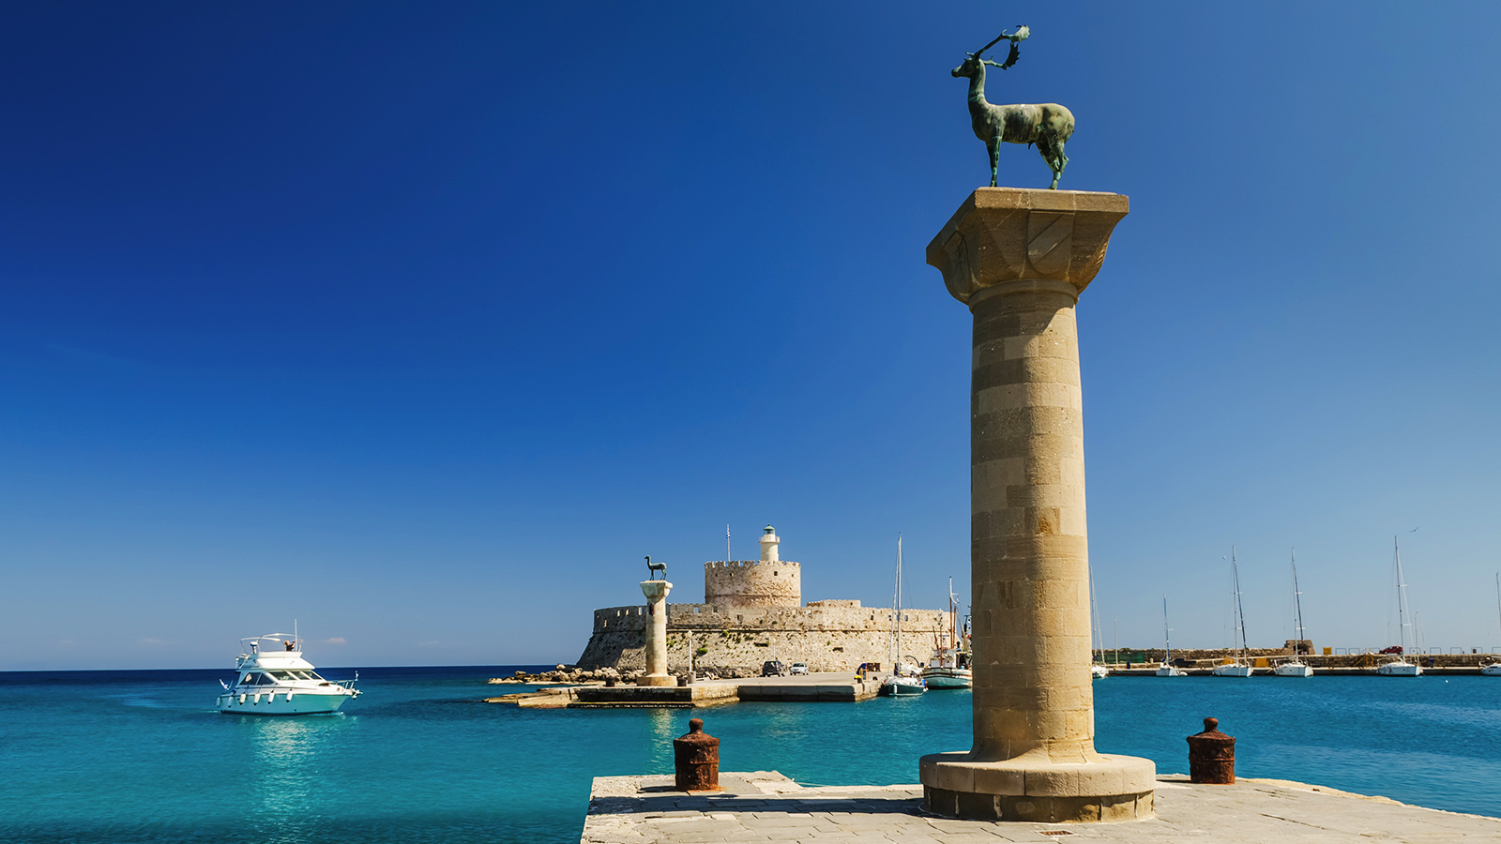
Rhodes is the largest of the
Dodecanese
islands and also the island group's historical capital.

Slide 3
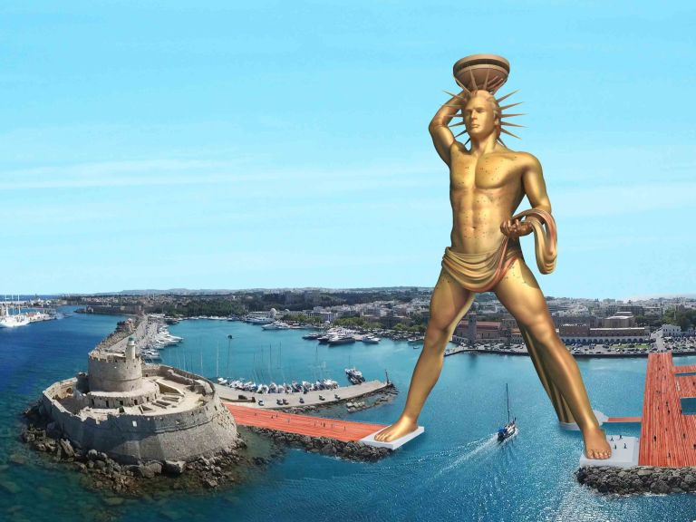
Historically, Rhodes was famous worldwide for the Colossus of Rhodes, one of the Seven Wonders of the Ancient World. The Medieval Old Town of the City of Rhodes has been declared a World Heritage Site. Today, it is one of the most popular tourist destinations in Europe.

Slide 4
The island of Rhodes is shaped like a spearhead, 79.7 km long and 38 km wide, with a total area of approximately 1,400 square kilometers and a coastline of approximately 220 km. The city of Rhodes is located at the northern tip of the island. It is the site of the ancient and modern commercial harbours. Diagoras International Airport is located 14 km to the southwest of the city. The road network radiates from the city along the east and west coasts.
Outside of the city of Rhodes, the island is dotted with small villages and spa resorts, among them Faliraki, Lindos, Kremasti, Haraki, Pefkos, Archangelos, Ixia, Afantou, Koskinou, Embona (Attavyros), Paradisi, and Trianta (Ialysos). There are mineral-rich spring waters (and sometimes sea water) which are used to give medicinal baths and the spa resorts offer various health treatments.
Rhodes is situated 363 km south-east from the Greek mainland, and 18 km from the southern shore of Turkey

Slide 5
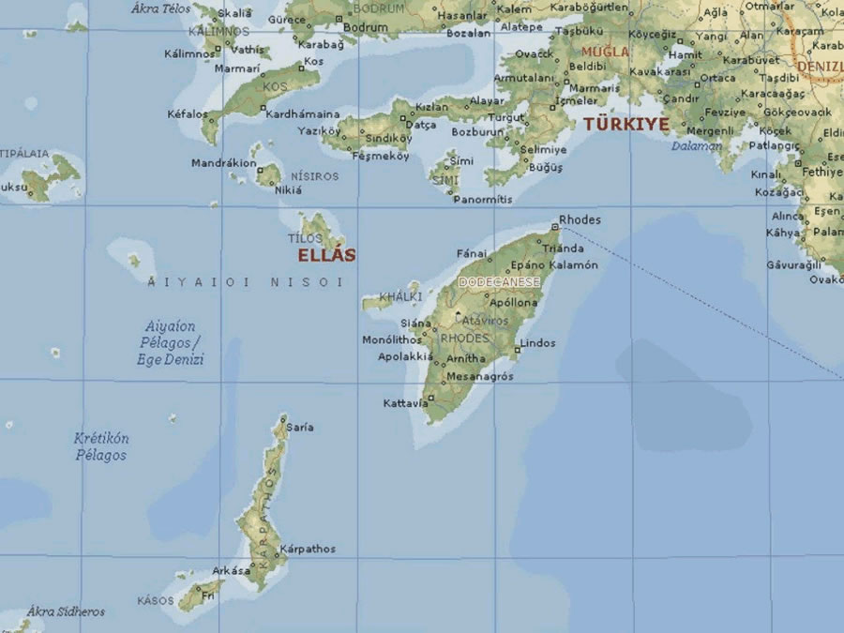

Slide 6
TOURISM
Rhodes is one of the most attractive tourist destinations in Greece. After Crete, it is the most visited destination in Greece, with arrivals standing at 1.785.305 in 2013. In 2014 they reached 1.931.005, while in 2015 the arrivals showed a small reduction and reached 1.901.000. The average length of stay is estimated at 8 days. Guests mostly come from Great Britain, Israel, France, Italy, Sweden and Norway. In Rhodes the supply of available rooms is high, since more than 550 hotels are operating in the island, the majority of which are 2 star hotels. Additionally, in terms of competitiveness, the World Tourism Organization ranks Greece in the 31st position globally.

Slide 7


Slide 8
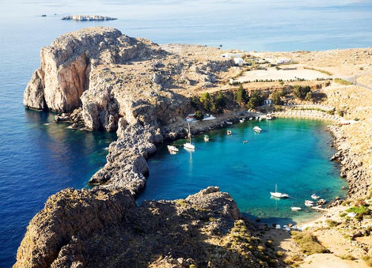
Rhodes has many beautiful beaches. In the next picture we see one of the best beaches, Agios Paulos

Slide 9
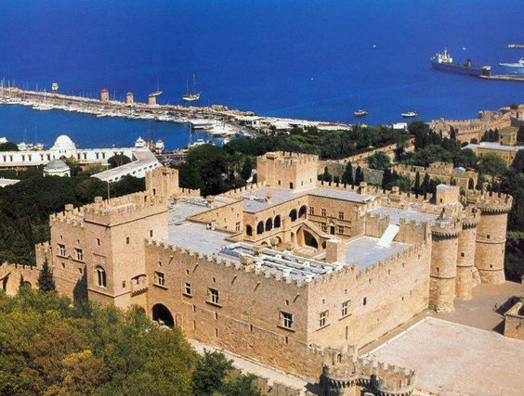
Historical sites on the island of Rhodes include the Acropolis of Lindos, the Acropolis of Rhodes with the Temple of Pythian Apollo and an ancient theatre and stadium,^{[35]} ancient Ialysos, ancient Kamiros, the Governor's Palace, Rhodes Old Town (walled medieval city), the Palace of the Grand Masters, Kahal Shalom Synagogue in the Jewish Quarter, the Archeological Museum, the ruins of the castle of Monolithos, the castle of Kritinia, St. Catherine Hospice and Rhodes Footbridge

Slide 10
THE END
PERDIKAKI DESPOINA
SPANOUDAKI VALSA

