Slide 1
POLA DE LAVIANA

Slide 2
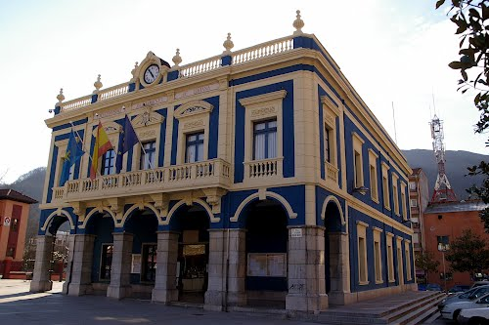
TOWN HALL

Slide 3
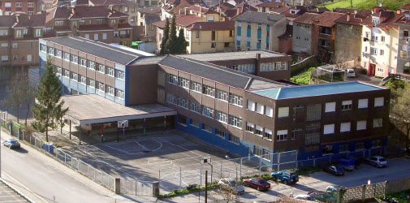
HIGH SCHOOL

Slide 4
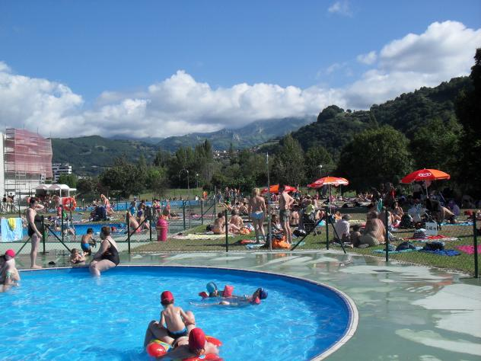
SWIMMING POOLS

Slide 5
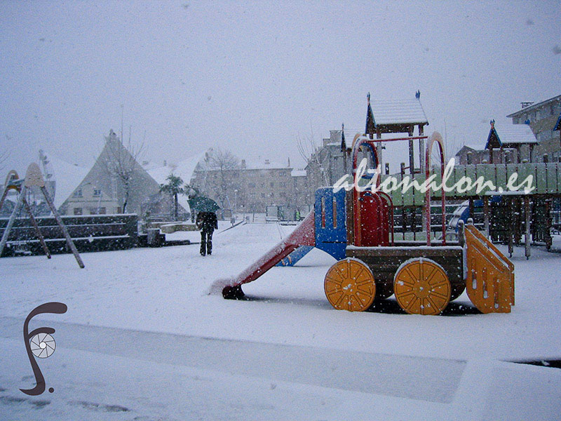
PARK

Slide 6
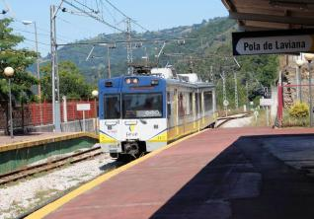
TRAIN STATION

Slide 7
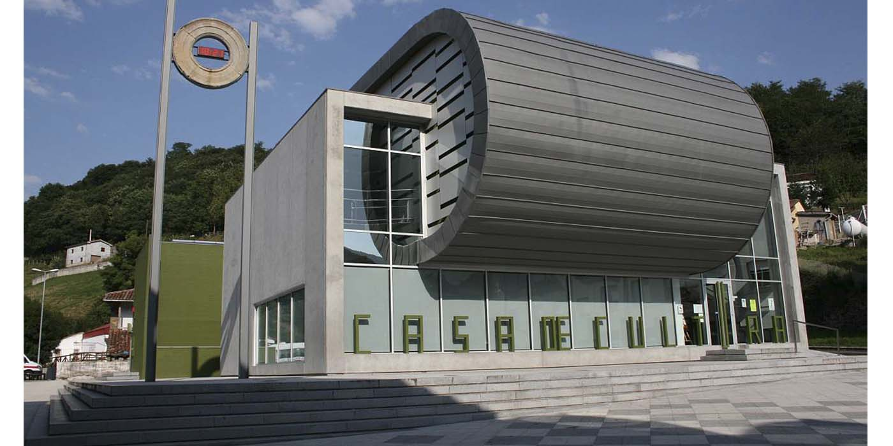
LIBRARY

Slide 8
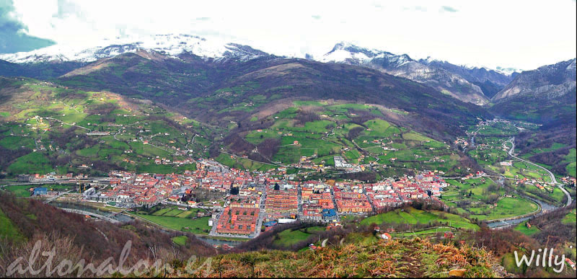
LANDSCAPE

