Slide 1
COLEGIUL TEHNIC TRAIAN VUIA ORADEA
Student: NICHITA CĂTĂLINA DAIANA
Grade: 10th C

Slide 2
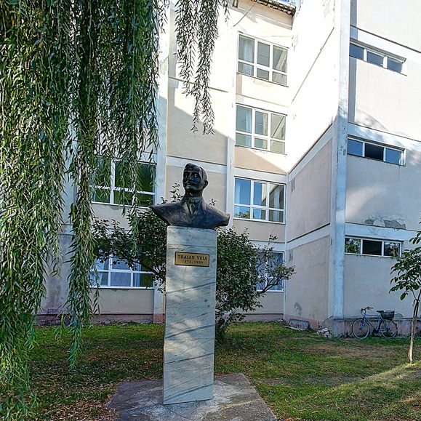
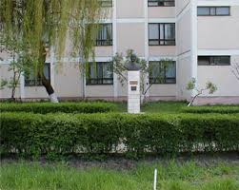
THE STATUE IN FRONT OF THE SCHOOL

Slide 3
SCHOOL LOGO AND MOTTO

Slide 4
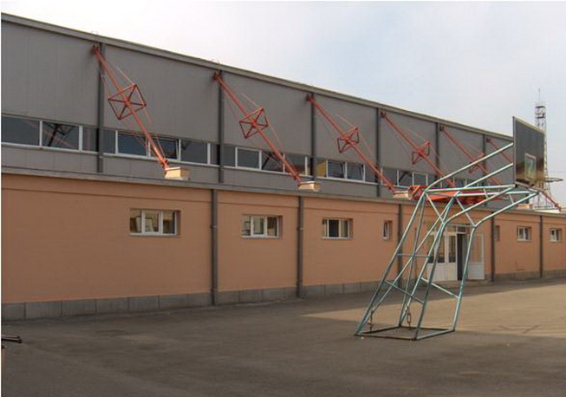
SPORTS HALL

Slide 5
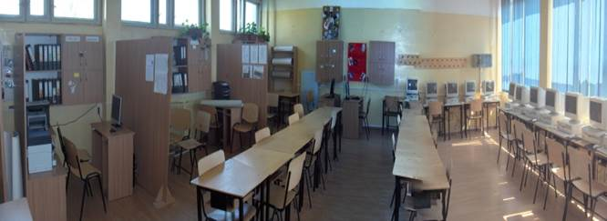
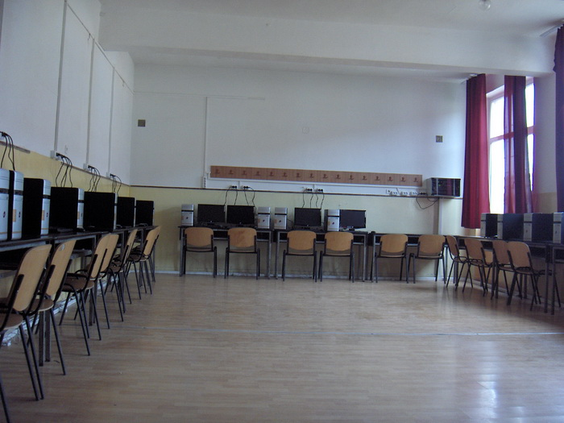
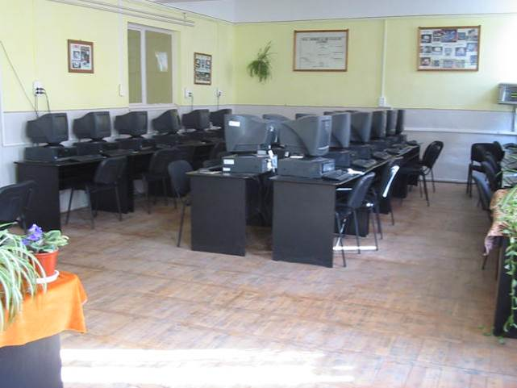
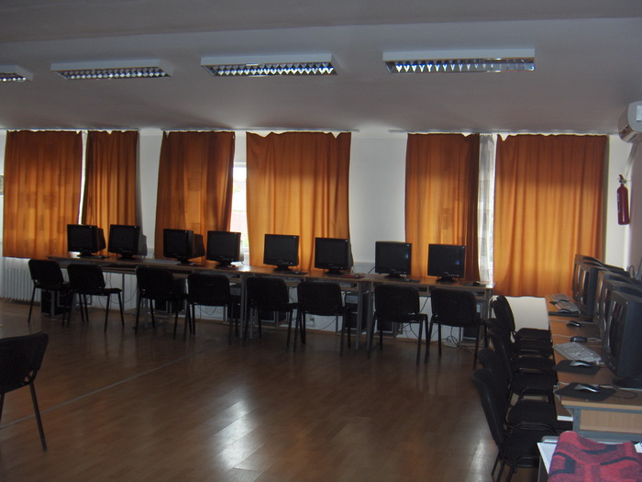
ICT AND TRAINING FIRMS LABS

Slide 6
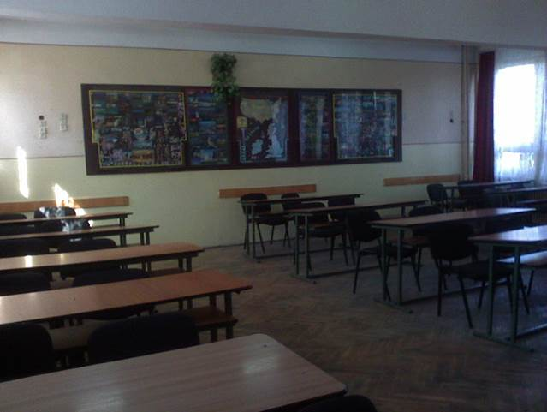
A CLASSROOM

Slide 7
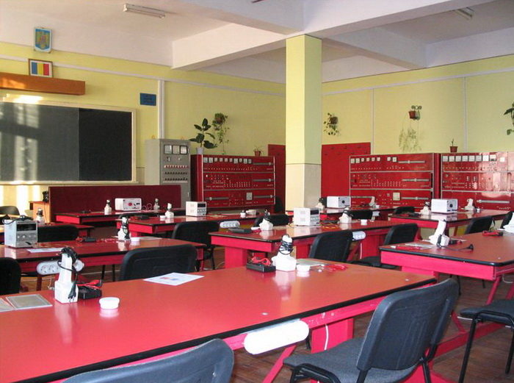
ELECTRONICS AND ELECTROTECHNICS LAB

Slide 8
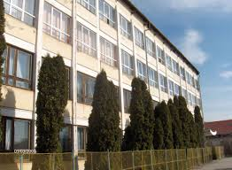
THE SCHOOL FROM THE SCHOOLYARD

Slide 9
THANK YOU FOR YOUR ATTENTION!

