Slide 1
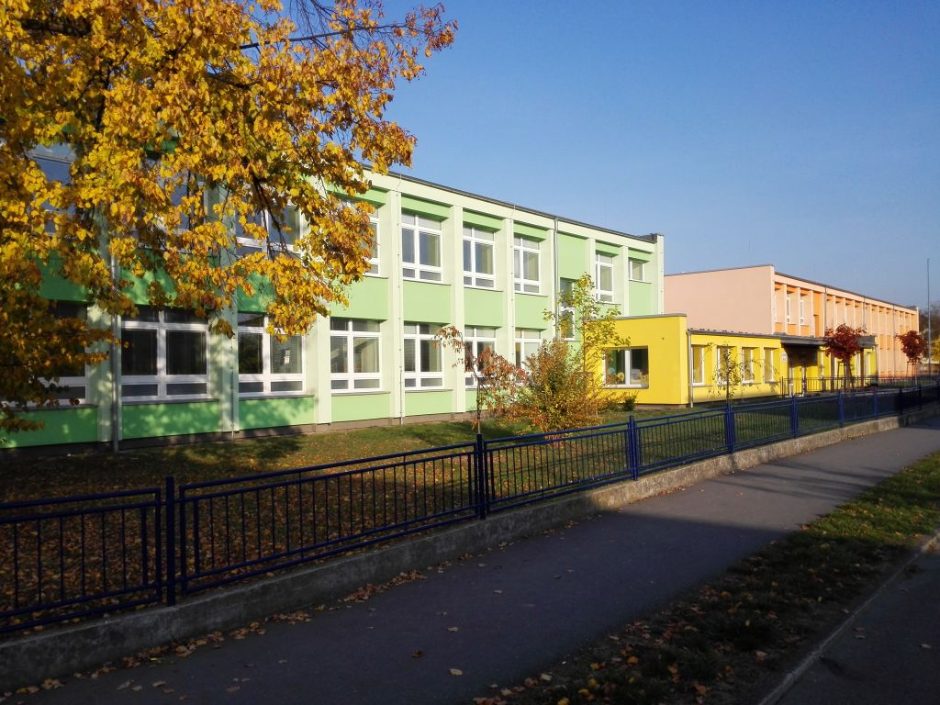
ZS HLUCIN HORNICKA
CZECH REPUBLIC

Slide 2
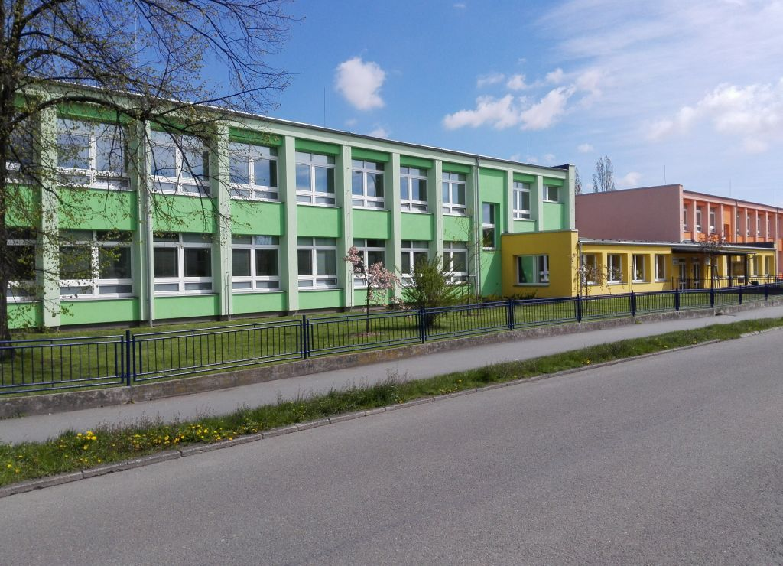
Hello, we’re students from Czech Republic and this is our school ;)

Slide 3
And this is the outdoor area of our school

Slide 4
Have a nice day!
We hope that we will become friends across eTwinning and we will have fun together ☺


