Slide 1
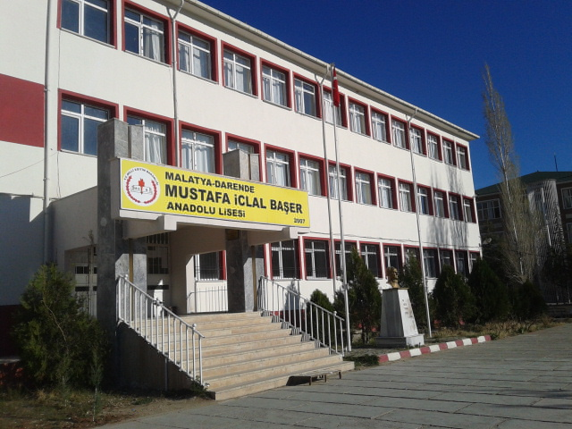
MUSTAFA İCLAL BAŞER ANADOLU LİSESİ

Slide 2
Mustafa İclal Başer Anatolia U.School 280 students.

Slide 3
Our school’s foundation date is 2007.

Slide 4
University excitement starts. Entrance word of same universities.

Slide 5
Nevzat Yüksek is deputy magger of our school.

Slide 6
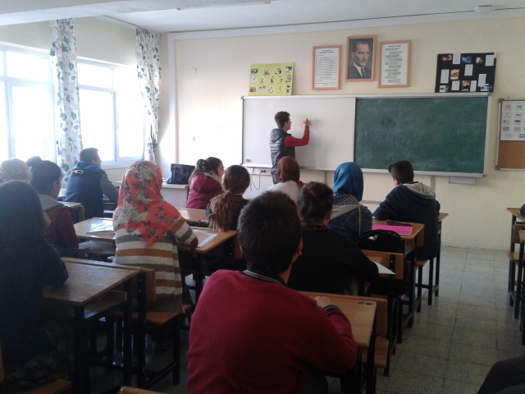
Our class is the craziest but hardworking class.

Slide 7
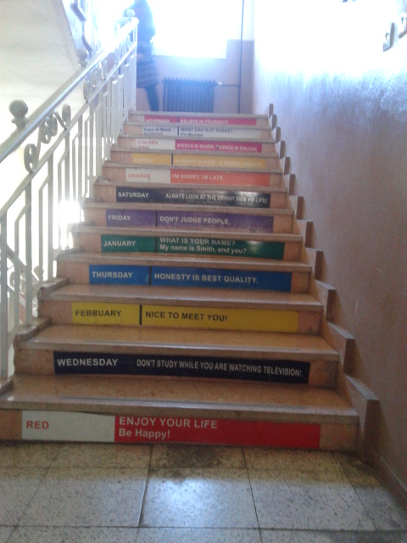
Our Analotiz Malatya Project.

Slide 8
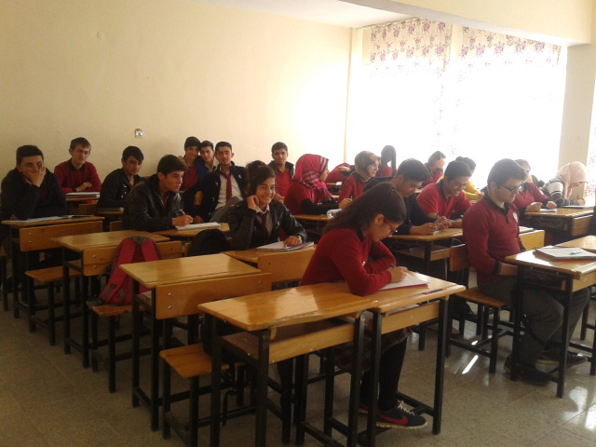
11\A Social Class

Slide 9
Our school Librariy.

Slide 10
Teachers room and teachers.

Slide 11
Principle Mustafa Delier.

Slide 12
12\B class

Slide 13
Our adsiver teacher Arzu Özkan.

Slide 14
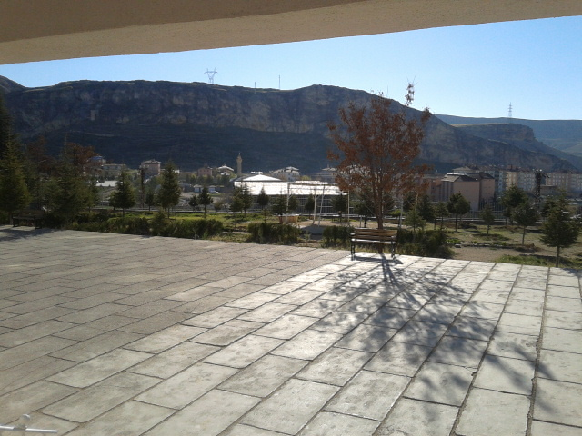
Our small but lovely garden.

Slide 15
Hazırlayan:Utku Can EROL
Thank you…. ☺ ☺

