Slide 1
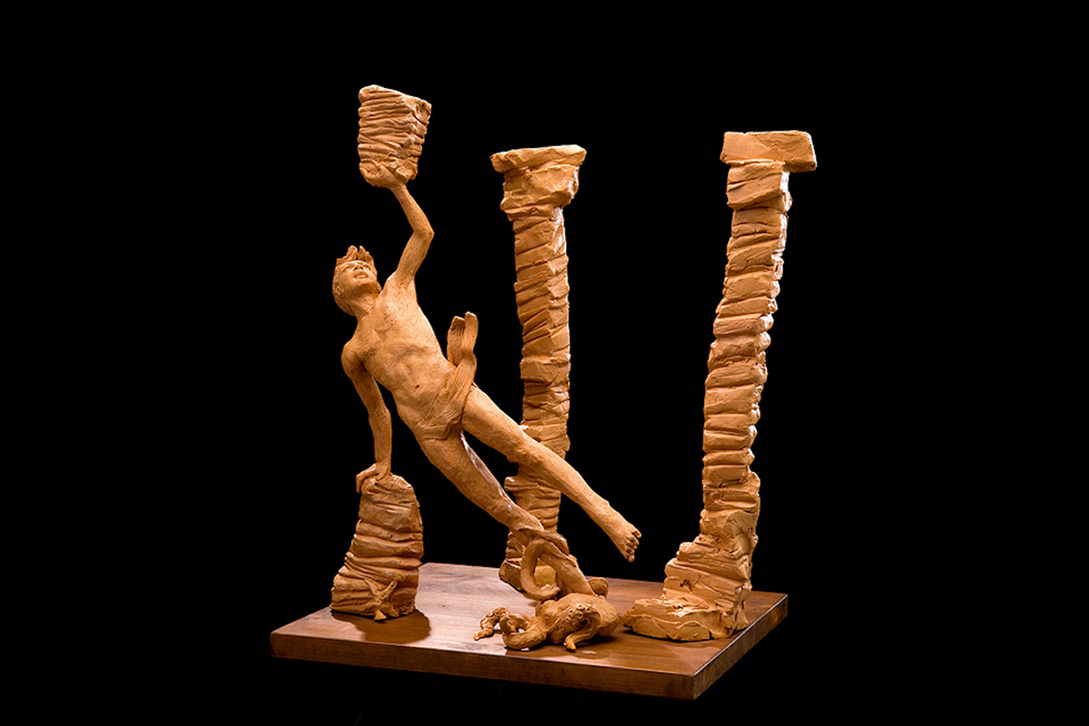
C
O
L
A
P
E
S
C
E
L
E
G
E
N
D

Slide 2
Cola loved the sea…
…and he spent his days swimming and diving

Slide 3
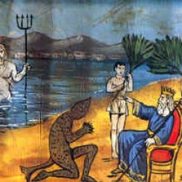
Federico II king of Sicily asks to Colapesce to have a look in the deepest sea to find out
what can hold the the sicilian island up

Slide 4
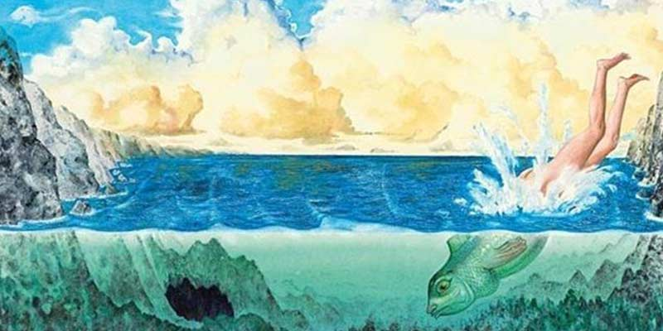
« Sicily is hold up by three columns…
…but one of them has been damaged by a magic fire»

Slide 5
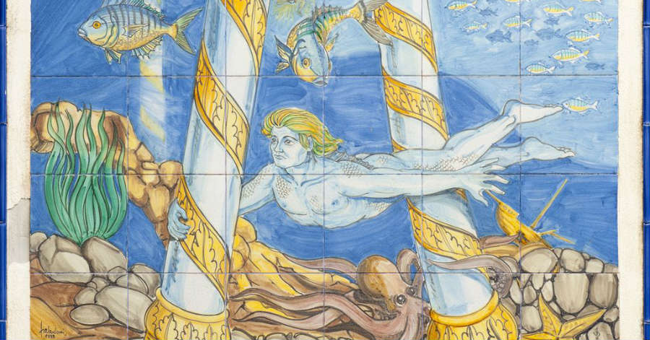
Everybody said that Colapesce had become half man and half fish…
…and had remained under the sea helping the third column to remain stable

