Slide 1
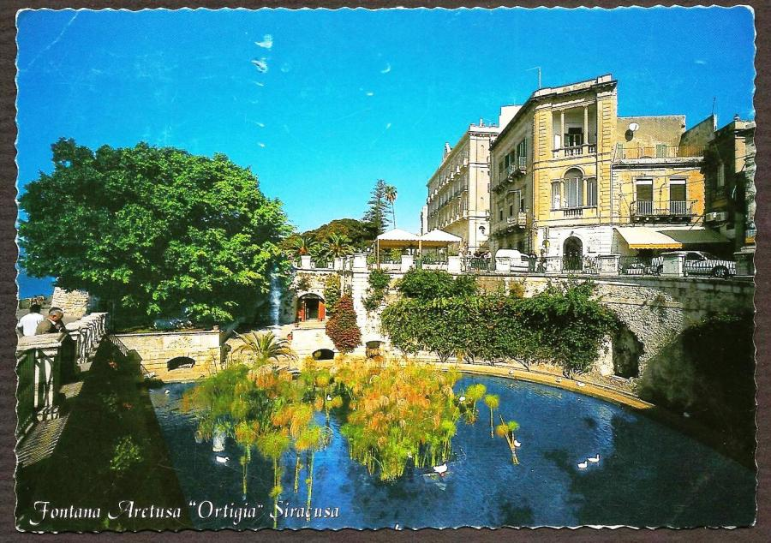
THE LEGEND OF ARETHUSA

Slide 2
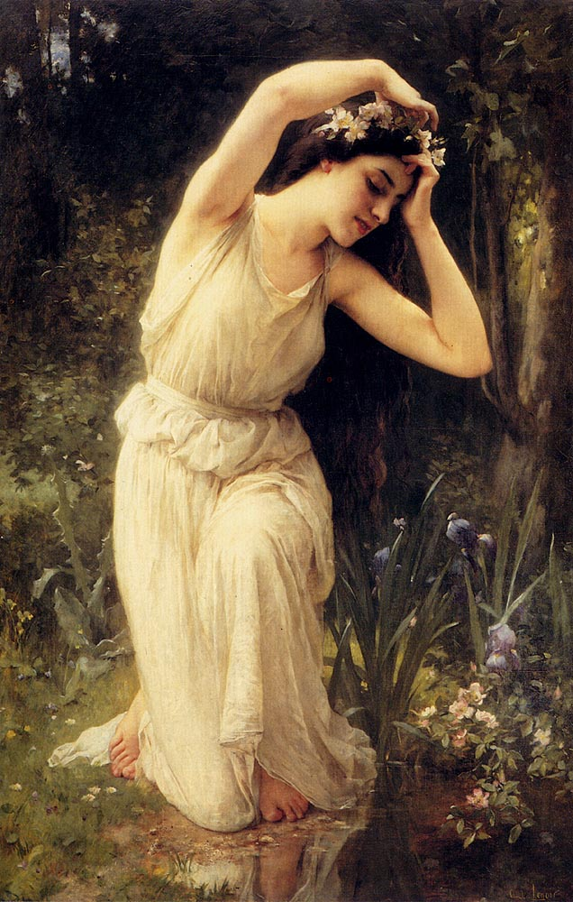
Arethusa was a nymph, daughter of Nereus and Doris, who had sworn her allegiance and chastity to the goddess of the hunt, Artemis.

Slide 3
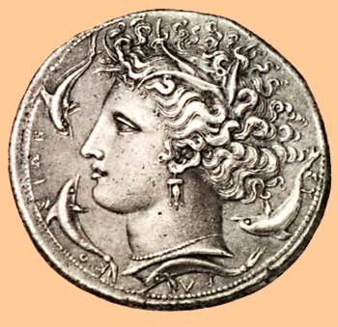

Slide 4
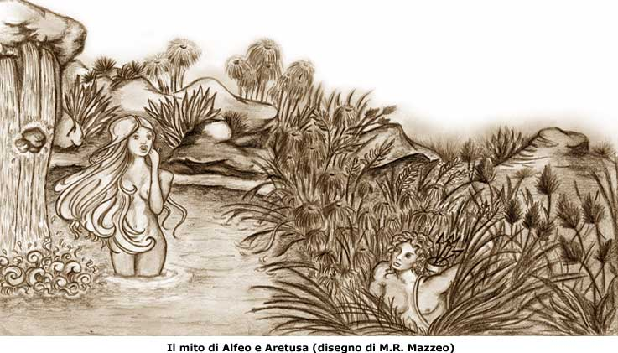
One day while running in the forest in Greece, Arethusa decided to take a refreshing swim in a stream. While in the water, she felt something move around her, it was the river god Alpheus who looked at her in love.

Slide 5
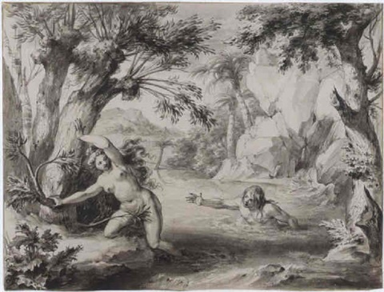
Arethusa was scared and ran away. Alpheus followed her and she running and escaping from him, began to get tired.

Slide 6
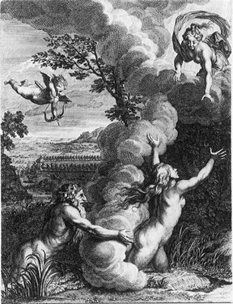
So Arethusa asked for help to Artemis who at first enveloped her in a cloud, hidden from Alpheus.

Slide 7
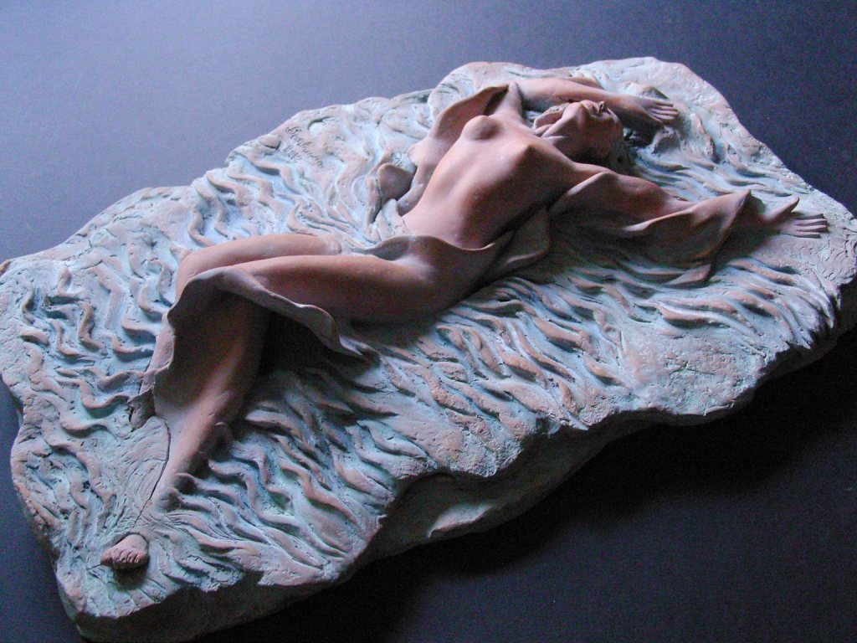
Then Artemis turned her into a source and took her in the island of Ortygia, of the Sicilian city of Syracuse.

Slide 8
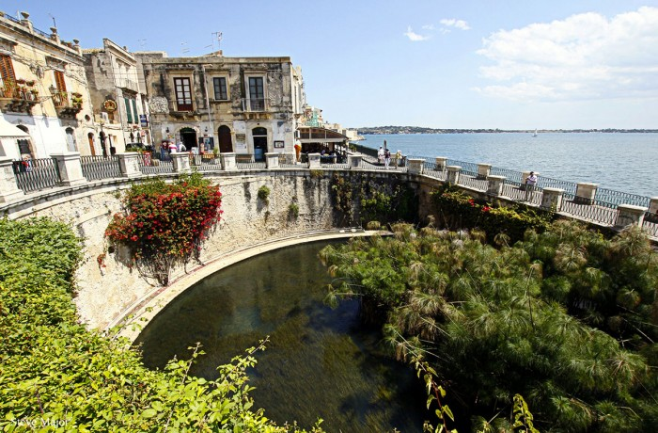

Slide 9
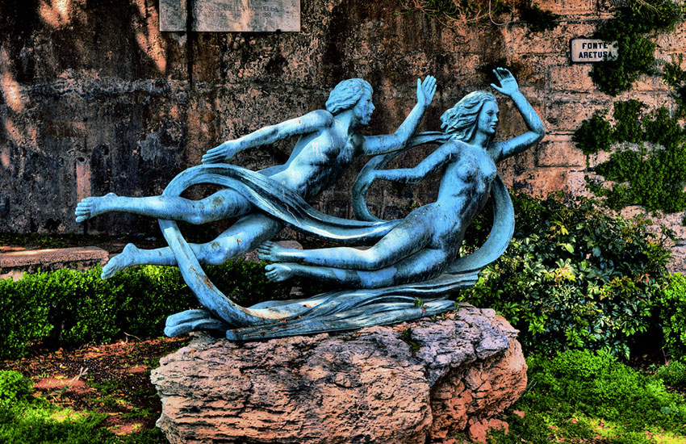
Alpheus turned himself into a river and he dug an underground channel from Greece under the Ionian Sea to Sicily…

Slide 10
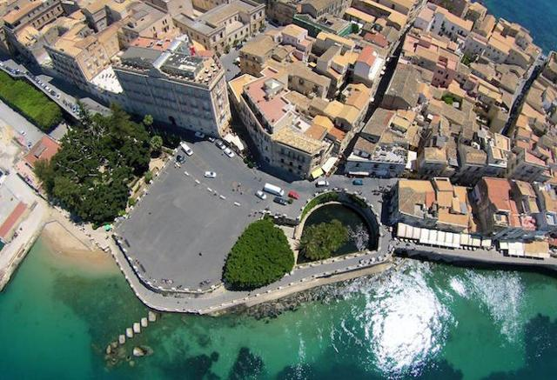
…and rejoined his lover mixing its waters with those of the Arethusa source.

Slide 11
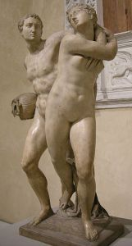

Slide 12
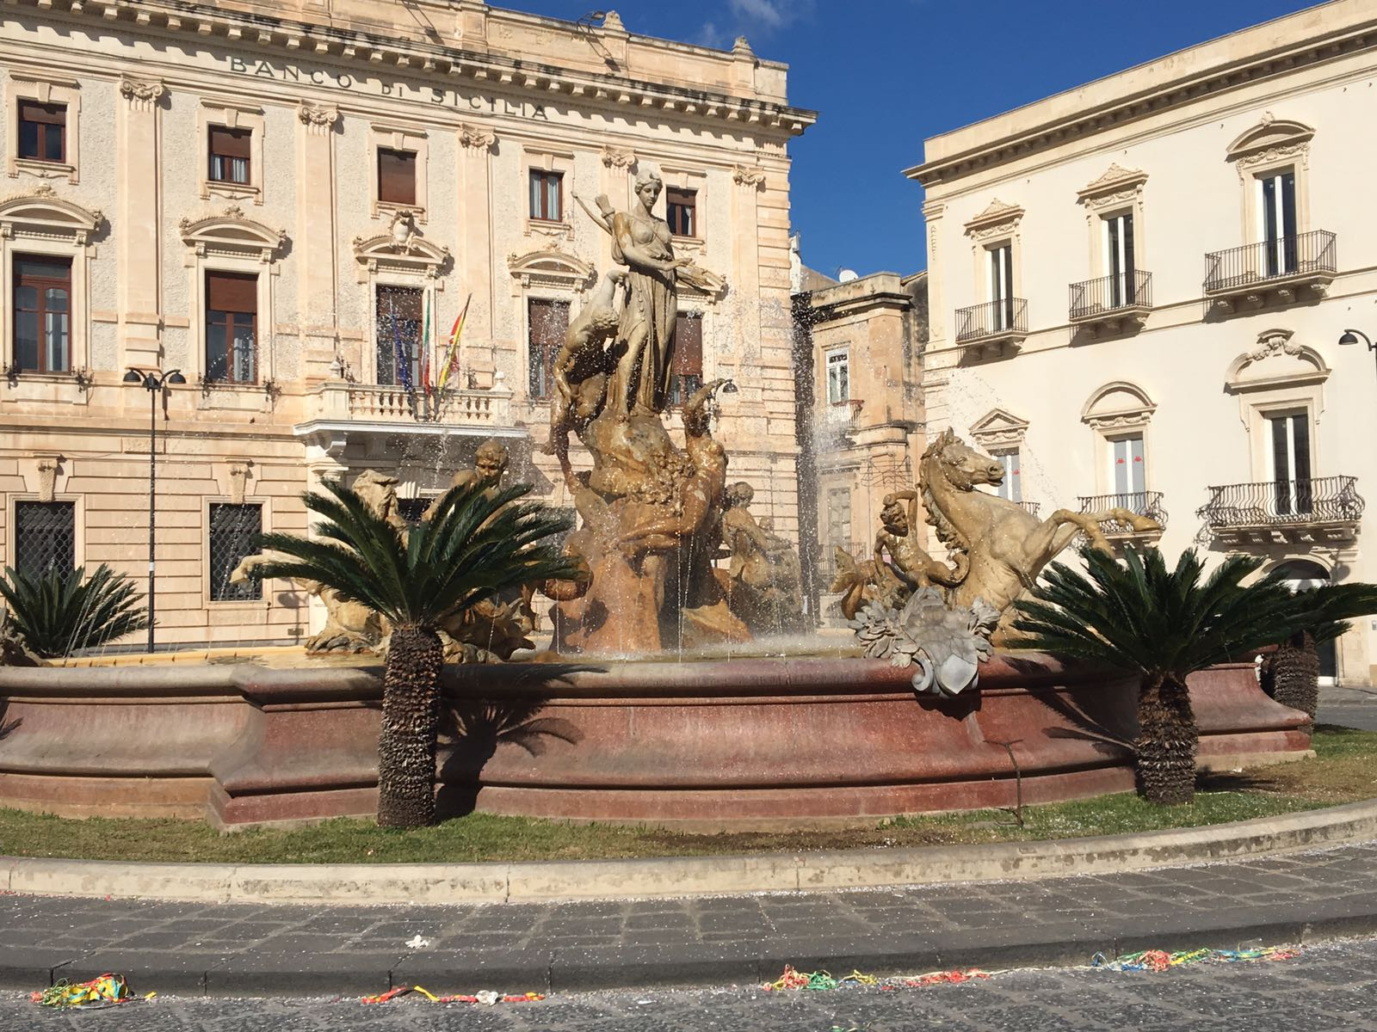
THE FOUNTAIN OF DIANA,
SYRACUSE

Slide 13
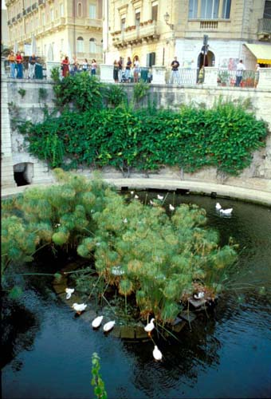
In the center of the Arethusa source, the papyrus plant grows…
In Sicily this source is also called «a funtana re papiri»

Slide 14
Francesca Mercante 3Q

