Slide 1
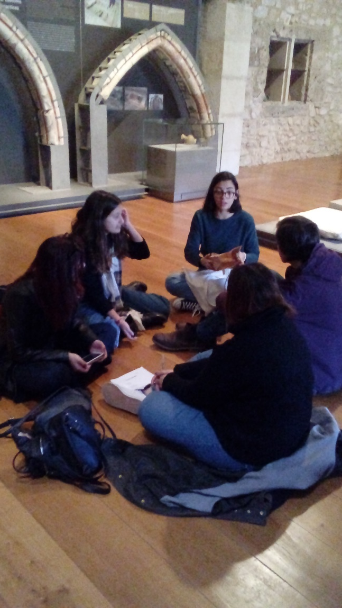
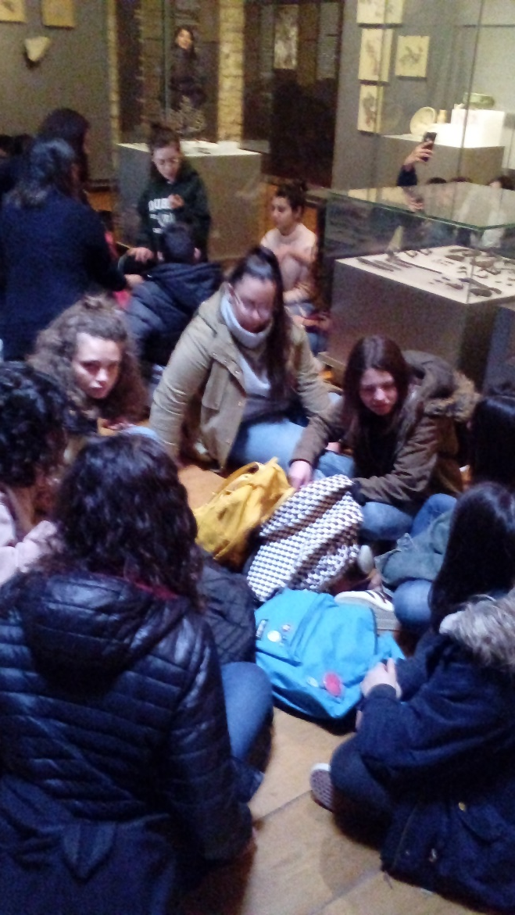
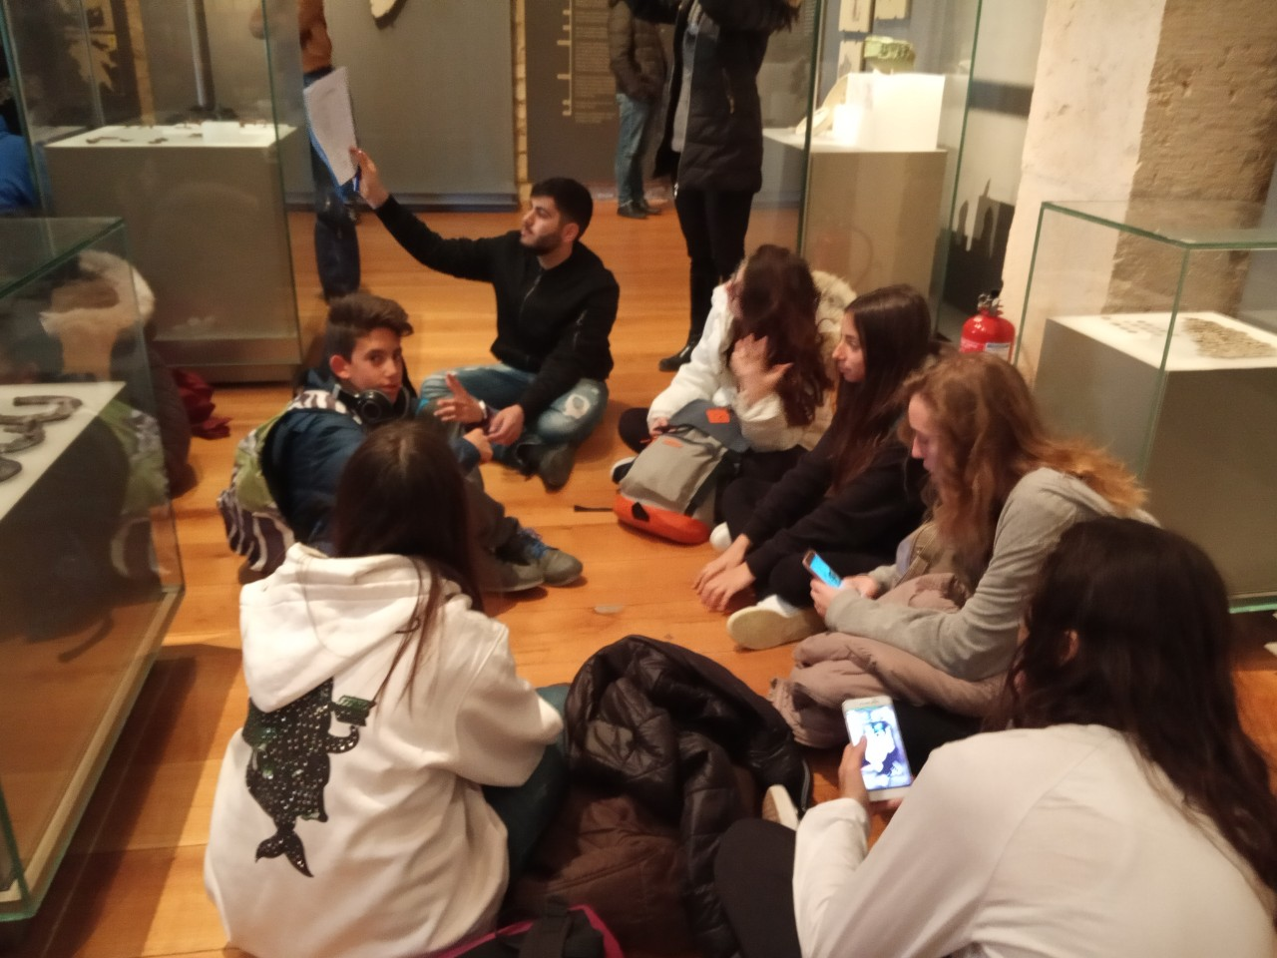
Creating acrostic poems in Chlemoutsi’s Castle Museum

Slide 2
Day by day
Ocean will show the way
Listen to the sound that it makes
Perfect waves, perfect sounds
How could we just ignore them
In the light or in the dark
Never forget its mark

Slide 3
Many people like music
Each kind of music
Rap, rock, classic and pop
Music connects people
All of us are
In love with music
Dance and singing

Slide 4
Pleased with the sound
Of Apollos Lyra
Swimming around
Everything feels right
Imagining the waves
Do I deserve this at all?
Or is this a dream?
Nothing really matters anymore…

Slide 5
Dreaming is like singing: everyone can do it
Of course you have to practice
Like swimming, singing is relaxing
People always say singing is easy
Hope, love and peace
Is everything you need
Never forget it

Slide 6
Music connects nations
Ends wars and
Removes hate
Music is salvation for
A lot of people with
Imagination and cooperation and we
Die with music

