Slide 2
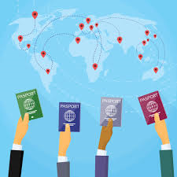
IMMIGRATION
TRUE STORIES OF IMMIGRANTS

Slide 3
People immigrate due to:
War
Better jobs & better future
(better life quality)
Economical crisis

Slide 4
We interviewed people who have experienced immigration and we will present their stories…

Slide 5
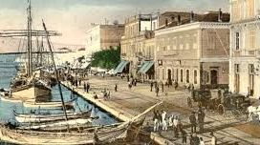
The story of Filaretos Ioannidis
Grandfather of our music teacher, Chrysanthi Ioannidou

Slide 6
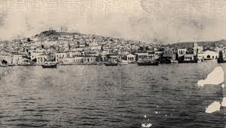
Filaretos Ioannidis was born in Antalya, Minor Asia, a man of Greek origin.
He was a landowner and had Turkish workers.
In 1922 he was forced to leave his home due to war.

Slide 7
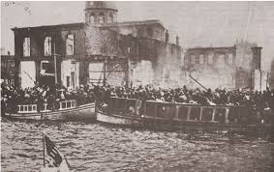
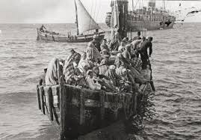
He moved to Greece with his wife and took almost none of his belongings with him.
He and his wife were lucky enough to get on a boat and save themselves, while at the same time other people lost their lives trying to get on a boat.

Slide 8
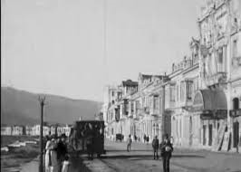
In Greece, he first went to Larisa where he managed to open a mini market and there he and his wife had 4 children.
Later he moved to Athens where he bought land.

Slide 9
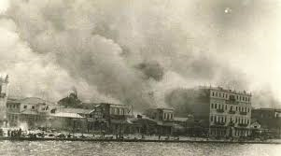
At first, he didn’t feel very well since for Greek people he was Turkish and for Turkish people he was Greek. As time went by he was integrated and after that he lived a completely normal life.
He always wanted to go back to Minor Asia, but he never managed to.

Slide 10
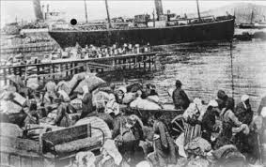
Due to his nostalgia for his homeland, he and his wife kept alive the customs and the culture of Minor Asia.
Mrs Chrysanthi remembers that as a kid she enjoyed the different food her grandma cooked, such as imam ballydi and syrupy orange.

Slide 11
Filaretos Ioannidis is no longer with us, but his grand-daughter remembers that every time he told his story he cried.

Slide 12
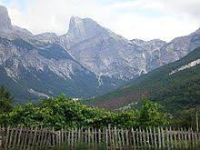
The story of Gjergji Sulaj
father of our 3rd grade student, Alda Sulaj

Slide 13
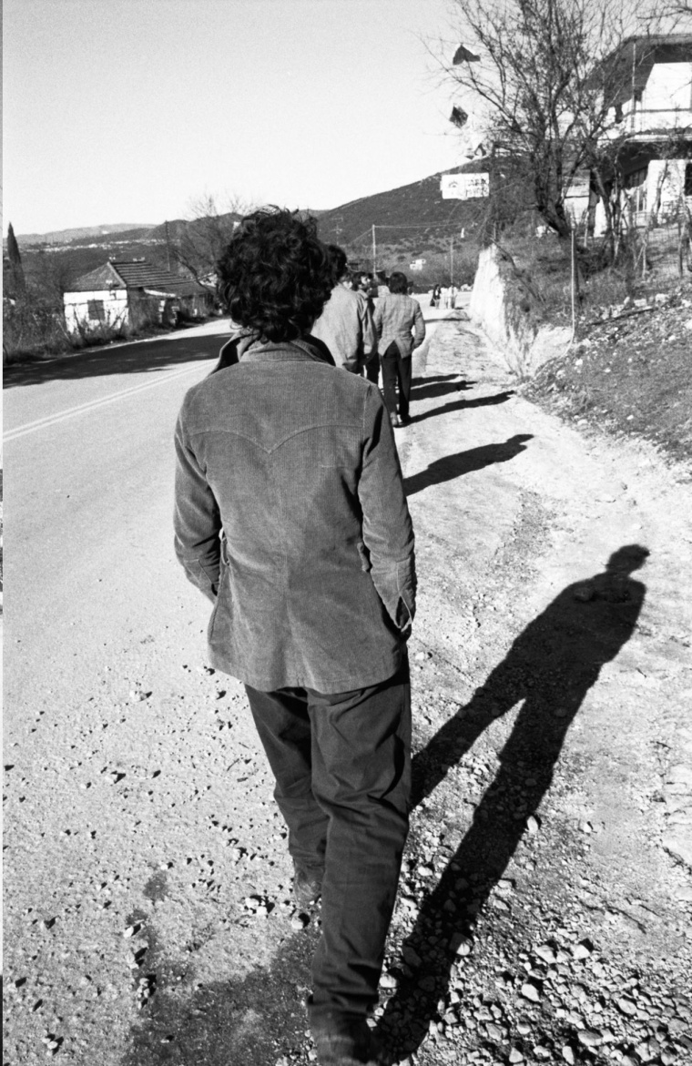
Gjergji was born in Albania .
He moved to Greece in 1990 when he was only 15.
He wanted to have a better future because Albania suffered from economical crisis.

Slide 14
He went to Greece on foot, with some of his friends.
He was very sad when he left his family and very stressed and frightened because he moved to a foreign country.

Slide 15
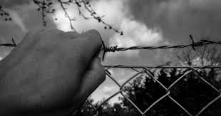
He faced many problems at first since he did not know the Greek language.
He could not go to school because he did not have any legal documents with him.
However, Greek people helped him and he managed to adjust to his new life.

Slide 16
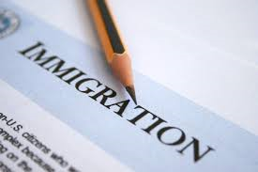
He went back home whenever he could and he helped his family there, giving money.
He felt safe and happy in his new country since Greek people treated him with respect and love.

Slide 17
This is why he had his family in Greece and decided to live there but he did not forget his home country. Therefore, he teaches his children Albanian customs and culture.

Slide 18
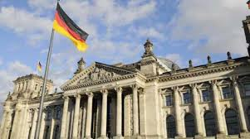
The story of Gerasimos Tarnavas
Uncle of our student, Heliana Tsagri

Slide 19
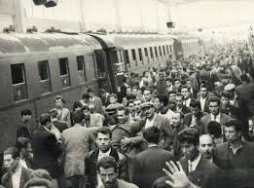
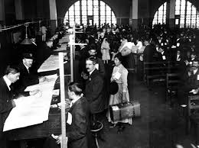
He was born in Greece but when he was 36 he moved to Germany because he wanted to find a better job.
At first things were a bit difficult but he managed to adjust perfectly well when he learnt the language.

Slide 20
German people welcomed him there and helped him.
He lived there for 18 years and only then went back to Greece for just once.

Slide 21
Gerasimos still lives in Germany. He feels that Germany is now his country but he always remembers Greece.

Slide 22
Team Members
Lykou Sophia
Sulaj Alda
Abelogianni Aggeliki
Tsagri Helianna
Boyzi Dimitra

Slide 23
The End

