Slide 1
Take a step forward
Civil workshop against social discriminations and xenophobia

Slide 2
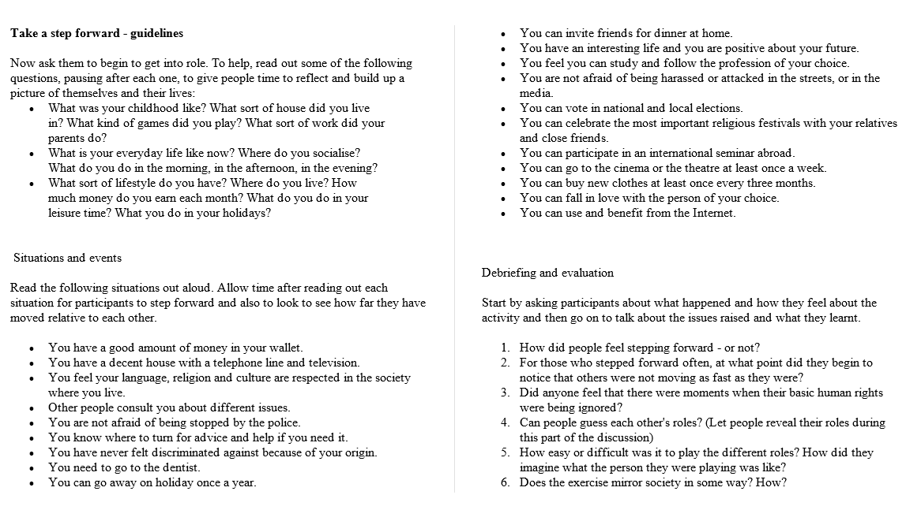

Slide 3
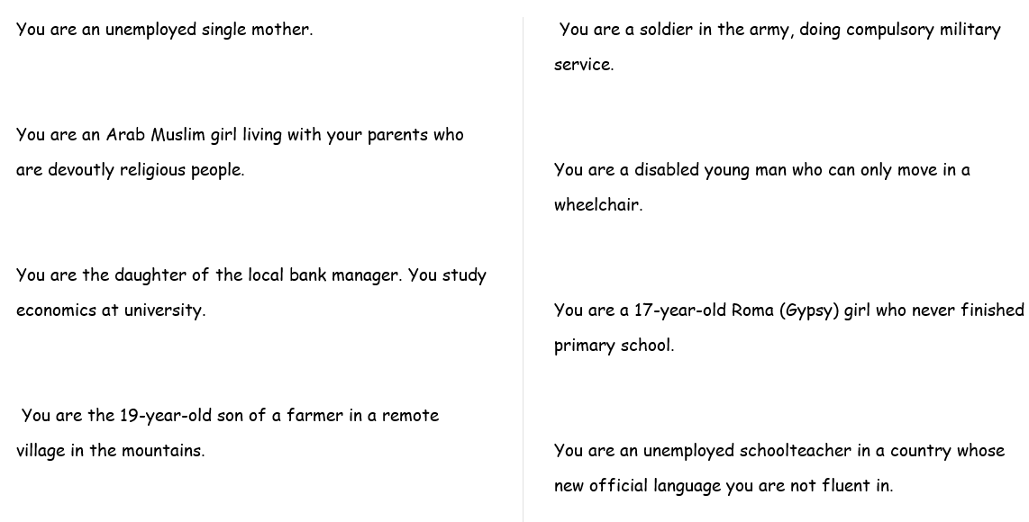
The roles…

Slide 4
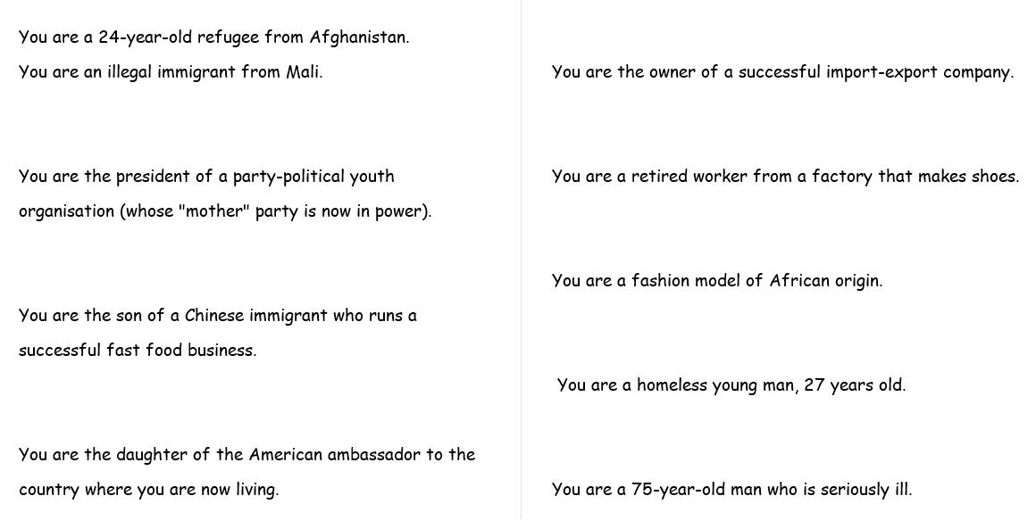
More roles…

Slide 5
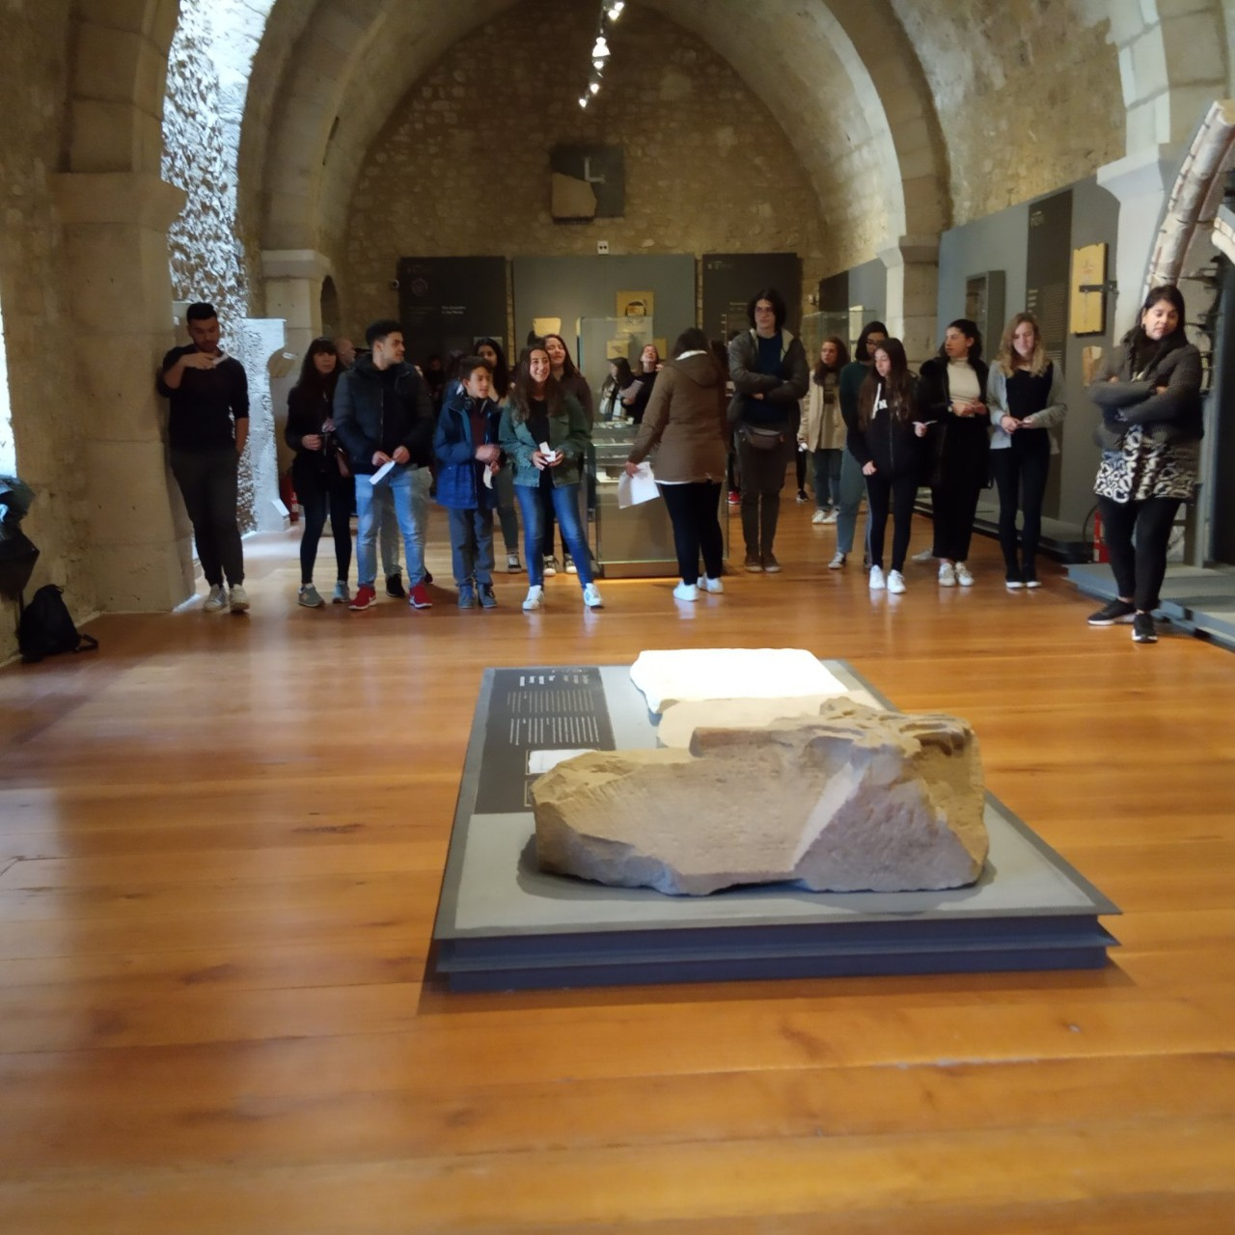

Slide 6
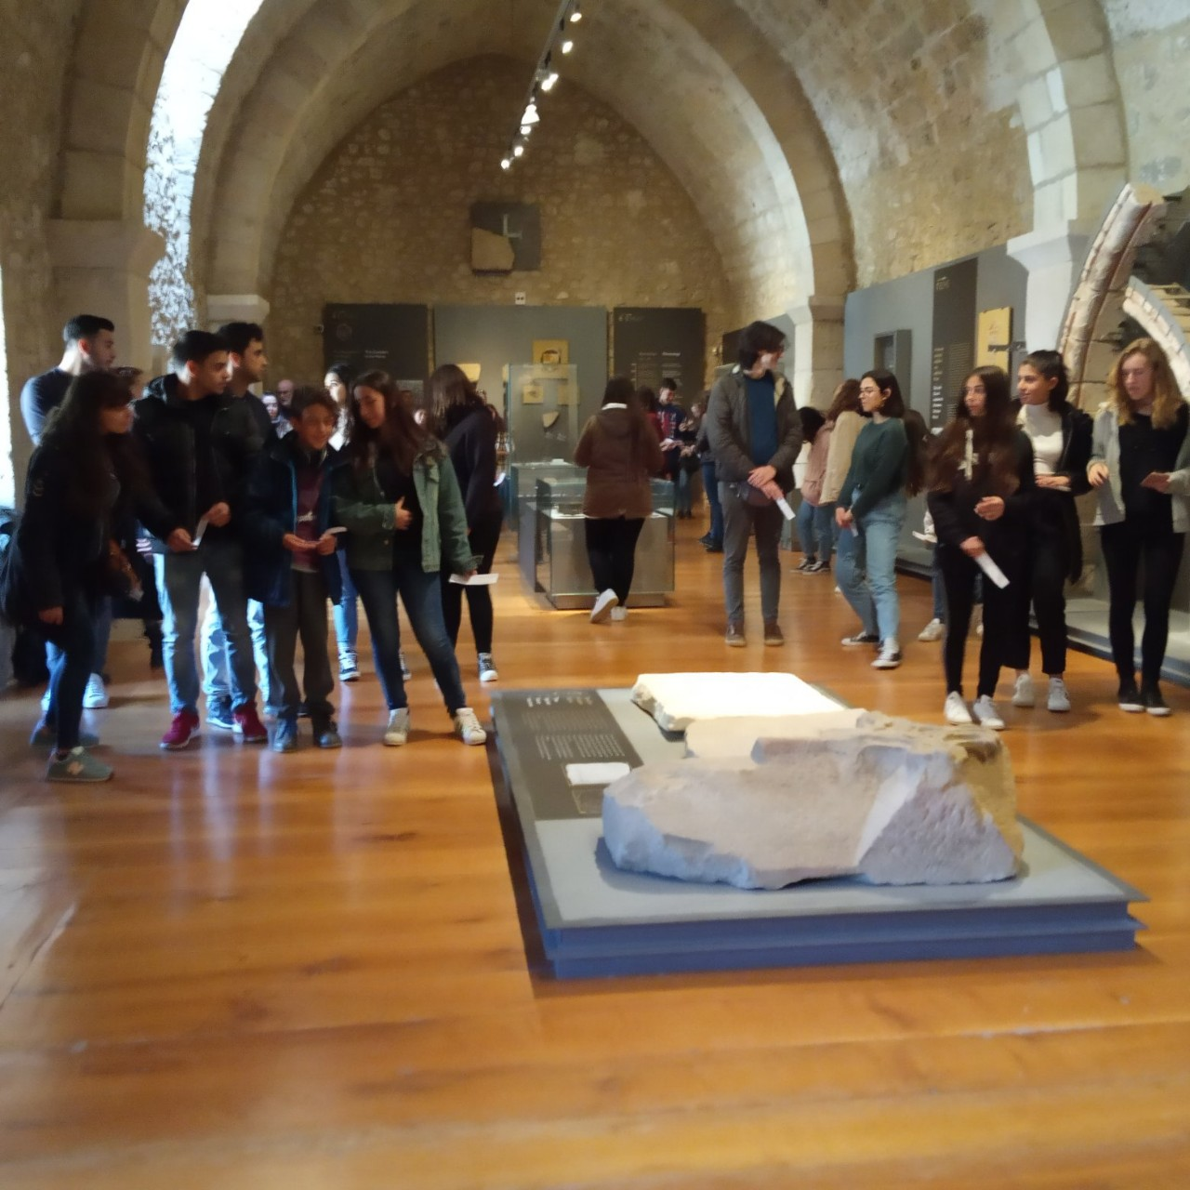

Slide 7
