Slide 1
THE MYTH OF Scylla and Charybdis

Slide 2
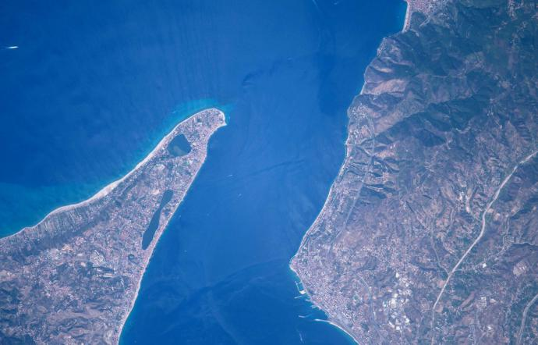
Scylla and Charybdis lived on two rocks facing each other on the two opposite banks of the Strait of Messina.

Slide 3
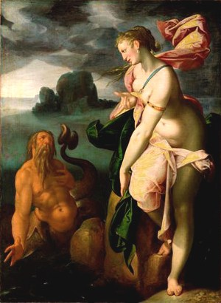
Scylla was originally a nymph. Glauco had fallen in love with her, even refusing the love of the sorceress Circe, who turned Scilla into a six-headed monster who ate all the passers-by on the sea

Slide 4
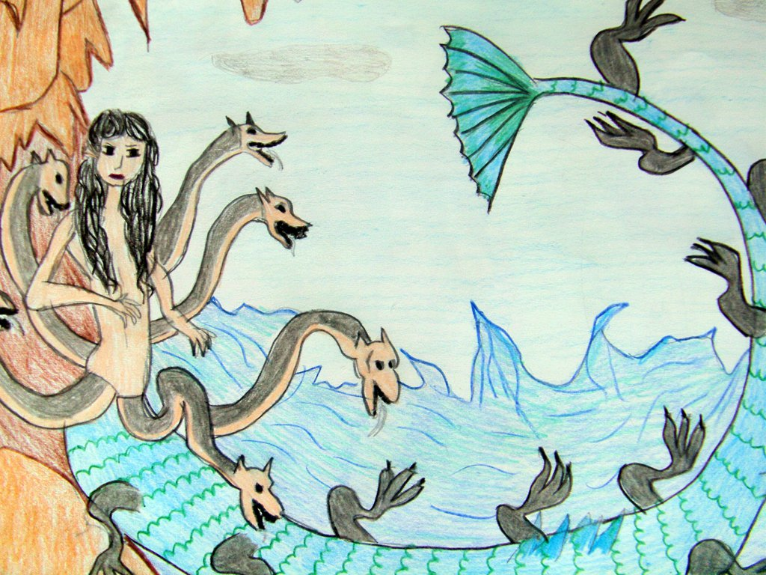

Slide 5
Charybdis was a greedy and hungry girl, who didn't care too much about what she ate ... one day she stole the oxen out of Heracles and as a punishment she was transformed by Zeus into a monster that absorbed and rejected three times a day the sea waves drinking together with water all the ships passed over the sea.

Slide 6
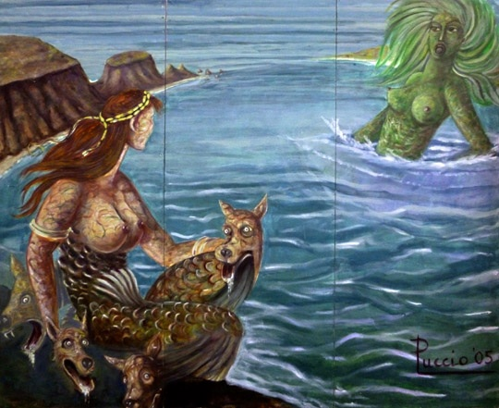

Slide 7
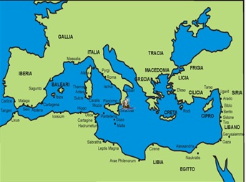
Ulysses and his companions during the Odyssey had to cross the strait of Messina tight and swirling between Scylla and Charybdis, so after passing Charybdis and lost 6 men in the jaws of Scylla, they arrived in Sicily.

Slide 8
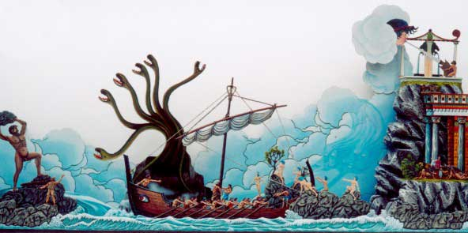

Slide 9
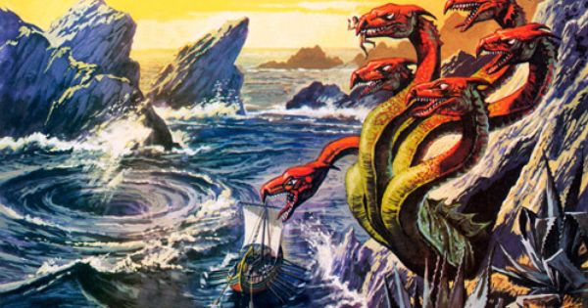

Slide 10
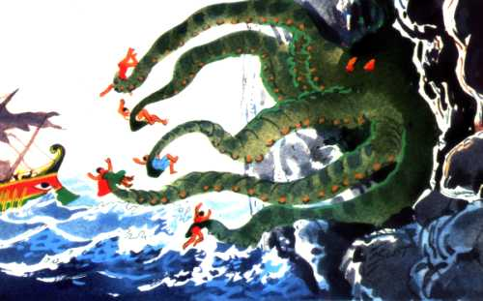

Slide 11
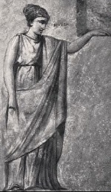
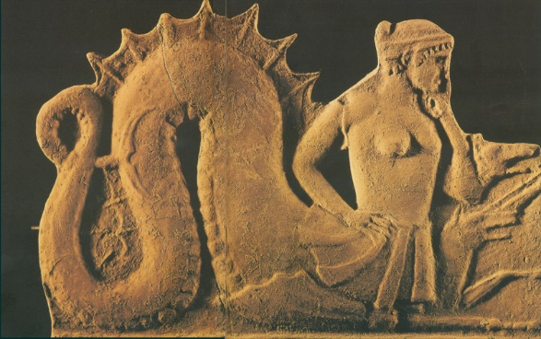
Some sculptural representation of Scylla and Charybdys
that you can find in Sicily, in Greek and in Calabria
Scylla
Mural painting
III sec. a.C.

Slide 12
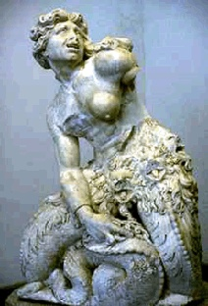
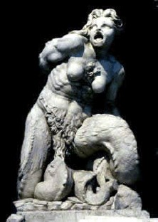
Scylla Giovanni Angelo Montorsoli, (1507 -1563) National Museum, Messina (Sicilia)
Charybdis Giovanni Angelo Montorsoli (1507 -1563), National Museum, Messina (Sicilia)

Slide 13
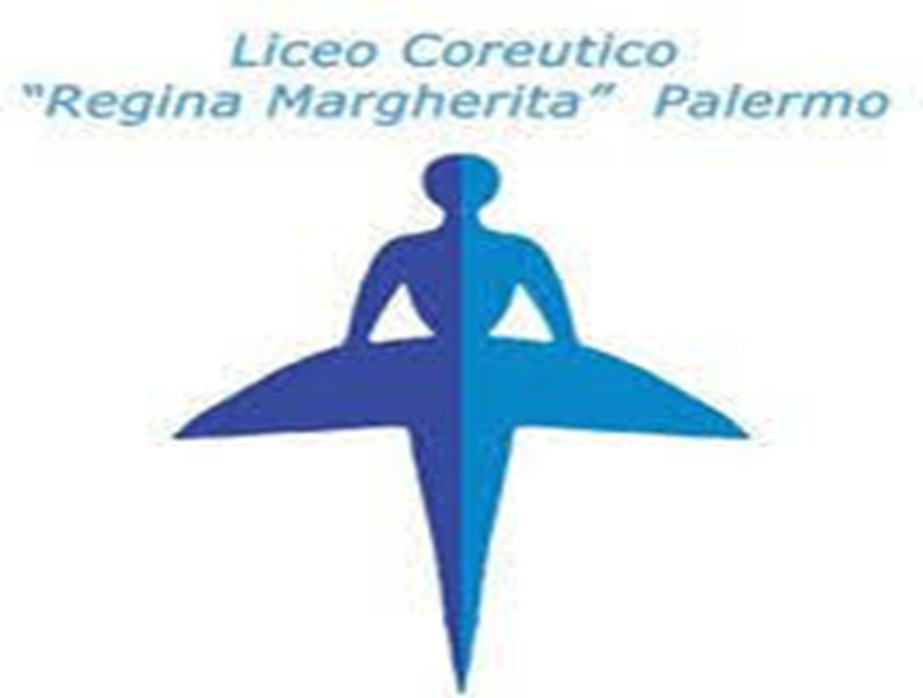
-Gloria Guarino
Classe 3Q

