Slide 1
ERASMUS+ SMILE
SEA AND MUSIC IN INTERCULTURAL LIFELONG EDUCATION
GREECE, CYPRUS, ITALY, SPAIN, PORTUGAL
Photo Contest for the European Maritime Day
Per uno sviluppo sostenibile – Perché il mare sia e continui ad essere immensa e straordinaria risorsa per tutti
For a sustainable development – To help keep the sea an immense amazing resource for all our lives

Slide 2
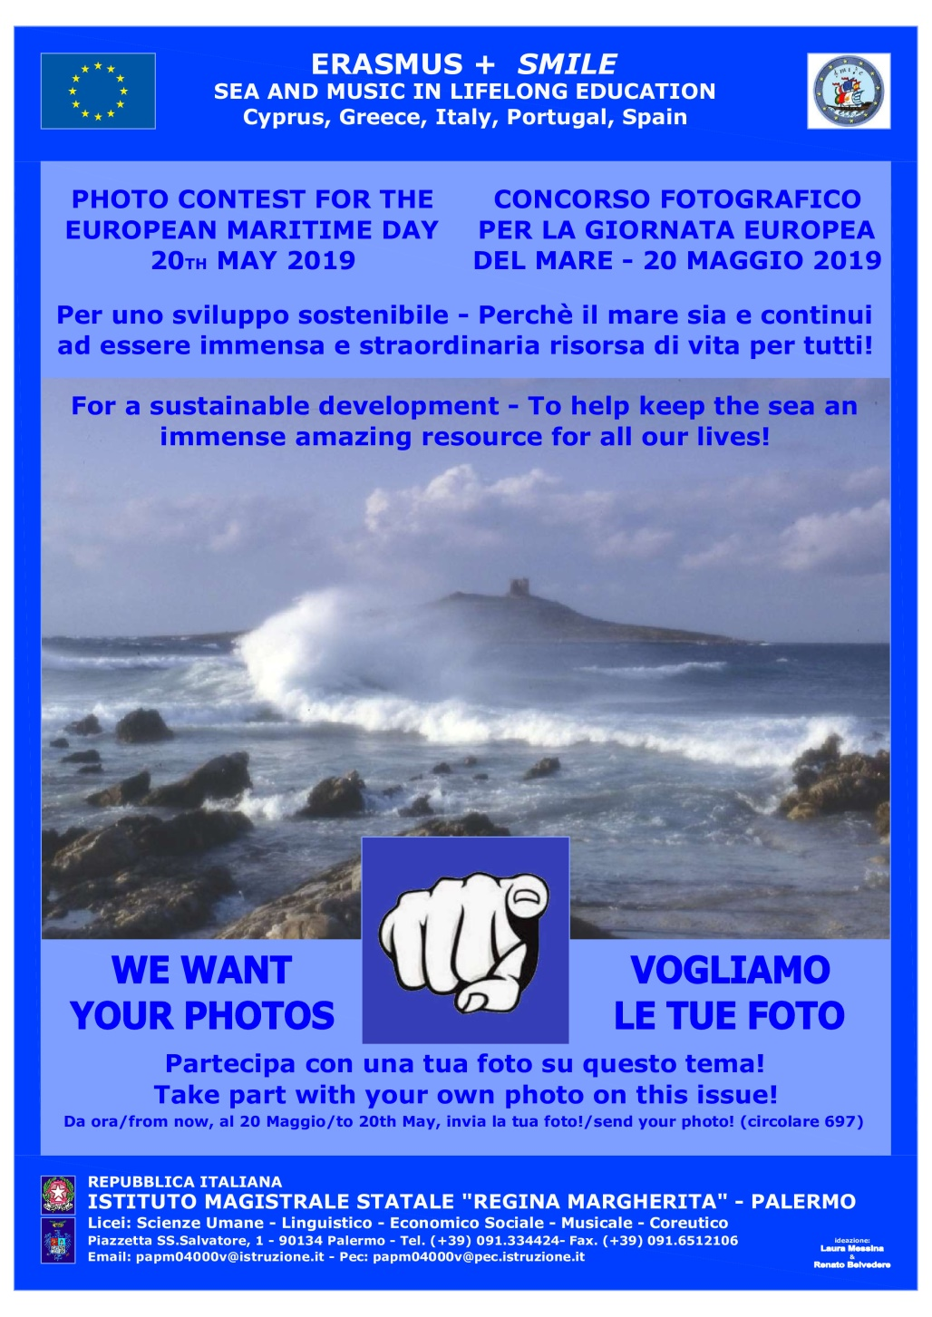

Slide 3
Paesaggio rosa Pink landscape as a V
IRENE LA BARBERA
3J

Slide 4
Il rumore del mare The sound of the sea
ALIDA DI MARCO
3G

Slide 5
Dipingi il mare Painting the sea
JENNIFER CARLOTTA SALERNO 3G

Slide 6
Il vento suo padrone The wind is its master
FRANCESCA MERCANTE 3Q

Slide 7
Il mare usa le onde per parlarci The sea talks through waves
Fabiana Garruzzo
3J

Slide 8
Breathe
ANGELA GIORGIA FICANO
3J

Slide 9
Mare e Luna: riflesso dell’anima The Sea and the Moon: the inner life of the soul
Caterina Di Carlo
4E

Slide 10
Tramonto sulle saline Sunset over the salt pants
Simona Alaimo
3LX

Slide 11
Chi vale vola Who’s worth can fly
GAIA LA BARBERA
4N

Slide 12
La cala The bay
Lorenzo D’Emma
4G

Slide 13
Lo stato d’animo The mood
Chiarastella santalucia
5G

Slide 14
Sea Colors
Vittoria Anello
3Q

Slide 15
Il piccolo borgo di Aspra The tiny hamlet of Aspra
Mattia Militello
3J

Slide 16
Stesso posto al sole Our place in the sun
Claudia Mora
5X

Slide 17
Riflessi e riflessioni Glares and thoughts
Ornella Realmonte
2LX

Slide 18
Shell
Cristina Di Trapani
3J

Slide 19
L’isola nell’isola The isle in the isle
Santina Pampillonia
5N

Slide 20
Sustainable fishing
Flavio Mattia Salerno
4Q

Slide 21
THE CERTIFICATE OF PARTICIPATION

Slide 22
….…….and the winner is
Second prize
Pink landscape as a V
Irene La Barbera 3J
First prize
The wind is its master
Francesca Mercante 3Q

Slide 23
EVALUATION COMMITTEE MICHELE BELLANTI GERLANDO DALLI CARDILLO RENATO BELVEDERE
PROJECT TEAM
PATRIZIA ANGELICO
LAURA MESSINA

Slide 24
First place Runner-up

Slide 25
