Slide 1
Pylos- Methoni
All-day trip

Slide 2
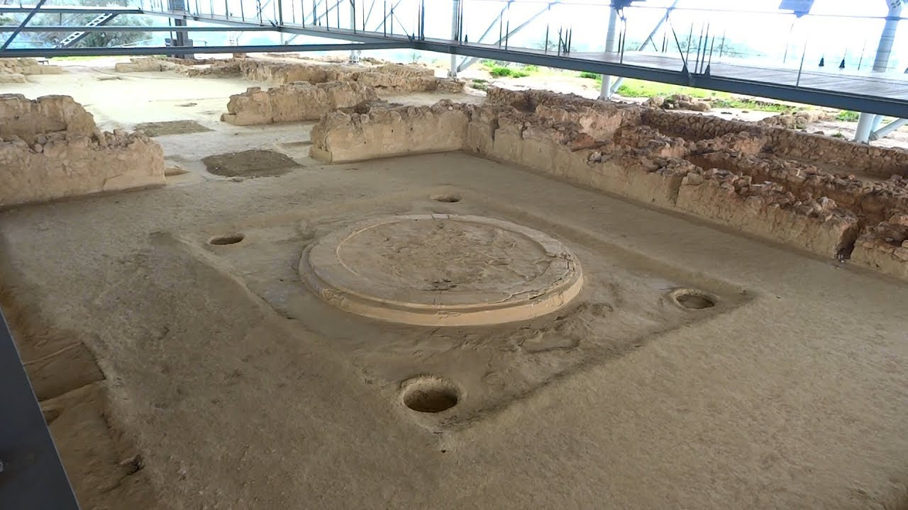
Pylos The palace of Nestor
was an important center in Mycenaean times, and described in Homer’s Odyssey and Iliad as Nestor’s kingdom of “sandy Pylos”

Slide 3
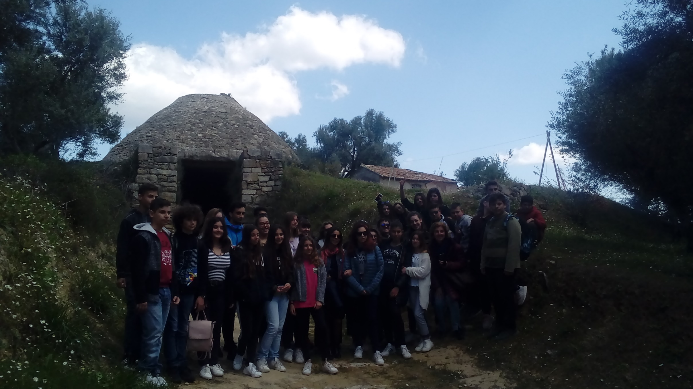
The tomb attributed to Nestor and his successor, Thrasymedes

Slide 4
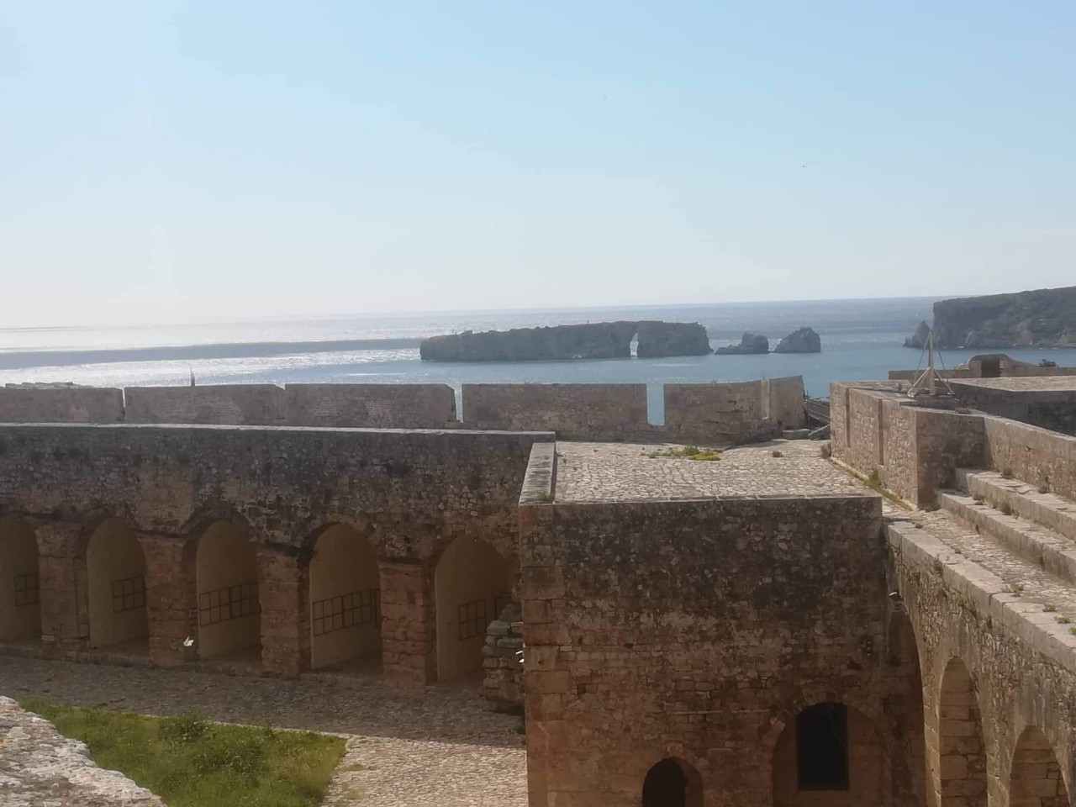
Pylos Castle

Slide 5
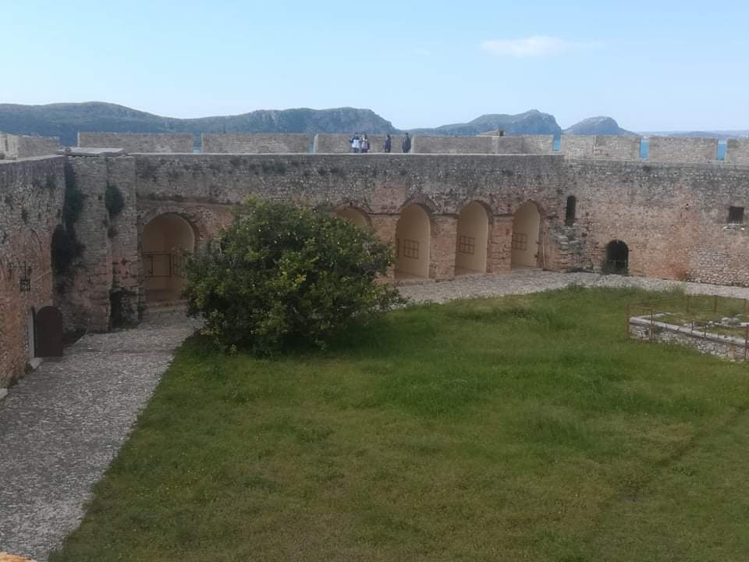

Slide 6
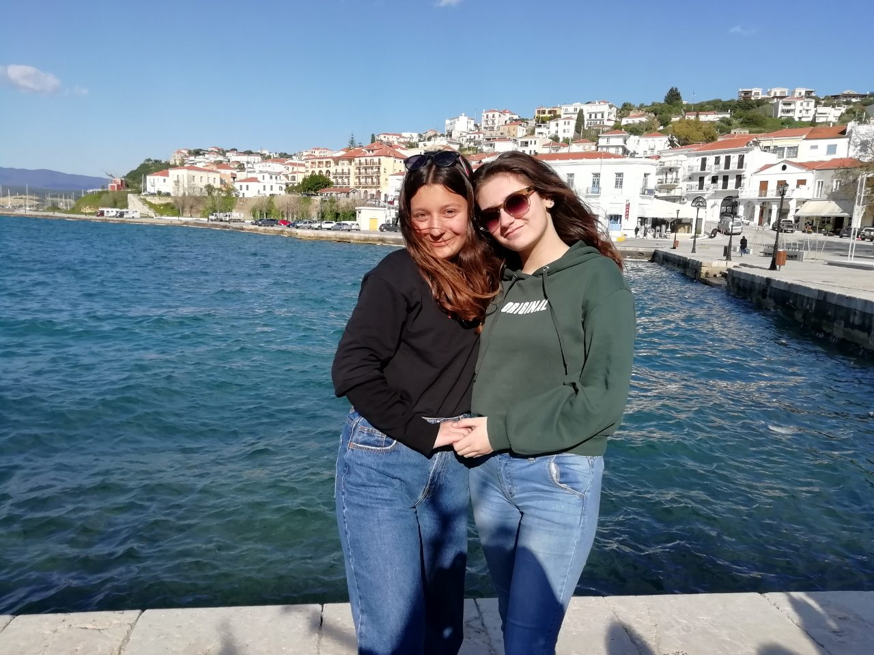
The modern town of Pylos

Slide 7
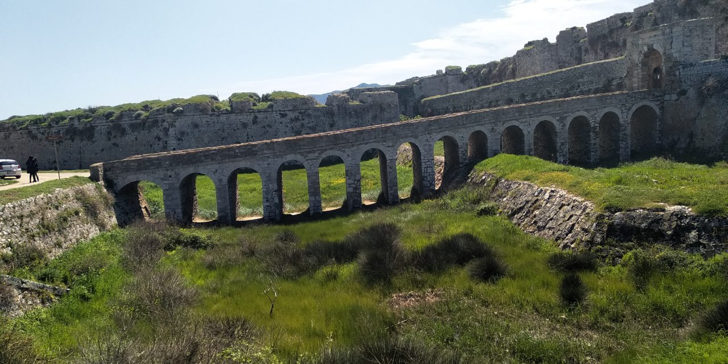
Methoni
The entrance to the castle

Slide 8
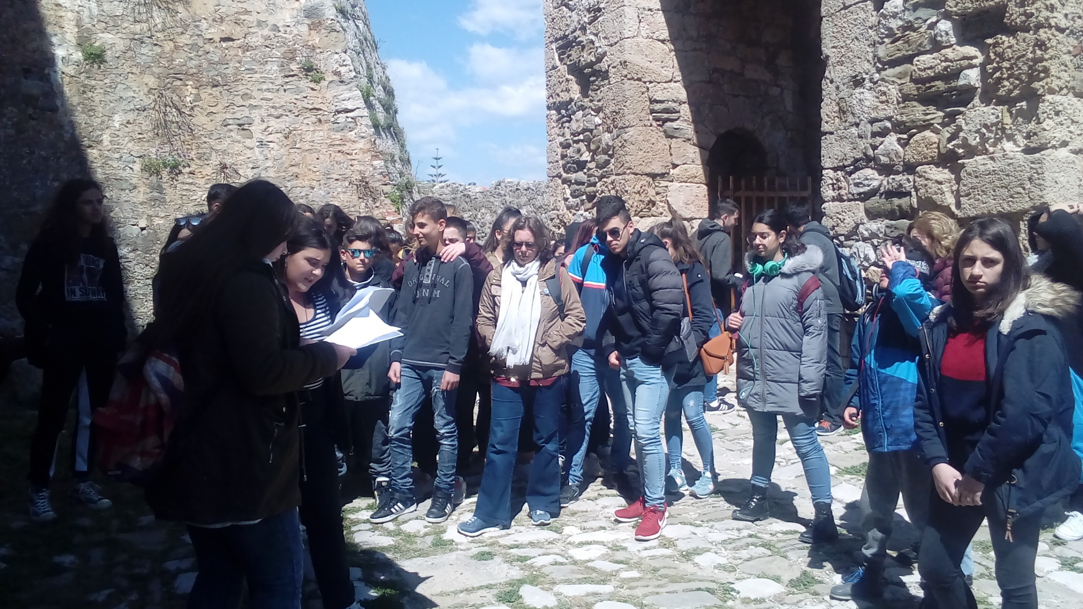
is a medieval fortification in the port town of Methoni

Slide 9
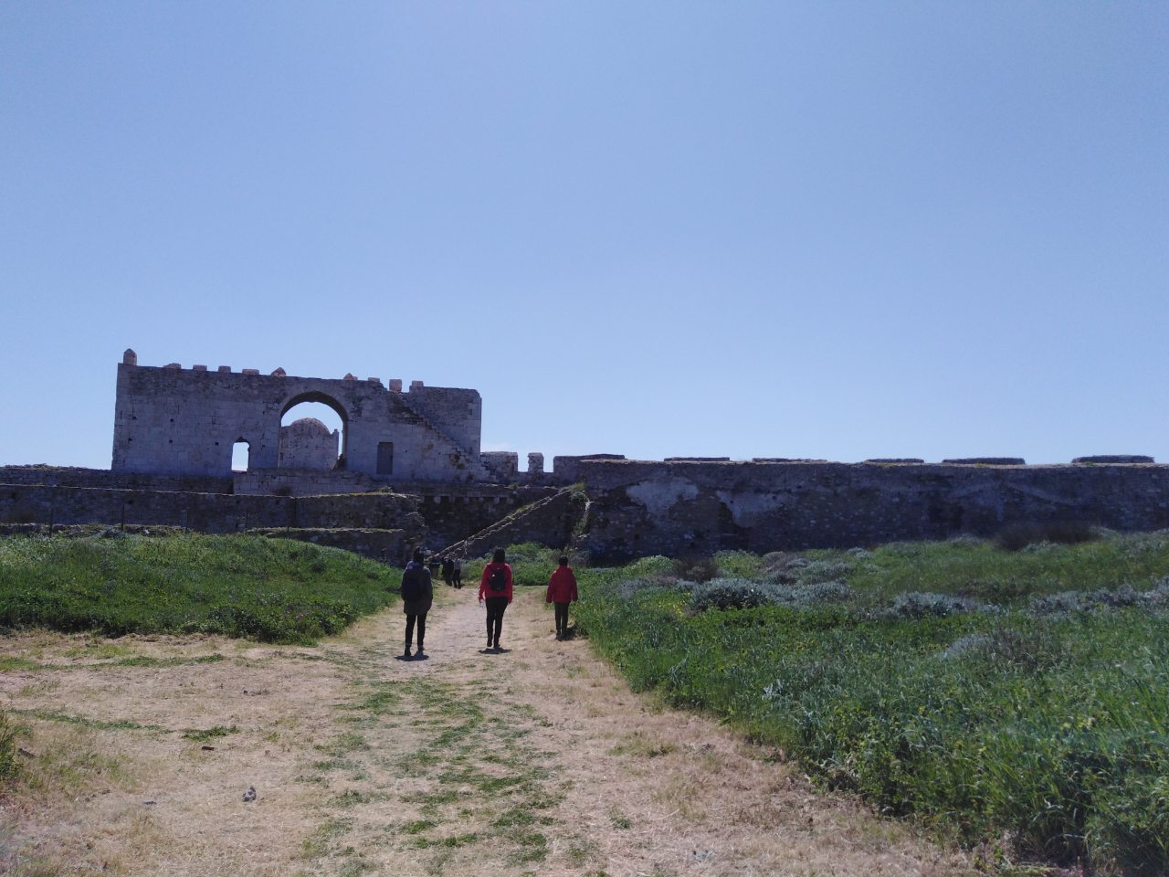
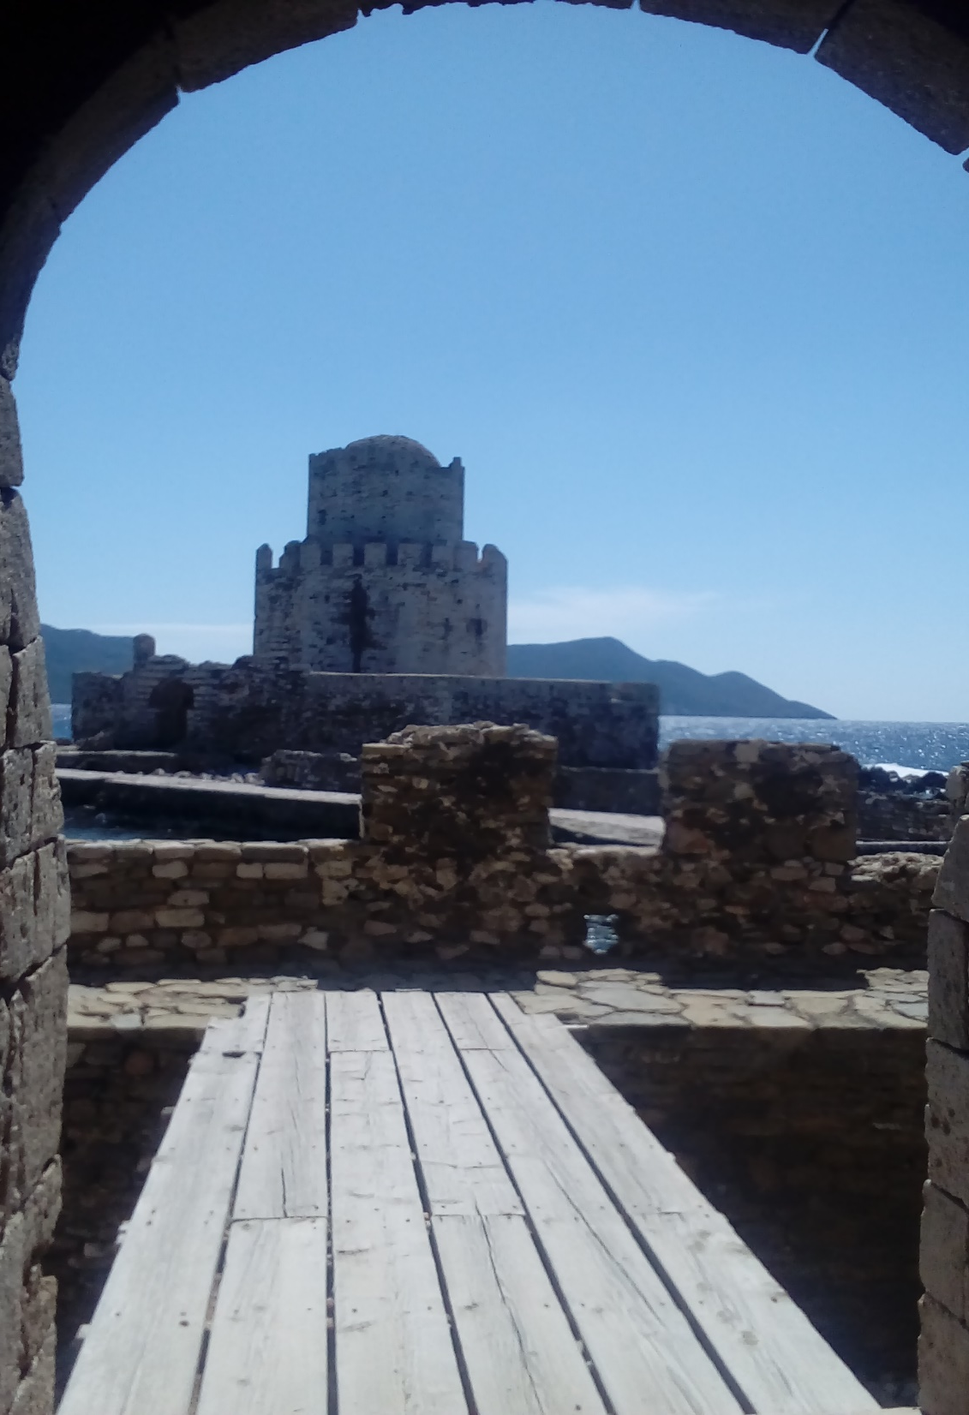
The road leads us to…
…Bourtzi

Slide 10
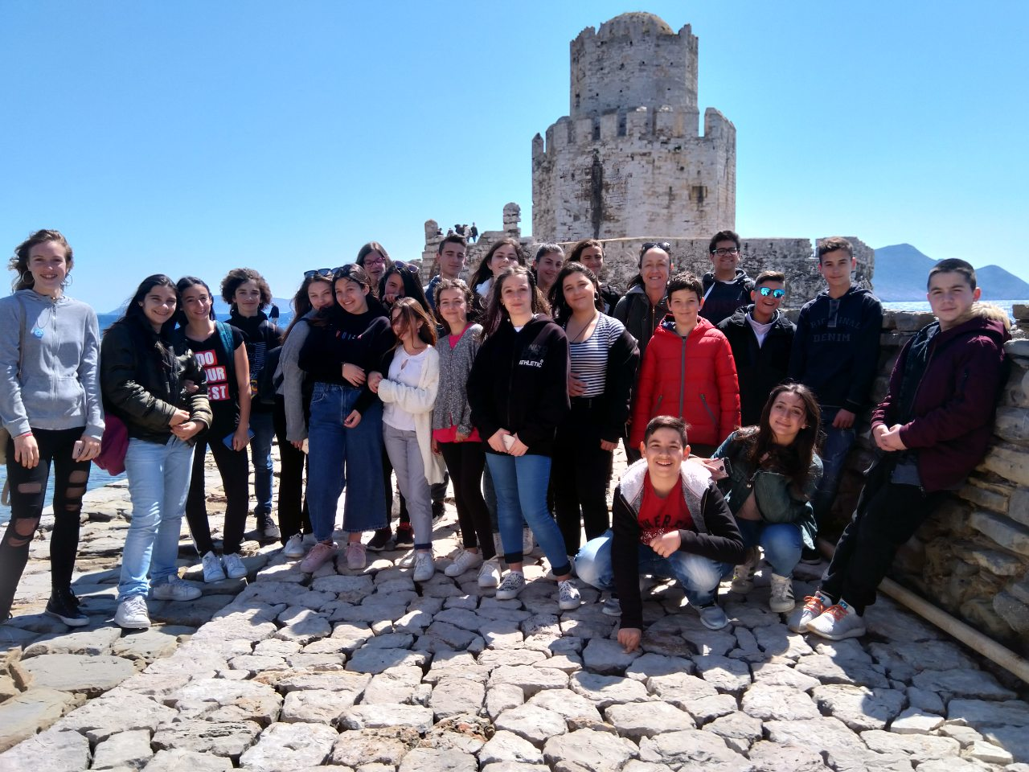
This is the place where many soldiers and inhabitants of Methoni were slaughtered, when the Turks occupied the fort in 1500.

Slide 11
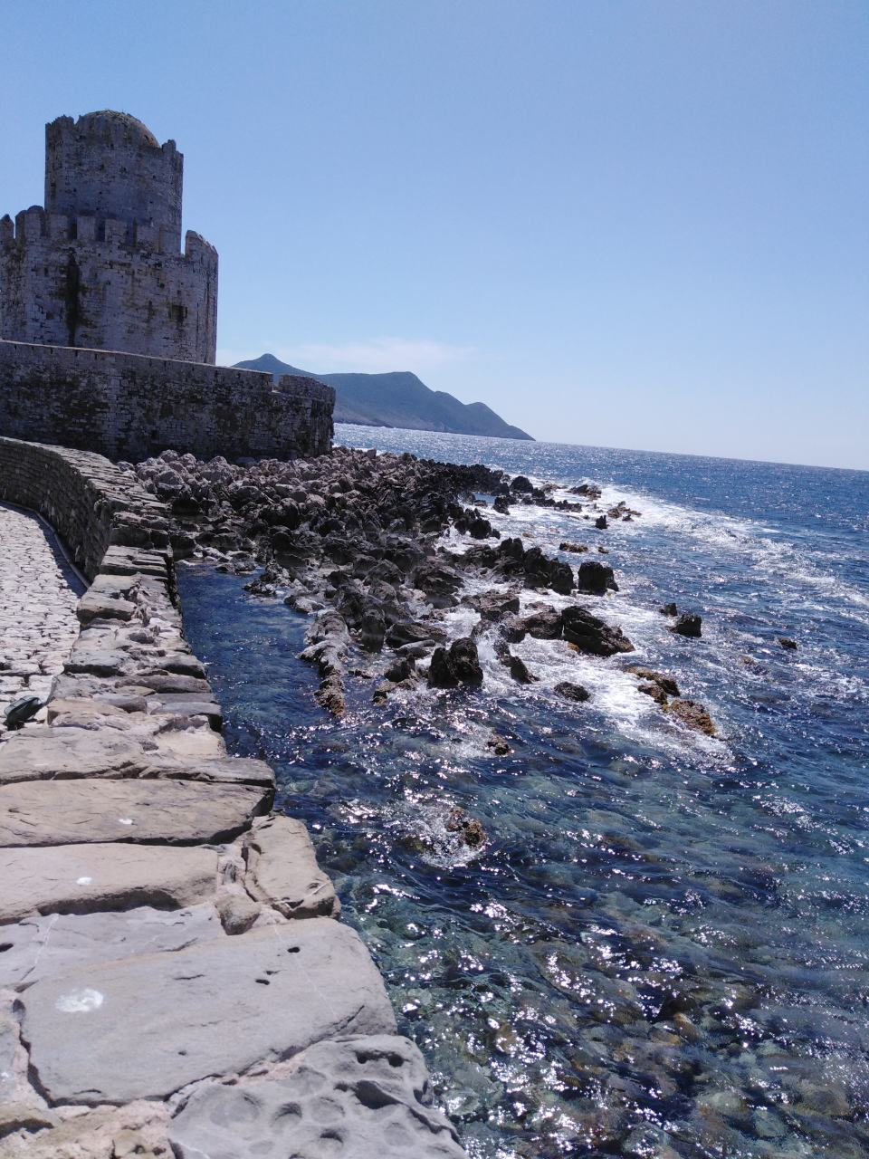
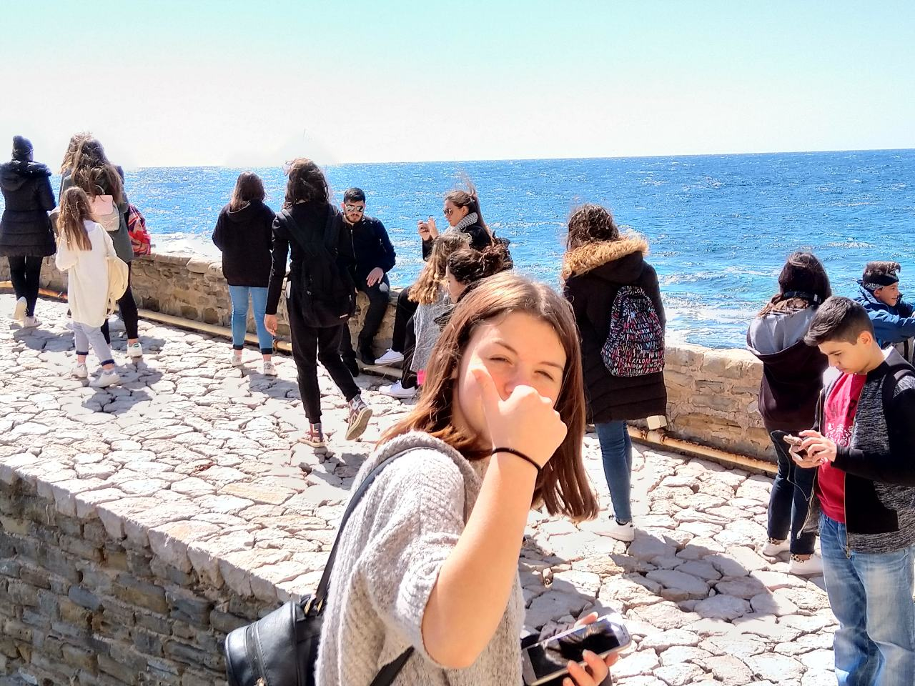

Slide 12
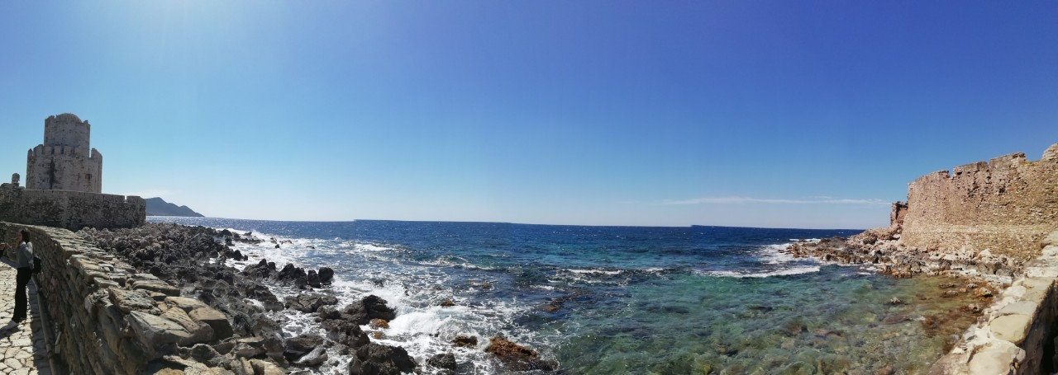
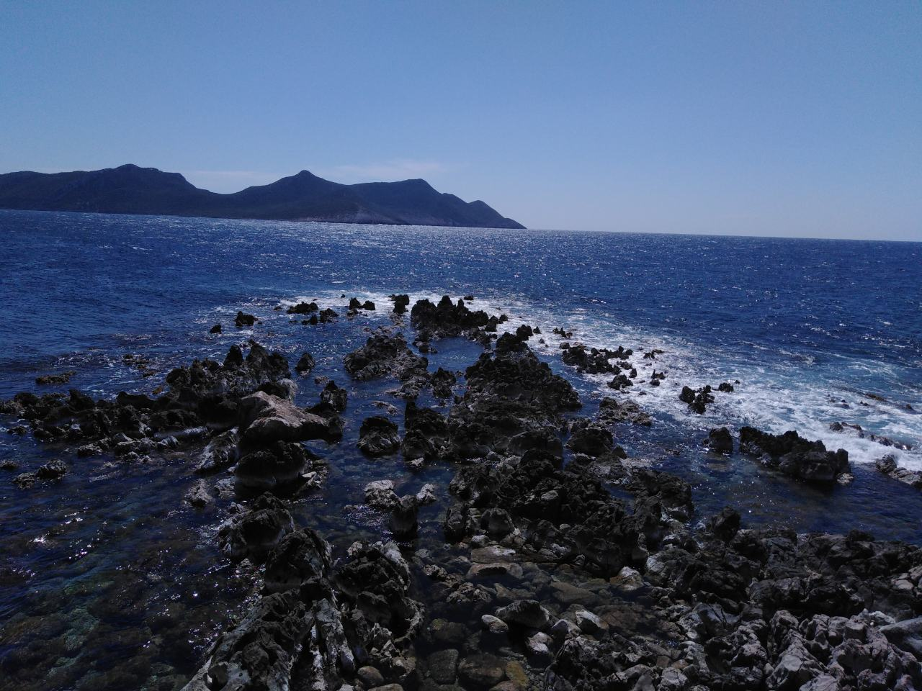

Slide 13
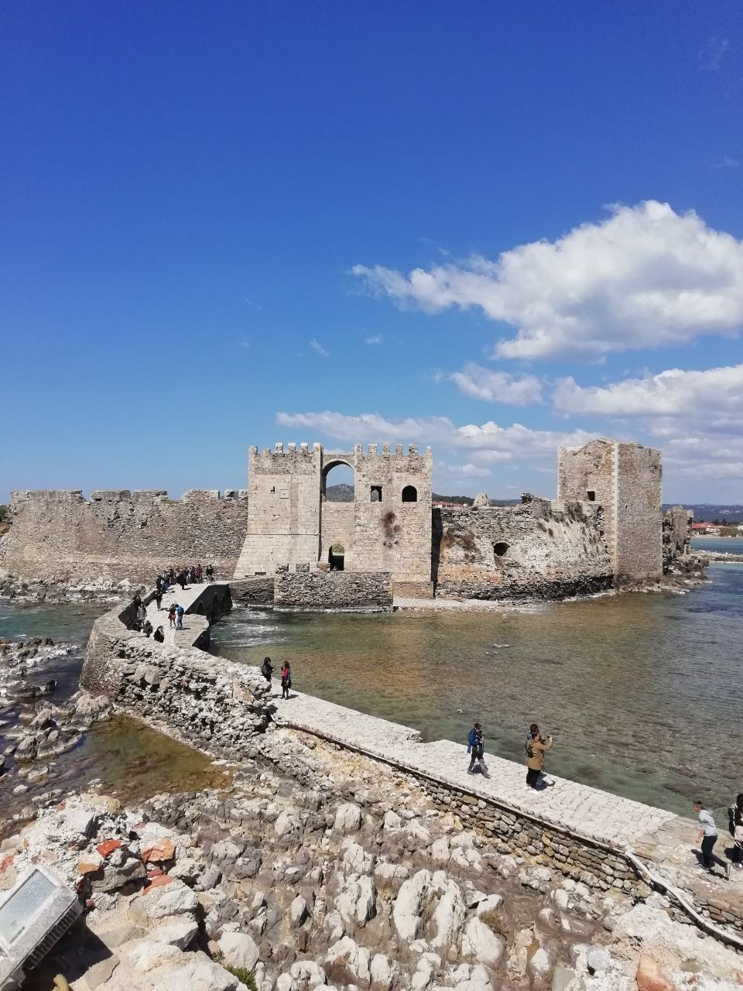
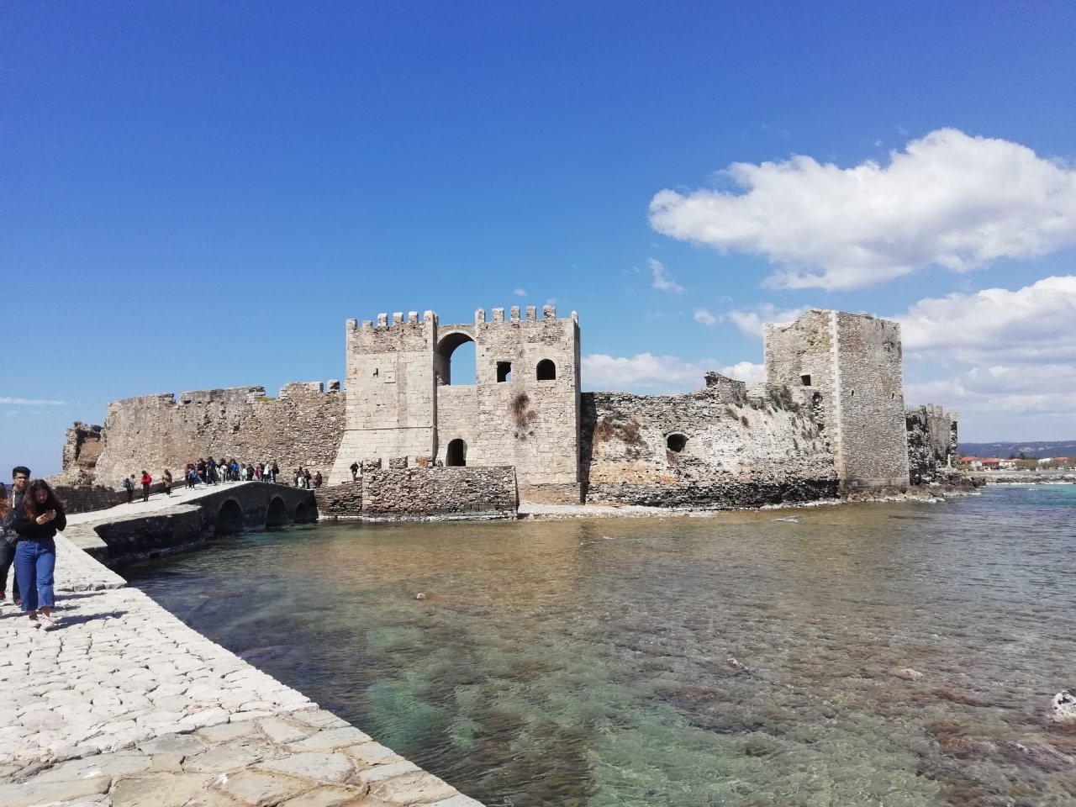
Methoni Castle

Slide 14
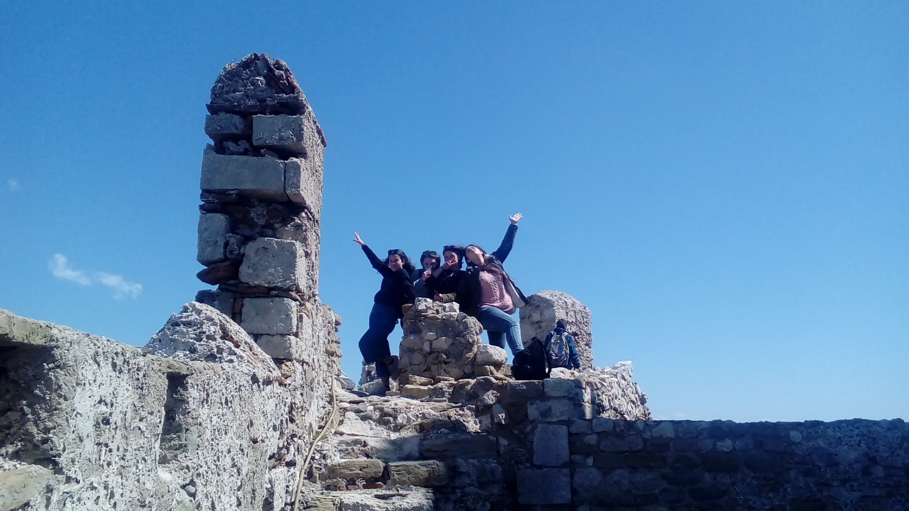

Slide 15
