Slide 1
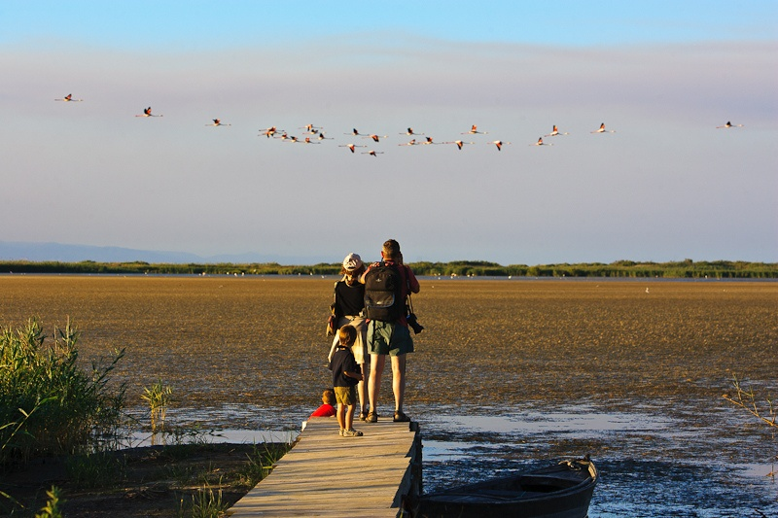
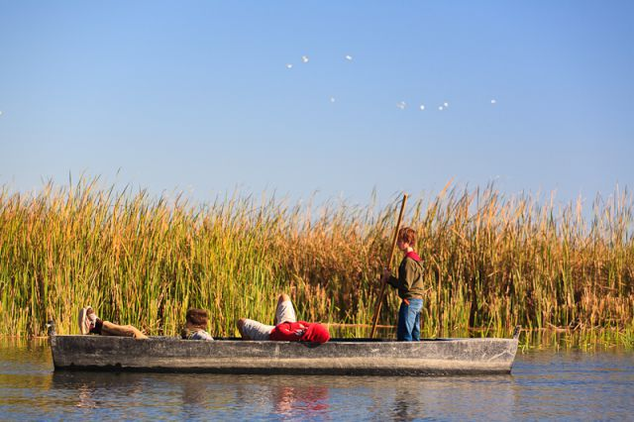
La Jota de les Terres de l’Ebre
http://www.escapadarural.com/blog/wp-content/uploads/2012/10/portada.jpg
http://www.que.es/archivos/201206/perxar.-pn-delta-de-lebre-640x640x80.jpg

Slide 2
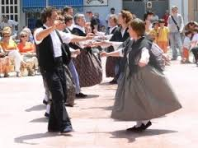
La Jota is the typical dance and song in Terres de l’Ebre.
https://encrypted-tbn3.gstatic.com/images?q=tbn:ANd9GcRmRS6LBHp-g1LEyzUfigJcV-gGgmLgakOj6JfT9SgqQgH0MERy

Slide 3
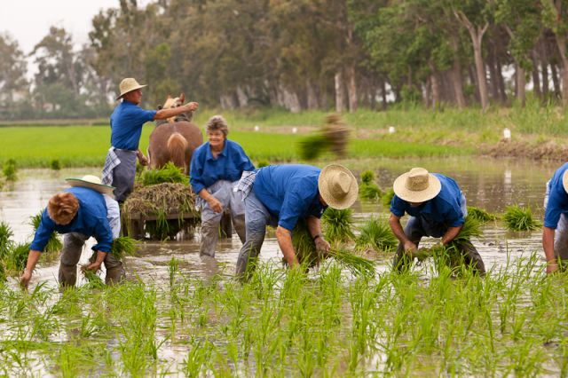
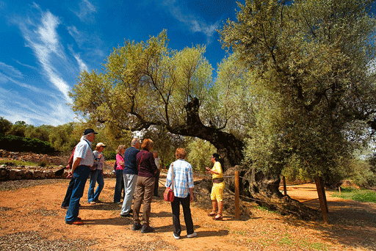
We sing “jota” to celebrate the different activities in the fields (rice planting, harvest, olive collection…) .
https://encrypted-tbn3.gstatic.com/images?q=tbn:ANd9GcREJz7gz5UPuFrdoNt4TtBwtsHGjKt5DYZxToofeaSC89rx1A0O2w
http://www.terresdelebre.travel/img/recursos/terres-del-ebre-descobreixnos-gastronomia-756.gif

Slide 4
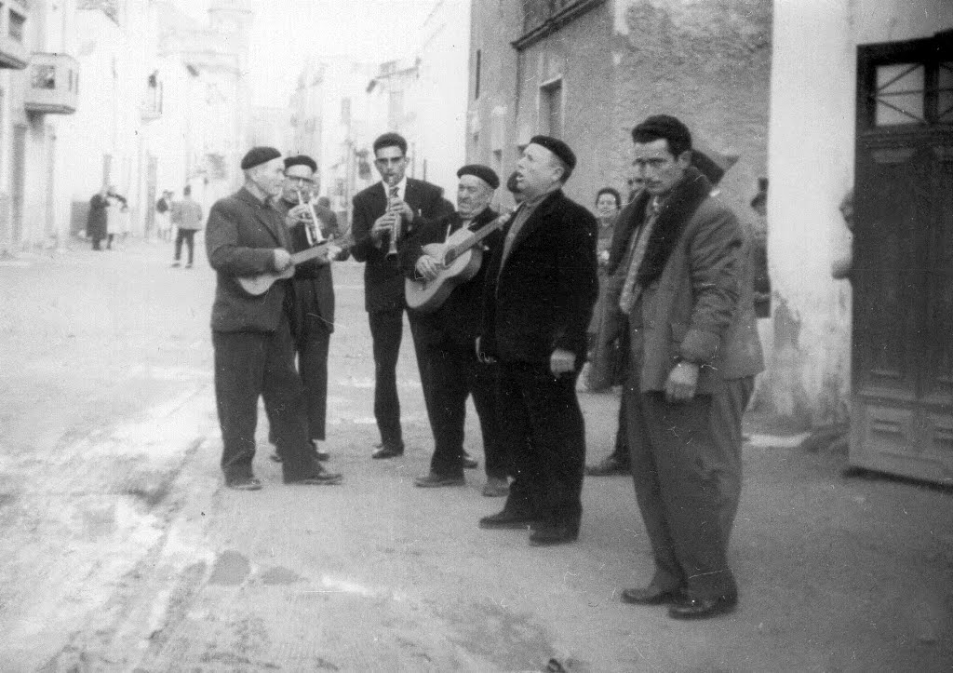
We also sing Jota to different people round the villages. That’s why a Jota is also known as a Rondalla .
http://3.bp.blogspot.com/-1_UGzXPq8qM/T2tX9NURR6I/AAAAAAAAO94/91nB0Goo5DQ/s1600/Canalero%2Bi%2BTeixidor%2Bfent%2Brondalla%2Ba%2BSB-732774.tif

Slide 5
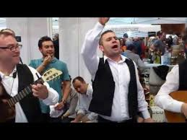
The lyrics of the song were completely improvised at the very moment of singing it, while the musicians were playing the instrumental part of the song (just a few seconds).
https://encrypted-tbn3.gstatic.com/images?q=tbn:ANd9GcTWXi4ef_3dyeL9PNAELV9VamqHt0LIlXgiKDYhU2WuvRd1hoe6

Slide 6
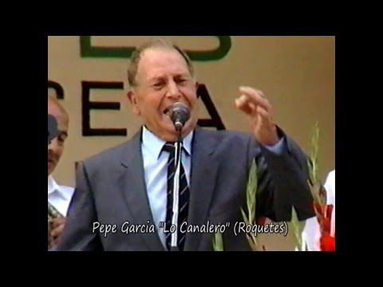
“You can not be taught to sing Jota, you just learn it while singing and having fun with your friends”. Lo Canalero
http://i2.ytimg.com/vi/HZCgTepaoHs/0.jpg

Slide 7
La Jota is composed of a four line verse (improvised) and then there are different refrains that are always the same.
Volem començar
A no maltractar
El nostre planeta,
Boscos conservar,
Tot ésser salvar,
Fer la terra neta.

Slide 8
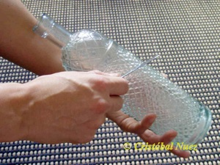
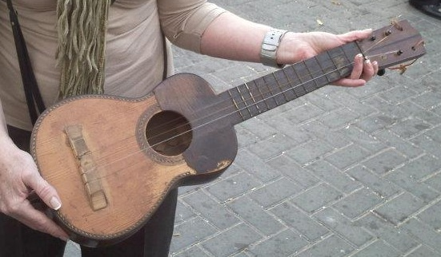
The instruments they used to accompany the singer were very simple ones: a cane, a bottle of liquor, the drums, a guitar ...
http://instrumentoscanarios.cristobalnuez.es/botella_files/tocando_bot_a.jpg
http://3.bp.blogspot.com/-Fpwb9T17HYA/TsJ3BUhqrhI/AAAAAAAAAPk/UZbjZHUEMNY/s1600/guitarro2.jpg

Slide 9
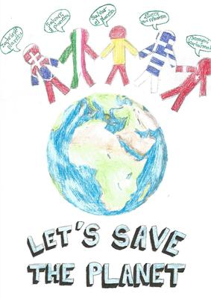
We hope you enjoy this personal jota of ours.

Slide 10
Som los xiquets catalans, We are the Spanish children
De l’Erasmus formem part, we are the Erasmus team
Una missió per complir, with a mission to accomplish
Molts idiomes compartir to share languages
I mentre fem amistats and while making friends
A fer el bé contribuir. To contribute and do good.

Slide 11
Volem començar We want to start
A no maltractar not to damage
El nostre planeta, our planet
Boscos conservar, to preserve the woods
Tot ésser salvar, to save every living bein
Fer la terra neta. To keep the Earth clean

Slide 12
De cinc països d’Europa From five European countries
Ens hem volgut reunir, we wanted to meet
Per reciclar i tenir cura to recycle and care
De l’estimada natura. for our well-loved nature.
Però això no es prou! But that’s not enough!
Demanem la vostra ajuda. We ask for your help.

Slide 13
Volem començar We want to start
A no maltractar not to damage
El nostre planeta, our planet
Boscos conservar, to preserve the woods
Tot ésser salvar, to save every living bein
Fer la terra neta. To keep the Earth clean

Slide 14
Thank you!!!!

