Slide 1
The Viking Age
Die Wikingerzeit
By Alfred and Sonja

Slide 2
When?
790-1100 A.D.
793: The attack on Lindisfarne
Ended in 1103/1104

Slide 3
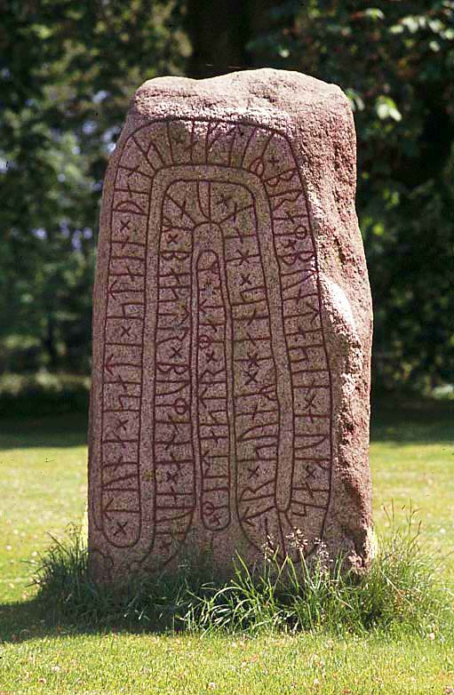
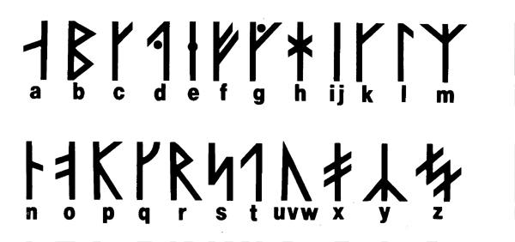
Who were the vikings?
Seafaring warriors, raiders
Modern day Sweden, Norway, Denmark and Iceland
Spoke old norse
Wrote runes
Poems, sagas and treatises

Slide 4
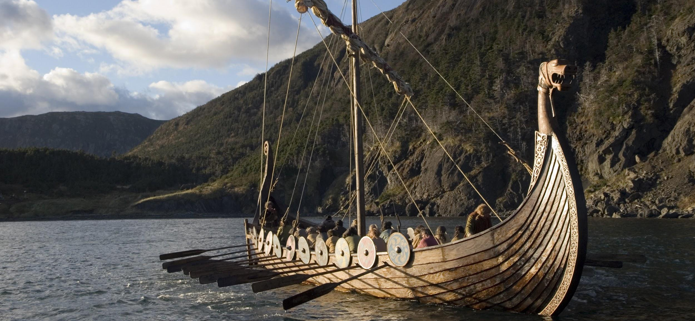
Viking travels and exploration

Slide 5
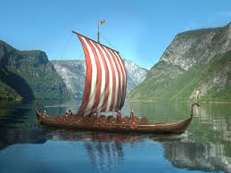
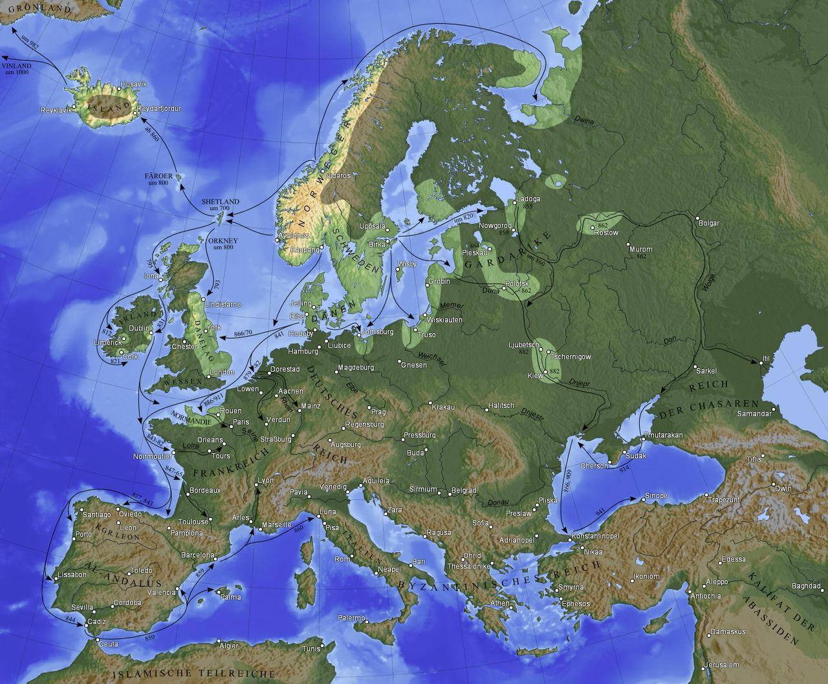
Travels
Good ships
Plundered
Explored, traded, colonized

Slide 6
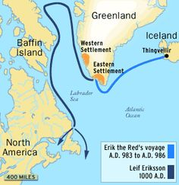
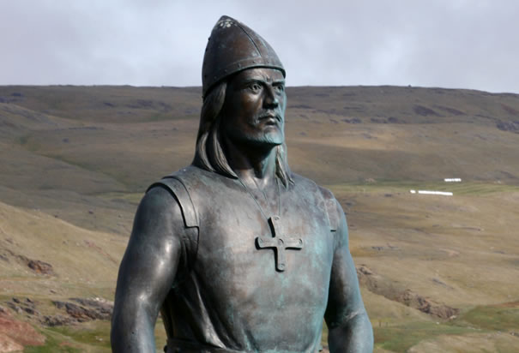
Leif Eriksson
“Discovered” north america nearly 500 years before Columbus
Went to north america from Greenland
Called it “Vinland” (“Land of wine”)
Started a settlement
Leif Erikson Day

Slide 7
Cnut the great
King of England, Denmark and Norway (1016-1035)
Conquered half of England
The other king died so he got the whole of England
His brother, king of Denmark died. He inherited Denmark.
Declared himself king of Norway

Slide 8
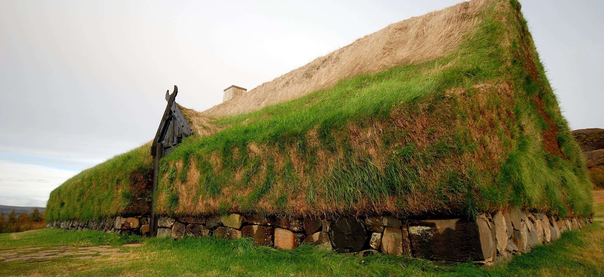
Viking architecture

Slide 9
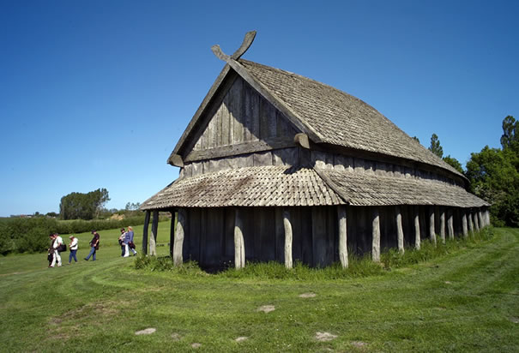
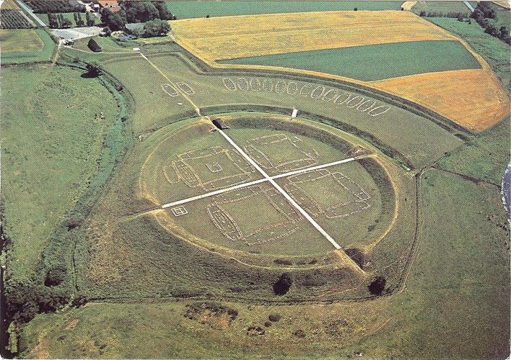
Building techniques
Timber
Practical
Made with the materials at hand
Turf rooves
Longhouse
Ring fortress

Slide 10
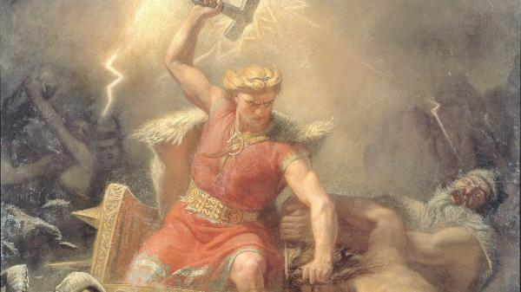
Norse mythology

Slide 11
What is Norse Mythology
Before converted to christianity, had their own religion
Norse mythology, set of religious stories the Vikings told
These myths revolved around deities
Oden
God of wisdom
Thor
God of thunder and war
Loki
troublemaker

Slide 12
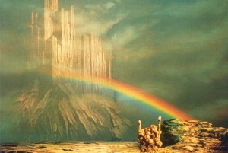
Worldview
The Nine Worlds held in the branches and roots of the world-tree Yggdrasil.
Asgard is located in the sky and is connected to Midgard, the world of humanity, by the rainbow bridge Bifrost.

