Slide 1
Germany
An overview

Slide 2
Geography
North and Baltic Sea

Slide 3
History
1989

Slide 4
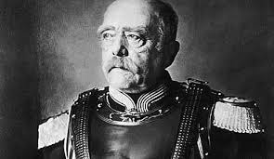
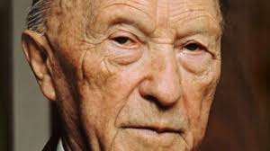
Politics
Angela Merkel Chancellor since 2005
Otto von Bismarck 1. Chancellor of German Empire
Konrad Adenauer 1.Chancellor of Germany

Slide 5
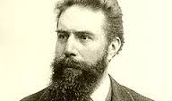
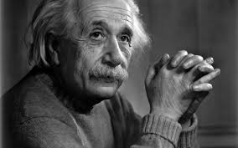
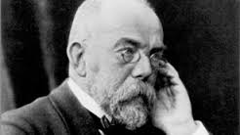
Science
Wilhelm Conrad Röntgen X-rays
Albert Einstein Theory of relativity
Robert Koch Discovery of tuberculosis pathogen

Slide 6
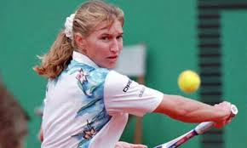
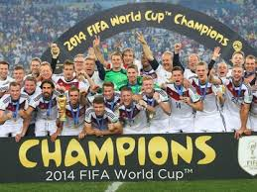
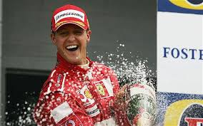
Sports
Steffi Graf (Tennis) 22 x Grand Slam titles
Olympic champion
German National Soccer Team
(4 x World Champion)
Michael Schuhmacher
Formula 1
7 x World Champion

Slide 7
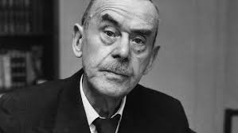
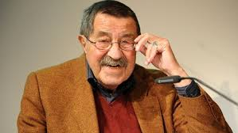
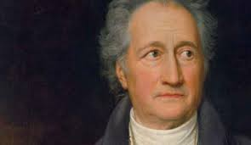
Literature
Thomas Mann „Buddenbrooks“
Nobel Prize laureate
Günther Grass „Die Blechtrommel“
Nobel Prize laureate
Johann Wolfgang von Goethe „Faust“

Slide 8
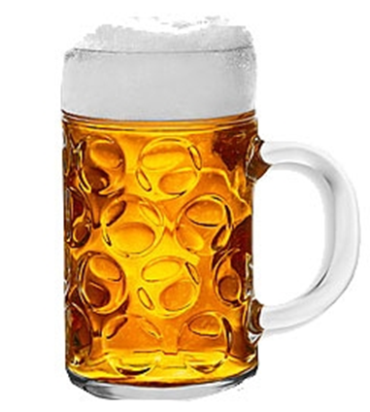
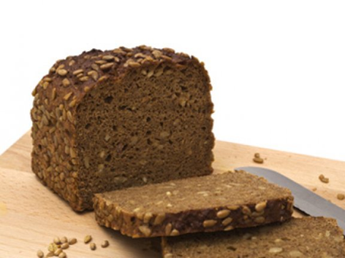
Typically German
BMW, Audi, VW, Mercedes
Punctuality
Beer
Dark bread

