Slide 1
Hygiene – the most important requirement for health
The conditions of cleanliness and Hygiene in the global south in contrast to Europe

Slide 2
Definition: Hygiene
Hygiene is the teaching of the health of the human being by keeping the body and clothing as well as the working environment clean
The derivation of the word hygiene comes from „hygieia“ the Greek word for health
Already had great importance in antique society

Slide 3
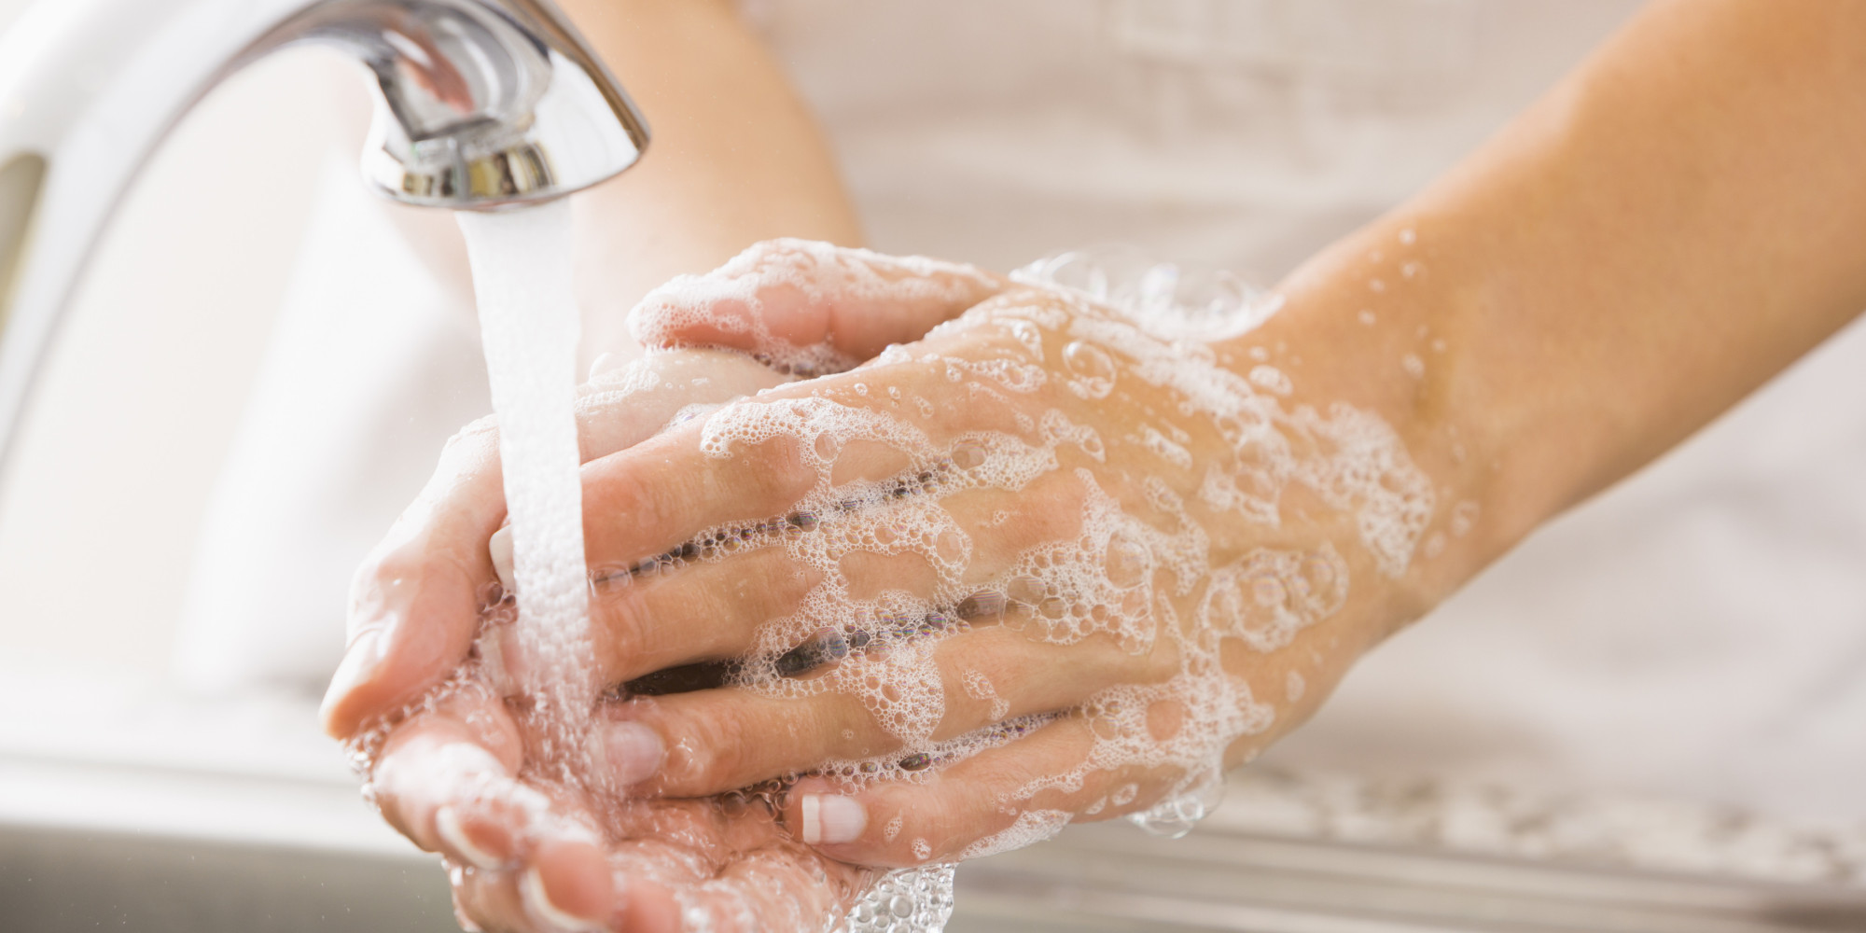
Hygiene in Europe
Knowledge
store food properly
eat with cutlery
Connection to clean drinking water
wash hands before eating
take a shower regulary
wash dishes after eating
Access to a toilet/ shower
keep the toilet and shower clean
use it properly
Cleaning products
wash clothes after using
keep the house clean

Slide 4
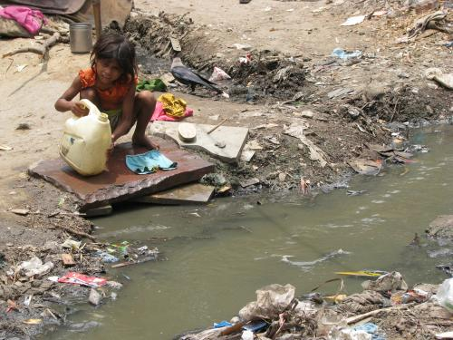
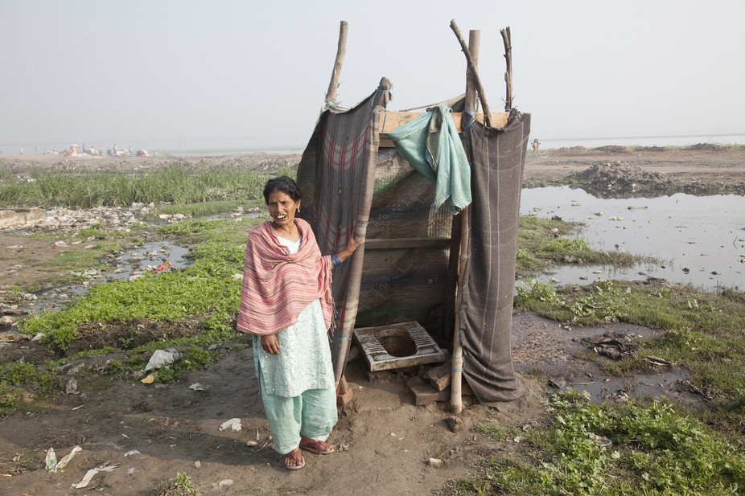
Hygiene in slums of India
Knowledge exists, but just a few opportunities on implementation
no money for cleaning products
pollution of the enviroment
missing waste disposal
Poor supply of sanitary facilities
not enough toilets
bad conditions
Access to dirty water
usually no clean water
can not take a shower or wash their hands

Slide 5
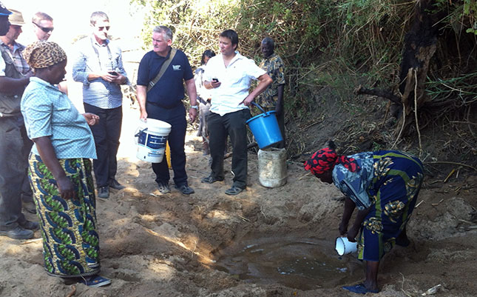
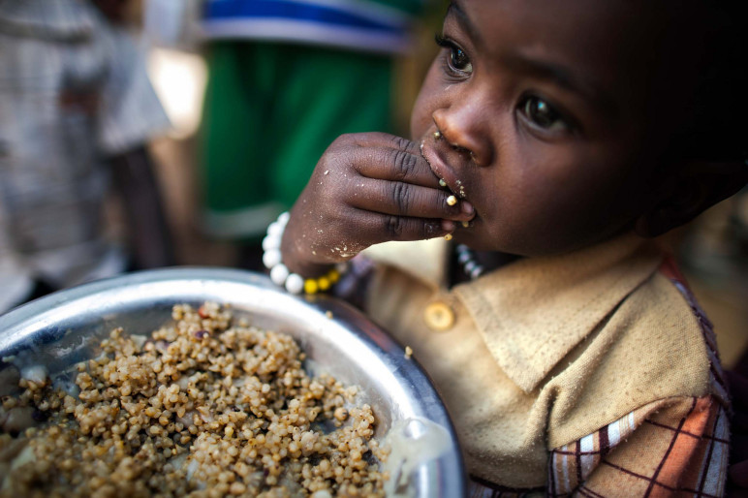
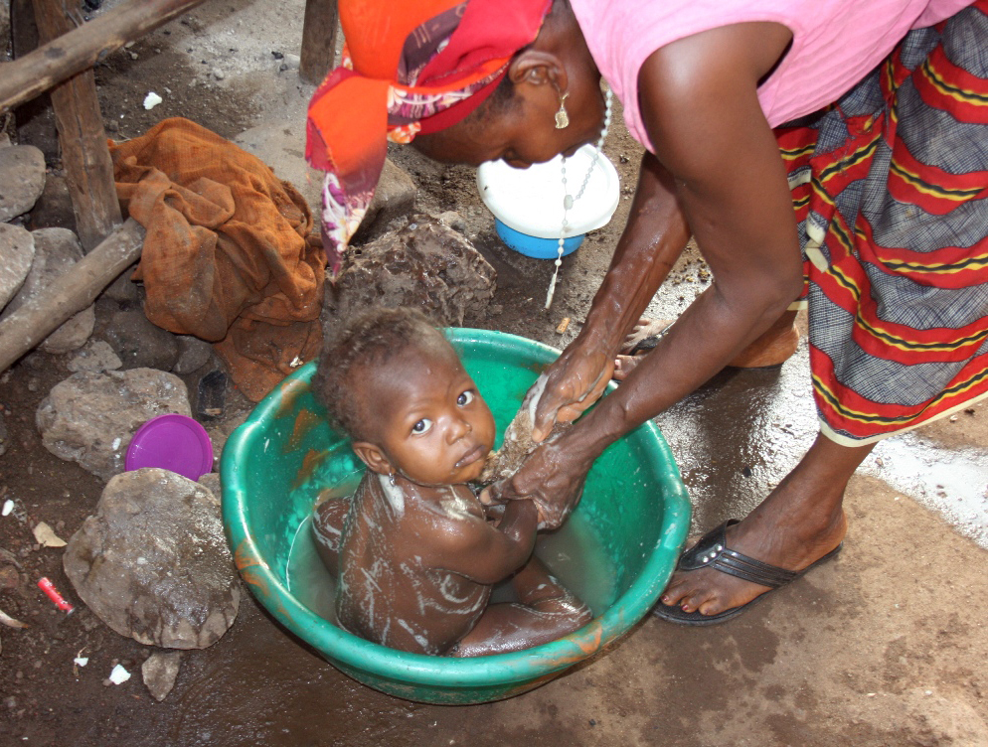
Hygiene in Niger
Not an organised community
Missing knowlege and generall lack of water
Can not build systems to get the underground water
few toilets and showers with clean water
few stores to buy cleaning products
no opportunities to store food properly
they eat with their hands

Slide 6
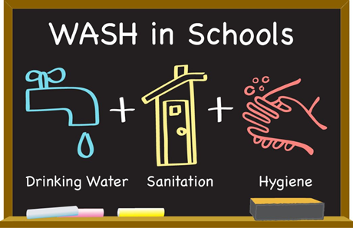
Hygiene in European schools
hygiene laws from the Health Department
These laws contain following topics:
Hygiene organisation (management, behavior)
personal hygiene (washing & sanitizing hands)
environmental hygiene (waste disposal)
nutrition hygiene (preparing of the school food)
Notes:
Every school in Europe has hygiene laws given from the Health Departments. Being healthy is really important for students and staff. Therefore, many different hygiene rules exist.
The first point is “hygiene organization“. It’s about management and behavior. For example: If somebody’s sick, they’re supposed to stay at home so they don’t infect others. The next point is “personal hygiene“. Many illnesses are spread by hand contact. That’s why it’s important to wash hands on a regular basis. The third point is “environmental health“. It’s important to throw trash away and check the drinking water often. The last point is about “nutrition hygiene“. Clean cafeteria food is important, so no one gets food poisoning.

Slide 7
Hygiene in the Global South
Provision with basic supplies is not guaranteed
Charity organisations like Unicef support projects like:
Teachers showing students how to wash properly separated bathrooms
Since the provision with basic supplies is not guaranteed, people care less for hygiene at school but rather appreciate if there‘s a school.
Notes:
The Global South is the complete opposite from Europe. The provision of basic supplies isn’t guaranteed in these countries. Neither, is it guaranteed in their schools. Charity organizations like Unicef support projects support projects like: Teachers showing students how to wash properly and separations of bathrooms. These projects only work if the school has an access to water tho. In the end, people care less for hygiene at school but rather appreciate having a school.

Slide 8
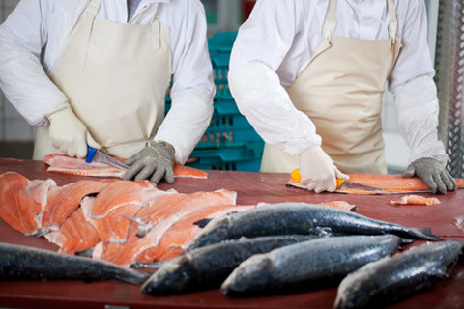
Situation in Europe Laws and Regulations
In many countries there are a lot of health authorities who guarantee the quality of food (for example: Livsmedelverket- Sweden, Gesundheitsamt- Germany, Sanepid- Poland)
Incerasing of stricter regulations in gastronomy (for example: hairnet, gloves, regular hand washing, desinfection of kitchen devices)

Slide 9
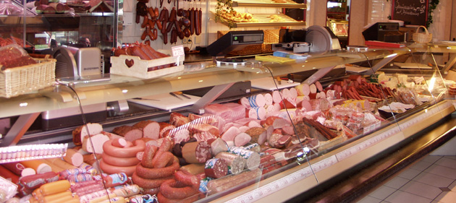
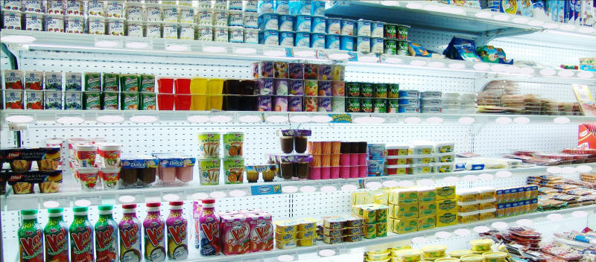
Conditions of sale and storage of food in Europe
Cooled and/or dry storage of food in private and public areas
Avoidance of vermin in the area around food
Sterilisation of the sales area

Slide 10
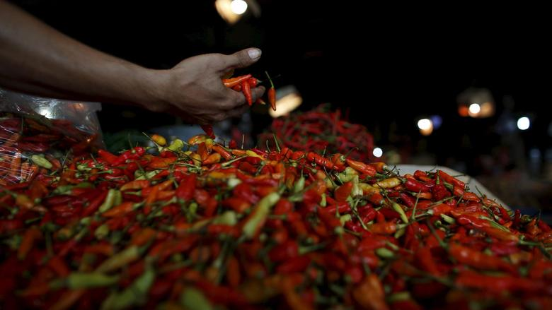
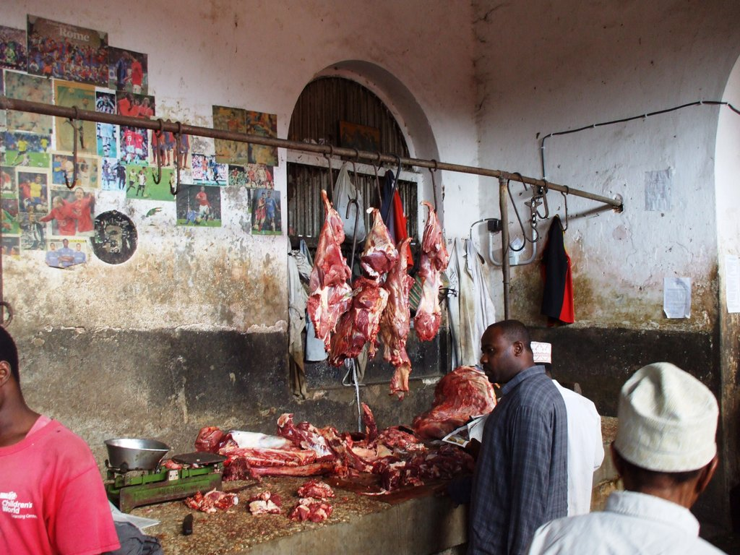
Situation in global south Laws and Regulations
Many countries in Global South have health authorities, but the main priority is to inform tourists about quality of the food
Those health authorities try to increase the quality but fail with their poor measures (for example: two weak punishments and hygiene standards)

Slide 11
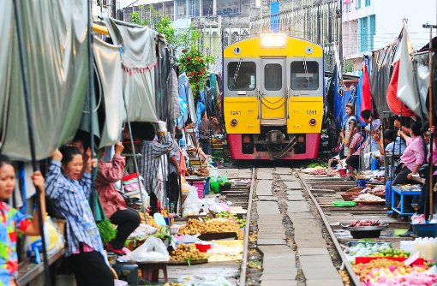
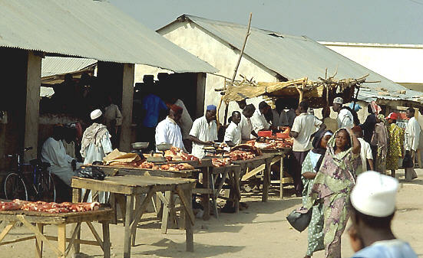
Conditions of sale and storage of food in the countries of global south
No ideal storage of food neither cooled nor by good humidity
Ignorance of vermin in the area of food or on the food
Saling areas are contaminated by harmful substances and are full of bacteria

Slide 12
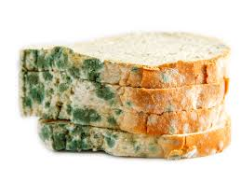
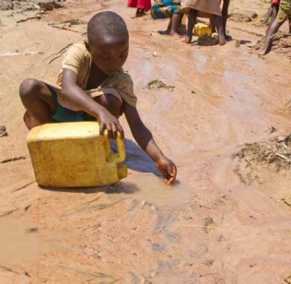
Food supply in the global south
Eatinng bad quality food because of food shortage
Eating rooten food
Drinking water from polluted sources

Slide 13
Hygiene in hospitals
1 – tasks of hygiene
2 – laws of hygiene
3 – lack of hygiene
4 – Scientific work for hygiene in hospitals

Slide 14
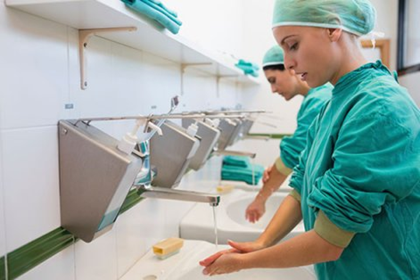
Germany & Europe
there are specific tasks for hygiene
after every treatment there is a disinfection of the arms and hands
there are laws for hygiene in hospital
one third of the infections in hospitals could be stopped

Slide 15
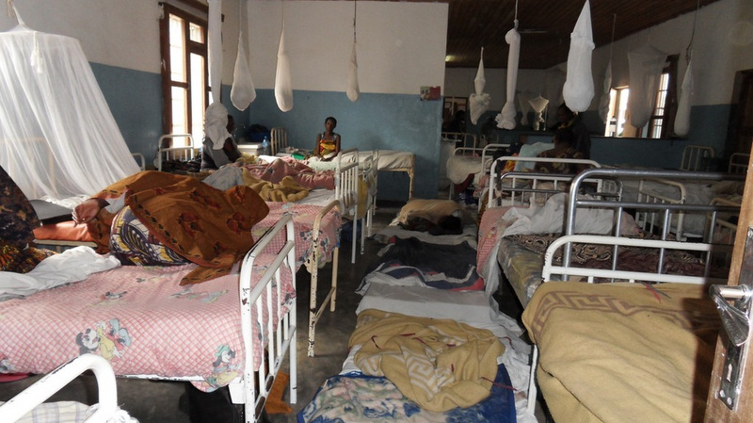
Global south
there are no specific tasks for hygiene
There are no future plans
there are no laws for hygiene in hospitals
there is a real lack of hygiene

Slide 16
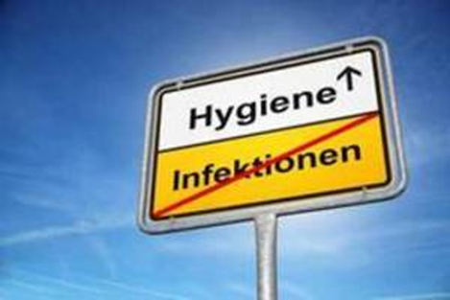
Scientific work
In the DGKH (Deutsche Gesellschaft für Krankenhaushygiene) scientists work on the problems in Germany´s hospitals to solve them
there is no cooperation with the global south

Slide 17
Conclusion
Conclusion: Without financial, material and logistical support, the hygienic conditions of the countries of the global South will scarcely improve and remain a breeding ground for infectious diseases and epidemics

