Slide 1
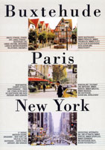
Buxtehude – fairytale city

Slide 2
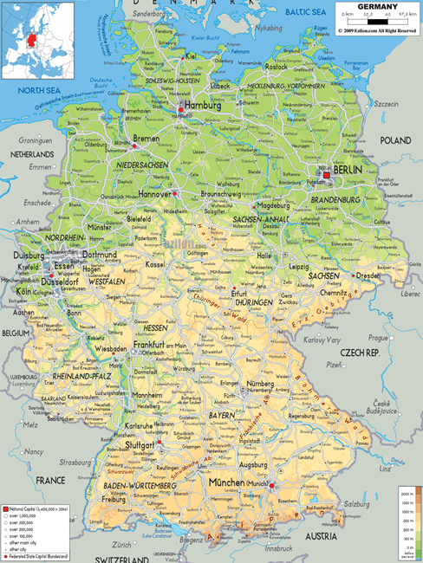
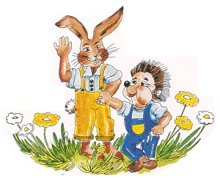
B
U
X
T
E
H
U
D
E
General facts
about
40 000 inhabitants
state: Lower Saxony
(capital: Hannover)
bordering on
‘‘Altes Land‘‘ (fruit-
growing area)

Slide 3
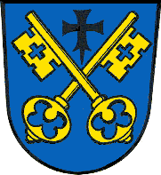
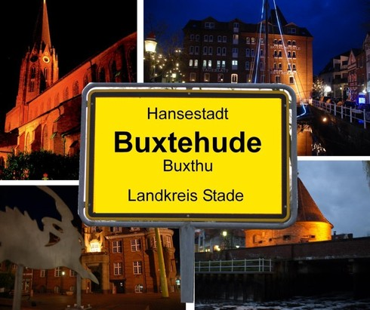
History and general
sister cities:
Blagnac (France)
Ribnitz-Damgarten
1280 to 1285: founded as city fortress in the middle of a moor
1328: conferment of the town charter of Hamburg
2014: Buxtehude re-became a Hanseatic city
Hanse: originally confederation of merchants in the Middle Ages
coat of arms of Buxtehude
place name sign

Slide 4
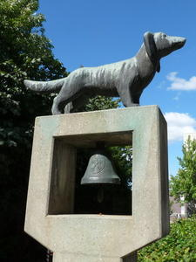
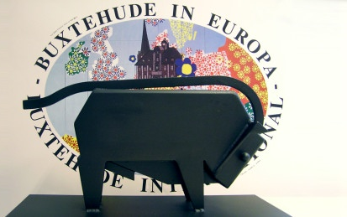
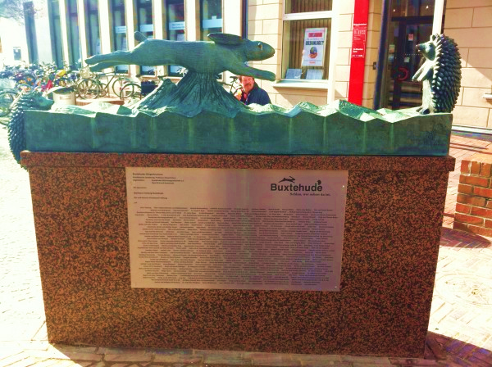
Culture
‘fairytale city’
“hare and hedgehog’’ (retold by the Brothers Grimm),
“The dog which is barking by his tail’’
located on the “German fairytale street’’
renowned youth literature award ‘ Buxtehuder Bulle’ (‘bull of Buxtehude’)

Slide 5
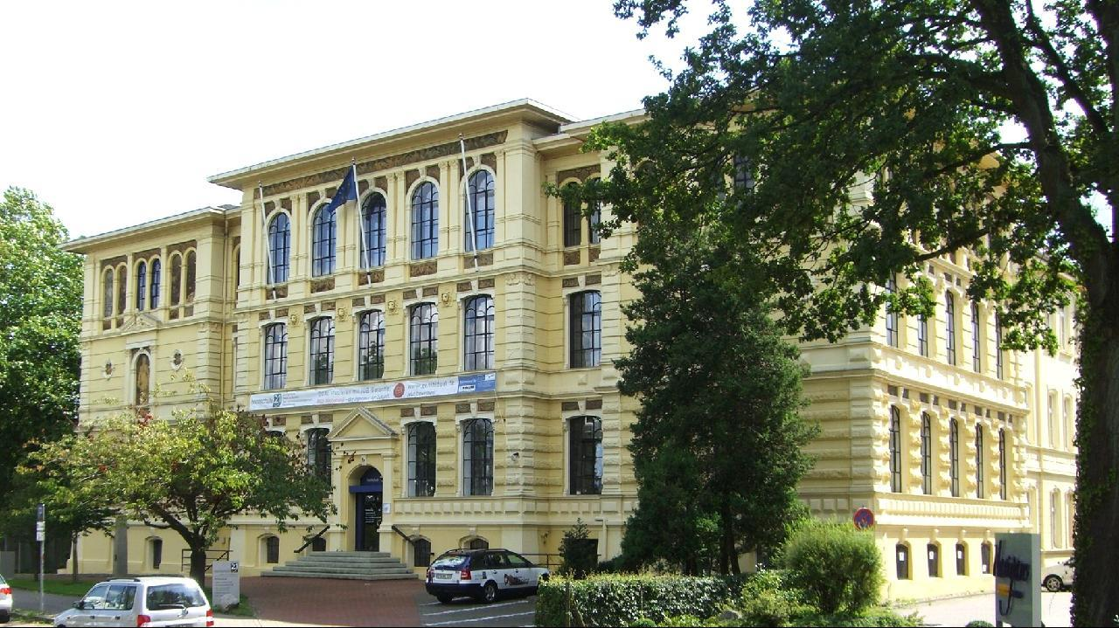
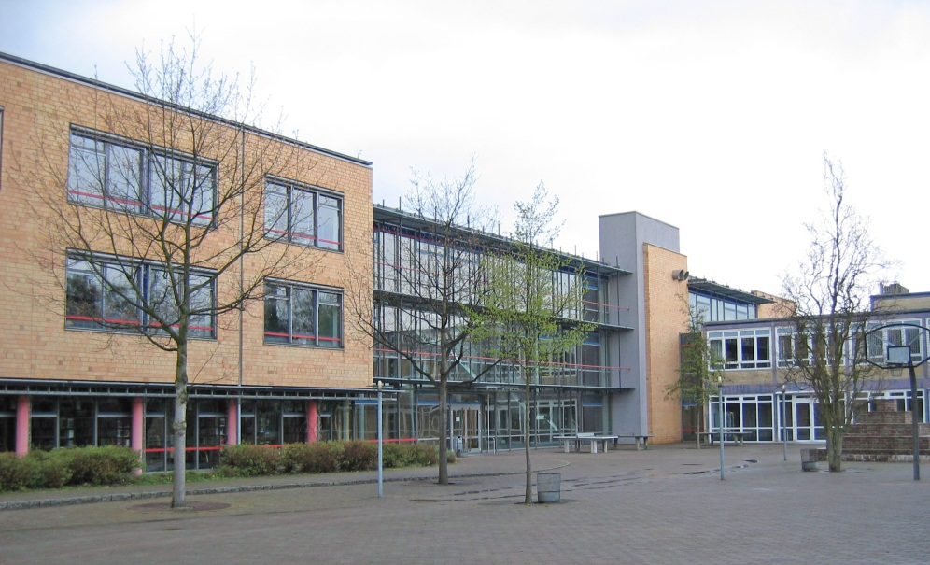
Education
secondary schools: Schulzentren Nord und Süd, Gymnasium Halepaghen-Schule, Gymnasium Süd, BBS Buxtehude (vocational school), IGS Buxtehude (comprehensive school)
Hochschule 21 (private college), adult education centre, painters’ school

Slide 6
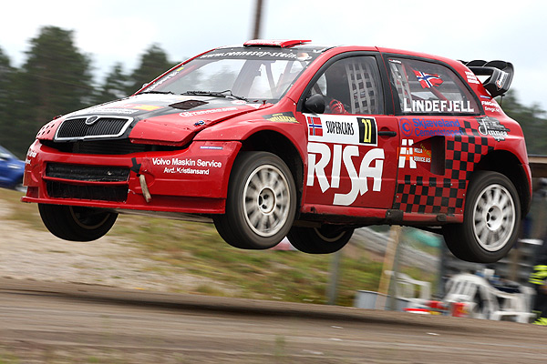
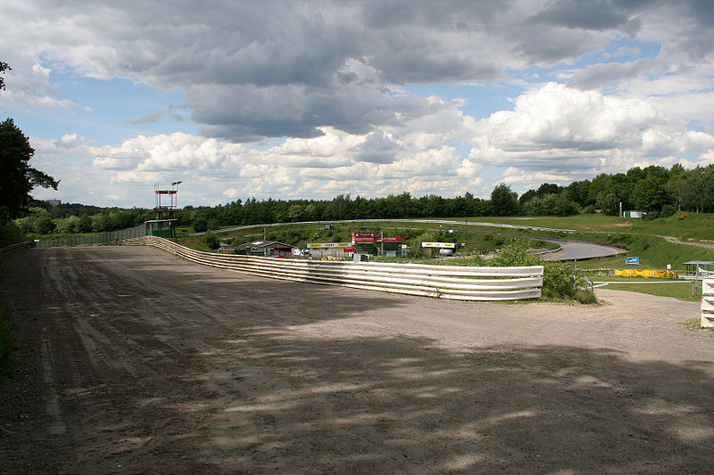
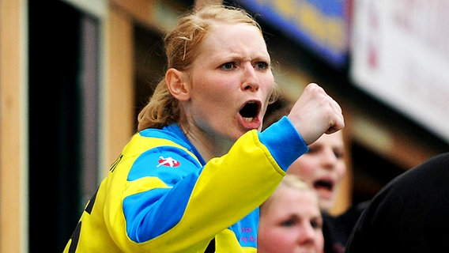
Sports
BSV Buxtehude ladies handball
(first national league + European compeptitions)
rallyecross “Estering” (Este circuit)

Slide 7
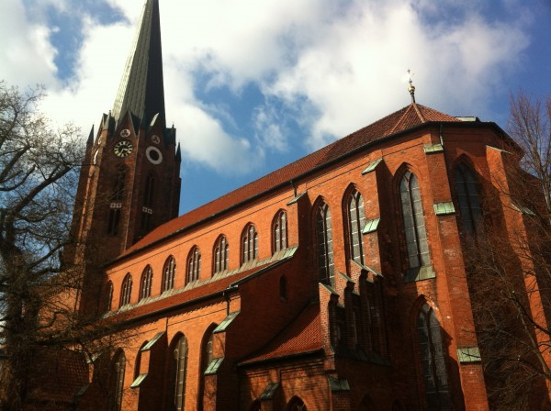
St. Petri Church
built in 1320

Slide 8
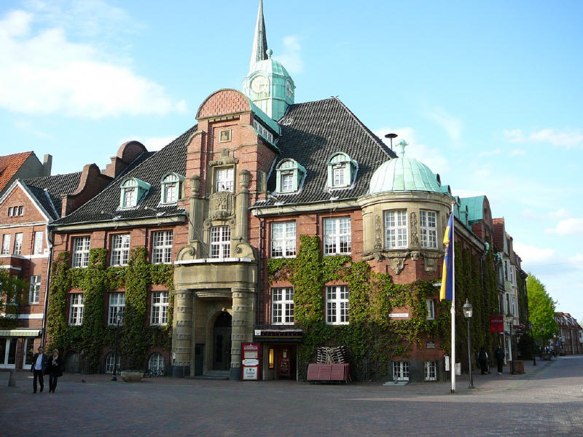
City hall of Buxtehude
initially built in 1418, destroyed in 1911 and finally rebuilt in 1913/14

Slide 9
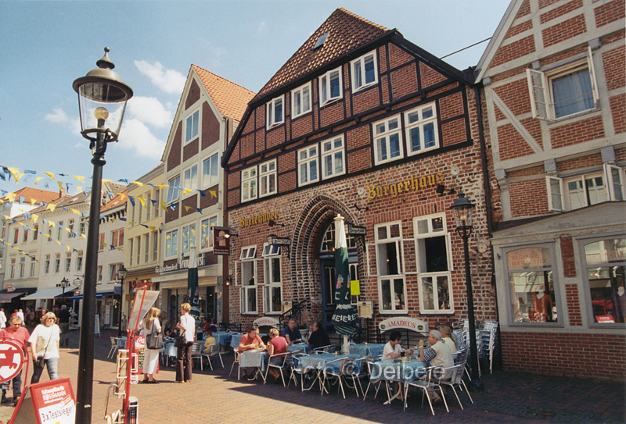
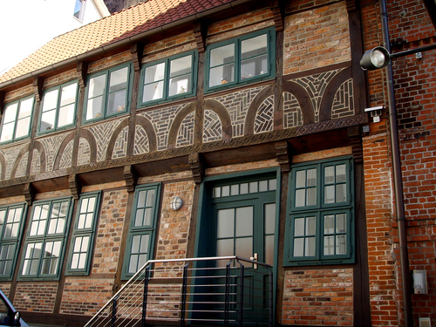
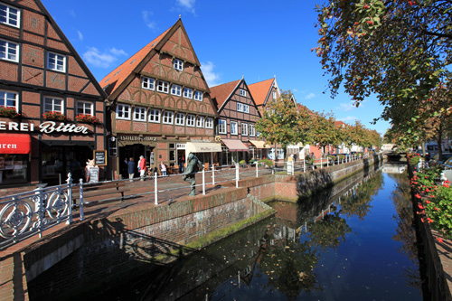
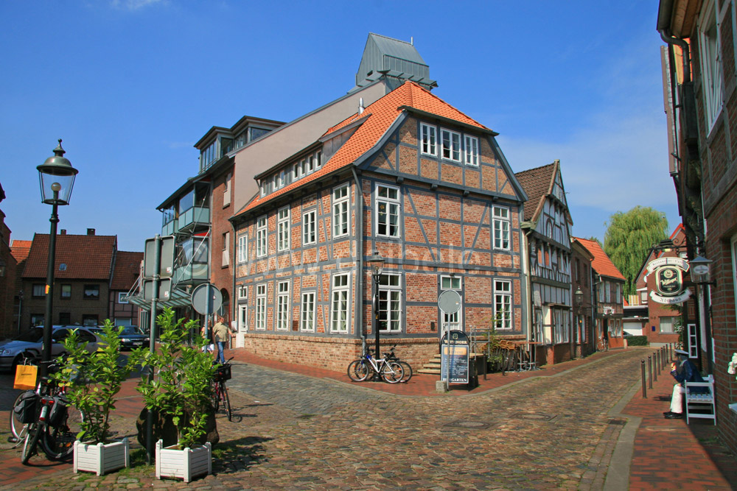
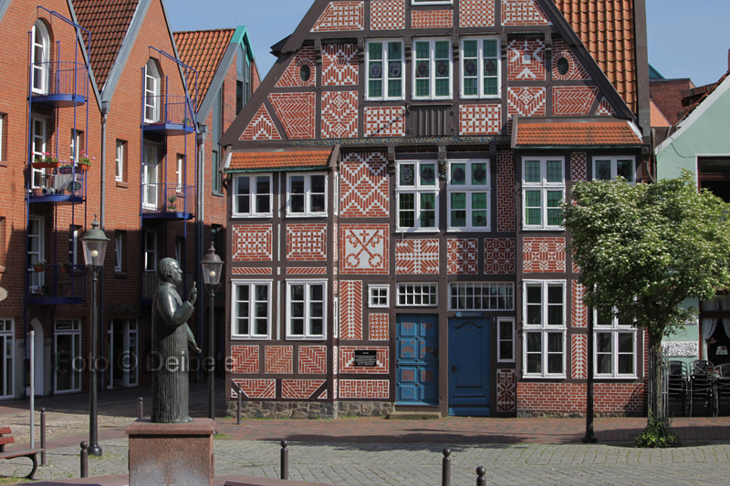
Half-timbered houses of Buxtehude

Slide 10
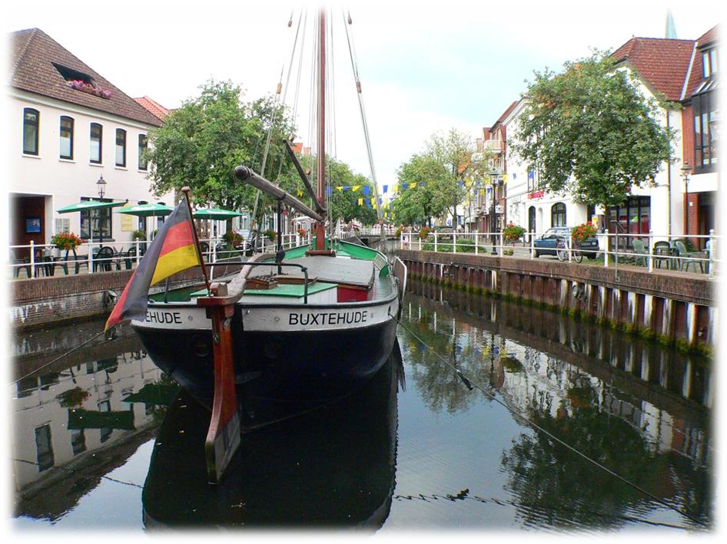
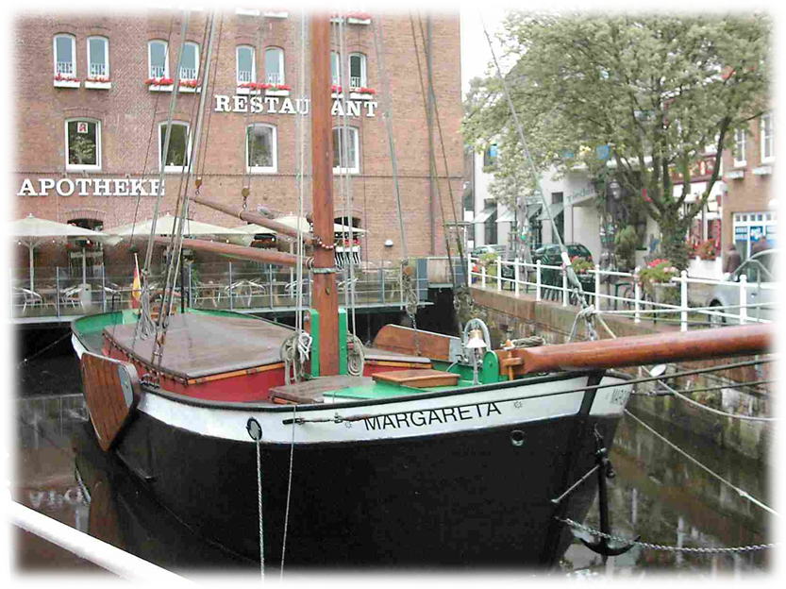
Margareta (museum ship)
built in 1897

Slide 11
