Slide 1
Milestone 1945: Flight and Expulsion

Slide 2
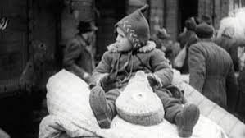
Content
Second world war
migratory movement
facts and figures
how did Hamburg and Buxtehude deal with it?
individual fates

Slide 3
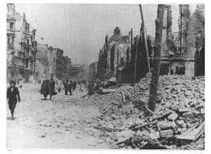
The Second World War
1945 end of World War II
1946: Potsdam Conference Explusion form East Central Europe
Germans were expelled from Poland, Hungry and Czechoslovakia
migratory movement

Slide 4
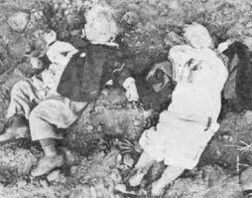
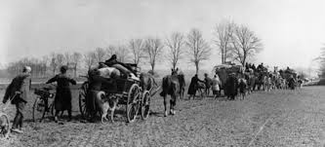
migratory movement
biggest and crulest in history.
Ways:
  expulsion
  deportation
  return

Slide 5
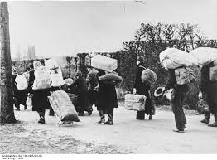
Explusion and Flight
Explusion of:
      „Volksdeutsche “
          from East Prussia, Poland, Czechia, Slowakia, Yugoslawia, Romania, Hungary
      people from of the Baltic states
      Polish forced laborers from Germany
      people of the Soviet Union from Poland

Slide 6
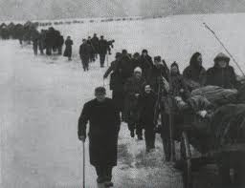
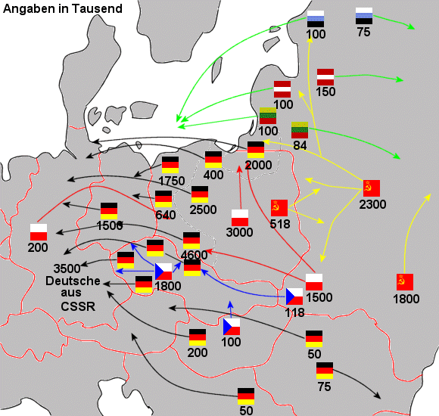
Explusion and Flight
Flight of :
      forced laborers
        2,4 mil. from Soviet Union, 1,5 mil. from Poland, 1,1 mil. from the Baltic states
      flight of German people
      Escape from the Red Army
        between 1,1 mil. and 1,8 mil.
      deported people

Slide 7
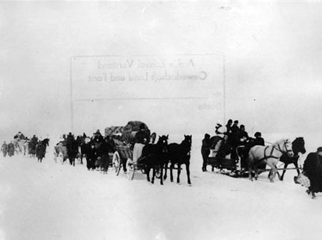
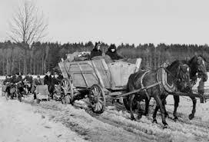
Facts and Numbers
total number:11.935.000
14 mil. Germans left home after war
Schleswig and Holstein: population rose by ≈ 33% 6.944.000 mil. German citizens escaped

Slide 8

Effects for Buxtehude
also belonged to British zone of occupation
many people died on their way to Buxtehude
but 1.851.000 found a new home
Population

Slide 9
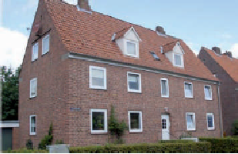
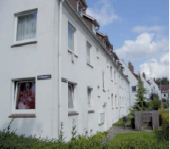
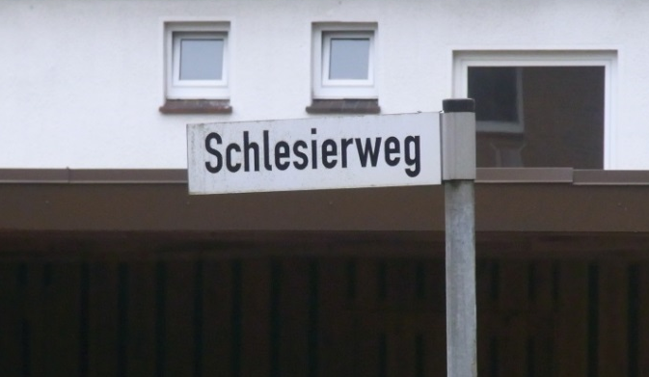
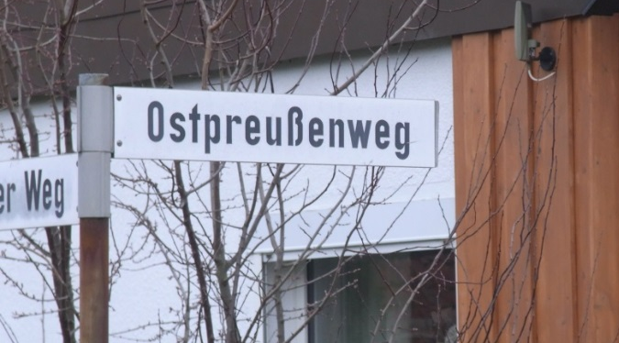
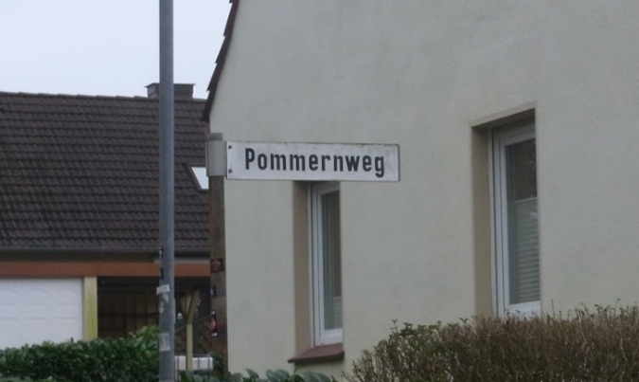
small houses
streets

Slide 10

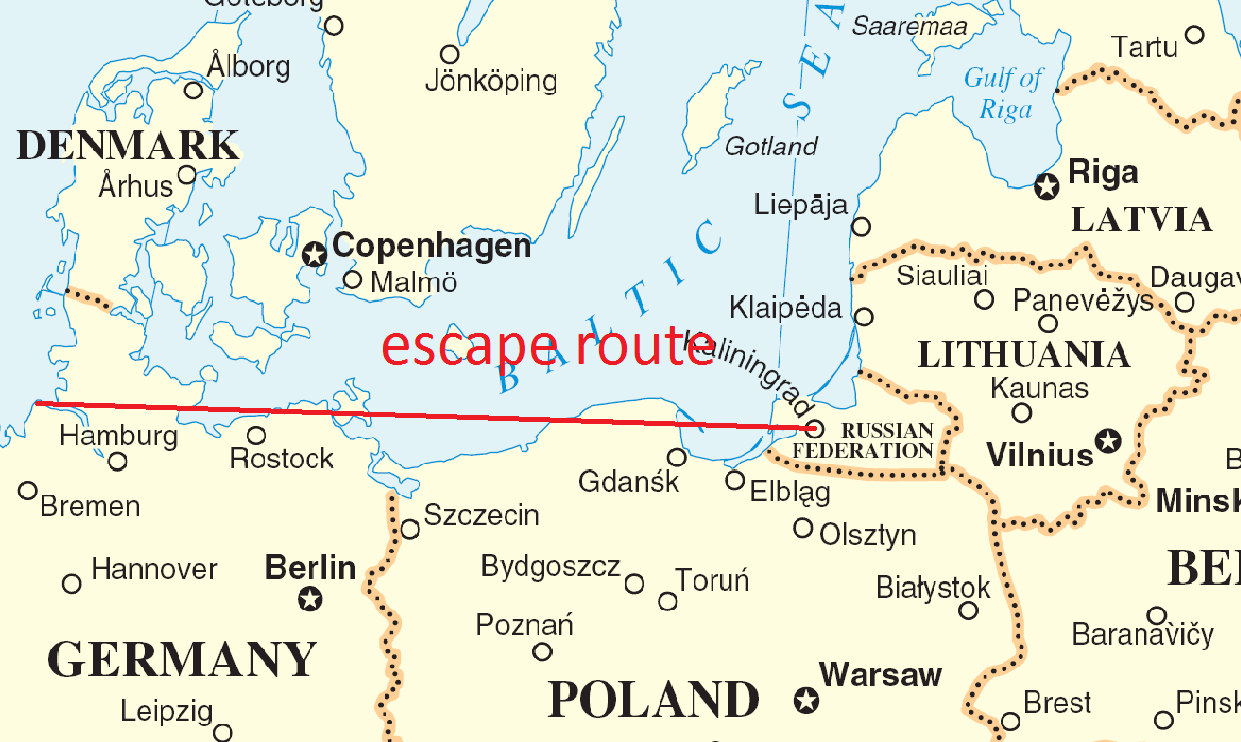
Ingetraud Lippmann
from 'Königsberg' to 'Kehdingen'
the children went to school
bad grade, because they were immigrants
death refugees were buried on the dogs cemetery

Slide 11
poor people were nice
air attacks → no school
food in school
help in the household
after school t: no job → nobody wanted refugees
went to Hamburg, found a job and now lives there

