Slide 1
Buxtehude
Fairytale city

Slide 2
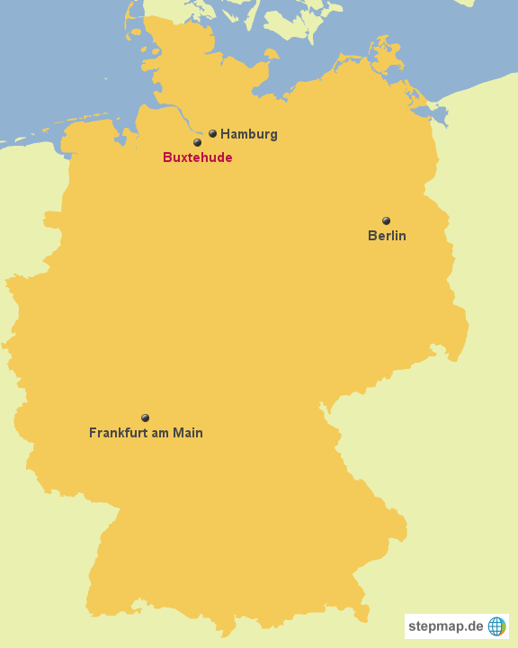
General facts
Round about 40 000 inhabitants
Lower Saxony
South of Hamburg, near the Elbe
Sister cities: Ribnitz-Damgarten Blagnac

Slide 3
HISTORY
Founded as city fortress in 1285
1328 "Buxtehude" became a self-govering advancing
2014 Buxtehude re-became a Hanseatic city Hanse: originally

Slide 4
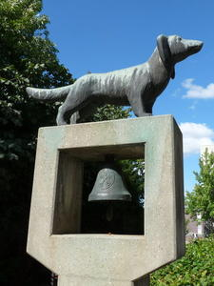
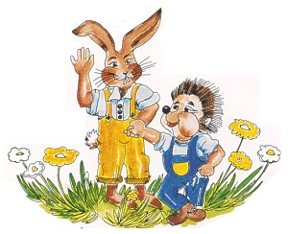
CULTURE
Fairytale city
“ The dog that is barking by it‘s tail“
“hare and headgehog“ (retold by the Brothers Grimm)

Slide 5
CULTURE
renowned youth literature award ‘ Buxtehuder Bulle’ (‘bull of Buxtehude’)
located on the “German Fairytale street’’

Slide 6
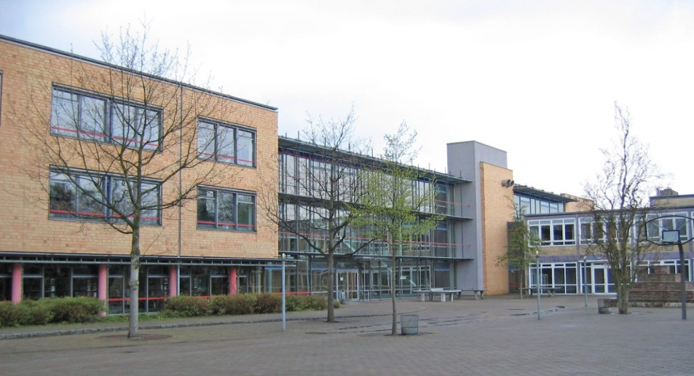
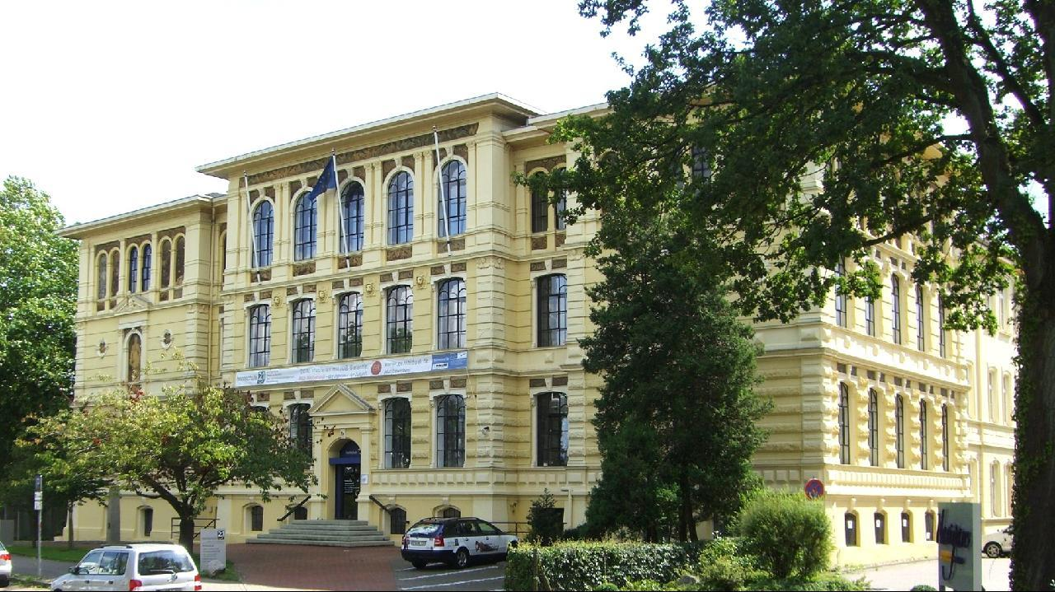
Education
High Schools: 2 Schulzentren (Nord und Süd) 2 Gymnasien (Halepaghen-Schule und Süd) Berufsbildene Schule (BBS)
Hochschule 21 is a private university

Slide 7
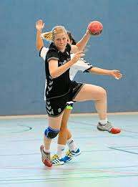
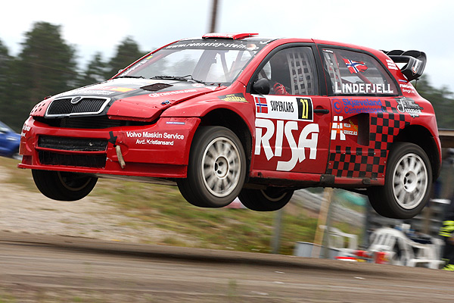
Sports
Handball - BSV Buxtehude
First German league and international competitions
Rallycross

Slide 8
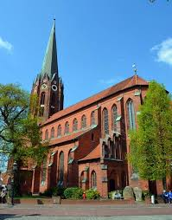
Sight-seeing
St Petri Church
Old town hall

Slide 9
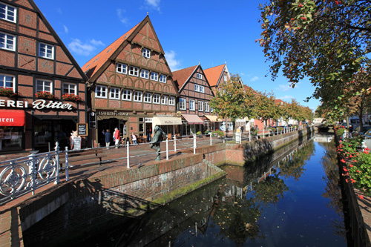
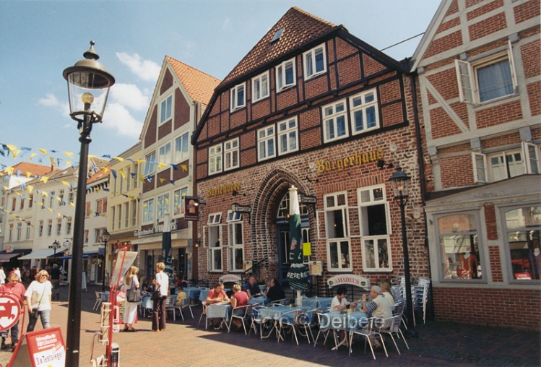
Sight seeing
Half-timbered houses

Slide 10
Thanks for the attention

