Slide 1
What it means to be a refugee

Slide 2
Who is a refugee?
A refugee is a person who flees to a foreign country to escape danger or persecution

Slide 3
Why do you think they choose to migrate?

Slide 4
There are various reasons,
some that the media talk about,
some they don’t

Slide 5
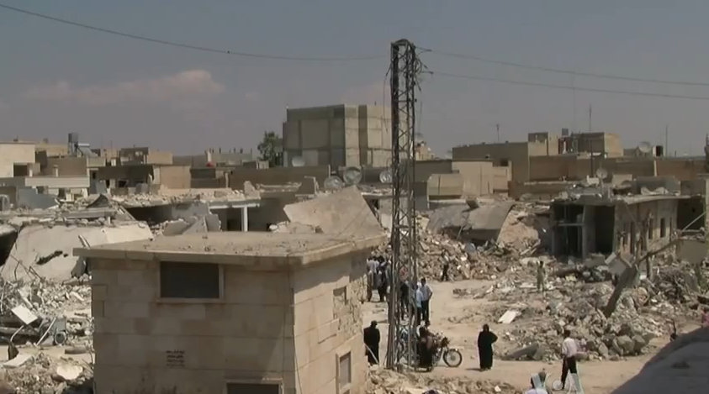
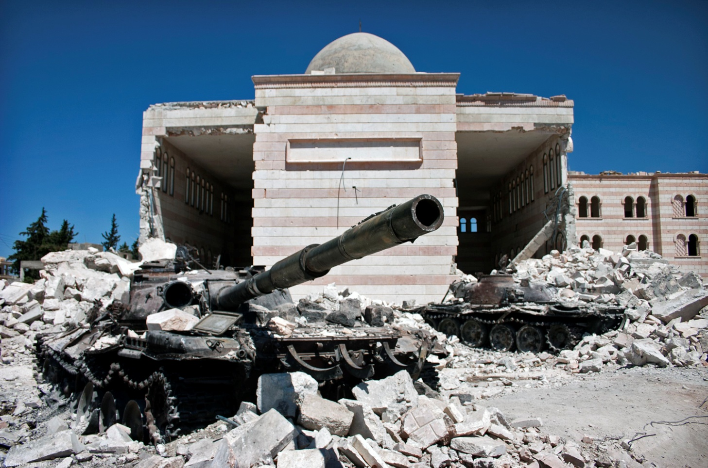
What the media say …
… wars…

Slide 6
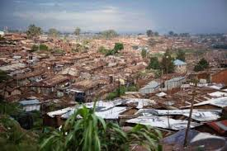
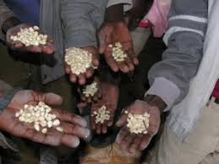
… poverty…

Slide 7
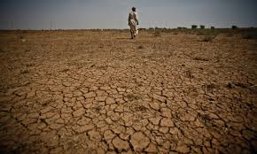
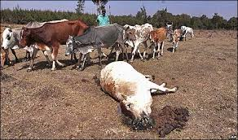
… climate change…

Slide 8
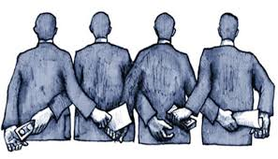
What the media don’t say…
… governement corruption…

Slide 9
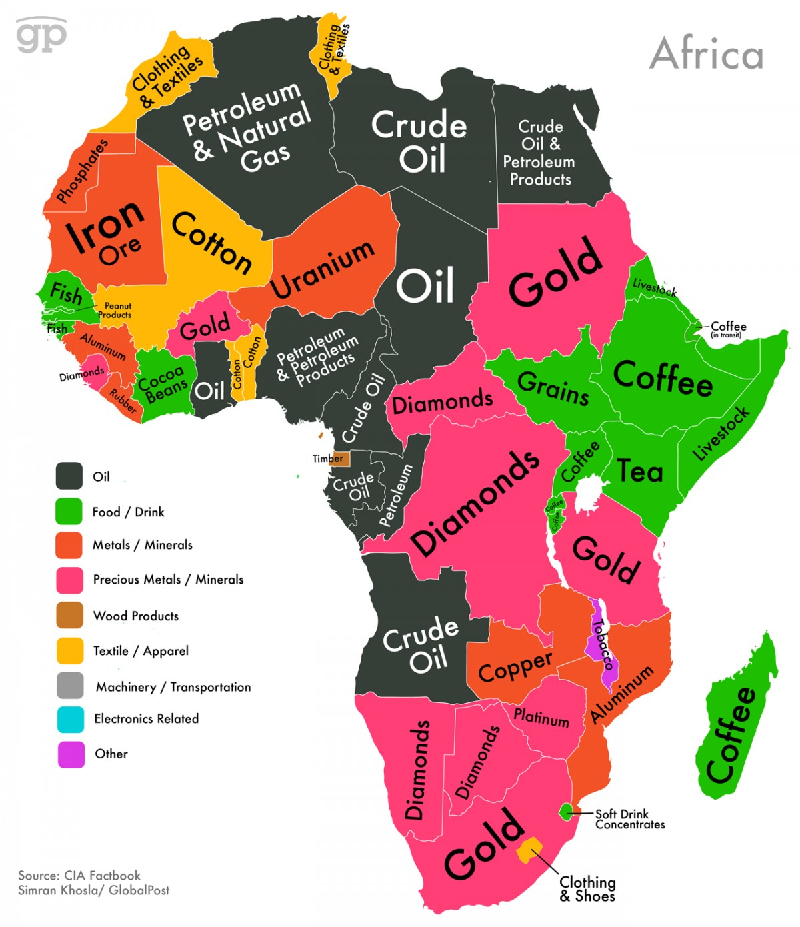
… exploitation of mineral resources…

Slide 10
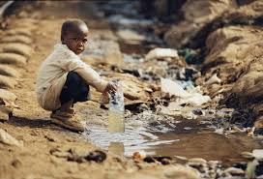
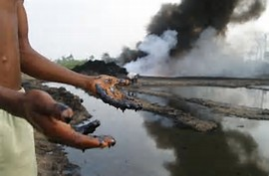
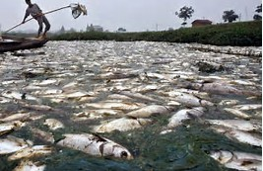
… pollution…

Slide 11
What do you think migrants have to give up?

Slide 12
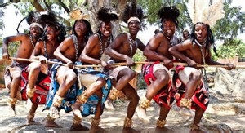
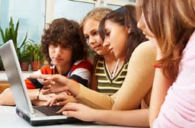
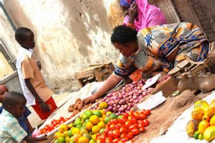
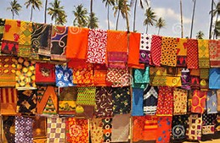
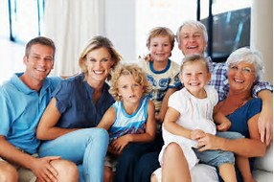
… so they have to give up:

Slide 13
Let’s watch this thought-provoking video
https://youtu.be/RBQ-IoHfimQ

Slide 14
Do you know what migrants have to face during the journey to Europe? What do you think they know about it?

Slide 15
… Here are some direct and indirect experiences, which we’ve heard about this week…

Slide 16
… and now other experiences…
https://youtu.be/hXuVxFLGpFM
https://youtu.be/D1KwuolIV7A

Slide 17
Have you learnt anything new?
Has your opinion changed? Why or why not?

Slide 18
Websites from where we took the photos:
radioinblu.it
adiozioneadistanza.actionaid.it
un.org
borgenproject.org
tunisia-live.net
pinterest.com
passnownow.com
tes.com
environewsnigeria.com
ecologiaverde.com
popolis.it
odontoiatrika.it
caffenews.it
tipicamente.it
it.dreamstime.com
afrotourism.com

