Slide 1
Deutsche Auswanderung im 19. Jahrhundert German emigration in the 19th century
Warum wanderte man aus?
Why did germans emigrate to other countries?

Slide 2
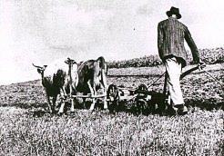
Around 1815
Germany was separated into many different regions ruled by kings and princes
Political disagreement between these regions did not allow a structural developement, so poverty was part of everyday life of the vast underclass
Crop failures, epidemics and famine were big problems in this society
Notes:
Fügen Sie ein Bild von einem geografischen Merkmal des Lands ein.

Slide 3
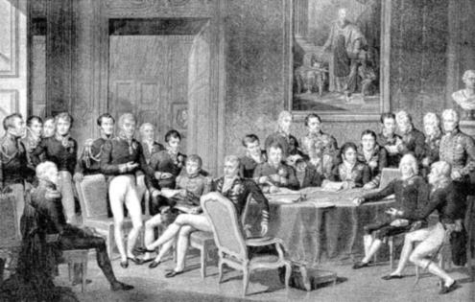
1815-1830
Princes and Kings agreed, that they wouldn‘t respect any kind of revolution
They wanted to defend their claim, so in 1815, they founded the „German Confederation“
Furthermore, they wanted a strict prosecution of government critics
Notes:
Fügen Sie ein Bild zu einer Jahreszeit in dem Land ein.

Slide 4
1830-1848
In the 1830s social unrests developed in the lower social classes
Many people lost their jobs in traditional crafts, and this effected an impoverishment of big parts in society
At the same time birth rates and food prices got higher and higher, but food supply stopped working effectively
Famines and malnutritions were the effect of this change in the economic structur
People formed regional groups to fight for rights like expression and press freedom, but especially for the foundation of an all-German parliament
Notes:
Fügen Sie ein Bild eines in dem Land vorkommenden Tiers oder einer Pflanze ein.

Slide 5
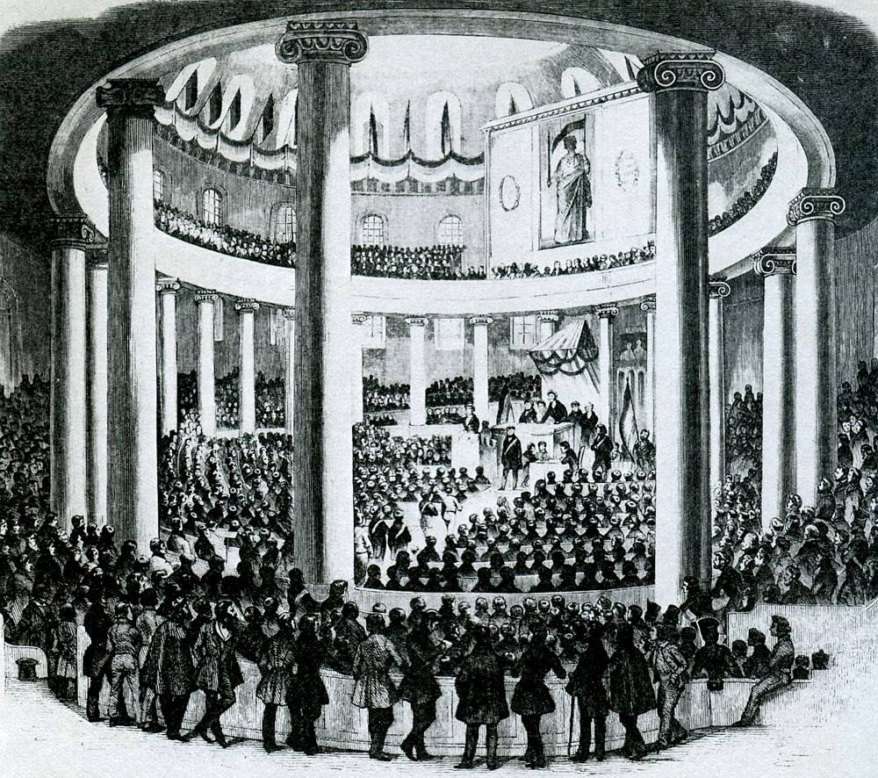
1848/1849 Political developement
After the revolution in France in March 1848, the situation in Germany also escalated; there were street battles for example in Berlin
Two months after this escalation there was the first german national assembley and a constitution was adopted
But the princes didn‘t change their policy and in March 1849 the first parliament was suppressed by the military
Notes:
Fügen Sie hier ein Bild ein, mit dem ein Brauch oder eine Tradition veranschaulicht wird.

Slide 6
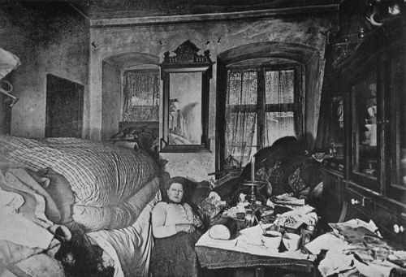
1848/1849 Situation of the society
Industrialization in Germany
By opening the markets, workers got the free choice for residence and career
Many people moved to the cities, because they hoped for better living conditions, but after a short time the cities were overcrowded
Workers had to work long times for low wages and had to accept the overpriced rents and food prices
There wasn‘t any welfare system, so many people feared losing their excistence in case of old age or illness
Notes:
Fügen Sie ein Bild des Staatsoberhaupts des Lands ein.

Slide 7
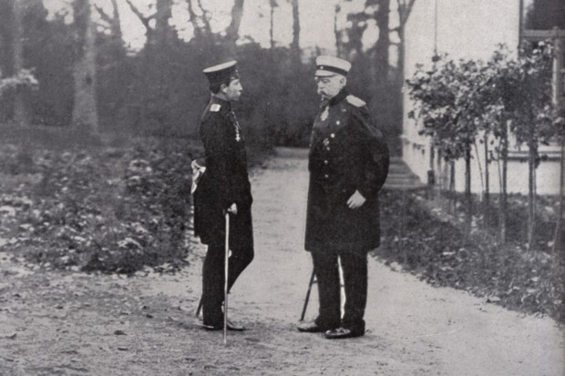
1850-1871
Bismarck became prime minister of prussia
Bismarck mocked the demands of Napoleon, and out of this a big conflict about the german-french relationship started
German-French War
While this war the different regions in Germany joined together and forgot about their old conflicts
After a german victory the „German Empire“ was founded in 1871
Notes:
Fügen Sie ein Bild ein, mit dem ein Teil der Wirtschaft des Lands veranschaulicht wird.

Slide 8
1871-1900
For the german population, especially the new welfare system was a big progress
But a big problem had been and remained the migration to the cities
Eventhough Germany then had a constitutional monarchy, the gap between rich and poor people was still large
Still no social justice
Problems of the beginning of the century were indeed reduced but not fully destroyed
Notes:
Fügen Sie ein Bild von einer Sehenswürdigkeit des Lands ein.

Slide 9
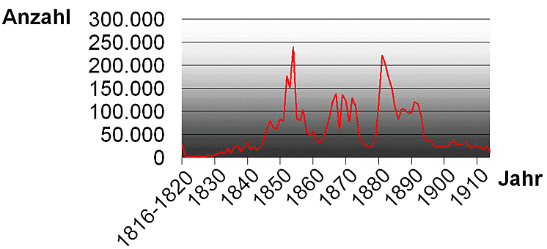
German Emigration
You could divide the developement of emigration into three climax (1850-55,1865-75 and 1880-85) and lower rates between, before and after it
After a big famine in 1817 the rates sank until they rose again in 1845, with the beginning of political unrests and the Industrial revolution
At this time many jobs were lost because of mechanisation, most people had hard living conditions and there was a revolutionary athmosphere

Slide 10
The economic situation, aswell as the number of people leaving Germany, depended on the climatic conditions and political moods in the country.
The industrialization in the first 50 years is considered to be particularly difficult, as there were no reliable social systems and a very sudden restructuring of the market
Thus, social relations were mostly unfair and often an emigration, for example to America, was a last option.
Only when the social welfare system had stabilized, the number of emigrants decreased.

Slide 11
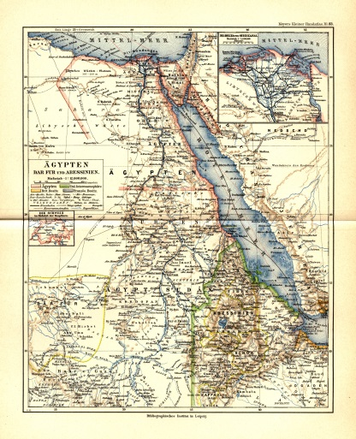
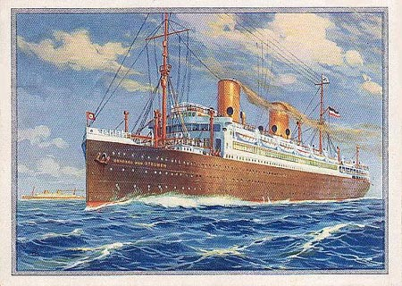
Reasons in the early years
Around 1800 not many people needed to emigrate, so at the beginning of the 19th century the most frequent reasons were rather personally, like the desire for freedom or adventures far away from home
Many Germans, especially young people, felt restricted in their ideas of living and broke with the traditional values. The older generation accepted the dominion of princes and kings, but for the new generation this meant restricton that they couldn‘t live with
For example Jakob. He lives in a small german village and dreams of emigration as a romantic adventure. So he makes secret plans to escape from his life in Germany
At first emigration wasn‘t a big matter in german society

Slide 12
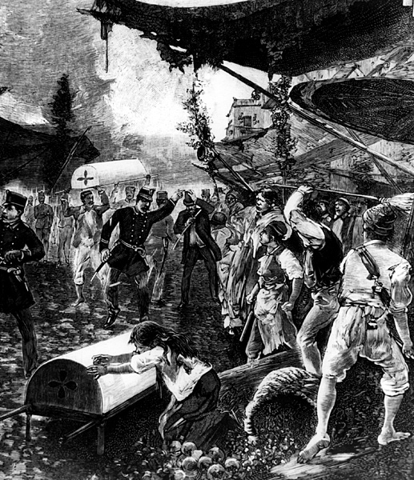
Reasons of the lower social classes
Famines and epidemics are part of everyday countryside life of the 19th century
Although socage and bondage didn‘t exist anymore, farmers had to pay taxes to the princes, which meant, that they didn‘t have money for any kind of modernization
The law of real division resulted in a fragmentation of the farms which led to an inefficiency of production
Hard winters and dry or missing summers led to crop failures and famines
The constant malnutrition made ​​a spread of diseases easily possible.
Death was a “daily companion”
Life in other countries seemed more attractive, because there was nothing, that kept the people staying in Germany with pleasure

Slide 13
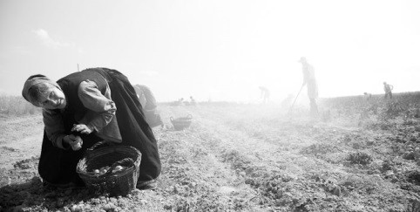
Daily work at countryside
The working conditions for people at the countryside were hard, because they hadn‘t any guarantee that they could sell their products or, depending on climate, that there would grow anything.
So there was a high risk for their existence.
Many people decided to move into cities or they planned to emigrate

Slide 14
Examples: Famine and death
In many winters the food ressources were so small, that many people died of the famines and epidemics

Slide 15
Advertisements for Emigration
If somebody made music or any kind of theater on the market, everybody came watching. But if the one also could promis a better future in another country, people in 19th century regarded this as a wonderful escape frome their hopeless life at home. For example Jakob was really unhappy with his life in Germany, and when he saw this advertisement he started to make big dreams and plans about emigration.

Slide 16
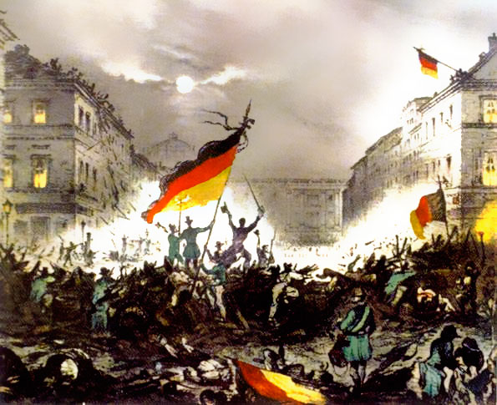
Political reasons
After the failed revolution of 1848, many people decided for a new beginning in the distance, because they didn’t see any chance for better a German politic
Especially people whose relatives had emigrated in the previous years decided to leave Germany at this point
The political situation was rather hopeless. The lower social class got poorer and poorer while the higher social class gained profit of the industrialization. Compared with that, living conditions, for example in America, were quite inexpensive

Slide 17
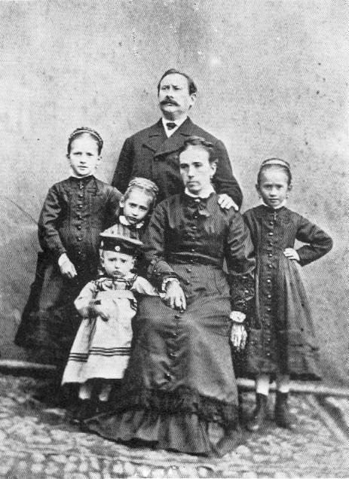
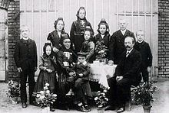
Additional reasons & Conclusion
Higher social classes with more fortune often emigrated to reduce taxation
Furthermore businessmen emigrated to open new and even cheaper factory sites
Politicians used emigration as a kind of deportation for prostitutes and criminals
All in all, we could say, that emigration was often used as a way to esacpe all the miserables in the Germany of the 19th century. Also we could add, that some people emigrated to increase their own assets and emigration was a kind of deportation.

Slide 18
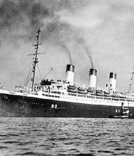
Transit

Slide 19
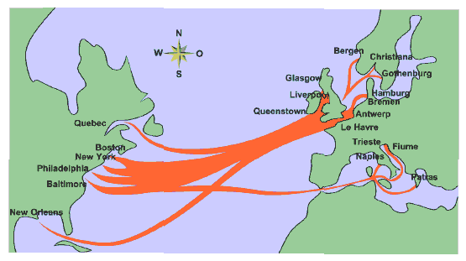
The beginning of the voyage
Notes:
19
Fügen Sie eine Karte des Lands ein.

Slide 20
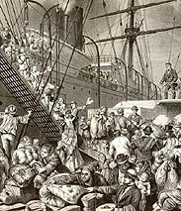
Travel on sailing boats
Very bad conditions:
People lived very close to each other
Often without daylight
Often no fresh air
Unhygienic conditions
People had to care for their food themselves
rapid spreading of illnesses, high infectiousness
many people died because of
illnesses
hunger crisis
catastrophes
Notes:
20
Fügen Sie ein Bild von einem geografischen Merkmal des Lands ein.

Slide 21
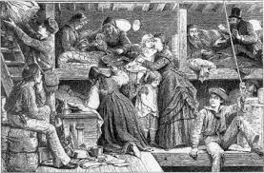
Tween deck
Notes:
21
Fügen Sie ein Bild zu einer Jahreszeit in dem Land ein.

Slide 22
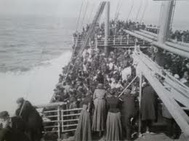
Hundred of people on a sailboat
Beschreiben Sie einige der einheimischen Tiere und Pflanzen des Landes.
Notes:
22
Fügen Sie ein Bild eines in dem Land vorkommenden Tiers oder einer Pflanze ein.

Slide 23
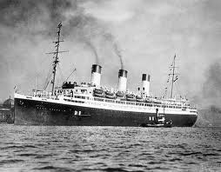
Travel on steamboat
1850: sailing boats were slowly replaced by steamboats
But cost much more
luxury: better conditions
regular meals
Everybody had its own mattress
Entertainment program
From 1900 on: higher competitions in the steamboat branch
travelling with steamboats became cheaper
Notes:
23
Fügen Sie der Zeitskala die wichtigsten Ereignisse in der Geschichte des Lands hinzu.

Slide 24
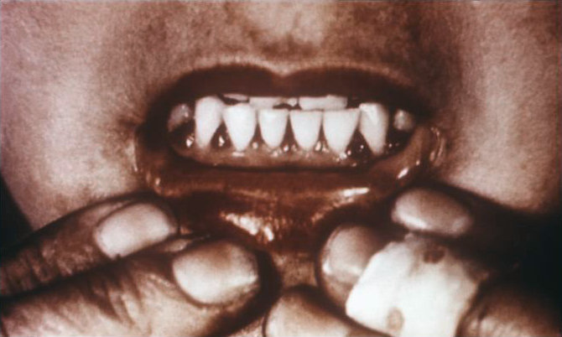
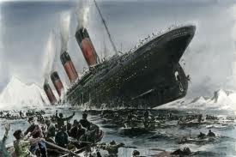
Facts:
Lenghts of travelling:
6-10 weeks (longest travel 9 months)
Many people didn´t survive the jounrey
Reasons:
illnesses f.g. scurvy
Famine
Catastrophes f.g. Titanic
Notes:
24
Fügen Sie hier ein Bild ein, mit dem ein Brauch oder eine Tradition veranschaulicht wird.

Slide 25
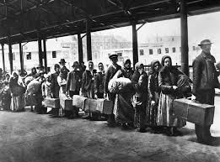
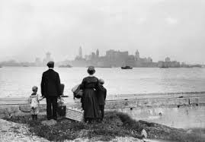
arrival
Many challenges:
new language
completely new environment
new culture
Notes:
25
Fügen Sie ein Bild des Staatsoberhaupts des Lands ein.

Slide 26
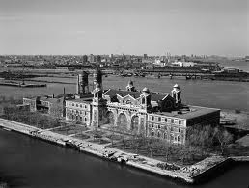
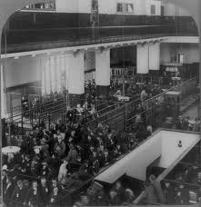
Ellis Island
Island is in the harbor of New York
immigrant inspection station from 1892 until 1954
Aim: better control who enter to America
To stay in America people had do pass many processes like:
Medical inspections
Answer many questions relating to nationality, age
tests
Notes:
26
Fügen Sie ein Bild von einer Sehenswürdigkeit des Lands ein.

Slide 27
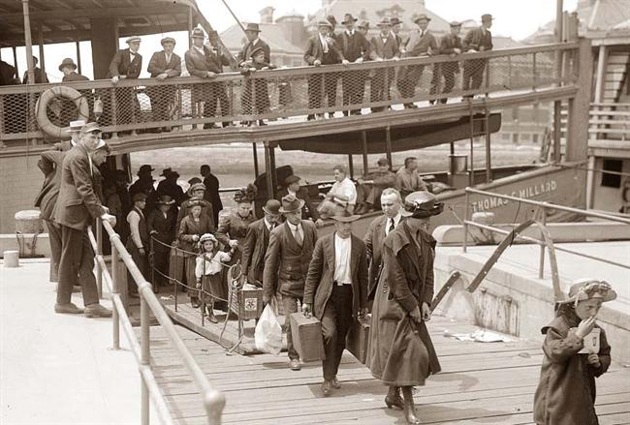
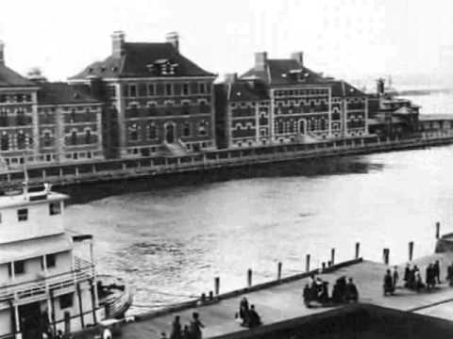
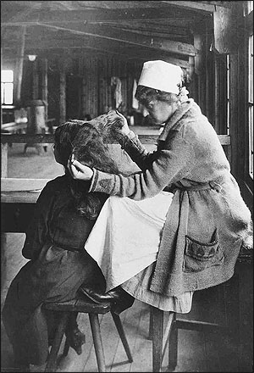
Island of Hope- Island of Tears
A Virtual Voyage to Ellis Island:
http://www.youtube.com/watch?v=5rredHTyKaQ&hd=1

Slide 28
The German emigration in the 19th century The Arrival in the new home country The USA as example

Slide 29
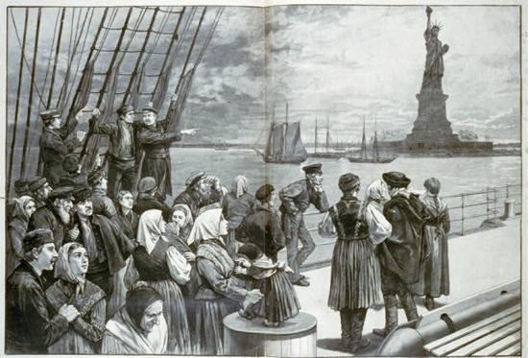
After long boat trips
Notes:
Fügen Sie eine Karte des Lands ein.

Slide 30
Consequences after the ride across the Atlantic Ocean
Building up new towns in the great American West without any help
Bad living conditions e.g. in smaller towns, not enough food, no qualified workers (…)
Working on plantations to payback the money for the expensive trip to the US

Slide 31
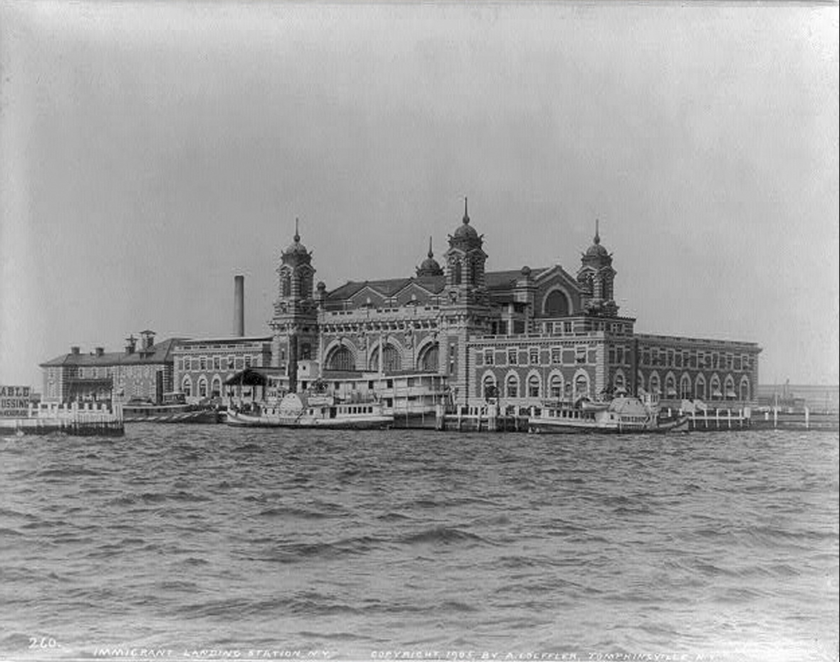
Different expectations of the German Immigrants after the Arrival
After the arrival most of the German had two chances and expectations:
1. Settling in
the next big
cities or
directly at
their arrival
point.

Slide 32
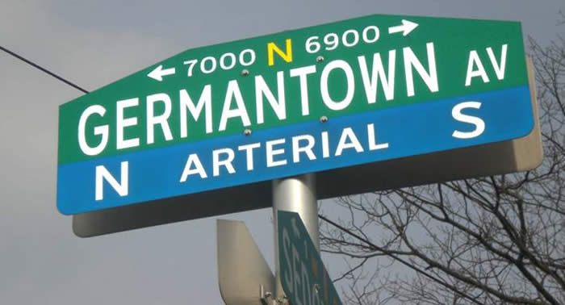
The First Chance
The First German city was ‘German town’,
today's district of Philadelphia

Slide 33
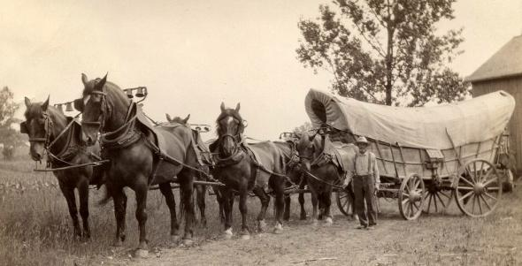
The Second Chance
2. Going Westside, searching for places to build up new towns.

Slide 34
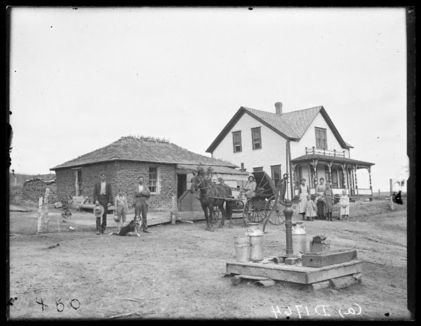
The Second Chance

Slide 35
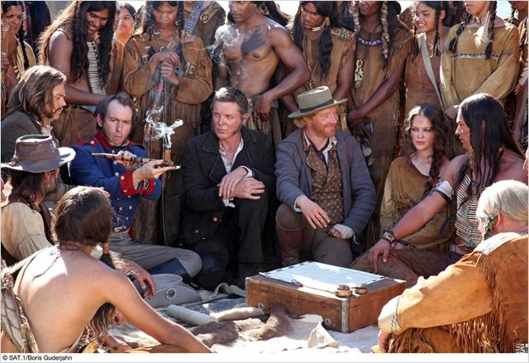
Trailer
Trailer „In einem wilden Land“:
http://www.youtube.com/watch?v=TDgeedBeNEk&hd=1

Slide 36
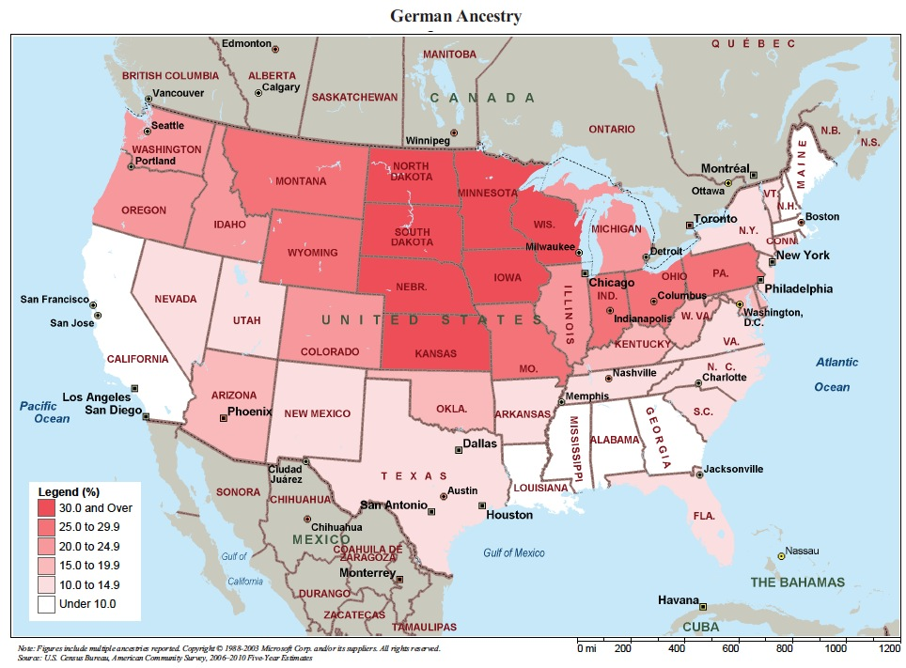
German immigration to the USA

