Slide 1
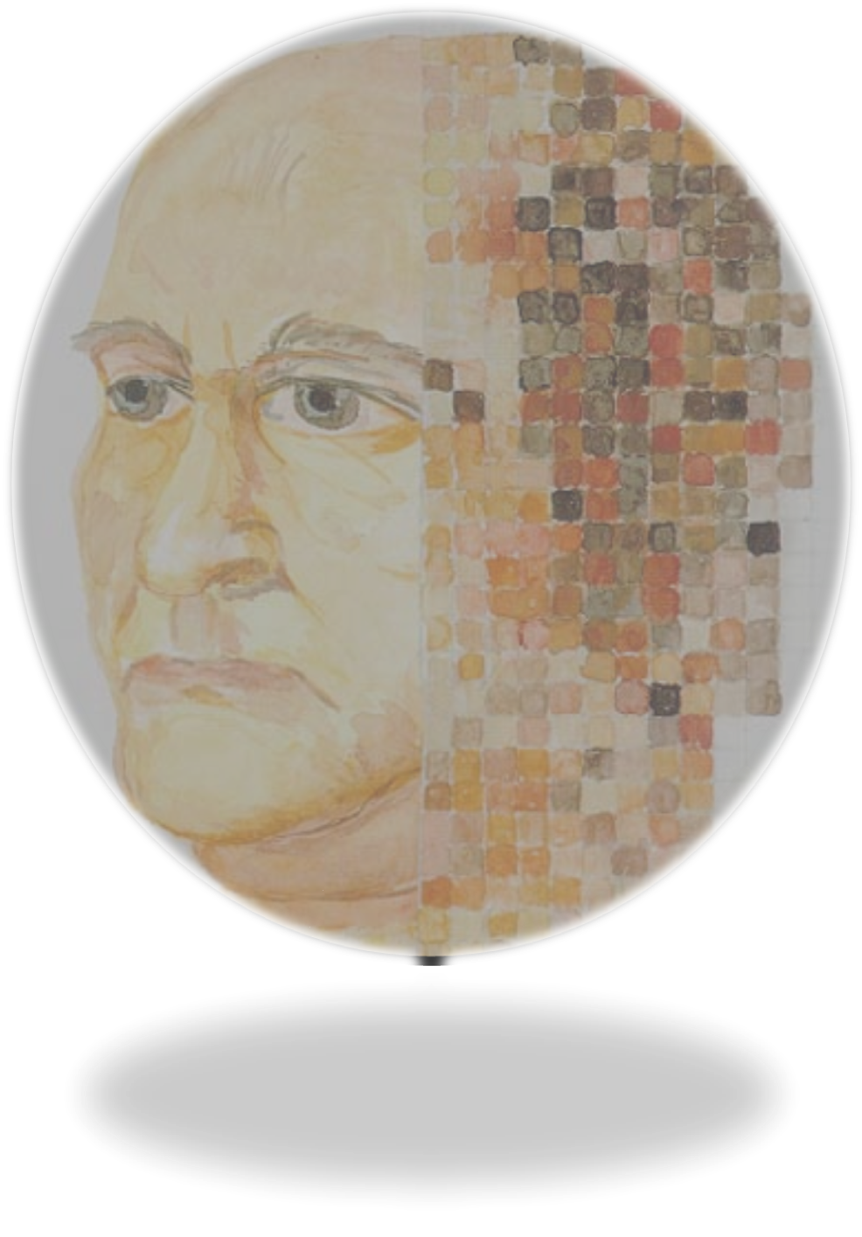
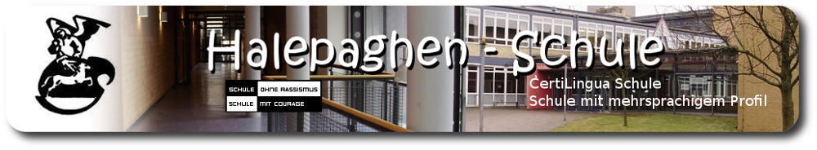

Presentation of
Halepaghen-Schule
Buxtehude
www.halepaghen-schule.de

Slide 2
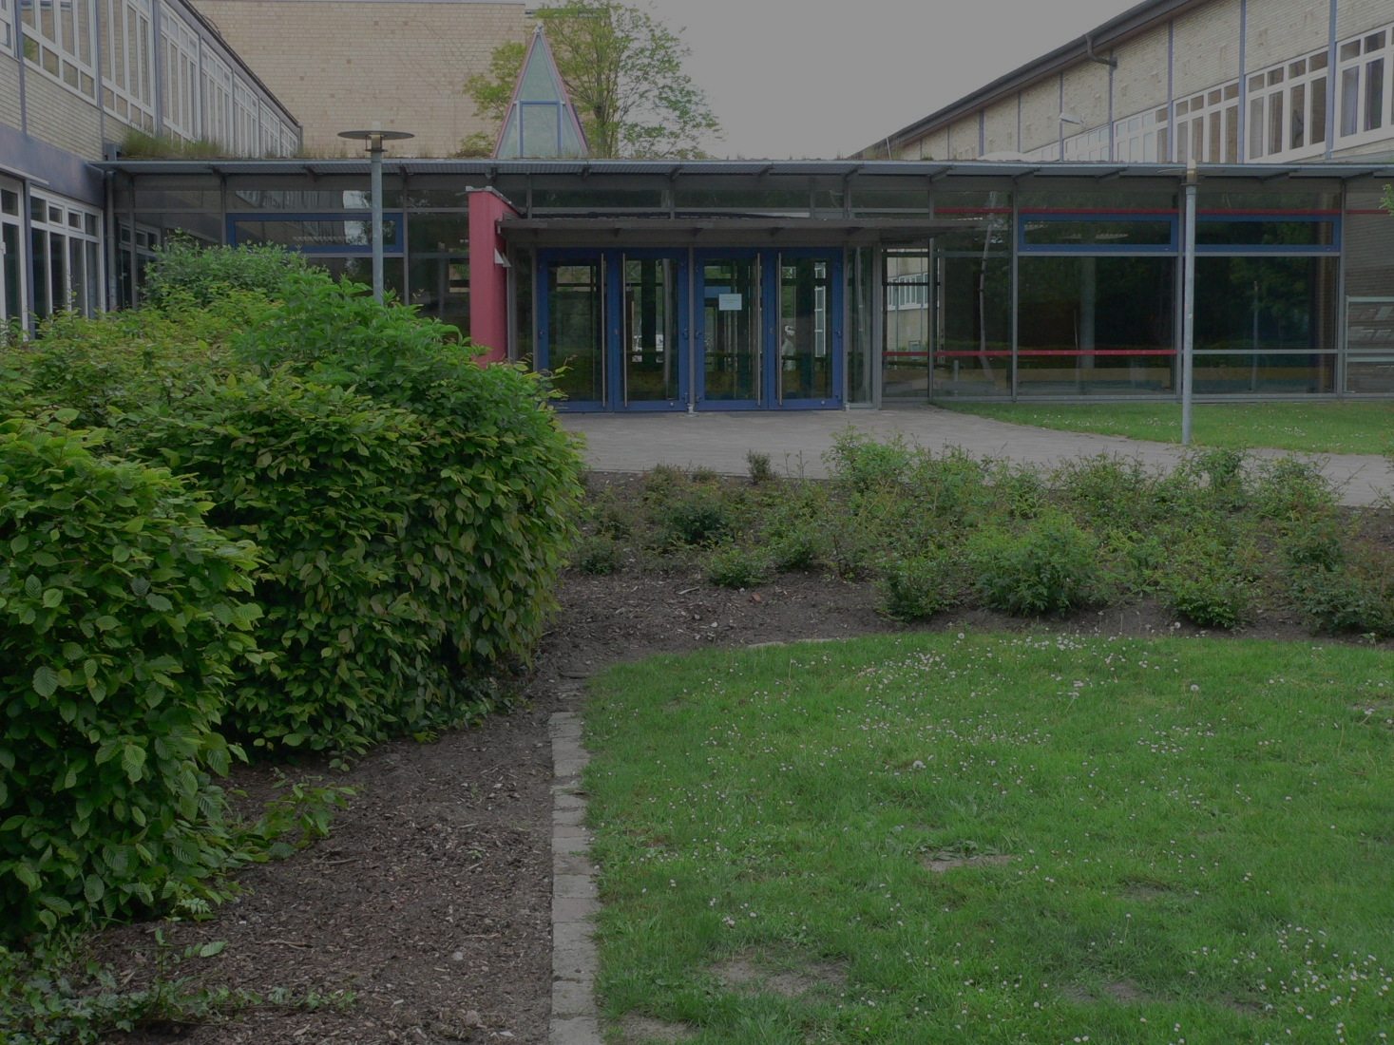
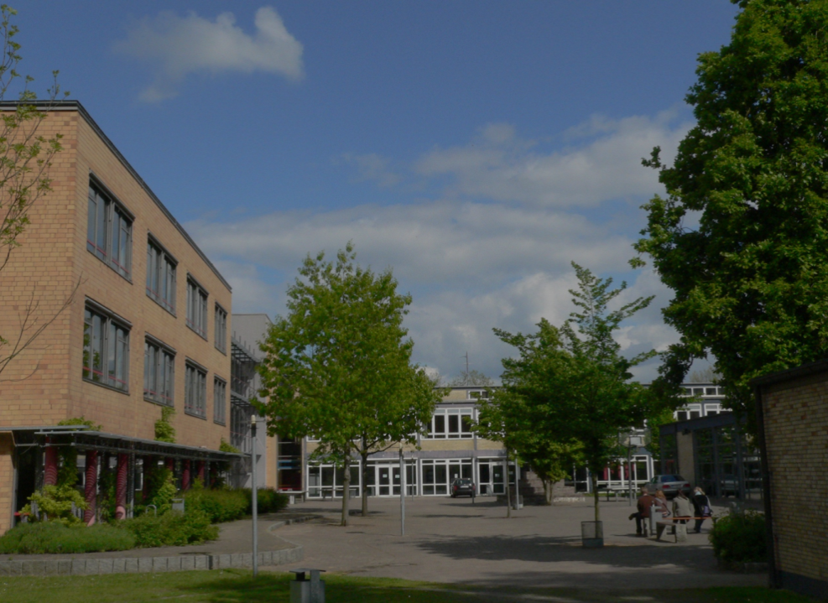

Slide 3
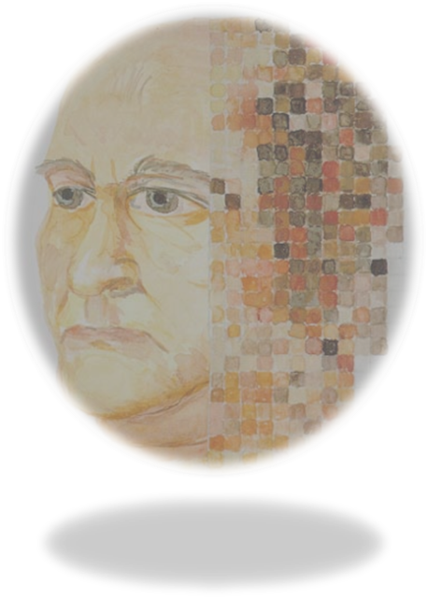
Facts
Data
Students: ~1.250
Teachers: ~110
Origin of the name
Magister Gerhard Halepaghe (*1430 Buxtehude)
Former teacher and priest in the St.-Petri-Church in Buxtehude

Slide 4
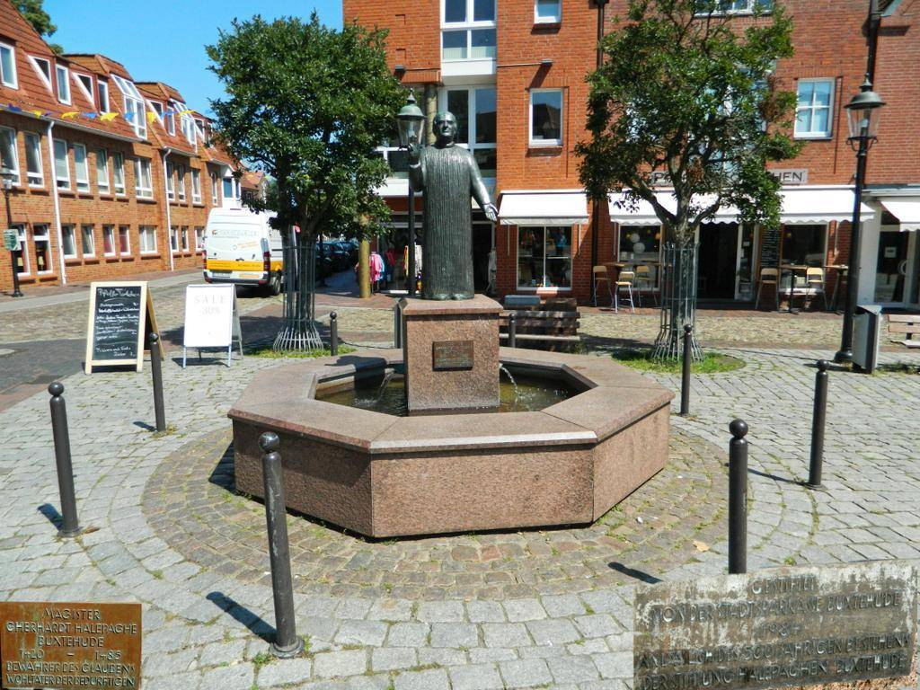

Slide 5

Profile and focus
Multilingual profile
Languages: English, French, Spanish, Latin, Russian
Bilingual lessons (geography, history and biology)
Certificates (DELE, DELF, Cambridge and CertiLingua)
Exchange programs (Sweden, Turkey, France, Spain, USA, Lithuania)
Participation in competitions

Slide 6
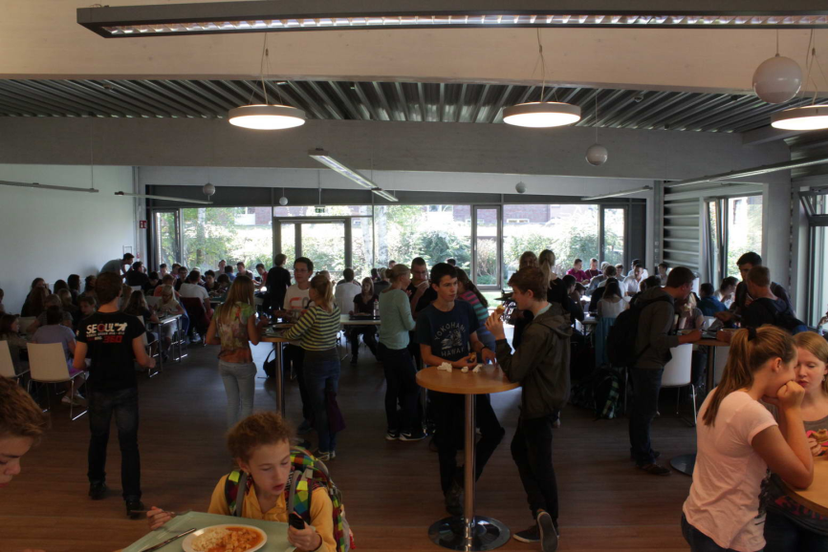
Profile and focus
School medical service
Students help students
Cooperation with universities
Lunch in the canteen (‚Mensa‘)
„School without racism – School with courage“

Slide 7
Timetable: an example
Monday
Tuesday
Wednesday
Thursday
Friday
1
7.55 – 8.40
English
Role Play
Chemistry
Maths
German
2
8.45 – 9.30
Maths
3
9.50 – 10.35
Physics
French
Geography
French
Sports
4
10.40 - 11.25
Maths
Physics
5
11.45 – 12.30
Spanish
History
Spanish
English
Biology
6
12.35 – 13.20
Geography
7
13.40 – 14.25
Politics
Religion
German
–
–
8
14.30 – 15.15
–
–

